Slide 1
5th PIRC Meeting (Mt. Abu, 30th May 2019)
Progress Review Presentations

Slide 2
5th PIRC Meeting (Mt. Abu, 30th May 2019): Progress Review Presentations
INDEX
Sr. No. | State | State Representatives |  | CWC Representatives
 |  | Name | Designation | Name | Designation
1. | Andhra Pradesh | Sh.L.V.Ramana Murty | SE | Sh. D. Ganesh Kumar | Dy. Director, M&A (KGBO Hyderabad)
2. | Assam | Sh. Sayed Nur Rahman | CHD (Irrigation), BTC | Sh P.M.Scott | CE (B&BBO, Shillong)
3. | Bihar | Sh. Ram Pukar Ranjan | EIC, CAD | Sh.Shashi Rakesh | SE (LGBO Patna )
4. | Chhattisgarh | Sh. A. K. Somawar | CE | Sh.Aditya Sharma | CE (NBO Bhopal)
5. | Goa | Sh. S.T. Nadkarni | CE | Sh.Sushil Kumar | CE (MSO Bengaluru)
6 | Gujarat | Sh. T.S. Shah | CE | Sh.M.P.Singh | CE (MTBO Gandhinagar)
7. | J&K | Sh. Mohd. Harun Malik | Director, KAS | Sh. Yoki Vijay IBO Chandigarh | Director M&A
8. | Jharkhand | Sh. Gopaljee | SE | Sh.Shashi Rakesh | SE(LGBO Patna)
Consolidated

Slide 3
5th PIRC Meeting (Mt. Abu, 30th May 2019): Progress Review Presentations
INDEX (contd.)
Sr. No. | State | State Representatives |  | CWC Representatives
 |  | Name | Designation | Name | Designation
9. | Karnataka | Sh. B.R.Anil Kumar | CE | Sh.Sushil Kumar | CE (MSO Bengaluru)
10. | Kerala | Sh. B. Shaji | SE | Sh.Krishnanunni.N.M | CE (C & SRO, CWC, Coimbatore)
11. | Madhya Pradesh | Sh. Shrikant Dandekar | Commissioner (CAD) | Sh.Aditya Sharma | CE (NBO Bhopal)
12. | Maharashtra | Sh.Rajendra Pawar | Secretary(CAD) | Sh.D.K.Tiwari | CE (MCO Nagpur)
13. | Manipur | Sh. Suresh Singh Ningombam | Addl CE | Sh P.M.Scott | CE (B&BBO, Shillong)
14. | Odisha | Sh. Jena | Principal Secretary Of DOWR | Sh.Ambarish Nayak | CE (MERO Bhubaneswar)
Consolidated

Slide 4
5th PIRC Meeting (Mt. Abu, 30th May 2019): Progress Review Presentations
INDEX (contd.)
Sr. No. | State | State Representatives |  | CWC Representatives
 |  | Name | Designation | Name | Designation
15. | Rajasthan | Sh Naveen Mahajan | Secretary, WR, | Sh. Vivek Kumar Singh | DD (YBO, Delhi)
16. | Telangana | Sh. Anantha Ramulu | SE | Sh. D. Ganesh Kumar | DD (KGBO Hyderabad)
17. | Uttar Pradesh | Devendra Pratap Shukla | BSA | Sh.Bhopal Singh | CE (UGBO Lucknow)
Consolidated

Slide 5
5th PIRC Meeting (Mt. Abu, 30th May 2019): Progress Review Presentations
Status of Inclusion
Out of 99 projects, 9 projects are not being proposed by State Governments for inclusion under CADWM program for CAD works. One Project of Rajasthan (Narmada Canal) is included for Non- Structural intervention only. These projects are:
Sl. No. | State | Project | CCA as per Cabinet Note ( Th. ha) | Remarks
1 | Maharashtra | Dongargaon | 2.76 | CAD Works completed through state funds
2 | Maharashtra | Wang | 7.06 | CAD Works not required; direct lifting by farmers
3 | Maharashtra | Nardave | 12.28 | CAD Works not required; direct lifting by farmers
4 | Maharashtra | Warna | 54.74 | CAD Works not required; direct lifting by farmers
5 | Punjab | Kandi Canal Stage II | 23.33 | Works completed under AIBP
6 | Punjab | Ist Patiala feeder & Kotla Branch | 9.1 | Proposed under ISBIG for enhanced target
7 | Andhra Pradesh | Maddigedda | 1.42 | Works completed through state funds
8 | Jammu & Kashmir | Modernisation of Ravi Canal | 50.75 | Works completed earlier through Central funding
9 | Uttar Pradesh | Bansagar | 150.13 | Works completed through state funds
10 | Rajasthan | Narmada Canal project* | 245.88 | Structural Works completed under AIBP
 |  | Total | 557.45

Slide 6
5th PIRC Meeting (Mt. Abu, 30th May 2019): Progress Review Presentations
Status of Inclusion (contd.)
As of now, 87* projects in balance Culturable Command Area (CCA) of 43.51 lakh hectares have been included under CADWM programme with Central Assistance (CA) of Rs 7,927 Crore against estimated cost of Rs 17,876 Crore.
Sl. No. | Projects yet to be included
1 | Punpun (Bihar)
2 | Karipuzha (Kerala)
3 | Madhya Ganga (Uttar Pradesh)
* Includes Narmada Canal Project of Rajasthan for non-structural intervention.

Slide 7
5th PIRC Meeting (Mt. Abu, 30th May 2019): Progress Review Presentations
Consolidated Status
Number of Projects : 90(99-9) Projects Included: 87 Projects Availing CA: 70 Projects Reporting Progress:53
Physical Progress
Consolidated

Slide 8
5th PIRC Meeting (Mt. Abu, 30th May 2019): Progress Review Presentations
CCA Progress
( Area in Th. Ha.)
Sr. No. | State | Balance CCA Target | CCA Progress |  |  |  |  | Target for 2019-20
 |  |  | 2016-17 | 2017-18 | 2018-19 | Total | % Progress
1. | AP | 178.62 | 0.00 | 0.00 | 0.00 | 0.00 | 0.00 | 61.60
2. | Assam | 46.62 | 0.00 | 1.19 | 13.06 | 14.25 | 30.57 | 32.40
3. | Bihar | 32.24 | 2.25 | 5.49 | 4.00 | 11.74 | 36.40 | 18.80
4. | Chhattisgarh | 42.63 | 0.00 | 0.00 | 0.00 | 0.00 | 0.00 | 11.00
5. | Goa | 8.67 | 0.01 | 0.01 | 0.75 | 0.77 | 8.83 | 3.95
6 | Gujarat | 1363.86 | 385.33 | 290.06 | 260.17 | 935.56 | 68.60 | 187.87
7. | J&K | 2.46 | 0.00 | 0.00 | 1.28 | 1.28 | 52.11 | 1.18
8. | Jharkhand | 66.65 | 0.00 | 0.00 | 0.00 | 0.00 | 0.00 | 13.33
9. | Karnataka | 84.03 | 11.08 | 11.50 | 8.35 | 30.93 | 36.81 | 11.17

Slide 9
5th PIRC Meeting (Mt. Abu, 30th May 2019): Progress Review Presentations
CCA Progress(contd.)
( Area in Th. Ha.)
Sr. No. | State | Balance CCA Target | CCA Progress |  |  |  |  | Target for 2019-20
 |  |  | 2016-17 | 2017-18 | 2018-19 | Total | % Progress
10. | Kerala | 17.25 | 0.00 | 0.00 | 0.00 | 0.00 | 0.00 | 2.40
11. | Madhya Pradesh | 635.13 | 76.33 | 83.23 | 46.88 | 210.04 | 33.07 | 118.50
12. | Maharashtra | 517.40 | 5.27 | 18.42 | 34.19 | 57.88 | 11.19 | 80.50
13. | Manipur | 22.04 | 0.00 | 5.03 | 0.00 | 5.03 | 23.00 | 17.01
14. | Odisha | 236.30 | 9.49 | 26.99 | 18.69 | 55.17 | 23.35 | 35.21
15. | Rajasthan | 43.49 | 6.86 | 7.22 | 7.08 | 21.17 | 48.67 | 9.50
16. | Telangana | 529.03 | 0.00 | 0.00 | 0.00 | 0.00 | 0.00 | 141.78
17. | Uttar Pradesh | 524.38 | 0.00 | 0.00 | 0.00 | 0.00 | 0.00 | 172.75
 | Total | 4350.78 | 496.62 | 449.14 | 394.44 | 1343.82 | 30.89 | 918.94

Slide 10
5th PIRC Meeting (Mt. Abu, 30th May 2019): Progress Review Presentations
WUA Progress
(WUA’s in No’s)
Sr. No. | State | WUA Target | WUA Progress |  |  |  |  |  | Target for 2019-20
 |  |  | Before April 2016 | 2016-17 | 2017-18 | 2018-19 | Total | % Progress
1. | AP | 418 | 5 | 0 | 0 | 0 | 5 | 1 | 292
2. | Assam | 100 | 3 | 20 | 5 | 44 | 72 | 72 | 28
3. | Bihar | 30 | 0 | 0 | 0 | 8 | 8 | 27 | 22
4. | Chhattisgarh | 32 | 10 | 10 | 0 | 0 | 20 | 63 | Not Reported
5. | Goa | 150 | 42 | 0 | 0 | 0 | 42 | 28 | 33
6. | Gujarat | 4466 | 1894 | 428 | 46 | 526 | 2894 | 65 | 1200
7. | J&K | 6 | 0 | 0 | 0 | 2 | 2 | 33 | 3
8. | Jharkhand | 256 | 0 | 0 | 0 |  | 0 | 0 | 106
9. | Karnataka | 807 | 0 | 46 | 98 | 91 | 235 | 29 | 534

Slide 11
5th PIRC Meeting (Mt. Abu, 30th May 2019): Progress Review Presentations
WUA Progress (Contd.)
(WUA’s in No’s)
Sr. No. | State | WUA Target | WUA Progress |  |  |  |  |  | Target for 2019-20
 |  |  | Before April 2016 | 2016-17 | 2017-18 | 2018-19 | Total | % Progress
10. | Kerala | 240 | 95 | 0 | 0 | 19 | 114 | 48 | 32
11. | Madhya Pradesh | 437 | 286 | 40 | 15 | 0 | 351 | 80 | 31
12. | Maharashtra | 1689 | 0 | 648 | 0 | 193 | 841 | 50 | 408
13. | Manipur | 74 | 0 | 0 | 29 | 5 | 34 | 46 | 40
14. | Odisha | 545 | 0 | 16 | 69 | 27 | 112 | 21 | 124
15. | Rajasthan | 2268 | 2180 | 56 | 1 | 14 | 2251 | 99 | 17
16. | Telangana | 1148 | 0 | 0 | 0 | 0 | 0 | 0 | 8
17. | Uttar Pradesh | 1068 | 0 | 0 | 0 | 0 | 0 | 0 | 0
 | Total | 13734 | 4515 | 1264 | 263 | 929 | 6981 | 51 | 2878

Slide 12
5th PIRC Meeting (Mt. Abu, 30th May 2019): Progress Review Presentations
CA Release Progress
(CA in Rs. Crores)
Sr. No. | State | Overall CA Target | CA Release Progress |  |  |  |  | Target for 2019-20
 |  |  | 2016-17 | 2017-18 | 2018-19 | Total | % Progress
1. | AP | 349.40 | 0.00 | 0.00 | 69.18 | 69.18 | 19.80 | 118.70
2. | Assam | 106.28 | 0.00 | 0.00 | 3.56 | 3.56 | 3.35 | 83.23
3. | Bihar | 55.60 | 12.60 | 8.76 | 14.42 | 35.82 | 64.46 | 7.53
4. | Chhattisgarh | 79.57 | 0.00 | 11.80 | 9.93 | 21.70 | 27.28 | 19.90
5. | Goa | 18.70 | 0.00 | 0.00 | 0.00 | 0.00 | 0.00 | 7.15
6 | Gujarat | 2510.88 | 681.64 | 690.48 | 347.04 | 1719.16 | 68.47 | 499.75
7. | J&K | 5.24 | 0.00 | 0.00 | 1.70 | 1.70 | 32.44 | 1.40
8. | Jharkhand | 133.32 | 0.00 | 0.00 | 0.00 | 0.00 | 0.00 | 149.50
9. | Karnataka | 179.90 | 31.42 | 15.25 | 13.49 | 60.16 | 33.44 | 23.30

Slide 13
5th PIRC Meeting (Mt. Abu, 30th May 2019): Progress Review Presentations
CA Release Progress( Contd.)
(CA in Rs. Crores)
Sr. No. | State | Overall CA Target | CA Release Progress |  |  |  |  | Target for 2019-20
 |  |  | 2016-17 | 2017-18 | 2018-19 | Total | % Progress
10. | Kerala | 48.71 | 0.00 | 0.00 | 0.00 | 0.00 | 0.00 | 4.00
11. | Madhya Pradesh | 1242.48 | 77.74 | 102.80 | 70.91 | 251.40 | 20.24 | Not Reported
12. | Maharashtra | 983.39 | 15.17 | 32.81 | 25.79 | 73.77 | 196.90 | 101.00
13. | Manipur | 63.66 | 0.00 | 0.00 | 0.00 | 0.00 | 0.00 | 46.08
14. | Odisha | 420.20 | 35.28 | 58.57 | 3.65 | 97.49 | 23.20 | 107.34
15. | Rajisthan | 115.30 | 0.00 | 2.48 | 7.44 | 9.92 | 8.60 | 31.20
16. | Telangana | 700.22 | 0.00 | 10.22 | 26.12 | 36.34 | 5.19 | 103.93
17. | Uttar Pradesh | 914.92 | 0.00 | 0.00 | 0.00 | 0.00 | 0.00 | 300.31
 | Total | 7927.77 | 853.85 | 933.17 | 593.23 | 2380.20 | 30.02 | 1604.31

Slide 14
5th PIRC Meeting (Mt. Abu, 30th May 2019): Progress Review Presentations
Total Expenditure Progress
(TE in Rs. Crores)
Sr. No. | State | Total Expenditure Target | Total Expenditure Progress |  |  |  |  | Target for 2019-20
 |  |  | 2016-17 | 2017-18 | 2018-19 | Total | % Progress
1. | AP | 971.42 | 0.00 | 0.00 | 0.00 | 0.00 | 0.00 | 411.95
2. | Assam | 215.46 | 0.00 | 8.76 | 13.21 | 21.97 | 10.20 | 165.16
3. | Bihar | 148.57 | 7.86 | 20.20 | 17.60 | 45.58 | 30.68 | 89.41
4. | Chhattisgarh | 159.76 | 0.00 | 0.00 | 0.00 | 0.00 | 0.00 | 68.00
5. | Goa | 153.67 | 4.72 | 7.17 | 9.09 | 21.00 | 13.65 | 70.00
6 | Gujarat | 5021.77 | 1435.91 | 1224.73 | 861.68 | 3522.32 | 70.14 | 999.49
7. | J&K | 11.64 | 0.00 | 0.00 | 1.74 | 1.74 | 14.95 | 9.90
8. | Jharkhand | 747.53 | 0.00 | 0.00 | 0.00 | 0.00 | 0.00 | 149.50
9. | Karnataka | 1012.17 | 38.94 | 41.64 | 32.44 | 113.00 | 11.17 | 64.32

Slide 15
5th PIRC Meeting (Mt. Abu, 30th May 2019): Progress Review Presentations
Total Expenditure Progress ( Contd.)
(TE in Rs. Crores)
Sr. No. | State | Total Expenditure Target | Total Expenditure Progress |  |  |  |  | Target for 2019-20
 |  |  | 2016-17 | 2017-18 | 2018-19 | Total | % Progress
10. | Kerala | 107.29 | 1.54 | 0.00 | 0.00 | 1.54 | 1.44 | 8.00
11. | Madhya Pradesh | 2345.39 | 189.69 | 308.25 | 120.41 | 618.35 | 26.36 | 131.20
12. | Maharashtra | 2066.00 | 1.32 | 41.30 | 113.80 | 156.40 | 7.57 | 213.05
13. | Manipur | 122.71 | 0.00 | 19.34 | 0.00 | 19.34 | 16.00 | 103.37
14. | Odisha | 1265.20 | 58.76 | 100.80 | 109.40 | 268.90 | 21.25 | 213.85
15. | Rajasthan | 220.49 | 10.43 | 13.00 | 14.90 | 38.27 | 17.36 | 58.50
16. | Telangana | 1478.81 | 0.00 | 0.00 | 0.00 | 0.00 | 0.00 | 648.02
17. | Uttar Pradesh | 1828.10 | 0.00 | 0.00 | 0.00 | 0.00 | 0.00 | 600.00
 | Total | 17875.98 | 1749.17 | 1785.19 | 1294.27 | 4828.41 | 27.01 | 4003.73

Slide 16
5th PIRC Meeting (Mt. Abu, 30th May 2019): Progress Review Presentations
Broad Review
(CCA in Th. ha.)
Sr. No. | State | CADWM |  |  |  |  | AIBP
 |  | Total CCA of Project | CCA developed before 31.03. 2016 (A)* | Progress in CCA for 99 Priority Projects (B) | Cumulative CCA developed (A+B) | % CCA Progress | Ultimate Irrigation Potential | Potential Created | % IPC
1 | AP | 266.1 | 87.49 | 0 | 87.49 | 32.88 | 294.9 | 230.3 | 78.09
2. | Assam | 54.12 | 7.5 | 14.25 | 21.75 | 40.19 | 114.33 | 81.78 | 71.53
3. | Bihar | 32.47 | 1.96 | 11.74 | 13.7 | 42.19 | 39.61 | 26.5 | 66.90
4. | Chhattisgarh | 42.63 | 0 | 0 | 0 | 0 | 44.63 | 38.8 | 86.94
5. | Goa | 14.52 | 5.85 | 0.77 | 6.62 | 45.59 | 21.05 | 11.83 | 56.20
6 | Gujarat | 1792 | 602.45 | 935.56 | 1538 | 85.83 | 1792 | 1647.2 | 91.92
7. | J&K | 5.5 | 3.04 | 1.28 | 4.32 | 78.55 | 10.69 | 8.12 | 75.96
8. | Jharkhand | 66.65 | 0 | 0 | 0 | 0 | 236.85 | 107.33 | 45.32
9. | Karnataka | 176.48 | 90.93 | 30.93 | 121.86 | 69.05 | 252.81 | 241.22 | 95.42
* i.e. CCA developed under CADWM (up to 31-03-2016) and before CADWM inclusion.

Slide 17
5th PIRC Meeting (Mt. Abu, 30th May 2019): Progress Review Presentations
Broad Review ( Contd.)
(CCA in Th. ha.)
Sr. No. | State | CADWM |  |  |  |  | AIBP
 |  | Total CCA of Project | CCA developed before 31.03. 2016 (A)* | Progress in CCA for 99 Priority Projects (B) | Cumulative CCA developed (A+B) | % CCA Progress | Ultimate Irrigation Potential | Potential Created | % IPC
10. | Kerala | 19.24 | 1.99 | 0 | 1.99 | 10.34 | 30.72 | 27.82 | 90.56
11. | Madhya Pradesh | 664.44 | 101.78 | 210.04 | 311.82 | 46.93 | 847.77 | 775.85 | 91.52
12. | Maharashtra | 706 | 205.4 | 57.88 | 263.28 | 37.29 | 777.5 | 74.01 | 9.52
13. | Manipur | 22.04 | 8.97 | 5.03 | 14 | 63.52 | 36.99 | 20.96 | 56.66
14. | Odisha | 238.96 | 2.75 | 55.17 | 57.92 | 24.24 | 331.56 | 177.61 | 53.57
15. | Rajisthan | 291.69 | 247.39 | 21.17 | 268.56 | 92.07 | 342.39 | 342.32 | 99.98
16. | Telangana | 529.03 | 0 | 0 | 0 | 0 | 636.04 | 324.12 | 50.96
17. | Uttar Pradesh | 524.38 | 0 | 0 | 0 | 0 | 663.9 | 221.15 | 33.31
 | Total | 5446.25 | 1367.50 | 1343.82 | 2711.32 | 49.78 | 6473.74 | 4356.87 | 67.30
* i.e. CCA developed under CADWM (up to 31-03-2016) and before CADWM inclusion.

Slide 18
5th PIRC Meeting (Mt. Abu, 30th May 2019): Progress Review Presentations
CADWM- Monitoring
Officers of CAD Wing, MoWR, RD & GR has undertaken visits to 16 projects while CWC CAD cells and Project Monitoring Unit (PMU) has undertaken 123 & 142 monitoring visits respectively to CAD projects during 2018-19.
Four meetings of the Project Implementation Review Committee (PIRC) have been held so far. The 4th meeting was held on 4-5th February 2019 at Nagpur.
Onsite MIS training was also conducted on 8 places : CSMRS , New Delhi (25/09/2018); Nasik (22/05/2018); Vadodara (10/05/2018); Lucknow(03/07/2018); Bhubaneswar (26/07/2018); Jaipur(25/09/2018), Nagpur(04/10/2018); Bikaner(14/01/2019).
CA release proposals were processed thorugh online system in 41 cases.
61 observations of field inspection were recorded online in respect of 33 projects.
Progress was captured on MIS by State nodals outlet-wise.

Slide 19
5th PIRC Meeting (Mt. Abu, 30th May 2019): Progress Review Presentations
LAG in Project Progress

Slide 20
5th PIRC Meeting (Mt. Abu, 30th May 2019): Progress Review Presentations
STATE/ PROJECTS LAGGING IN PROGRESS
17 Projects (in 10 states) out of 87 included Projects covering 8.38 Lakh Ha of CCA ( about 20 % of total target) with CA share of Rs 1628 Crore have yet not availed any CA.
Non-Starter State / Projects ( i.e. ‘Nil’ CA availed)
Assam(2/3 Projects; Dhansiri, Boralia)
Goa (1/1 Project; Tillari)
Jharkhand (1/1 Projects; Subarnrekha)
Karnataka (1/5 Projects; NLBC)
Kerala (1/1 Project; Muvattapuzha)
Maharashtra (4/22 Projects; Nandur Madhmaheswar, Aruna, Lower Pedhi & Kudali)
Manipur (2/2 Projects; Thoubal, Dolaithabi)
Rajasthan (1/2 projects; Narmada Canal)
Telangana (2/11 Projects; Peddavagu, Rajiv Bhima L.I.)
Uttar Pradesh (2/2 Projects; Arjun Sahayak, Saryu Nahar)

Slide 21
5th PIRC Meeting (Mt. Abu, 30th May 2019): Progress Review Presentations
Key Reasons For Progress Delays
Status | Key Reason
√ | Absence of Hydraulic Connectivity up to Outlet.
√ | Delay in Govt/Administrative clearances.
√ | State budget constraints.
√ | Unwillingness of farmers.
√ | Delays in tendering.
√ | Capacity related issues of Implementing Agencies.
√ | Capacity related issues of Contractors/Suppliers.

Slide 22
Thank You

Slide 23
5th PIRC Meeting (Mt. Abu, 30th May 2019): Progress Review Presentations
Andhra Pradesh
Number of Projects : 7 Projects Included: 7 Projects Availing CA: 7 Projects Reporting Progress:0
Physical Progress

Slide 24
5th PIRC Meeting (Mt. Abu, 30th May 2019): Progress Review Presentations
CCA Progress
( Area in Th. Ha.)
Sr. No. | Project | Balance CCA Target | CCA Progress |  |  |  |  | Target for 2019-20
 |  |  | 2016-17 | 2017-18 | 2018-19 | Total | % Progress
1 | Gundalkamma | 32.400 | 0 | 0 | 0 | 0 | 0 | 23.328
2. | Musurumilli | 5.915 | 0 | 0 | 0 | 0 | 0 | 1.137
3. | Pushkara LIS | 46.546 | 0 | 0 | 0 | 0 | 0 | 11.476
4. | Tadipudi LIS | 54.346 | 0 | 0 | 0 | 0 | 0 | 13.168
5. | Taraka Thirtha Sagaram Reservoir | 4.351 | 0 | 0 | 0 | 0 | 0 | 0.820
6 | Sardar Gouthu Lachanna Thotapali Barrage Project | 29.138 | 0 | 0 | 0 | 0 | 0 | 8.499
7. | Yerracalva | 5.924 | 0 | 0 | 0 | 0 | 0 | 3.172
 | TOTAL | 178.620 | 0 | 0 | 0 | 0 | 0 | 61.600

Slide 25
5th PIRC Meeting (Mt. Abu, 30th May 2019): Progress Review Presentations
WUA Progress
(WUA’s in No’s)
Sr. No. | Project | WUA Target | WUA Progress |  |  |  |  |  | Target for 2019-20
 |  |  | Before April 2016 | 2016-17 | 2017-18 | 2018-19 | Total | % Progress
1 | Gundalkamma | 40 | 0 | 0 | 0 | 0 | 0 | 0 | 40
2. | Musurumilli | 11 | 0 | 0 | 0 | 0 | 0 | 0 | 11
3. | Pushkara LIS | 100 | 0 | 0 | 0 | 0 | 0 | 0 | 100
4. | Tadipudi LIS | 138 | 0 | 0 | 0 | 0 | 0 | 0 | 90
5. | Taraka Thirtha Sagaram Reservoir | 20 | 0 | 0 | 0 | 0 | 0 | 0 | .....
6. | Sardar Gouthu Lachanna Thotapali Barrage Project | 98 | 0 | 0 | 0 | 0 | 0 | 0 | 45
7. | Yerracalva | 11 | 5 | 0 | 0 | 0 | 5 | 45.45 | 6
 | TOTAL | 418 | 5 | 0 | 0 | 0 | 5 | 1.196 | 292

Slide 26
5th PIRC Meeting (Mt. Abu, 30th May 2019): Progress Review Presentations
CA Release Progress
(CA in Rs. Crores)
Sr. No. | Project | Overall CA Target | CA Release Progress |  |  |  |  | Target for 2019-20
 |  |  | 2016-17 | 2017-18 | 2018-19 | Total | % Progress
1 | Gundalkamma | 47.1481 | 0 | 0 | 3.64 | 3.64 | 7.72 | 8.51
2. | Musurumilli | 12.6772 | 0 | 0 | 4.49 | 4.49 | 35.41 | 6.33
3. | Pushkara LIS | 99.6564 | 0 | 0 | 35.85 | 35.85 | 35.97 | 33.24
4. | Tadipudi LIS | 109.3363 | 0 | 0 | 16.40 | 16.40 | 15 | 32.80
5. | Taraka Thirtha Sagaram Reservoir | 10.1452 | 0 | 0 | 0.61 | 0.61 | 6.01 | 6.00
6 | Sardar Gouthu Lachanna Thotapali Barrage Project | 58.5332 | 0 | 0 | 6.37 | 6.37 | 10.88 | 27.49
7. | Yerracalva | 11.8752 | 0 | 0 | 1.82 | 1.82 | 15.33 | 4.33
 | TOTAL | 349.4 | 0 | 0 | 69.18 | 69.18 | 19.80 | 118.7

Slide 27
5th PIRC Meeting (Mt. Abu, 30th May 2019): Progress Review Presentations
Total Expenditure Progress
(TE in Rs. Crores)
Sr. No. | Project | Total Expenditure Target | Total Expenditure Progress |  |  |  |  | Target for 2019-20
 |  |  | 2016-17 | 2017-18 | 2018-19 | Total | % Progress
1 | Gundalkamma | 102.79 | 0 | 0 | 0 | 0 | 0 | 90.64
2. | Musurumilli | 31.73 | 0 | 0 | 0 | 0 | 0 | 13.17
3. | Pushkara LIS | 240.87 | 0 | 0 | 0 | 0 | 0 | 96.35
4. | Tadipudi LIS | 277.73 | 0 | 0 | 0 | 0 | 0 | 124.98
5. | Taraka Thirtha Sagaram Reservoir | 25.92 | 0 | 0 | 0 | 0 | 0 | 6.66
6 | Sardar Gouthu Lachanna Thotapali Barrage Project | 265.84 | 0 | 0 | 0 | 0 | 0 | 59.76
7. | Yerracalva | 26.54 | 0 | 0 | 0 | 0 | 0 | 20.39
 | TOTAL | 971.42 | 0 | 0 | 0 | 0 | 0 | 411.95

Slide 28
5th PIRC Meeting (Mt. Abu, 30th May 2019): Progress Review Presentations
Broad Review
(CCA in Th. ha.)
Sr. No. | Project | CADWM |  |  |  |  | AIBP
 |  | Total CCA of Project | CCA developed before 31.03. 2016 (A)* | Progress in CCA for 99 Priority Projects (B) | Cumulative CCA developed (A+B) | % CCA Progress | Ultimate Irrigation Potential | Potential Created | % IPC
1 | Gundalkamma | 32.4 | 0 | 0 | 0 | 0 | 32.4 | 28.42 | 87.72
2. | Musurumilli | 9.16 | 3.25 | 0 | 3.25 | 35.48 | 9.16 | 9.16 | 100.00
3. | Pushkara LIS | 75.24 | 28.69 | 0 | 28.69 | 38.13 | 75.24 | 59.96 | 79.69
4. | Tadipudi LIS | 83.61 | 29.26 | 0 | 29.26 | 35 | 83.61 | 63.76 | 76.26
5. | Taraka Thirtha Sagaram Reservoir | 10 | 5.65 | 0 | 5.65 | 56.5 | 10 | 0 | 0
6 | Sardar Gouthu Lachanna Thotapali Barrage Project | 45.7 | 16.57 | 0 | 16.57 | 36.26 | 74.46 | 62.14 | 83.45
7. | Yerracalva | 9.99 | 4.07 | 0 | 4.07 | 40.74 | 9.99 | 6.88 | 68.87
 | TOTAL | 266.1 | 87.49 | 0 | 87.49 | 32.88 | 294.9 | 230.3 | 78.11
* i.e. CCA developed under CADWM (up to 31-03-2016) and before CADWM inclusion.

Slide 29
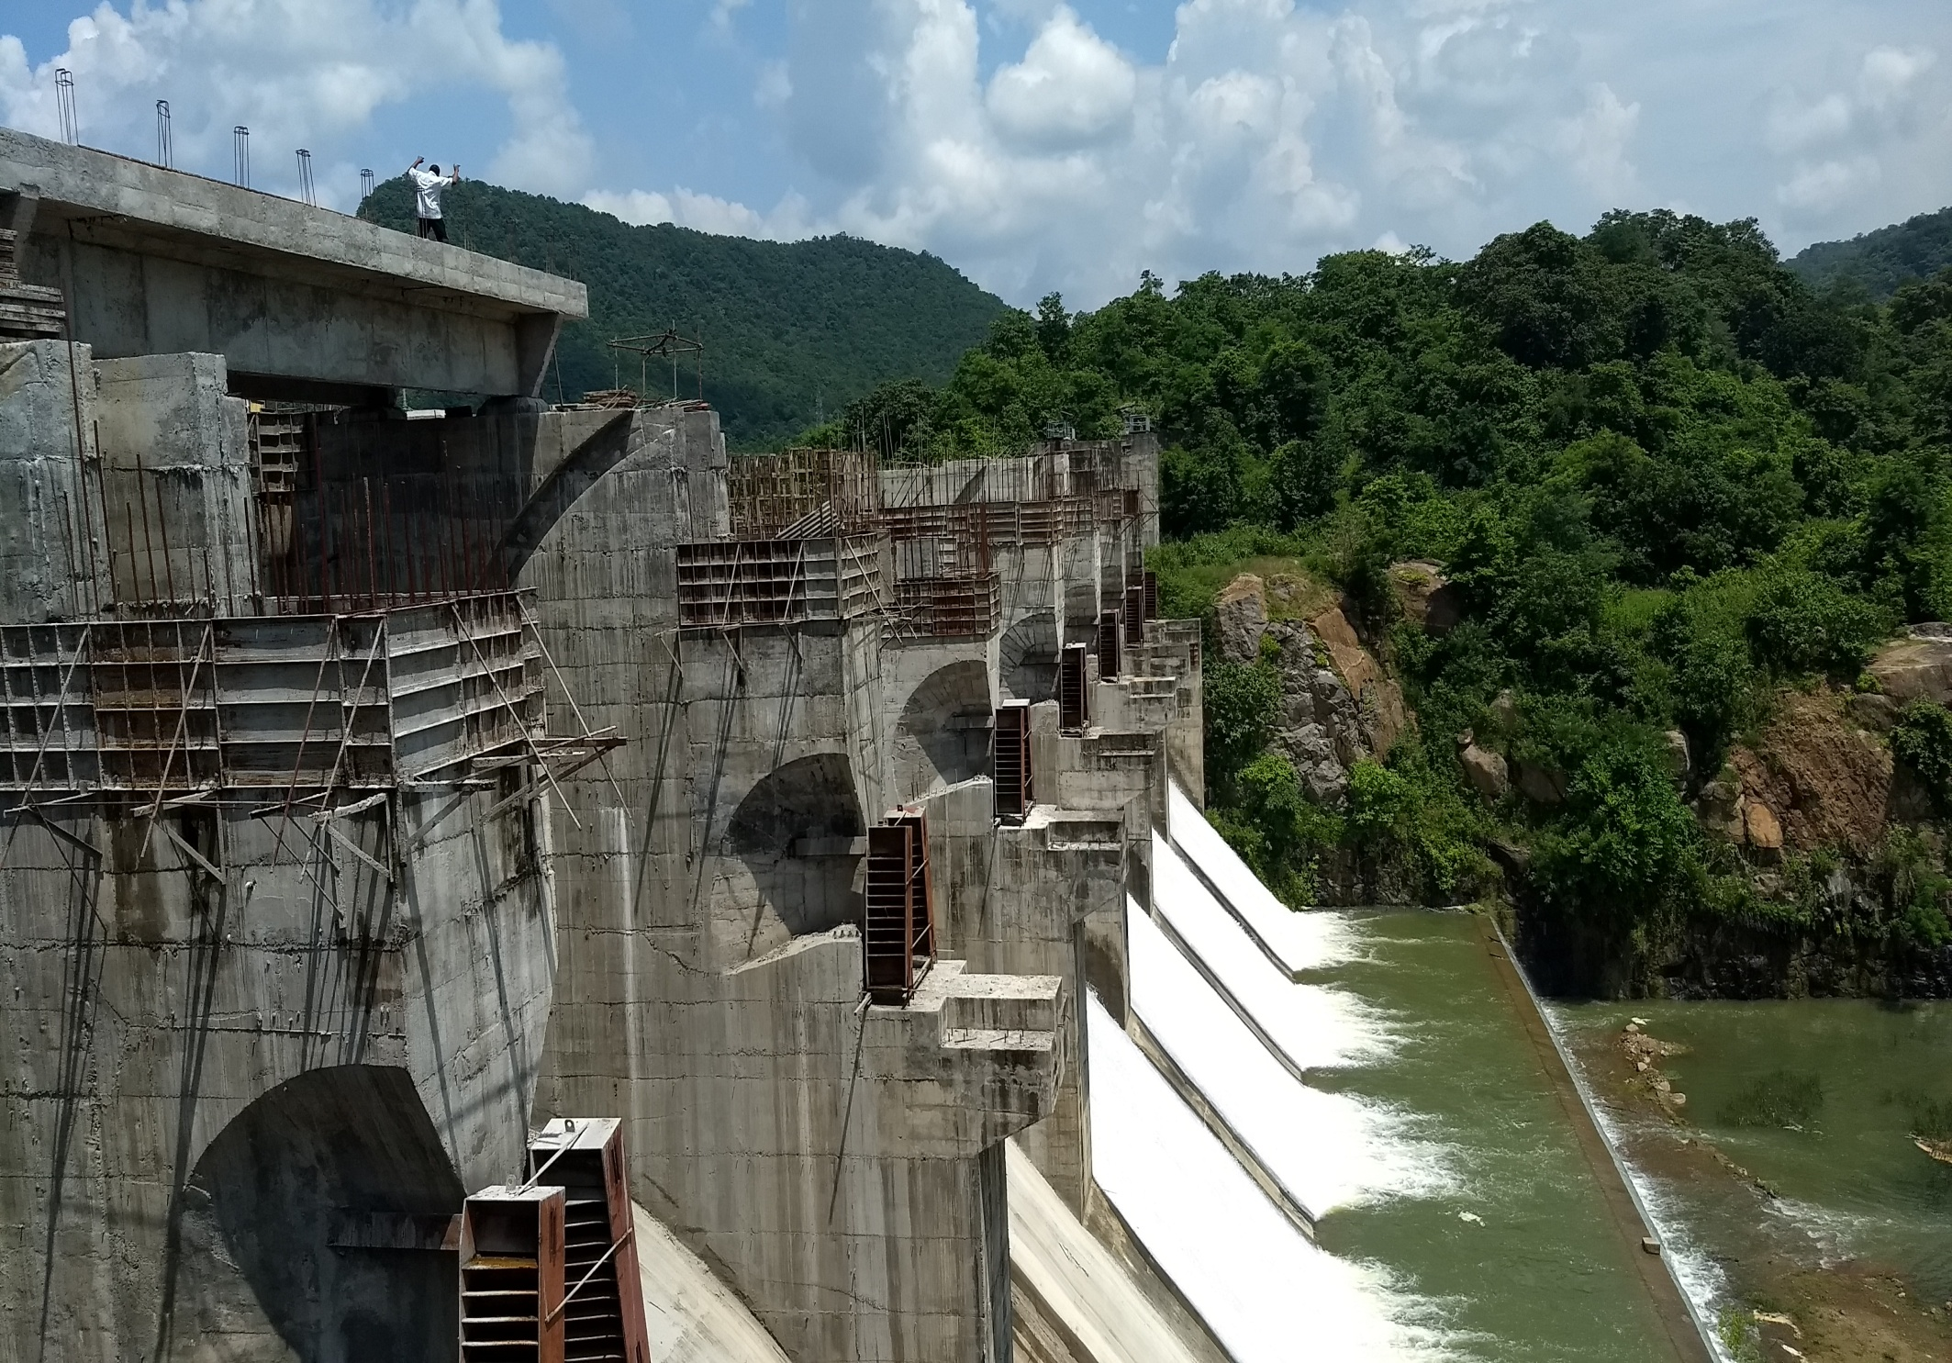
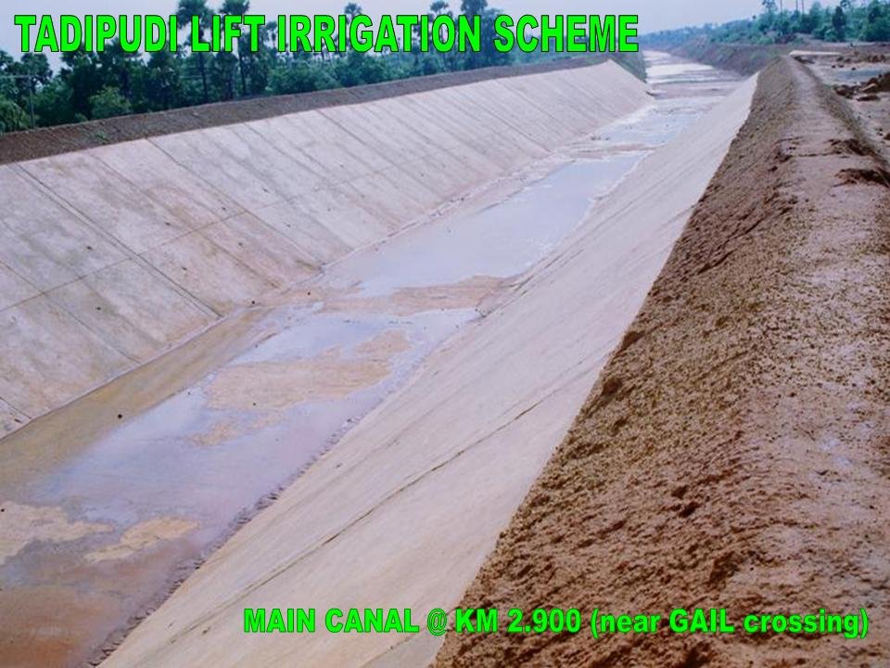

Slide 30
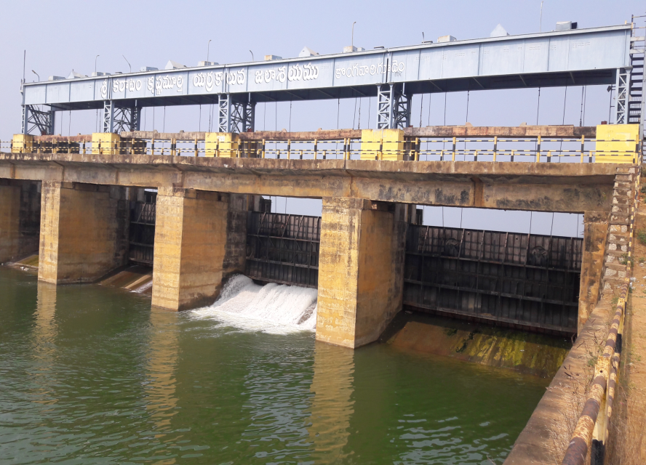
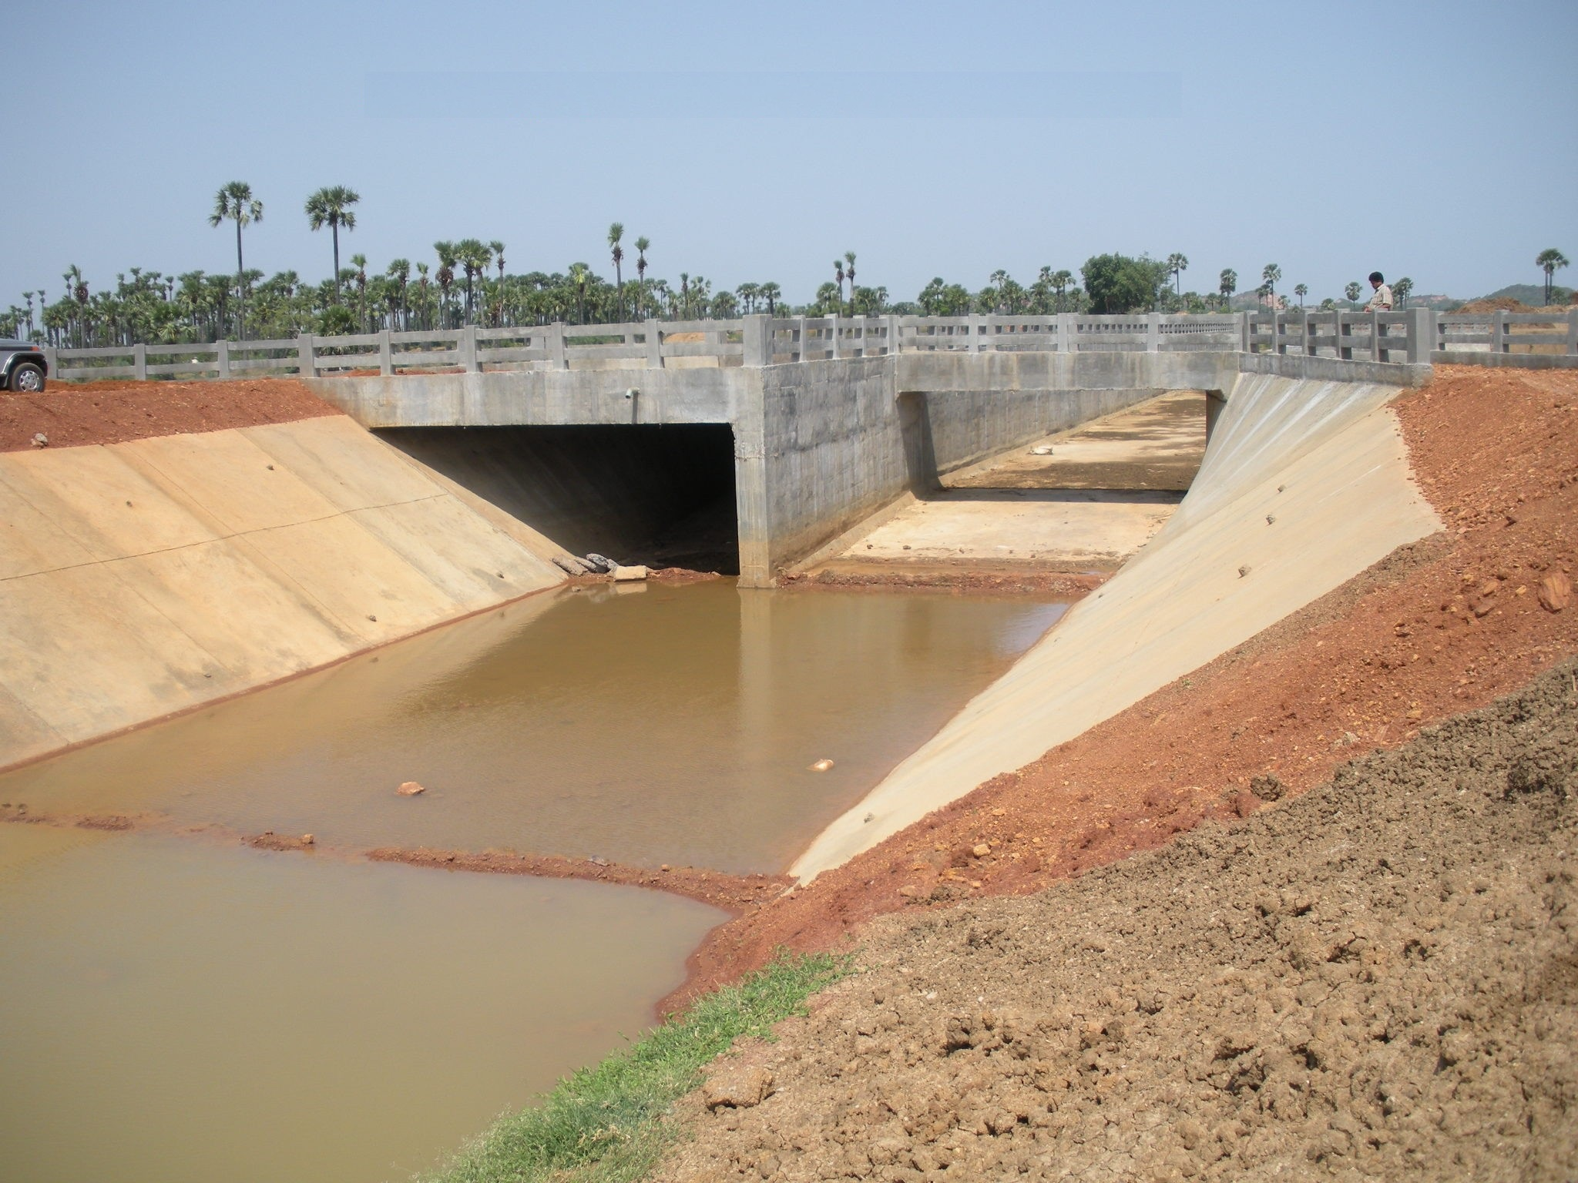
Yerracalva project

Slide 31
5th PIRC Meeting (Mt. Abu, 30th May 2019): Progress Review Presentations
Key Reasons For Progress Delays
Status | Key Reason
√ | Absence of Hydraulic Connectivity up to Outlet.
√ | Delay in Govt/Administrative clearances.
X | State budget constraints.
X | Unwillingness of farmers.
√ | Delays in tendering.
√ | Capacity related issues of Implementing Agencies.
X | Capacity related issues of Contractors/Suppliers.

Slide 32
5th PIRC Meeting (Mt. Abu, 30th May 2019): Progress Review Presentations
Extra Information
STATUS OF CADWM WORKS
The administrative approval accorded for all 7 projects by Government of Andhra Pradesh for Survey, Planning, and Design of OFD works and for Preparation of DPR.
Technical Sanction accorded for Yerrakalva, Musurumilli and Gundlakamma Projects.
The Work of Yerrakalva Project is in progress.
Tenders are held up for Model code of conduct.
Tenders will be invited very soon.

Slide 33
Thank You

Slide 34
5th PIRC Meeting (Mt. Abu, 30th May 2019): Progress Review Presentations
ASSAM
Number of Projects : 3 Projects Included: 3 Projects Availing CA: 1 Projects Reporting Progress:2
Physical Progress
ASSAM

Slide 35
5th PIRC Meeting (Mt. Abu, 30th May 2019): Progress Review Presentations
CCA Progress
( Area in Th. Ha.)
Sr. No. | Project | Balance CCA Target | CCA Progress |  |  |  |  | Target for 2019-20
 |  |  | 2016-17 | 2017-18 | 2018-19 | Total | % Progress
1 | Champamati | 6.59 | 0 | 1.191(FC) | 1.817(FC) 1.347(MI) | 4.36 | 66.12 | 2.23
2. | Dhansiri Irrigation Project | 31.12 | 0 | 0 | .140(MI), 9.758 (OFD) | 9.90 | 31.81 | 21.2
3. | Borolia | 8.9 | 0 | 0 | 0 | 0.00 | 0 | 8.92
 | TOTAL | 46.62 | 0 | 1.19 | 13.06 | 14.25 | 30.57 | 32.4

Slide 36
5th PIRC Meeting (Mt. Abu, 30th May 2019): Progress Review Presentations
WUA Progress
(WUA’s in No’s)
Sr. No. | Project | WUA Target | WUA Progress |  |  |  |  |  | Target for 2019-20
 |  |  | Before April 2016 | 2016-17 | 2017-18 | 2018-19 | Total | % Progress
1 | Champamati | 40 | 0 | 20 | 5 | 0 | 25 | 62.5 | 15
2. | Dhansiri Irrigation Project | 50 | 0 | 0 | 0 | 44 | 44 | 88 | 6
3. | Borolia | 10 | 3 | 0 | 0 | 0 | 3 | 30 | 7
 | TOTAL | 100 | 3 | 20 | 5 | 44 | 72 | 72 | 28

Slide 37
5th PIRC Meeting (Mt. Abu, 30th May 2019): Progress Review Presentations
CA Release Progress
(CA in Rs. Crores)
Sr. No. | Project | Overall CA Target | CA Release Progress |  |  |  |  | Target for 2019-20
 |  |  | 2016-17 | 2017-18 | 2018-19 | Total | % Progress
1. | Champamati | 13.72 | 0 | 0 | 3.56 | 3.56 | 25.95 | 6.95
2. | Dhansiri Irrigation Project | 76.04 | 0 | 0 | 0 | 0 | 0 | 66.31
3. | Borolia | 16.52 | 0 | 0 | 0 | 0 | 0 | 9.97
 | TOTAL | 106.28 | 0 | 0 | 3.56 | 3.56 | 3.35 | 83.23

Slide 38
5th PIRC Meeting (Mt. Abu, 30th May 2019): Progress Review Presentations
Total Expenditure Progress
(TE in Rs. Crores)
Sr. No. | Project | Total Expenditure Target | Total Expenditure Progress |  |  |  |  | Target for 2019-20
 |  |  | 2016-17 | 2017-18 | 2018-19 | Total | % Progress
1 | Champamati | 27.23 | 0.00 | 6.43 | 7.11 | 13.54 | 49.72 | .....
2. | Dhansiri Irrigation Project | 151.99 | 0.00 | 2.33 | 6.10 | 8.43 | 5.55 | 143.56
3. | Borolia | 36.24 | 0.00 | 0.00 | 0.00 | 0.00 | 0.00 | 21.60
 | TOTAL | 215.46 | 0.00 | 8.76 | 13.21 | 21.97 | 10.20 | 165.16

Slide 39
5th PIRC Meeting (Mt. Abu, 30th May 2019): Progress Review Presentations
Broad Review
(CCA in Th. ha.)
Sr. No. | Project | CADWM |  |  |  |  | AIBP
 |  | Total CCA of Project | CCA developed before 31.03. 2016 (A)* | Progress in CCA for 99 Priority Projects (B) | Cumulative CCA developed (A+B) | % CCA Progress | Ultimate Irrigation Potential | Potential Created | % IPC
1 | Champamati | 6.59 | 0 | 4.36 | 4.36 | 66.12 | 23.54 | 23.22 | 98.64
2. | Dhansiri Irrigation Project | 38.62 | 7.50 | 9.90 | 17.40 | 45.06 | 77.23 | 55.26 | 71.55
3. | Borolia | 8.92 | 0 | 0 | 0 | 0 | 13.56 | 3.30 | 24.34
 | TOTAL | 54.12 | 7.50 | 14.25 | 21.75 | 40.19 | 114.33 | 81.78 | 71.53
* i.e. CCA developed under CADWM (up to 31-03-2016) and before CADWM inclusion.

Slide 40
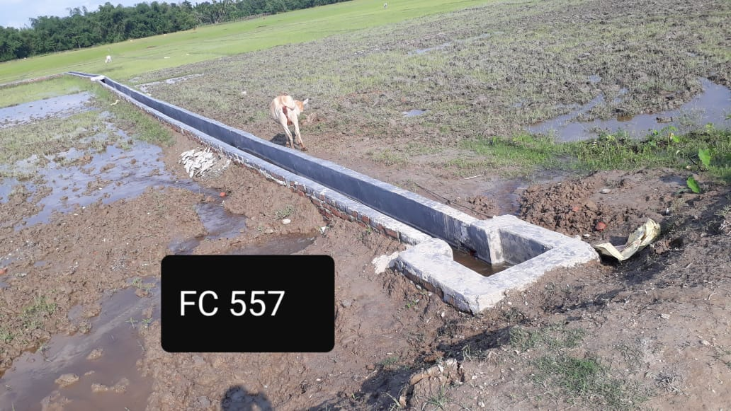
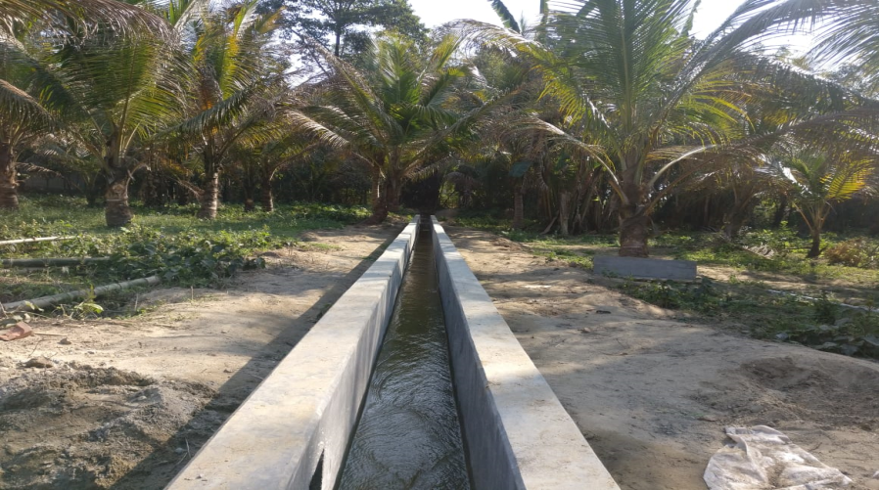
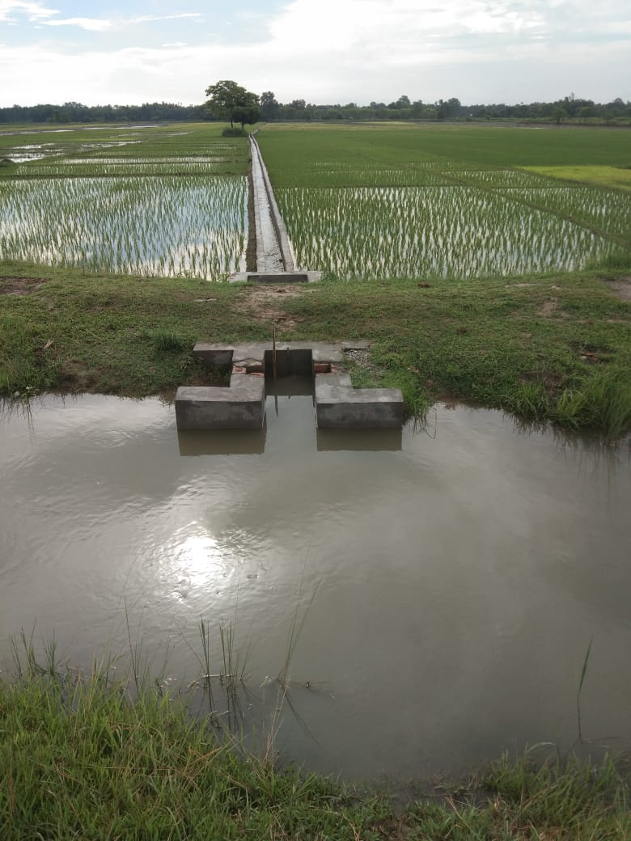
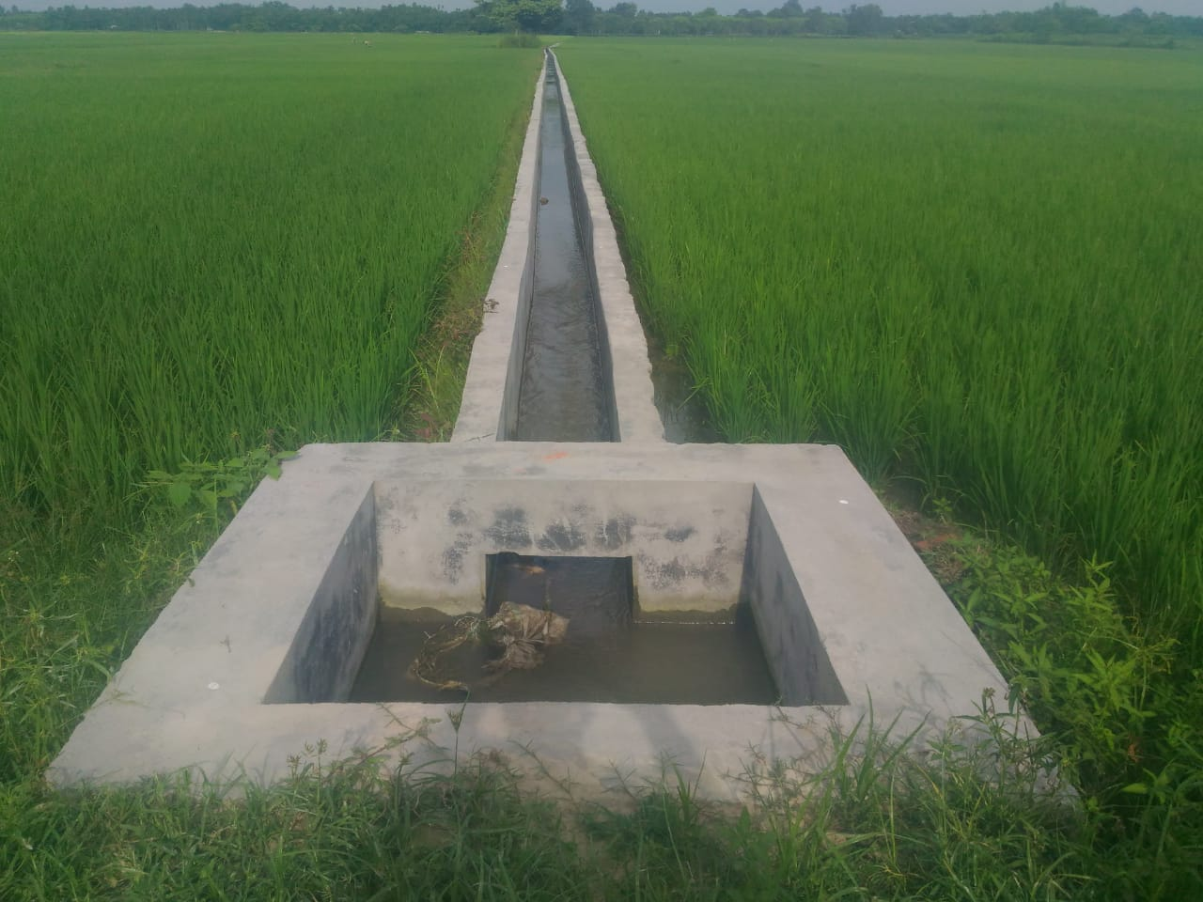
5th PIRC Meeting (Mt. Abu, 30th May 2019): Progress Review Presentations
Brick Lined Field Channel

Slide 41
5th PIRC Meeting (Mt. Abu, 30th May 2019): Progress Review Presentations
Key Reasons For Progress Delays
Status | Key Reason
X | Absence of Hydraulic Connectivity up to Outlet.
√ | Delay in Govt/Administrative clearances.
√ | State budget constraints.
X | Unwillingness of farmers.
X | Delays in tendering.
X | Capacity related issues of Implementing Agencies.
X | Capacity related issues of Contractors/Suppliers.
X | Other Issue (to be specified).

Slide 42
5th PIRC Meeting (Mt. Abu, 30th May 2019): Progress Review Presentations
Extra Slides
Dhansiri Irrigation Project (Major), in Udalguri District (BTAD), Assam was initiated in the year 1975 across the river Dhansiri at Bhairabkunda near Tri-Junction of Assam, Arunachal and Bhutan.
Targeted Potential AIA = 77230 Ha.
CCA = 38615 Ha.
Intensity of Irrigation = 200%
Up to date Potential Created = 55258 Ha.
Potential Utilized = 21800 Ha.
Balance Potential to be Created = 21972 Ha.

Slide 43
5th PIRC Meeting (Mt. Abu, 30th May 2019): Progress Review Presentations
Extra Slides
YEAR OF INCLUSION | 2014-15
Project Cost | Rs.151.99 Cr.
C.C.A. to be Covered | 38615 Ha.
MoU SIGNED | 22/02/2016
Revised MoU | Submitted (on 08-05-2019)
C.A. RELEASED | Rs. 9.73 Cr.
U.C. Submitted (on 08-05-2019) | Rs.8.429 Cr.
Target Date of Completion | March /2020
Up to date Physical Progress up to March/19 | 31.81%
Target up to March/2020 | 100%

Slide 44
Thank You

Slide 45
5th PIRC Meeting (Mt. Abu, 30th May 2019): Progress Review Presentations
Bihar
Number of Projects : 2 Projects Included: 1 Projects Availing CA: 1 Projects Reporting Progress:1
Physical Progress

Slide 46
5th PIRC Meeting (Mt. Abu, 30th May 2019): Progress Review Presentations
CCA Progress
( Area in Th. Ha.)
Sr. No. | Project | Balance CCA Target | CCA Progress |  |  |  |  | Target for 2019-20
 |  |  | 2016-17 | 2017-18 | 2018-19 | Total | % Progress
1 | Durgawati | 32.24 | 2.25 | 5.49 | 3.998 | 11.74 | 36.40 | 18.8
 | TOTAL | 32.24 | 2.25 | 5.49 | 4.00 | 11.74 | 36.40 | 18.8

Slide 47
5th PIRC Meeting (Mt. Abu, 30th May 2019): Progress Review Presentations
WUA Progress
(WUA’s in No’s)
Sr. No. | Project | WUA Target | WUA Progress |  |  |  |  |  | Target for 2019-20
 |  |  | Before April 2016 | 2016-17 | 2017-18 | 2018-19 | Total | % Progress
1 | Durgawati | 30 | 0 | 0 | 0 | 8 | 8 | 26.67 | 22
 | TOTAL | 30 | 0 | 0 | 0 | 8 | 8 | 26.67 | 22

Slide 48
5th PIRC Meeting (Mt. Abu, 30th May 2019): Progress Review Presentations
CA Release Progress
(CA in Rs. Crores)
Sr. No. | Project | Overall CA Target | CA Release Progress |  |  |  |  | Target for 2019-20
 |  |  | 2016-17 | 2017-18 | 2018-19 | Total | % Progress
1 | Durgawati | 55.6 | 12.6 | 8.76 | 14.42 | 35.82 | 64.46 | 7.53
 | TOTAL | 55.6 | 12.6 | 8.76 | 14.42 | 35.82 | 64.46 | 7.53

Slide 49
5th PIRC Meeting (Mt. Abu, 30th May 2019): Progress Review Presentations
Total Expenditure Progress
(TE in Rs. Crores)
Sr. No. | Project | Total Expenditure Target | Total Expenditure Progress |  |  |  |  | Target for 2019-20
 |  |  | 2016-17 | 2017-18 | 2018-19 | Total | % Progress
1 | Durgawati | 148.57 | 7.86 | 20.2 | 17.6 | 45.58 | 30.68 | 89.41
 | TOTAL | 148.57 | 7.86 | 20.2 | 17.6 | 45.58 | 30.68 | 89.41

Slide 50
5th PIRC Meeting (Mt. Abu, 30th May 2019): Progress Review Presentations
Broad Review
(CCA in Th. ha.)
Sr. No. | Project | CADWM |  |  |  |  | AIBP
 |  | Total CCA of Project | CCA developed before 31.03. 2016 (A)* | Progress in CCA for 99 Priority Projects (B) | Cumulative CCA developed (A+B) | % CCA Progress | Ultimate Irrigation Potential | Potential Created | % IPC
1 | Durgawati | 32.47 | 1.96 | 11.7 | 13.7 | 42.20 | 39.61 | 26.5 | 66.90
 | TOTAL | 32.47 | 1.96 | 11.7 | 13.7 | 42.20 | 39.61 | 26.5 | 66.90
* i.e. CCA developed under CADWM (up to 31-03-2016) and before CADWM inclusion.

Slide 51
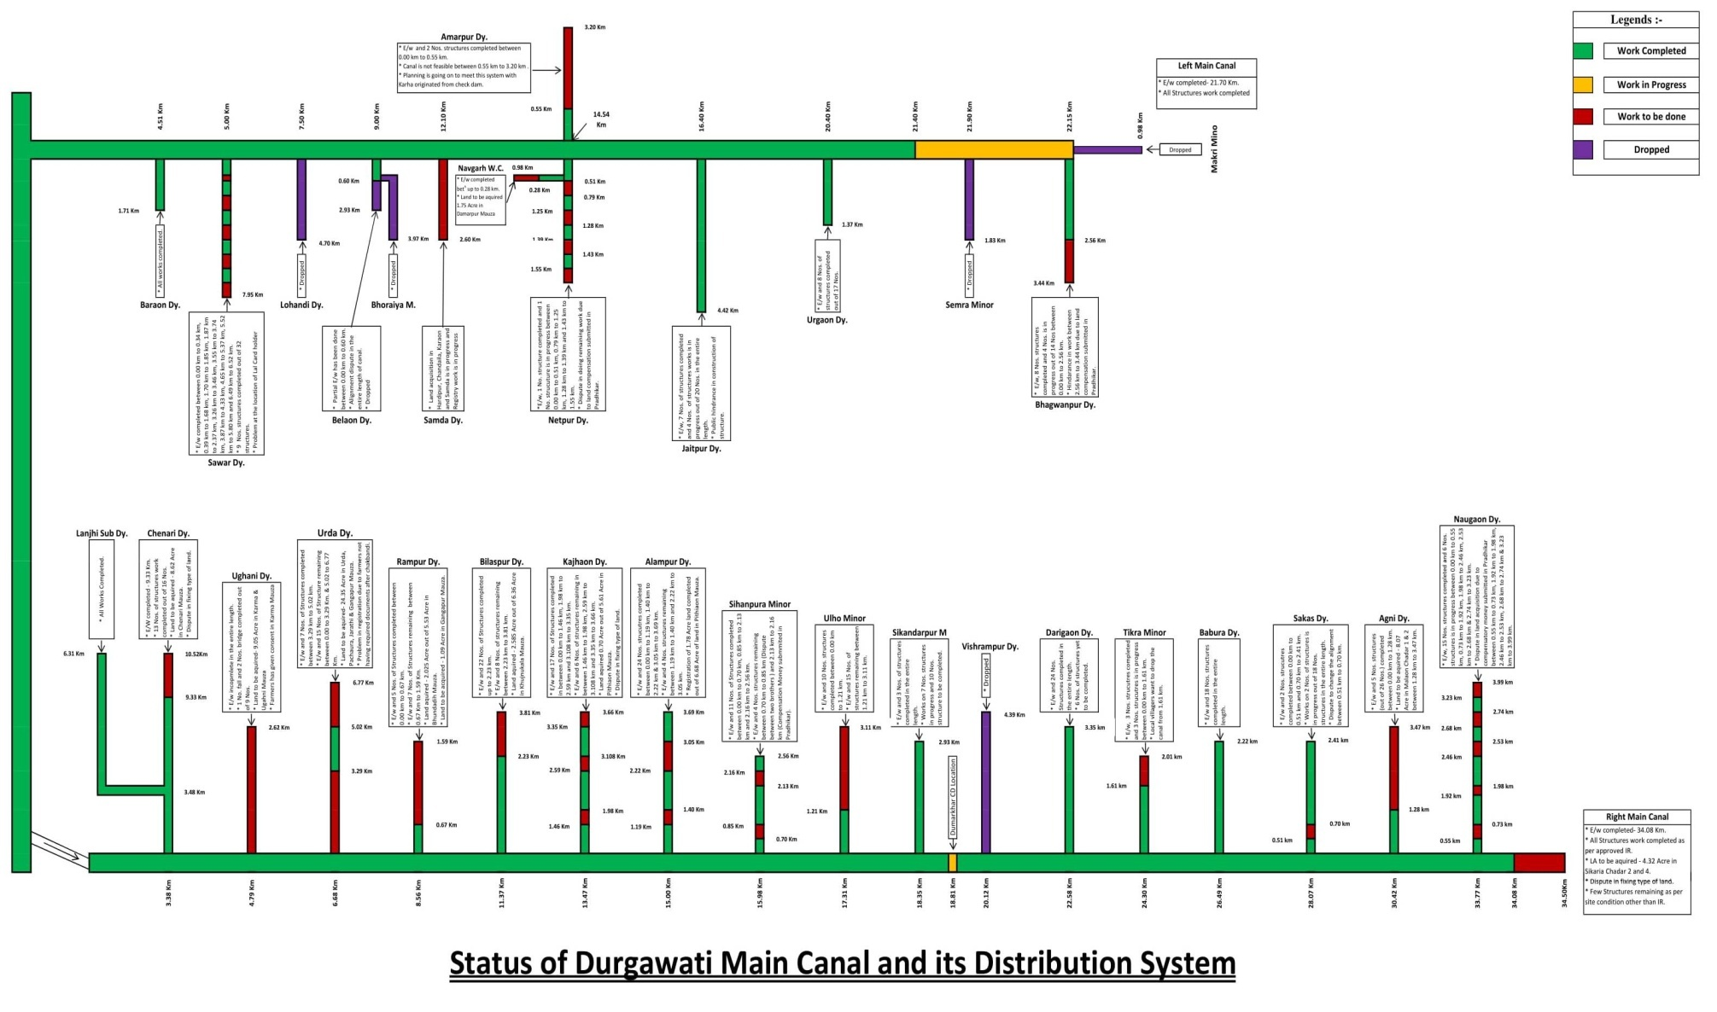
Schematic Diagram for Durgawati Reservoir Project

Slide 52
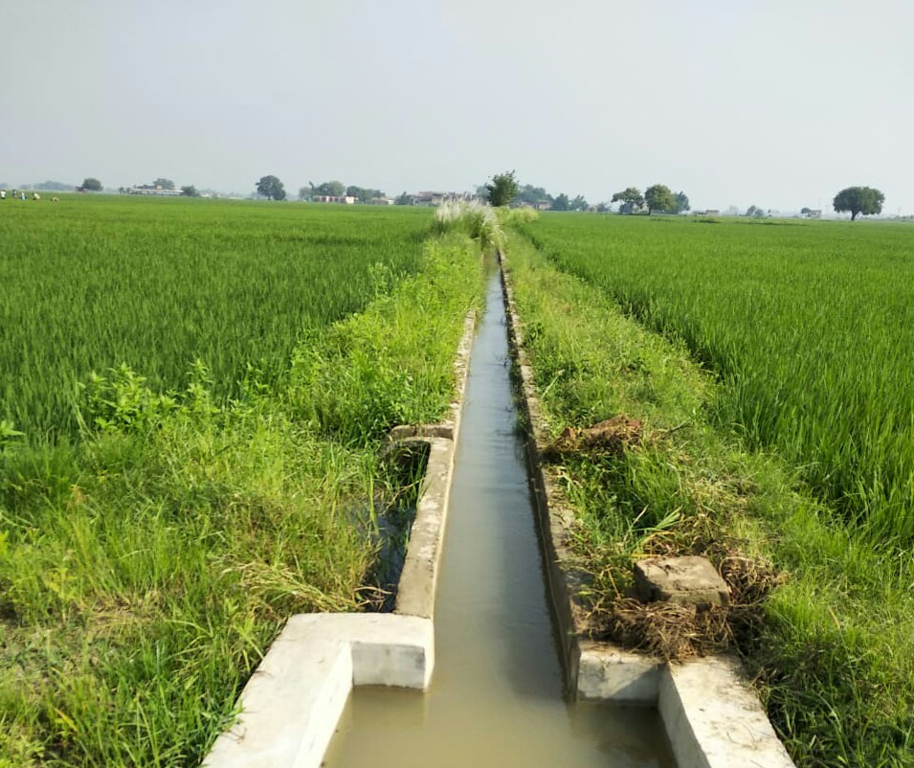
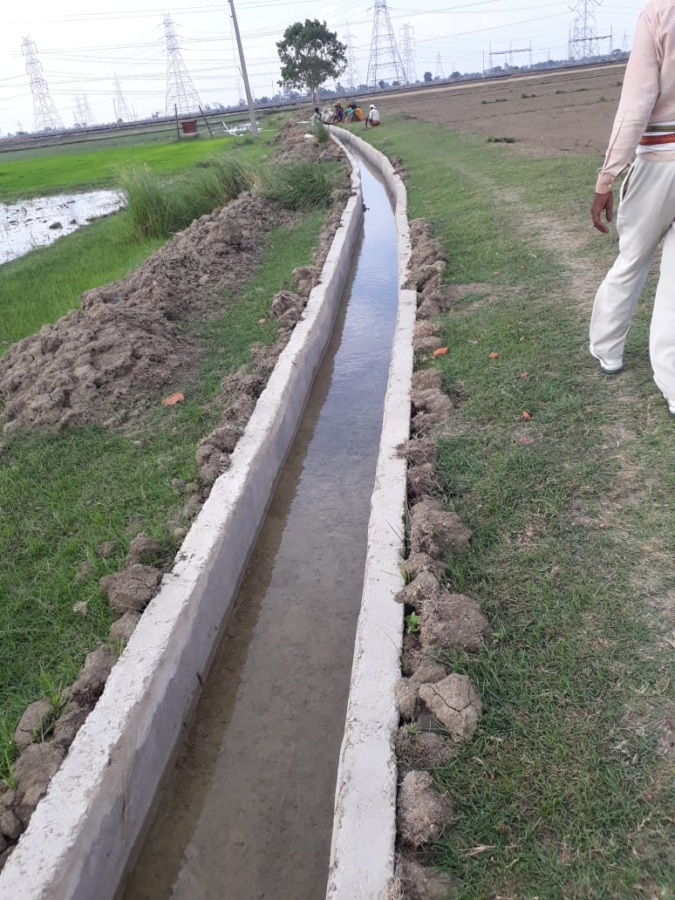
Photographs for Field Channels and Infrastructure for Micro Irrigation.

Slide 53
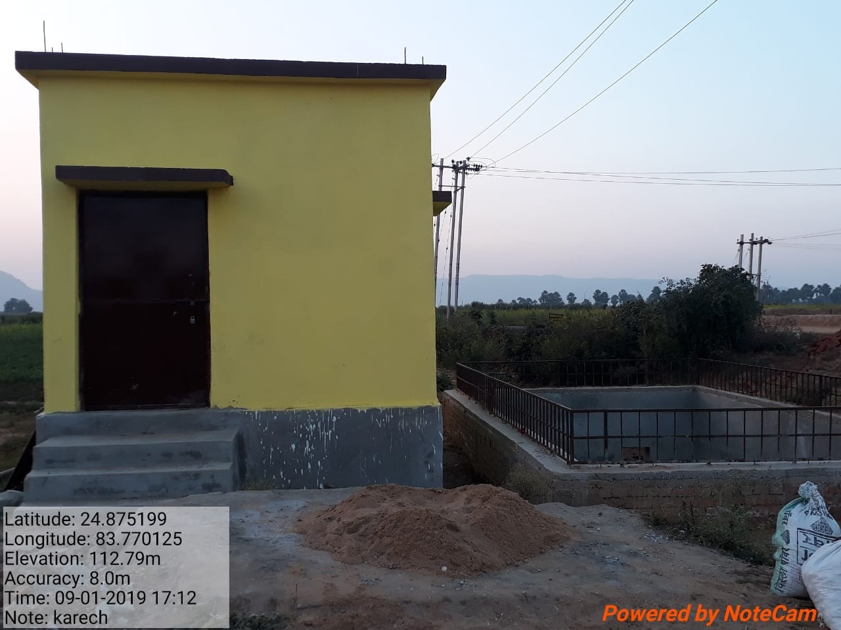
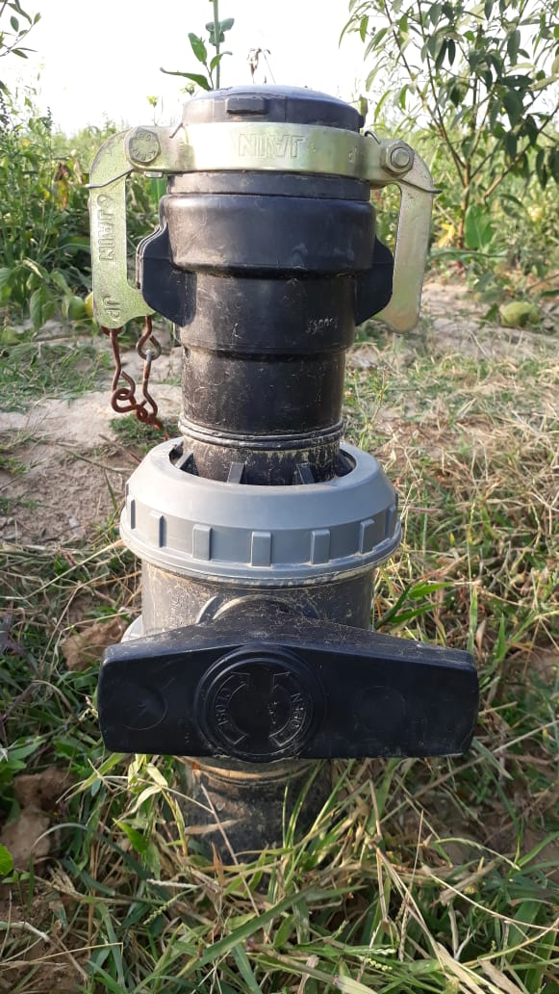

Slide 54
5th PIRC Meeting (Mt. Abu, 30th May 2019): Progress Review Presentations
Key Reasons For Progress Delays
Status | Key Reason
√ | Absence of Hydraulic Connectivity up to Outlet.
X | Delay in Govt/Administrative clearances.
X | State budget constraints.
√ | Unwillingness of farmers.
X | Delays in tendering.
X | Capacity related issues of Implementing Agencies.
X | Capacity related issues of Contractors/Suppliers.
√ | Other Issue (to be specified). (i) The working period for construction is available only for 3-4 months due to crops in the fields. (ii) Construction work of some of the distributaries has not been started yet due to land acquisition issues.

Slide 55
5th PIRC Meeting (Mt. Abu, 30th May 2019): Progress Review Presentations
Extra Slides
{ Project-specific information and Issues}
The construction of Lined field channels in about 3500 Ha. area of CCA is under progress.
Estimates of Lined field channels for 1000 Ha. is ready and is being sanctioned. Work on these will be started in June’2019.
The construction of Infrastructure development work for Micro irrigation in 200 Ha. is in Progress.
Another 1000 Ha. Area of CCA has been identified to be covered under Micro Irrigation.

Slide 56
5th PIRC Meeting (Mt. Abu, 30th May 2019): Progress Review Presentations
THANKS………

Slide 57
5th PIRC Meeting (Mt. Abu, 30th May 2019): Progress Review Presentations
Chhattisgarh
Number of Projects : 3 Projects Included: 3 Projects Availing CA: 3 Projects Reporting Progress:0
Physical Progress

Slide 58
5th PIRC Meeting (Mt. Abu, 30th May 2019): Progress Review Presentations
CCA Progress
( Area in Th. Ha.)
Sr. No. | Project | Balance CCA Target | CCA Progress |  |  |  |  | Target for 2019-20
 |  |  | 2016-17 | 2017-18 | 2018-19 | Total | % Progress
1 | Kelo | 22.81 | 0 | 0 | 0 | 0 | 0 | 5
2 | Kharung | 8.3 | 0 | 0 | 0 | 0 | 0 | 2.5
3 | Maniyari Tank | 11.52 | 0 | 0 | 0 | 0 | 0 | 3.5
 | TOTAL | 42.63 | 0 | 0 | 0 | 0 | 0 | 11

Slide 59
5th PIRC Meeting (Mt. Abu, 30th May 2019): Progress Review Presentations
WUA Progress
(WUA’s in No’s)
Sr. No. | Project | WUA Target | WUA Progress |  |  |  |  |  | Target for 2019-20
 |  |  | Before April 2016 | 2016-17 | 2017-18 | 2018-19 | Total | % Progress
1 | Kelo | 12 | 0 | 0 | 0 | 0 | 0 | 0 | .....
2 | Kharung | 10 | 10 | 0 | 0 | 0 | 10 | 100
3 | Maniyari Tank | 10 | 0 | 10 | 0 | 0 | 10 | 100
 | TOTAL | 32 | 10 | 10 | 0 | 0 | 20 | 62.5

Slide 60
5th PIRC Meeting (Mt. Abu, 30th May 2019): Progress Review Presentations
CA Release Progress
(CA in Rs. Crores)
Sr. No. | Project | Overall CA Target | CA Release Progress |  |  |  |  | Target for 2019-20
 |  |  | 2016-17 | 2017-18 | 2018-19 | Total | % Progress
1 | Kelo | 40.52 | 0 | 11.8 | 0 | 11.8 | 29.08 | 10
2 | Kharung | 16.43 | 0 | 0 | 4.95 | 4.95 | 30.14 | 4.95
3 | Maniyari Tank | 22.63 | 0 | 0 | 4.98 | 4.98 | 22.01 | 4.98
 | TOTAL | 79.57 | 0 | 11.8 | 9.93 | 21.7 | 27.28 | 19.9

Slide 61
5th PIRC Meeting (Mt. Abu, 30th May 2019): Progress Review Presentations
Total Expenditure Progress
(TE in Rs. Crores)
Sr. No. | Project | Total Expenditure Target | Total Expenditure Progress |  |  |  |  | Target for 2019-20
 |  |  | 2016-17 | 2017-18 | 2018-19 | Total | % Progress
1 | Kelo | 81.2089 | 0 | 0 | 0 | 0 | 0 | 40
2 | Kharung | 33.1828 | 0 | 0 | 0 | 0 | 0 | 12
3 | Maniyari Tank | 45.3722 | 0 | 0 | 0 | 0 | 0 | 16
 | TOTAL | 159.764 | 0 | 0 | 0 | 0 | 0 | 68

Slide 62
5th PIRC Meeting (Mt. Abu, 30th May 2019): Progress Review Presentations
Broad Review
(CCA in Th. ha.)
Sr. No. | Project | CADWM |  |  |  |  | AIBP
 |  | Total CCA of Project | CCA developed before 31.03. 2016 (A)* | Progress in CCA for 99 Priority Projects (B) | Cumulative CCA developed (A+B) | % CCA Progress | Ultimate Irrigation Potential | Potential Created | % IPC
1 | Kelo | 22.81 | 0 | 0 | 0 | 0 | 22.81 | 17 | 74.40
2 | Kharung | 8.3 | 0 | 0 | 0 | 0 | 10.3 | 10.3 | 100.00
3 | Maniyari Tank | 11.515 | 0 | 0 | 0 | 0 | 11.52 | 11.5 | 100.00
 | TOTAL | 42.625 | 0 | 0 | 0 | 0 | 44.63 | 38.8 | 86.91
* i.e. CCA developed under CADWM (up to 31-03-2016) and before CADWM inclusion.

Slide 63
5th PIRC Meeting (Mt. Abu, 30th May 2019): Progress Review Presentations
Key Reasons For Progress Delays
Status | Key Reason
X | Absence of Hydraulic Connectivity up to Outlet.
√ | Delay in Govt/Administrative clearances.
X | State budget constraints.
X | Unwillingness of farmers.
√ | Delays in tendering.
X | Capacity related issues of Implementing Agencies.
X | Capacity related issues of Contractors/Suppliers.
X | Other Issue (to be specified).

Slide 64
5th PIRC Meeting (Mt. Abu, 30th May 2019): Progress Review Presentations
Extra Slides
Tender called for CADWM works of Kelo, Kharung and Maniyari Projects have been cancelled because of very much high rates quoted by tenderers. After expiry of Model code of Conduct for Loksabha Election, retendering process will be started.
CHHATTISGARH

Slide 65
5th PIRC Meeting (Mt. Abu, 30th May 2019): Progress Review Presentations
Goa
Number of Projects : 1 Projects Included: 1 Projects Availing CA: 0 Projects Reporting Progress:1
Physical Progress

Slide 66
5th PIRC Meeting (Mt. Abu, 30th May 2019): Progress Review Presentations
CCA Progress
( Area in Th. Ha.)
Sr. No. | Project | Balance CCA Target | CCA Progress |  |  |  |  | Target for 2019-20
 |  |  | 2016-17 | 2017-18 | 2018-19 | Total | % Progress
1 | Tillari | 8.667 | 0.01 | 0.01 | 0.75 | 0.77 | 8.83 | 3.95
 | TOTAL | 8.667 | 0.01 | 0.01 | 0.75 | 0.77 | 8.83 | 3.95

Slide 67
5th PIRC Meeting (Mt. Abu, 30th May 2019): Progress Review Presentations
WUA Progress
(WUA’s in No’s)
Sr. No. | Project | WUA Target | WUA Progress |  |  |  |  |  | Target for 2019-20
 |  |  | Before April 2016 | 2016-17 | 2017-18 | 2018-19 | Total | % Progress
1 | Tillari | 150 | 42 | 0 | 0 | 0 | 42 | 28 | 33
 | TOTAL | 150 | 42 | 0 | 0 | 0 | 42 | 28 | 33

Slide 68
5th PIRC Meeting (Mt. Abu, 30th May 2019): Progress Review Presentations
CA Release Progress
(CA in Rs. Crores)
Sr. No. | Project | Overall CA Target | CA Release Progress |  |  |  |  | Target for 2019-20
 |  |  | 2016-17 | 2017-18 | 2018-19 | Total | % Progress
1 | Tillari | 18.70 | 0 | 0 | 0 | 0 | 0 | 7.15
 | TOTAL | 18.70 | 0 | 0 | 0 | 0 | 0 | 7.15

Slide 69
5th PIRC Meeting (Mt. Abu, 30th May 2019): Progress Review Presentations
Total Expenditure Progress
(TE in Rs. Crores)
Sr. No. | Project | Total Expenditure Target | Total Expenditure Progress |  |  |  |  | Target for 2019-20
 |  |  | 2016-17 | 2017-18 | 2018-19 | Total | % Progress
1 | Tillari | 153.67 | 4.72 | 7.17 | 9.09 | 21 | 13.65 | 70
 | TOTAL | 153.67 | 4.72 | 7.17 | 9.09 | 21 | 13.65 | 70

Slide 70
5th PIRC Meeting (Mt. Abu, 30th May 2019): Progress Review Presentations
Broad Review
(CCA in Th. ha.)
Sr. No. | Project | CADWM |  |  |  |  | AIBP
 |  | Total CCA of Project | CCA developed before 31.03. 2016 (A)* | Progress in CCA for 99 Priority Projects (B) | Cumulative CCA developed (A+B) | % CCA Progress | Ultimate Irrigation Potential | Potential Created | % IPC
1 | Tillari | 14.52 | 5.85 | 0.77 | 6.62 | 45.58 | 21.05 | 11.83 | 56.20
 | TOTAL | 14.52 | 5.85 | 0.77 | 6.62 | 45.58 | 21.05 | 11.83 | 56.20
* i.e. CCA developed under CADWM (up to 31-03-2016) and before CADWM inclusion.

Slide 71
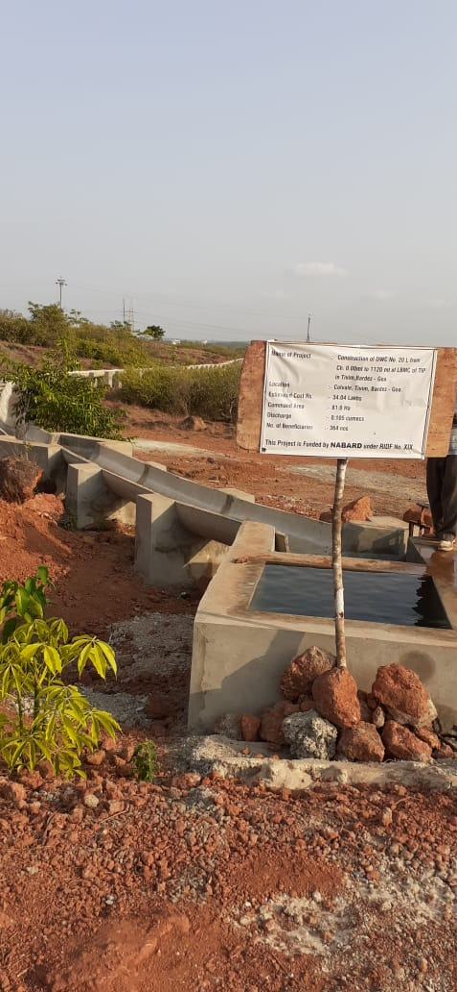
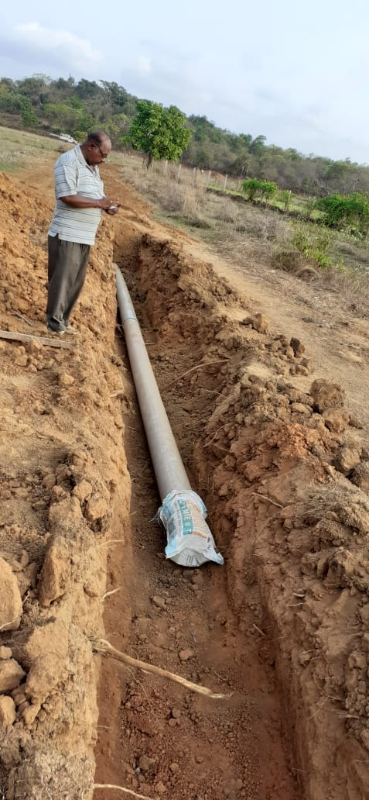
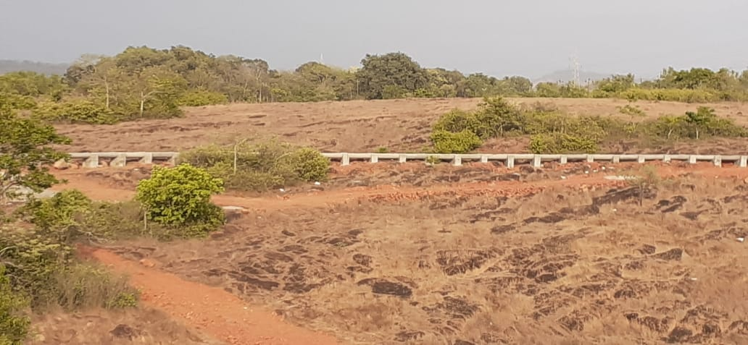
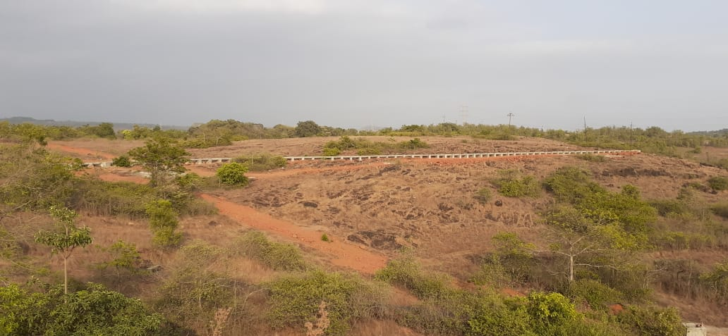
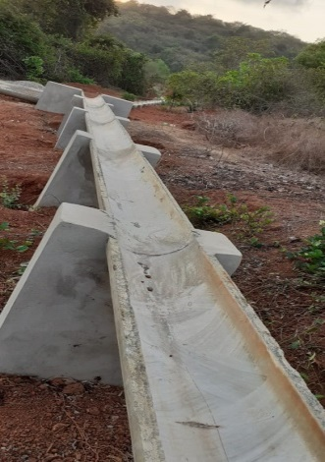
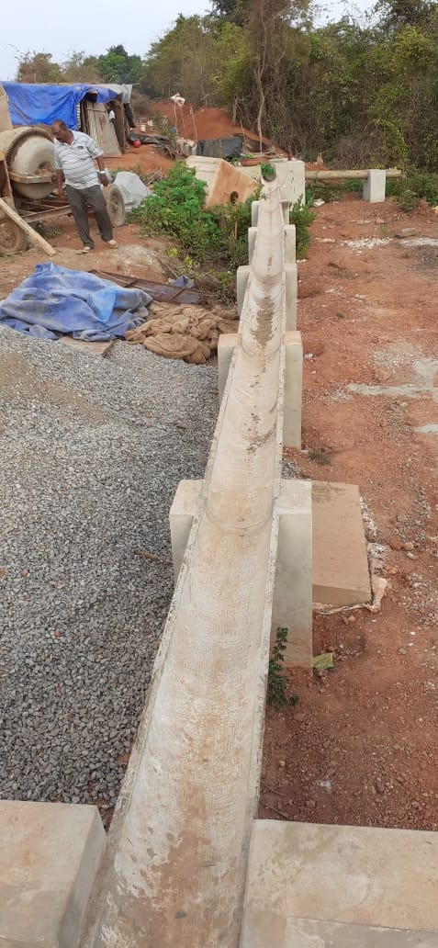
5th PIRC Meeting (Mt. Abu, 30th May 2019): Progress Review Presentations
Glimpses Of Project Progress
{.....Project Photographs (4/5) may be provided}

Slide 72
5th PIRC Meeting (Mt. Abu, 30th May 2019): Progress Review Presentations
Key Reasons For Progress Delays
Status | Key Reason
√ | Absence of Hydraulic Connectivity up to Outlet.
X | Delay in Govt/Administrative clearances.
X | State budget constraints.
√ | Unwillingness of farmers.
X | Delays in tendering.
X | Capacity related issues of Implementing Agencies.
X | Capacity related issues of Contractors/Suppliers.
X | Other Issue (to be specified).

Slide 73
5th PIRC Meeting (Mt. Abu, 30th May 2019): Progress Review Presentations
Gujarat
Number of Projects : 1 Projects Included: 1 Projects Availing CA: 1 Projects Reporting Progress:1
Physical Progress

Slide 74
5th PIRC Meeting (Mt. Abu, 30th May 2019): Progress Review Presentations
CCA Progress
( Area in Th. Ha.)
Sr. No. | Project | Balance CCA Target | CCA Progress |  |  |  |  | Target for 2019-20
 |  |  | 2016-17 | 2017-18 | 2018-19 | Total | % Progress
1 | Sardar Sarovar Project | 1363.859 | 385.330 | 290.061 | 260.165 | 935.556 | 68.60 | 187.869
 | TOTAL | 1363.859 | 385.330 | 290.061 | 260.165 | 935.556 | 68.60 | 187.869

Slide 75
5th PIRC Meeting (Mt. Abu, 30th May 2019): Progress Review Presentations
WUA Progress
(WUA’s in No’s)
Sr. No. | Project | WUA Target | WUA Progress (Registered) |  |  |  |  |  | Target for 2019-20
 |  |  | Before April 2016 | 2016-17 | 2017-18 | 2018-19 | Total | % Progress
1 | Sardar Sarovar Project | 4466 | 1894 | 428 | 46 | 526 | 2894 | 64.80 | 1200
 | TOTAL | 4466 | 1894 | 428 | 46 | 526 | 2894 | 64.80 | 1200

Slide 76
5th PIRC Meeting (Mt. Abu, 30th May 2019): Progress Review Presentations
CA Release Progress
(CA in Rs. Crores)
Sr. No. | Project | Overall CA Target | CA Release Progress |  |  |  |  | Target for 2019-20
 |  |  | 2016-17 | 2017-18 | 2018-19 | Total | % Progress
1 | Sardar Sarovar Project | 2510.883 | 681.644 | 690.476 | 347.040 | 1719.160 | 68.468 | 499.750
 | TOTAL | 2510.883 | 681.644 | 690.476 | 347.040 | 1719.160 | 68.468 | 499.750

Slide 77
5th PIRC Meeting (Mt. Abu, 30th May 2019): Progress Review Presentations
Total Expenditure Progress
(TE in Rs. Crores)
Sr. No. | Project | Total Expenditure Target | Total Expenditure Progress |  |  |  |  | Target for 2019-20
 |  |  | 2016-17 | 2017-18 | 2018-19 | Total | % Progress
1 | Sardar Sarovar Project | 5021.765 | 1435.906 | 1224.729 | 861.680 | 3522.315 | 70.141 | 999.490
 | TOTAL | 5021.765 | 1435.906 | 1224.729 | 861.680 | 3522.315 | 70.141 | 999.490

Slide 78
5th PIRC Meeting (Mt. Abu, 30th May 2019): Progress Review Presentations
Broad Review
(CCA in Th. ha.)
Sr. No. | Project | CADWM |  |  |  |  | AIBP
 |  | Total CCA of Project | CCA developed as on 31.03. 2016 (A)* | Progress in CCA for 99 Priority Projects (B) | Cumulative CCA developed (A+B) | % CCA Progress | Ultimate Irrigation Potential | Potential Created | % IPC
1 | Sardar Sarovar Project | 1792 | 602.446 | 935.556 | 1538 | 85.83 | 1792 | 1647.15 | 91.92
 | TOTAL | 1792 | 602.446 | 935.556 | 1538 | 85.83 | 1792 | 1647.15 | 91.92
* i.e. CCA developed under CADWM (up to 31-03-2016) and before CADWM inclusion.

Slide 79
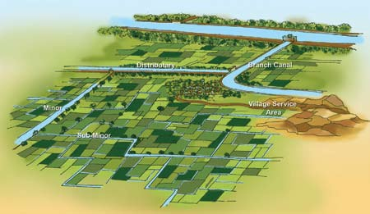
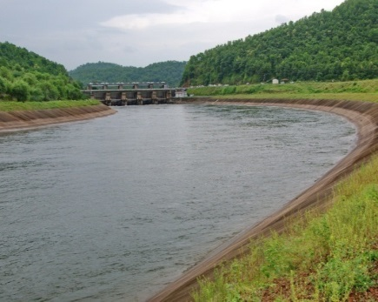
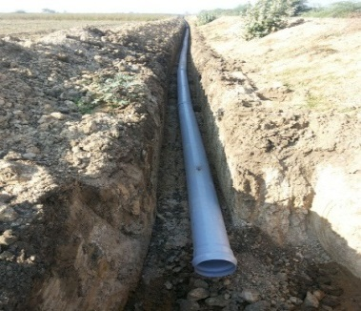
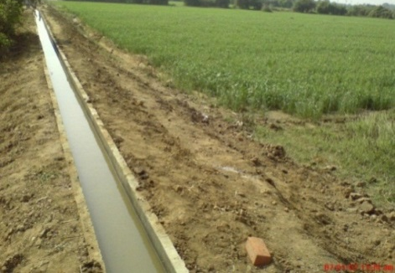
Progress of Canal Network
100%
95%
96%
88%
Open Gravity Channels
84%
Culturable Command Area Developed up to March-2019
15 lakh Ha.
79

Slide 80
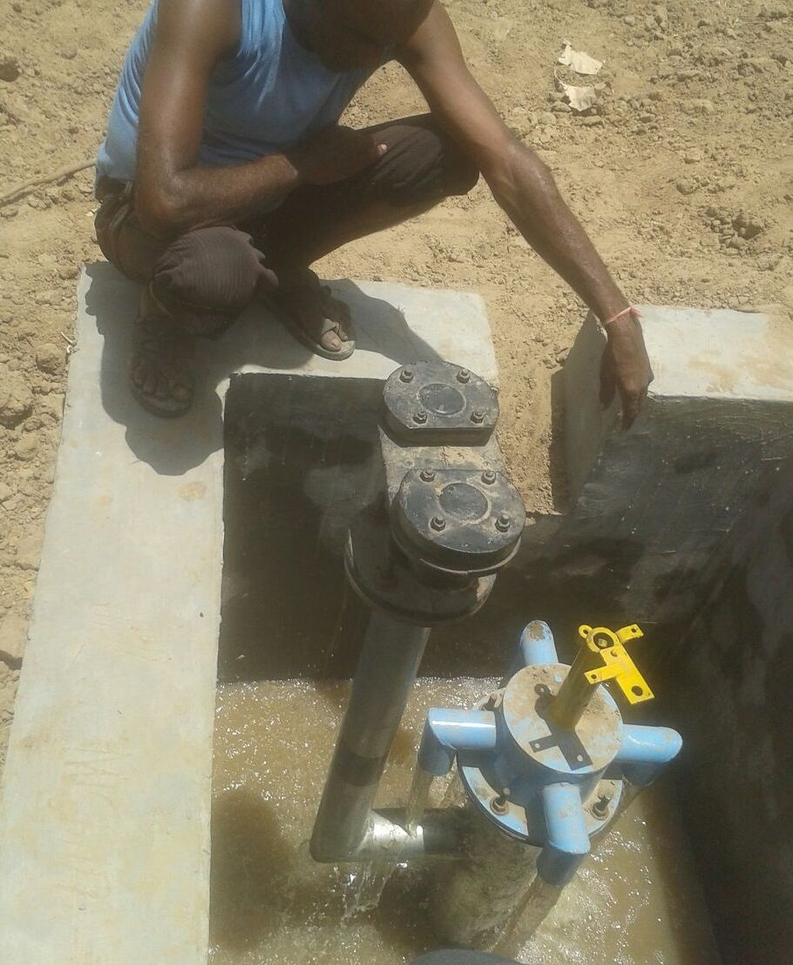
Air Valve and Turnout
AIR VALVE
TURN OUT
SUB MINOR- 07-JSM
DISTRY - JASHAVANTPURA MINOR (D.O.)
BRANCH- AMARAPURA
VILLAGE- JASHAVANTPURA, TALUKA- HARIJ
DISTRICT- PATAN

Slide 81
5th PIRC Meeting (Mt. Abu, 30th May 2019): Progress Review Presentations
Key Reasons For Progress Delays
Status | Key Reason
√ | Absence of Hydraulic Connectivity up to Outlet.
X | Delay in Govt/Administrative clearances.
X | State budget constraints.
√ | Unwillingness of farmers.
X | Delays in tendering.
X | Capacity related issues of Implementing Agencies.
X | Capacity related issues of Contractors/Suppliers.
X | Other Issue (to be specified).

Slide 82
- CCA developed upto subminor (UGPL) under Sardar Sarovar Project is 15 lakhs ha upto March-2019. - UGPL work in progress for the other areas of CCA
5th PIRC Meeting (Mt. Abu, 30th May 2019): Progress Review Presentations
Extra Slides

Slide 83
5th PIRC Meeting (Mt. Abu, 30th May 2019): Progress Review Presentations
Jammu And Kashmir
Number of Projects : 3 Projects Included: 3 Projects Availing CA: 3 Projects Reporting Progress:3
Physical Progress

Slide 84
5th PIRC Meeting (Mt. Abu, 30th May 2019): Progress Review Presentations
CCA Progress
( Area in Th. Ha.)
Sr. No. | Project | Balance CCA Target | CCA Progress |  |  |  |  | Target for 2019-20
 |  |  | 2016-17 | 2017-18 | 2018-19 | Total | % Progress
1 | Prakachik Khows Canal | 0.46 | 0 | 0 | 0.219 | 0.219 | 47.40 | 0.243
2. | Tral Lift Irrigation Project | 1.41 | 0 | 0 | 0.5 | 0.5 | 35.39 | 0.913
3. | Rajpora Lift Irrigation Project | 0.59 | 0 | 0 | 0.563 | 0.563 | 96.24 | 0.022
 | TOTAL | 2.46 | 0 | 0 | 1.282 | 1.282 | 52.11 | 1.178

Slide 85
5th PIRC Meeting (Mt. Abu, 30th May 2019): Progress Review Presentations
WUA Progress
(WUA’s in No’s)
Sr. No. | Project | WUA Target | WUA Progress |  |  |  |  |  | Target for 2019-20
 |  |  | Before April 2016 | 2016-17 | 2017-18 | 2018-19 | Total | % Progress
1 | Prakachik Khows Canal | 1 | 0 | 0 | 0 | 0 | 0 | 0 | 0
2. | Tral Lift Irrigation Project | 3 | 0 | 0 | 0 | 1 | 1 | 33.33 | 2
3. | Rajpora Lift Irrigation Project | 2 | 0 | 0 | 0 | 1 | 1 | 50.00 | 1
 | TOTAL | 6 | 0 | 0 | 0 | 2 | 2 | 33.33 | 3

Slide 86
5th PIRC Meeting (Mt. Abu, 30th May 2019): Progress Review Presentations
CA Release Progress
(CA in Rs. Crores)
Sr. No. | Project | Overall CA Target | CA Release Progress |  |  |  |  | Target for 2019-20
 |  |  | 2016-17 | 2017-18 | 2018-19 | Total | % Progress
1 | Prakachik Khows Canal | 0.709 | 0 | 0 | 0.21 | 0.21 | 29.619 | 0.49
2. | Tral Lift Irrigation Project | 3.011 | 0 | 0 | 0.64 | 0.64 | 21.255 | 0.237
3. | Rajpora Lift Irrigation Project | 1.521 | 0 | 0 | 0.85 | 0.85 | 55.884 | 0.67
 | TOTAL | 5.241 | 0 | 0 | 1.70 | 1.70 | 32.437 | 1.397
Note:- Central assistance (CA) released at the fag end of financial year, 2018-19 not received by executing agency yet.

Slide 87
5th PIRC Meeting (Mt. Abu, 30th May 2019): Progress Review Presentations
Total Expenditure Progress
(TE in Rs. Crores)
Sr. No. | Project | Total Expenditure Target | Total Expenditure Progress |  |  |  |  | Target for 2019-20
 |  |  | 2016-17 | 2017-18 | 2018-19 | Total | % Progress
1 | Prakachik Khows Canal | 1.866 | 0 | 0 | 0 | 0 | 0.00 | 1.87
2. | Tral Lift Irrigation Project | 6.161 | 0 | 0 | 1.05 (SS) | 1.05 | 17.04 | 5.11
3. | Rajpora Lift Irrigation Project | 3.613 | 0 | 0 | .69 (SS) | 0.69 | 19.10 | 2.92
 | TOTAL | 11.64 | 0 | 0 | 1.74 | 1.74 | 14.95 | 9.90
Note:- Central assistance (CA) released at the fag end of financial year, 2018-19 not received by executing agency yet.

Slide 88
5th PIRC Meeting (Mt. Abu, 30th May 2019): Progress Review Presentations
Broad Review
(CCA in Th. ha.)
Sr. No. | Project | CADWM |  |  |  |  | AIBP
 |  | Total CCA of Project | CCA developed before 31.03. 2016 (A)* | Progress in CCA for 99 Priority Projects (B) | Cumulative CCA developed (A+B) | % CCA Progress | Ultimate Irrigation Potential | Potential Created | % IPC
1 | Prakachik Khows Canal | 0.462 | 0 | 0.219 | 0.219 | 47.40 | 2.26 | 1.25 | 55.31
2. | Tral Lift Irrigation Project | 3.415 | 2.002 | 0.5 | 2.502 | 73.27 | 6 | 4.44 | 74.00
3. | Rajpora Lift Irrigation Project | 1.62 | 1.035 | 0.563 | 1.598 | 98.64 | 2.43 | 2.43 | 100.00
 | TOTAL | 5.497 | 3.037 | 1.282 | 4.319 | 78.57 | 10.69 | 8.12 | 75.96
* i.e. CCA developed under CADWM (up to 31-03-2016) and before CADWM inclusion.

Slide 89
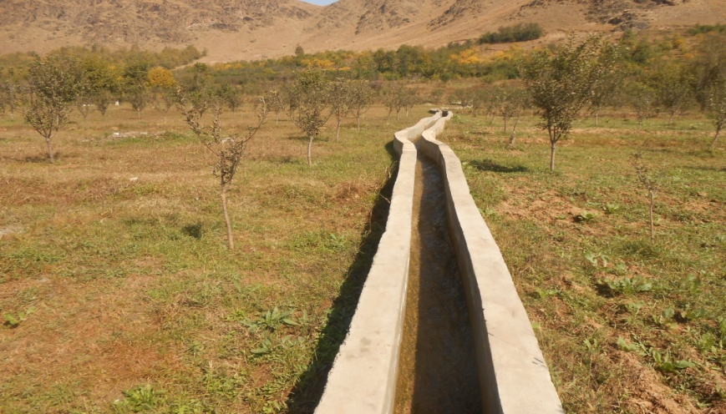
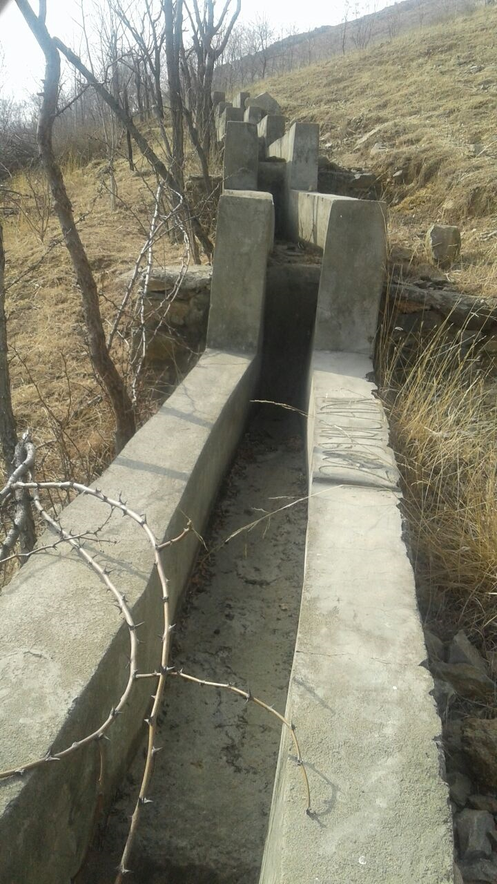
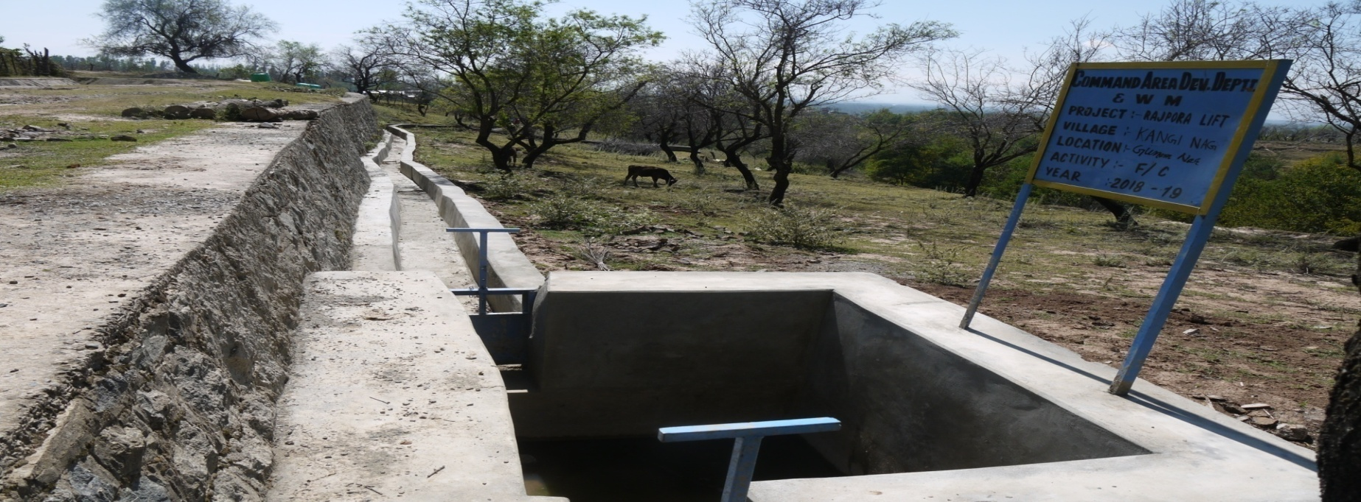
5th PIRC Meeting (Mt. Abu, 30th May 2019): Progress Review Presentations
Glimpses Of Project Progress
JAMMU AND KASHMIR

Slide 90
5th PIRC Meeting (Mt. Abu, 30th May 2019): Progress Review Presentations
Key Reasons For Progress Delays
Status | Key Reason
√ | Absence of Hydraulic Connectivity up to Outlet.
√ | Delay in Govt/Administrative clearances.
√ | State budget constraints.
√ | Unwillingness of farmers.
√ | Delays in tendering.
X | Capacity related issues of Implementing Agencies.
X | Capacity related issues of Contractors/Suppliers.
X | Other Issue (to be specified). : Central assistance (CA) released at the fag end of financial year, 2018-19 not received by executing agency yet to be utilized.

Slide 91
5th PIRC Meeting (Mt. Abu, 30th May 2019): Progress Review Presentations
Extra Slides
{....Present Project-specific information and Issues}

Slide 92
5th PIRC Meeting (Mt. Abu, 30th May 2019): Progress Review Presentations
Jharkhand
Number of Projects : 1 Projects Included: 1 Projects Availing CA: 0 Projects Reporting Progress:0
Physical Progress

Slide 93
5th PIRC Meeting (Mt. Abu, 30th May 2019): Progress Review Presentations
CCA Progress
( Area in Th. Ha.)
Sr. No. | Project | Balance CCA Target | CCA Progress |  |  |  |  | Target for 2019-20
 |  |  | 2016-17 | 2017-18 | 2018-19 | Total | % Progress
1 | Subarnarekha Multipurpose | 66.645 | 0 | 0 | 0 | 0 | 0 | 13.33
 | TOTAL | 66.645 | 0 | 0 | 0 | 0 | 0 | 13.33

Slide 94
5th PIRC Meeting (Mt. Abu, 30th May 2019): Progress Review Presentations
WUA Progress
(WUA’s in No’s)
Sr. No. | Project | WUA Target | WUA Progress |  |  |  |  |  | Target for 2019-20
 |  |  | Before April 2016 | 2016-17 | 2017-18 | 2018-19 | Total | % Progress
1 | Subarnarekha Multipurpose | 256 | 0 | 0 | 0 |  | 0 | 0 | 106
 | TOTAL | 256 | 0 | 0 | 0 |  | 0 | 0 | 106

Slide 95
5th PIRC Meeting (Mt. Abu, 30th May 2019): Progress Review Presentations
CA Release Progress
(CA in Rs. Crores)
Sr. No. | Project | Overall CA Target | CA Release Progress |  |  |  |  | Target for 2019-20
 |  |  | 2016-17 | 2017-18 | 2018-19 | Total | % Progress
1 | Subarnarekha Multipurpose | 133.32 | 0 | 0 | 0 | 0 | 0 | 149.50
 | TOTAL | 133.32 | 0 | 0 | 0 | 0 | 0 | 149.50

Slide 96
5th PIRC Meeting (Mt. Abu, 30th May 2019): Progress Review Presentations
Total Expenditure Progress
(TE in Rs. Crores)
Sr. No. | Project | Total Expenditure Target | Total Expenditure Progress |  |  |  |  | Target for 2019-20
 |  |  | 2016-17 | 2017-18 | 2018-19 | Total | % Progress
1 | Subarnarekha Multipurpose | 747.53 | 0 | 0 | 0 | 0 | 0 | 149.50
 | TOTAL | 747.53 | 0 | 0 | 0 | 0 | 0 | 149.50

Slide 97
5th PIRC Meeting (Mt. Abu, 30th May 2019): Progress Review Presentations
Broad Review
(CCA in Th. ha.)
Sr. No. | Project | CADWM |  |  |  |  | AIBP
 |  | Total CCA of Project | CCA developed before 31.03. 2016 (A)* | Progress in CCA for 99 Priority Projects (B) | Cumulative CCA developed (A+B) | % CCA Progress | Ultimate Irrigation Potential | Potential Created | % IPC
1 | Subarnarekha Multipurpose | 66.645 | 0 | 0 | 0 | 0 | 236.85 | 107.33 | 45.31
 | TOTAL | 66.645 | 0 | 0 | 0 | 0 | 236.85 | 107.33 | 45.31
* i.e. CCA developed under CADWM (up to 31-03-2016) and before CADWM inclusion.

Slide 98
5th PIRC Meeting (Mt. Abu, 30th May 2019): Progress Review Presentations
Key Reasons For Progress Delays
Status | Key Reason
√ | Absence of Hydraulic Connectivity up to Outlet.
√ | Delay in Govt/Administrative clearances.
X | State budget constraints.
X | Unwillingness of farmers.
X | Delays in tendering.
X | Capacity related issues of Implementing Agencies.
X | Capacity related issues of Contractors/Suppliers.
X | Other Issue (to be specified).

Slide 99
5th PIRC Meeting (Mt. Abu, 30th May 2019): Progress Review Presentations
Extra Slides
Thirty two no's IR and DPR of CADWM work of CLMC has been prepared by consultant M/S WAPCOS amounting to Rs 107.52 Cr. One no of UGPL work amounting to Rs 147.65 Lakh is in progress (OR-36 Ex K.M 80.78 of CLMC). Work of 2 no's CADWM work of OR-37 and OR -39 amounting to Rs 218.45 Lakh & Rs 988.92 Lakh respectively (Total Rs 12.07 Cr) has been tendered, which will be decided by the first week of June19.
IR and DPR of CADWM work of GLMC amounting to Rs 62.15 Cr has been prepared by consultant M/S WAPCOS. Certain queries have been asked by CE, LGBO, Patna and Monitoring & Evaluation Directorate, CWC, Ranchi which has been complied.
Six no’s of IR & DPR of CADWM work of GLMC amounting to Rs 12.34 Cr has been prepared

Slide 100
5th PIRC Meeting (Mt. Abu, 30th May 2019): Progress Review Presentations
KARNATAKA
Number of Projects : 5 Projects Included : 5 Projects Availing CA: 4 Projects Reporting Progress : 4
Physical Progress

Slide 101
5th PIRC Meeting (Mt. Abu, 30th May 2019): Progress Review Presentations
CCA Progress
( Area in Th. Ha.)
Sr. No. | Project | Balance CCA Target | CCA Progress |  |  |  |  | Target for 2019-20
 |  |  | 2016-17 | 2017-18 | 2018-19 | Total | % Progress
1 | Bhīma LIS | 12.9 | 3.396 | 5.373 | 2.754 | 11.52 | 89.33 | 1.375
2. | Upper Tunga Irrigation Project (Project extends beyond 2019-20) | 25.45 | 2.828 | 4.287 | 2.119 | 9.234 | 36.28 | 5
3. | Karanja | 5.588 | 0 | 0.547 | 0.758 | 1.305 | 23.35 | 4.283
4. | Narayana Left Bank Canal System (NLBC) - ERM | 28.67 | 0 | 0 | 0 | 0 | 0 | 0
5. | Sri Rameswar Lift Irrigation Scheme | 11.42 | 4.857 | 1.294 | 2.715 | 8.866 | 77.64 | 0.515
 | TOTAL | 84.03 | 11.08 | 11.50 | 8.346 | 30.93 | 36.81 | 11.17

Slide 102
5th PIRC Meeting (Mt. Abu, 30th May 2019): Progress Review Presentations
WUA Progress
(WUA’s in No’s)
Sr. No. | Project | WUA Target | WUA Progress |  |  |  |  |  | Target for 2019-20
 |  |  | Before April 2016 | 2016-17 | 2017-18 | 2018-19 | Total | % Progress
1 | Bhīma LIS | 47 | 0 | 0 | 38 | 2 | 40 | 85.11 | 7
2. | Upper Tunga Irrigation Project (Project extends beyond 2019-20) | 186 | 0 | 0 | 48 | 66 | 114 | 61.29 | 34
3. | Karanja | 51 | 0 | 45 | 3 | 3 | 51 | 100 | 0
4. | Narayana Left Bank Canal System (NLBC) - ERM | 501 | 0 | 0 | 0 | 14 | 14 | 2.79 | 487
5. | Sri Rameswar Lift Irrigation Scheme | 22 | 0 | 1 | 9 | 6 | 16 | 72.73 | 6
 | TOTAL | 807 | 0 | 46 | 98 | 91 | 235 | 29.12 | 534

Slide 103
5th PIRC Meeting (Mt. Abu, 30th May 2019): Progress Review Presentations
CA Release Progress
(CA in Rs. Crores)
Sr. No. | Project | Overall CA Target | CA Release Progress |  |  |  |  | Target for 2019-20
 |  |  | 2016-17 | 2017-18 | 2018-19 | Total | % Progress
1 | Bhīma LIS | 23.63 | 0 | 12.74 | 5.09 | 17.83 | 75.45 | 4.125
2. | Upper Tunga Irrigation Project (Project extends beyond 2019-20) | 59.86 | 21.04 | 0 | 0 | 21.04 | 35.15 | 8.31
3. | Karanja | 11.23 | 0 | 0 | 4.53 | 4.53 | 40.34 | 9.77
4. | Narayana Left Bank Canal System (NLBC) - ERM | 62.17 | 0 | 0 | 0 | 0 | 0 | 0
5. | Sri Rameswar Lift Irrigation Scheme | 22.99 | 10.38 | 2.51 | 3.87 | 16.76 | 72.90 | 1.09
 | TOTAL | 179.9 | 31.42 | 15.25 | 13.49 | 60.16 | 33.44 | 23.295

Slide 104
5th PIRC Meeting (Mt. Abu, 30th May 2019): Progress Review Presentations
Total Expenditure Progress
(TE in Rs. Crores)
Sr. No. | Project | Total Expenditure Target | Total Expenditure Progress |  |  |  |  | Target for 2019-20
 |  |  | 2016-17 | 2017-18 | 2018-19 | Total | % Progress
1 | Bhīma LIS | 56.56 | 10.87 | 17.91 | 5.45 | 34.23 | 60.52 | 8.17
2. | Upper Tunga Irrigation Project (Project extends beyond 2019-20) | 116.28 | 5.93 | 13.71 | 14.21 | 33.85 | 29.11 | 16.36
3. | Karanja | 42.6 | 0 | 1.88 | 1.52 | 3.4 | 7.98 | 37.78
4. | Narayana Left Bank Canal System (NLBC) - ERM | 750 | 0 | 0 | 0 | 0 | 0 | 0
5. | Sri Rameswar Lift Irrigation Scheme | 46.73 | 22.14 | 8.14 | 11.26 | 41.54 | 88.89 | 2.01
 | TOTAL | 1,012.17 | 38.94 | 41.64 | 32.44 | 113 | 11.17 | 64.32

Slide 105
5th PIRC Meeting (Mt. Abu, 30th May 2019): Progress Review Presentations
Broad Review
(CCA in Th. ha.)
Sr. No. | Project | CADWM |  |  |  |  | AIBP
 |  | Total CCA of Project | CCA developed before 31.03. 2016 (A)* | Progress in CCA for 99 Priority Projects (B) | Cumulative CCA developed (A+B) | % CCA Progress | Ultimate Irrigation Potential | Potential Created | % IPC
1 | Bhīma LIS | 24.292 | 11.39 | 11.52 | 22.91 | 94.31 | 24.29 | 24.29 | 100
2. | Upper Tunga Irrigation Project (Project extends beyond 2019-20) | 80.494 | 55.05 | 9.234 | 64.284 | 79.86 | 80.49 | 72.9 | 90.57
3. | Karanja | 29.227 | 22.11 | 1.305 | 23.415 | 80.11 | 29.23 | 25.83 | 88.37
4. | Narayana Left Bank Canal System (NLBC) - ERM | 28.67 | 0 | 0 | 0 | 0 | 105 | 104.4 | 99.43
5. | Sri Rameswar Lift Irrigation Scheme | 13.8 | 2.382 | 8.866 | 11.248 | 81.51 | 13.8 | 13.8 | 100
 | TOTAL | 176.48 | 90.932 | 30.925 | 121.86 | 69.05 | 252.81 | 241.22 | 95.42
*i.e. CCA developed under CADWM (up to 31-03-2016) and before CADWM inclusion.
**Out of 29.227 Ha CCA, 1.526Ha of CCA is dropped from the scope of project

Slide 106
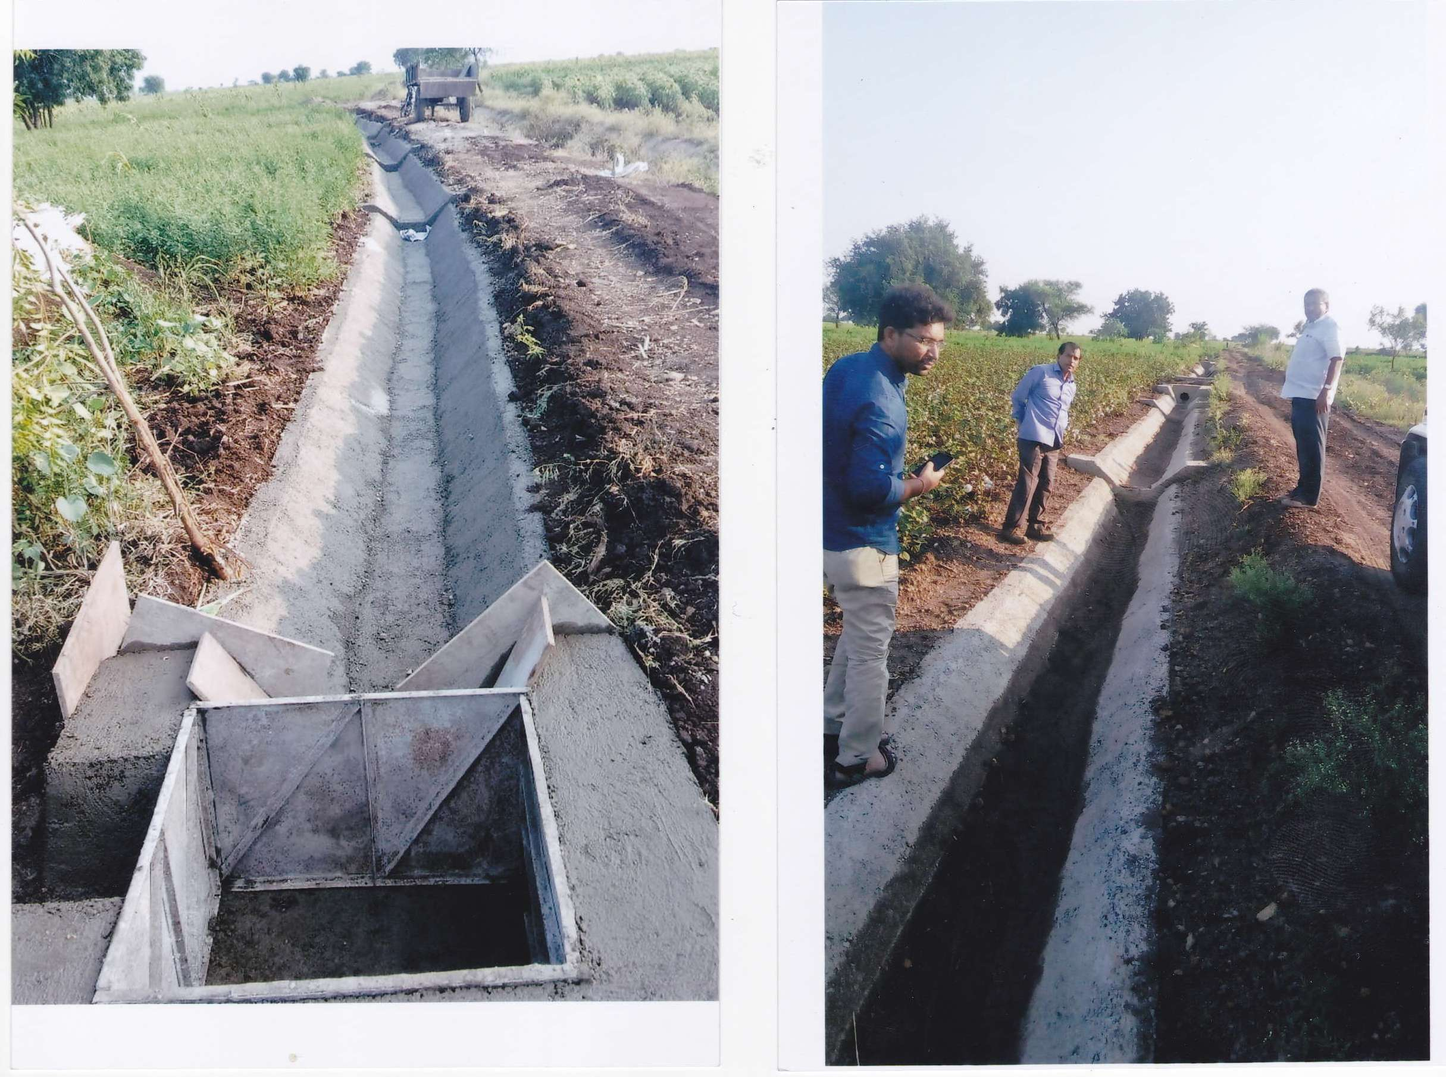
5th PIRC Meeting (Mt. Abu, 30th May 2019): Progress Review Presentations
Glimpses Of Project Progress: Photographs of Bhima Lift Irrigation Scheme
BLIS-Construction of FIC
BLIS-Construction of FIC

Slide 107
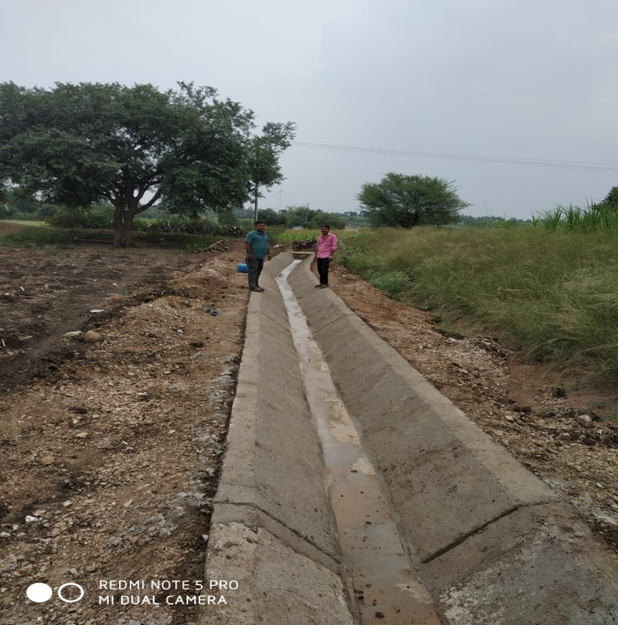
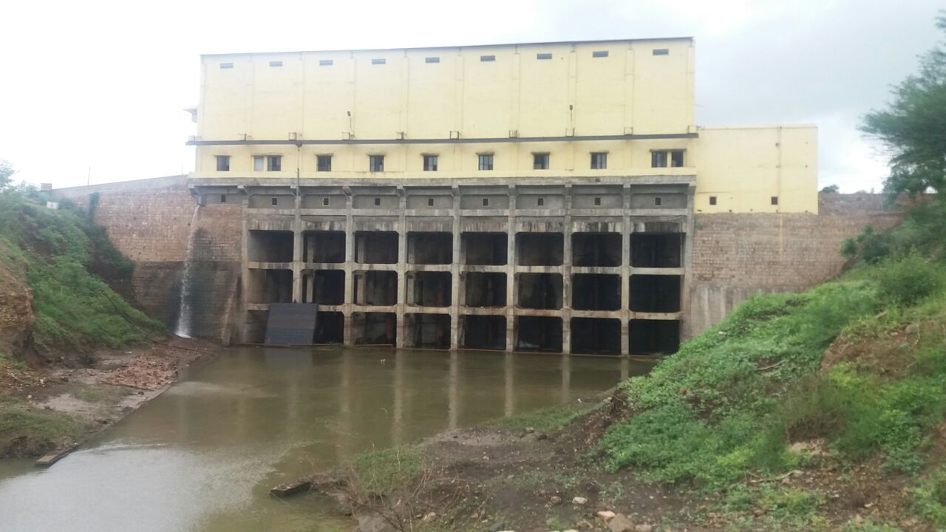
5th PIRC Meeting (Mt. Abu, 30th May 2019): Progress Review Presentations
Glimpses Of Project Progress: Photographs of Sri Rameshwara LIS
Jackwell cum pump house of Sri Rameshwara LIS at Aralimatti Village, Gokak Taluk
Construction of FIC under Bagojikoppa Main Canal

Slide 108
5th PIRC Meeting (Mt. Abu, 30th May 2019): Progress Review Presentations
Key Reasons For Progress Delays
Status | Key Reason
√ | Absence of Hydraulic Connectivity up to Outlet: At present there are no such issues reported
X | Delay in Govt/Administrative clearances: NLBC
X | State budget constraints: No issues
√ | Unwillingness of farmers: Under Sri Rameshwara LIS , as the farmers have made there own arrangements to irrigate the land, Farmers are not allowing to create FIC in an extent 487 Ha
X | Delays in tendering: No issues
X | Capacity related issues of Implementing Agencies: No issues
X | Capacity related issues of Contractors/Suppliers: No issues
X | Other Issue (to be specified) : Under Sri Rameshwara LIS, in the remaining 28 Ha, as there is change of land use, construction activity can be treated as almost complete.

Slide 109
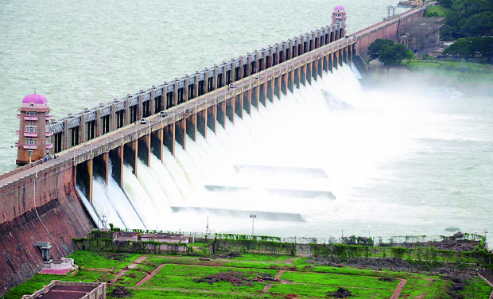
THANK YOU

Slide 110
5th PIRC Meeting (Mt. Abu, 30th May 2019): Progress Review Presentations
Kerala
Number of Projects : 2 Projects Included: 1 Projects Availing CA: 0 Projects Reporting Progress:1
Physical Progress

Slide 111
5th PIRC Meeting (Mt. Abu, 30th May 2019): Progress Review Presentations
CCA Progress
( Area in Th. Ha.)
Sr. No. | Project | Balance CCA Target | CCA Progress |  |  |  |  | Target for 2019-20
 |  |  | 2016-17 | 2017-18 | 2018-19 | Total | % Progress
1 | Muvattupuzha | 17.245 | 0 | 0 | 0 | 0 | 0 | 2.4
 | TOTAL | 17.245 | 0 | 0 | 0 | 0 | 0 | 2.4

Slide 112
5th PIRC Meeting (Mt. Abu, 30th May 2019): Progress Review Presentations
WUA Progress
(WUA’s in No’s)
Sr. No. | Project | WUA Target | WUA Progress |  |  |  |  |  | Target for 2019-20
 |  |  | Before April 2016 | 2016-17 | 2017-18 | 2018-19 | Total | % Progress
1 | Muvattupuzha | 240 | 95 | 0 | 0 | 19 | 114 | 47.5 | 32
 | TOTAL | 240 | 95 | 0 | 0 | 19 | 114 | 47.5 | 32

Slide 113
5th PIRC Meeting (Mt. Abu, 30th May 2019): Progress Review Presentations
CA Release Progress
(CA in Rs. Crores)
Sr. No. | Project | Overall CA Target | CA Release Progress |  |  |  |  | Target for 2019-20
 |  |  | 2016-17 | 2017-18 | 2018-19 | Total | % Progress
1 | Muvattupuzha | 48.71 | 0 | 0 | 0 | 0 | 0 | 4
 | TOTAL | 48.71 | 0 | 0 | 0 | 0 | 0 | 4

Slide 114
5th PIRC Meeting (Mt. Abu, 30th May 2019): Progress Review Presentations
Total Expenditure Progress
(TE in Rs. Crores)
Sl. No. | Project | Total Expenditure Target | Total Expenditure Progress |  |  |  |  | Target for 2019-20
 |  |  | 2016-17 | 2017-18 | 2018-19 | Total | % Progress
1 | Muvattupuzha | 107.29 | 1.54 | 0 | 0 | 1.54 | 1.44 | 8.00
 | TOTAL | 107.29 | 1.54 | 0.00 | 0.00 | 1.54 | 1.44 | 8.00

Slide 115
5th PIRC Meeting (Mt. Abu, 30th May 2019): Progress Review Presentations
Broad Review
(CCA in Th. ha.)
Sl. No | Project | CADWM |  |  |  |  | AIBP
 |  | Total CCA of Project | CCA developed before 31.03. 2016 (A)* | Progress in CCA for 99 Priority Projects (B) | Cumulative CCA developed (A+B) | % CCA Progress | Ultimate Irrigation Potential | Potential Created | % IPC
1 | Muvattupuzha | 19.237 | 1.992 | 0 | 1.992 | 10.355 | 30.719 | 27.824 | 90.576
 | TOTAL | 19.237 | 1.992 | 0.000 | 1.992 | 10.355 | 30.719 | 27.824 | 90.576
* i.e. CCA developed under CADWM (up to 31-03-2016) and before CADWM inclusion.

Slide 116
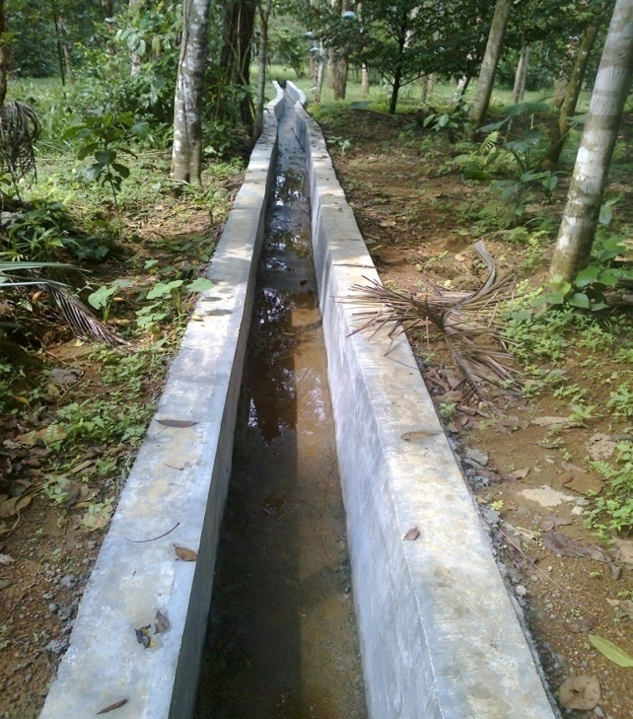
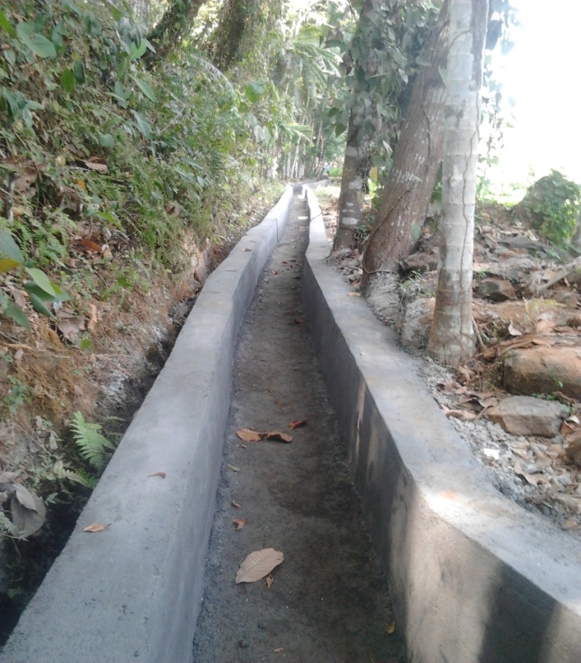
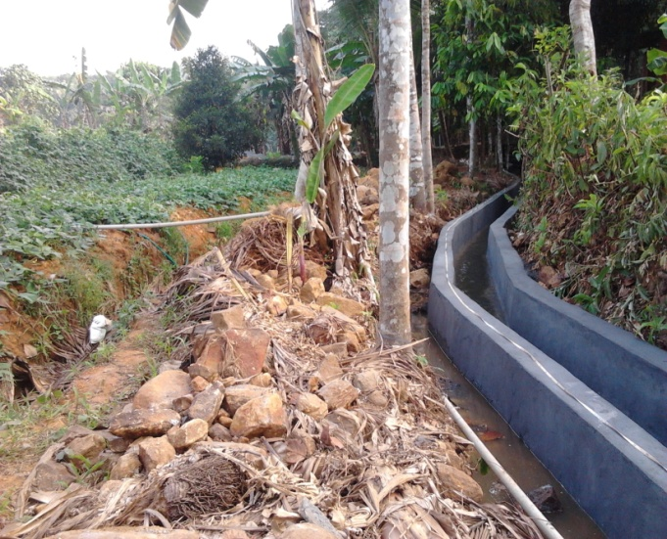
Glimpses Of Project Progress

Slide 117
5th PIRC Meeting (Mt. Abu, 30th May 2019): Progress Review Presentations
Key Reasons For Progress Delays
Status | Key Reason
√ | Absence of Hydraulic Connectivity up to Outlet.
√ | Delay in Govt/Administrative clearances.
√ | State budget constraints.
√ | Unwillingness of farmers.
√ | Delays in tendering.
X | Capacity related issues of Implementing Agencies.
X | Capacity related issues of Contractors/Suppliers.
√ | Other Issue (to be specified).

Slide 118
5th PIRC Meeting (Mt. Abu, 30th May 2019): Progress Review Presentations
Key Reasons For Progress Delays
 | Other Issues
1. | Muvattupuzha Valley Irrigation Project passing through Ghat areas. Due to the undulated topography, 100% efficiency can not be attained, as per the present norms of CADWM
2. | High labour cost.
3. | Changes in the climatic conditions and cropping pattern.
4. | As the value of land is high in this region, people are not willing to surrender land at free of cost.

Slide 119
5th PIRC Meeting (Mt. Abu, 30th May 2019): Progress Review Presentations
MADHYA PRADESH
Number of Projects : 14 Projects Included: 14 Projects Availing CA: 14 Projects Reporting Progress:14
Physical Progress

Slide 120
5th PIRC Meeting (Mt. Abu, 30th May 2019): Progress Review Presentations
CCA Progress
( Area in Th. Ha.)
Sr. No. | Project | Balance CCA Target | CCA Progress |  |  |  |  | Target for 2019-20
 |  |  | 2016-17 | 2017-18 | 2018-19 | Total | % Progress
1 | Bargi Diversion Project Phase-I | 21.19 | 0 | 0 | 0 | 0 | 0
2. | Indira Sagar Project Canal Phase - I & II | 11.77 | 0.78 | 2.12 | 0.95 | 3.85 | 32.71
3. | Indira Sagar Project Canal Phase - III | 23.49 | 0.42 | 0.63 | 0.41 | 1.46 | 6.22 | 18.75
4. | Omkareshwar Project Canal Phase-IV | 54.62 | 0 | 0 | 0 | 0.00 | 0 | 15.5
5. | Sindh Project Phase II | 90.56 | 28.3 | 29.27 | 9.18 | 66.75 | 73.71 | 6.05
6. | Bansagar Unit 2 | 97.04 | 19.36 | 15.17 | 10.96 | 45.49 | 46.88 | 8.14
7. | Bargi Diversion Project Phase – II | 31.9 | 0 | 0 | 0 | 0 | 0
8. | Bargi Diversion Project Phase III | 26 | 0 | 0 | 0 | 0 | 0
9. | Bargi Diversion Project Phase IV | 34 | 0 | 0 | 0 | 0 | 0
10. | Barriyarpur LBC | 19 | 4.99 | 3.39 | 0.6 | 8.97 | 47.21 | 1.71
11. | Indira Sagar Project Canal Ph IV | 19.6 | 0 | 0 | 0 | 0 | 0 | 3
12. | Indira Sagar Project Canal Ph - V | 33.14 | 0.24 | 0.5 | 0.24 | 0.97 | 2.93 | 32.17

Slide 121
5th PIRC Meeting (Mt. Abu, 30th May 2019): Progress Review Presentations
CCA Progress-Contd..
( Area in Th. Ha.)
Sr. No. | Project | Balance CCA Target | CCA Progress |  |  |  |  | Target for 2019-20
 |  |  | 2016-17 | 2017-18 | 2018-19 | Total | % Progress
13. | Mahan Project | 14.31 | 2.23 | 5.03 | 0 | 7.26 | 50.73 | 1.33
14. | Mahi Project | 28.13 | 1.06 | 6.07 | 4.66 | 11.78 | 41.88 | 5.25
15. | Mahuar Project | 9.16 | 5.96 | 2.25 | 0 | 8.21 | 89.63 | 0
16. | Omkareshwar Project Canal Phase-II | 19.57 | 3.07 | 2.45 | 0.7 | 9.88 | 50.49 | 9.69
17. | Omkareshwar Project Canal Phase-III | 48.59 | 0 | 3.87 | 6.94 | 10.80 | 22.23 | 11.2
18. | Pench Project | 28.07 | 5.83 | 5.19 | 3.19 | 14.21 | 50.62 | 4.38
19. | Sagad Project | 9.48 | 1.16 | 2.7 | 4.58 | 8.43 | 88.92 | 0.37
20. | Sanjay Sagar (Bah) Project | 9.67 | 1.04 | 1.36 | 4.47 | 6.86 | 70.94 | 0.76
21. | Singhpur Project | 5.84 | 1.89 | 3.23 | 0 | 5.12 | 87.67 | 0.19
 | TOTAL | 635.13 | 76.33 | 83.23 | 46.88 | 210.04 | 33.07 | 118.49
MADHYA PRADESH

Slide 122
5th PIRC Meeting (Mt. Abu, 30th May 2019): Progress Review Presentations
WUA Progress
(WUA’s in No’s)
Sr. No. | Project | WUA Target | WUA Progress |  |  |  |  |  | Target for 2019-20
 |  |  | Before April 2016 | 2016-17 | 2017-18 | 2018-19 | Total | % Progress
1 | Bargi Diversion Project Phase-I | 14 | 14 | 0 | 0 | 0 | 14 | 100 | 0
2. | Indira Sagar Project Canal Phase - I & II | 58 | 23 | 0 | 0 | 0 | 23 | 39.66 | 0
3. | Indira Sagar Project Canal Phase - III | 20 | 4 | 0 | 0 | 0 | 4 | 20 | 9
4. | Omkareshwar Project Canal Phase-IV | 29 | 0 | 0 | 14 | 0 | 14 | 48.28 | 0
5. | Sindh Project Phase II | 54 | 52 | 2 | 0 | 0 | 54 | 100 | 0
6. | Bansagar Unit 2 | 74 | 55 | 19 | 0 | 0 | 74 | 100 | 0
7. | Bargi Diversion Project Phase – II | 15 | 13 | 0 | 1 | 0 | 14 | 93 | 0
8. | Barriyarpur LBC | 23 | 23 | 0 | 0 | 0 | 23 | 100 | 0
9. | Indira Sagar Project Canal Phase – IV | 10 | 0 | 0 | 0 | 0 | 0 | 0 | 10
10. | Indira Sagar Project Canal Phase - V | 17 | 5 | 0 | 0 | 0 | 5 | 29 | 12

Slide 123
5th PIRC Meeting (Mt. Abu, 30th May 2019): Progress Review Presentations
WUA Progress-Contd..
(WUA’s in No’s)
Sr. No. | Project | WUA Target | WUA Progress |  |  |  |  |  | Target for 2019-20
 |  |  | Before April 2016 | 2016-17 | 2017-18 | 2018-19 | Total | % Progress
11. | Mahan Project | 10 | 10 | 0 | 0 | 0 | 10 | 100
12. | Mahi Project | 18 | 12 | 6 | 0 | 0 | 18 | 100
13. | Mahuar Project | 7 | 10 | 0 | 0 | 0 | 10 | 143
14. | Omkareshwar Project Canal Phase-II | 10 | 0 | 0 | 0 | 0 | 10 | 100
15. | Omkareshwar Project Canal Phase-III | 28 | 28 | 0 | 0 | 0.00 | 28 | 100
16. | Pench Project | 37 | 24 | 13 | 0 | 0 | 37 | 100
17. | Sagad Project | 4 | 4 | 0 | 0 | 0 | 4 | 100
18. | Sanjay Sagar (Bah) Project | 4 | 4 | 0 | 0 | 0 | 4 | 100
19. | Singhpur Project | 5 | 5 | 0 | 0 | 0 | 5 | 100
20. | Bargi Diversion Project Phase – III | 0 | 0 | 0 | 0 | 0 | 0 | 0
21. | Bargi Diversion Project Phase – IV | 0 | 0 | 0 | 0 | 0 | 0 | 0
 | TOTAL | 437 | 286 | 40 | 15 | 0 | 351 | 80.32 | 31
MADHYA PRADESH

Slide 124
5th PIRC Meeting (Mt. Abu, 30th May 2019): Progress Review Presentations
CA Release Progress
(CA in Rs. Crores)
Sr. No. | Project | Overall CA Target | CA Release Progress |  |  |  |  | Target for 2019-20
 |  |  | 2016-17 | 2017-18 | 2018-19 | Total | % Progress
1 | Bargi Diversion Project Phase-I | 41.18 | 0 | 0 | 5.98 | 5.98 | 14.52
2. | Indira Sagar Project Canal Phase - I,II,III,IV & V | 196.72 | 6.64 | 0 | 0 | 6.64 | 3.38
3. | Omkareshwar Project Canal Phase-II,III & IV | 306.92 | 9.61 | 0 | 0 | 9.61 | 3.13
4. | Sindh Project Phase II | 180.76 | 17.19 | 43.31 | 14.29 | 74.79 | 41.38
5. | Bansagar Unit 2 | 224.30 | 22.35 | 15.97 | 18.24 | 56.56 | 25.22
6. | Bargi Diversion Project Phase - II | 60.87 | 0.00 | 0.00 | 8.96 | 8.96 | 14.72
7. | Barriyarpur LBC | 25.93 | 7.14 | 3.97 | 4.99 | 16.10 | 62.08

Slide 125
5th PIRC Meeting (Mt. Abu, 30th May 2019): Progress Review Presentations
CA Release Progress-Contd…
(CA in Rs. Crores)
Sr. No. | Project | Overall CA Target | CA Release Progress |  |  |  |  | Target for 2019-20
 |  |  | 2016-17 | 2017-18 | 2018-19 | Total | % Progress
8. | Mahan Project | 27.26 | 2.14 | 6.38 | 3.09 | 11.61 | 42.59 | 0
9. | Mahi Project | 64.28 | 2.34 | 8.72 | 6.05 | 17.11 | 26.61 | 0
10. | Mahuar Project | 16.80 | 2.92 | 5.28 | 0.60 | 8.80 | 52.41 | 0
11. | Pench Project | 51.22 | 5.35 | 8.60 | 5.90 | 19.85 | 38.76 | 0
12. | Sagad Project | 17.68 | 0 | 4.34 | 2.15 | 6.49 | 36.69 | 0
13. | Sanjay Sagar (Bah) Project | 18.09 | 0 | 4.02 | 0.00 | 4.02 | 22.23 | 0
14. | Singhpur Project | 10.37 | 2.06 | 2.20 | 0.66 | 4.92 | 47.50 | 0
 | TOTAL | 1242.48 | 77.74 | 102.80 | 70.91 | 251.40 | 20.24 | 0
MADHYA PRADESH

Slide 126
5th PIRC Meeting (Mt. Abu, 30th May 2019): Progress Review Presentations
Total Expenditure Progress
(TE in Rs. Crores)
Sr. No. | Project | Total Expenditure Target | Total Expenditure Progress |  |  |  |  | Target for 2019-20
 |  |  | 2016-17 | 2017-18 | 2018-19 | Total | % Progress
1 | Bargi Diversion Project Phase-I | 82.52 | 0 | 0 | 0 | 0 | 0
2. | Indira Sagar Project Canal Phase - I & II | 29.42 | 1.95 | 5.30 | 2.37 | 9.62 | 32.70
3. | Indira Sagar Project Canal Phase - III | 58.72 | 1.06 | 1.57 | 1.02 | 3.65 | 6.22 | 50.76
4. | Omkareshwar Project Canal Phase-IV | 326.65 | 0 | 0 | 0 | 0 | 0
5. | Sindh Project Phase II | 361.53 | 70.00 | 166.80 | 26.97 | 263.77 | 72.96 | 19.10
6. | Bansagar Unit 2 | 448.60 | 49.01 | 38.53 | 27.94 | 115.48 | 25.74 | 22.00
7. | Bargi Diversion Project Ph – II | 121.99 | 0 | 0 | 0 | 0 | 0
8. | Barriyarpur LBC | 51.85 | 12.68 | 8.57 | 1.53 | 22.79 | 43.95 | 5.30
9. | Indira Sagar Project Canal Ph – IV | 49.00 | 0 | 0 | 0 | 0 | 0
10. | Indira Sagar Project Canal Ph - V | 165.70 | 1.18 | 2.49 | 1.18 | 4.84 | 2.92 | 123.97

Slide 127
5th PIRC Meeting (Mt. Abu, 30th May 2019): Progress Review Presentations
Total Expenditure Progress-Contd..
(TE in Rs. Crores)
Sr. No. | Project | Total Expenditure Target | Total Expenditure Progress |  |  |  |  | Target for 2019-20
 |  |  | 2016-17 | 2017-18 | 2018-19 | Total | % Progress
11. | Mahan Project | 54.52 | 5.59 | 17.60 | 0.11 | 23.30 | 42.74 | 3.64
12. | Mahi Project | 128.34 | 2.66 | 15.79 | 11.39 | 29.84 | 23.25 | 14.34
13. | Mahuar Project | 33.60 | 16.06 | 7.18 | 1.06 | 24.30 | 72.34 | 1.04
14. | Omkareshwar Project Canal Phase-II | 68.19 | 4.63 | 3.70 | 1.75 | 10.08 | 14.078
15. | Omkareshwar Project Canal Ph-III | 169.37 | 0.00 | 9.17 | 13.15 | 22.32 | 13.18
16. | Pench Project | 102.44 | 14.61 | 13.02 | 9.07 | 36.70 | 35.82 | 12.49
17. | Sagad Project | 35.37 | 2.92 | 7.03 | 11.77 | 21.72 | 61.41
18. | Sanjay Sagar (Bah) Project | 36.19 | 2.61 | 3.40 | 11.10 | 17.11 | 47.26 | 2.53
19. | Singhpur Project | 21.39 | 4.73 | 8.10 | 0.00 | 12.83 | 59.98
20. | Bargi Diversion Project Ph – III | 0 | 0 | 0 | 0 | 0 | 0
21. | Bargi Diversion Project Ph – IV | 0 | 0 | 0 | 0 | 0 | 0
 | TOTAL | 2345.39 | 189.69 | 308.25 | 120.41 | 618.35 | 26.36 | 131.20

Slide 128
5th PIRC Meeting (Mt. Abu, 30th May 2019): Progress Review Presentations
Broad Review
(CCA in Th. ha.)
Sr. No. | Project | CADWM |  |  |  |  | AIBP
 |  | Total CCA of Project | CCA developed before 31.03. 2016 (A)* | Progress in CCA for 99 Priority Projects (B) | Cumulative CCA developed (A+B) | % CCA Progress | Ultimate Irrigation Potential | Potential Created | % IPC
1 | Bargi Diversion Project Phase-I | 22.587 | 1.39 | 0 | 1.39 | 6.15 | 34.12 | 20.09 | 58.88
2. | Indira Sagar Proj Canal Ph I & II | 11.77 | 2.475 | 3.85 | 6.325 | 53.74 | 62.2 | 62.2 | 100
3. | Indira Sagar Proj Canal Ph III | 23.49 | 0.812 | 1.46 | 2.272 | 9.67 | 16 | 16.68 | 104.25
4. | Omkareshwar Proj Canal Ph-IV | 54.63 | 3.435 | 0.00 | 3.435 | 6.29 | 54.63 | 54.63 | 100
5. | Sindh Project Phase II | 98.25 | 7.69 | 66.75 | 74.44 | 75.77 | 162.1 | 162.1 | 100
6. | Bansagar Unit 2 | 154.69 | 57.65 | 45.49 | 103.14 | 66.68 | 154.54 | 154.54 | 100
7. | Bargi Diversion Project Phase - II | 31.9 | 0 | 0 | 0 | 0 | 51.36 | 41.63 | 81.06
8. | Barriyarpur LBC | 38.99 | 19.99 | 8.97 | 28.96 | 74.28 | 43.85 | 43.85 | 100
9. | Indira Sagar Proj Canal Ph IV | 19.6 | 0 | 0.00 | 0 | 0.00 | 27.05 | 8.5 | 31.42
10. | Indira Sagar Project Canal Ph - V | 33.14 | 0.968 | 0.97 | 1.938 | 5.85 | 33.14 | 32 | 96.56
* i.e. CCA developed under CADWM (up to 31-03-2016) and before CADWM inclusion.

Slide 129
5th PIRC Meeting (Mt. Abu, 30th May 2019): Progress Review Presentations
Broad Review-Contd
(CCA in Th. ha.)
Sr. No. | Project | CADWM |  |  |  |  | AIBP
 |  | Total CCA of Project | CCA developed before 31.03. 2016 (A)* | Progress in CCA for 99 Priority Projects (B) | Cumulative CCA developed (A+B) | % CCA Progress | Ultimate Irrigation Potential | Potential Created | % IPC
11. | Mahan Project | 16.15 | 1.84 | 7.26 | 9.1 | 56.35 | 19.74 | 16.89 | 85.56
12. | Mahi Project | 28.13 | 0 | 11.78 | 11.78 | 41.88 | 33.75 | 26.07 | 77.24
13. | Mahuar Project | 9.5 | 0.34 | 8.21 | 8.55 | 90.00 | 13.78 | 13.78 | 100
14. | OSP Proj Canal Ph-II | 19.58 | 4.61 | 9.88 | 14.49 | 74.00 | 19.58 | 15.8 | 80.69
15. | OSP Proj Canal Ph-III | 48.59 | 0 | 10.80 | 10.8 | 22.23 | 48.59 | 40.75 | 83.86
16. | Pench Project | 28.07 | 0.2 | 14.21 | 14.41 | 51.34 | 28.27 | 21.27 | 75.24
17. | Sagad Project | 9.48 | 0 | 8.43 | 8.43 | 88.92 | 17.06 | 17.06 | 100
18. | Sanjay Sagar (Bah) Project | 9.89 | 0.22 | 6.86 | 7.08 | 71.59 | 17.81 | 17.81 | 100
19. | Singhpur Project | 6 | 0.16 | 5.12 | 5.28 | 88.00 | 10.2 | 10.2 | 100
20. | Bargi Diversion Proj Ph – III | 0 | 0 | 0 | 0 | 0 | 0 | 0 | 0
21. | Bargi Diversion Proj Ph – IV | 0 | 0 | 0 | 0 | 0 | 0 | 0 | 0
 | TOTAL | 664.44 | 101.78 | 210.04 | 311.82 | 46.93 | 847.77 | 775.85 | 91.52
* i.e. CCA developed under CADWM (up to 31-03-2016) and before CADWM inclusion.

Slide 130
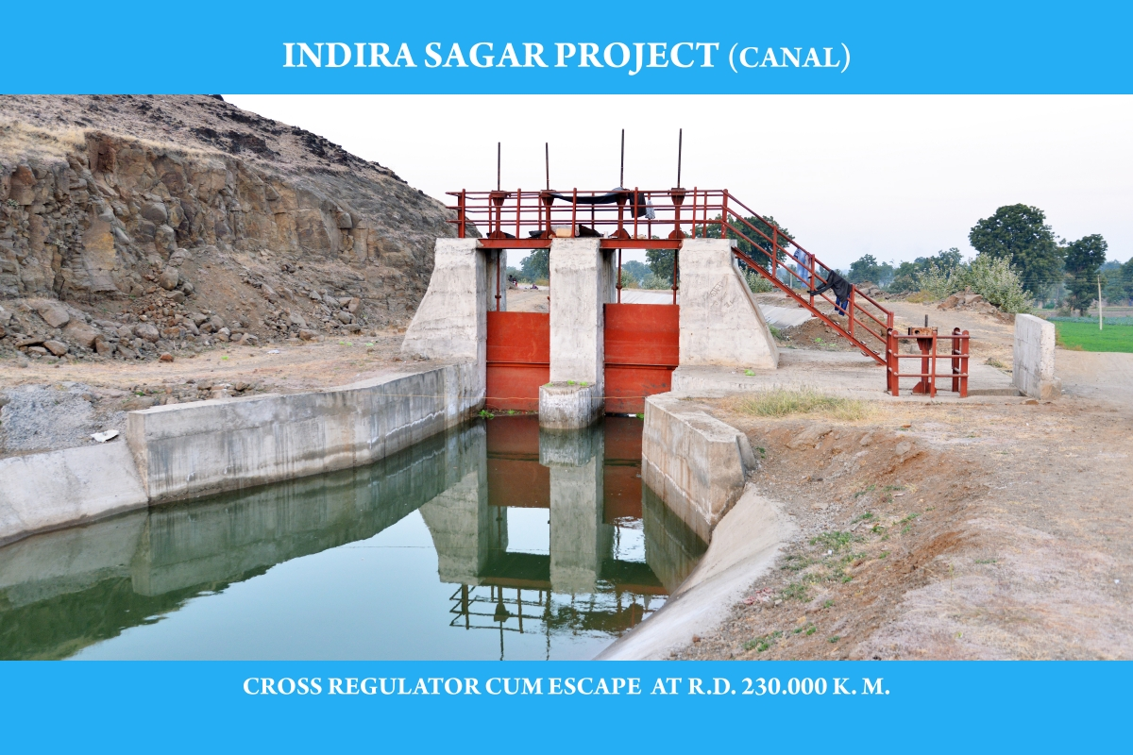
5th PIRC Meeting (Mt. Abu, 30th May 2019): Progress Review Presentations
Glimpses Of Project Progress

Slide 131
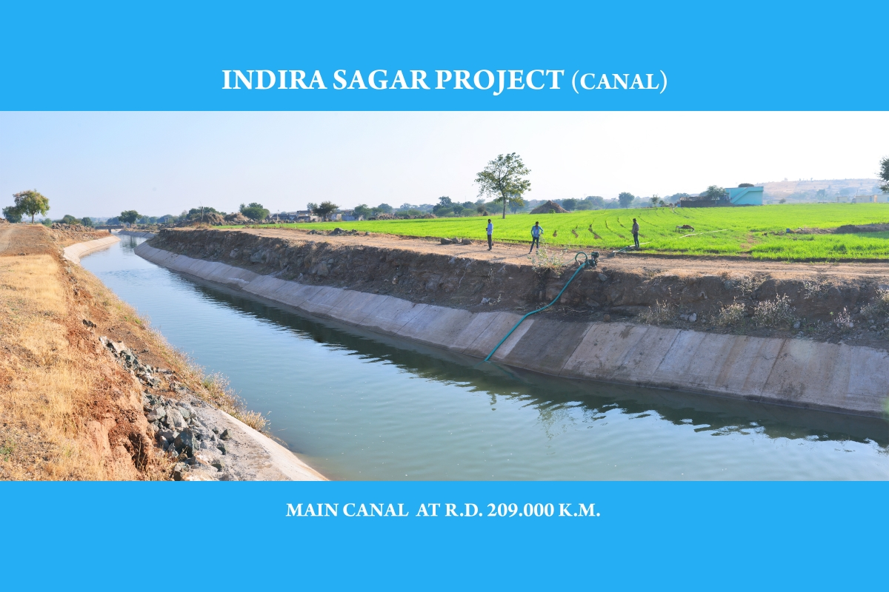

Slide 132
5th PIRC Meeting (Mt. Abu, 30th May 2019): Progress Review Presentations
Key Reasons For Progress Delays
Status | Key Reason
√ | Absence of Hydraulic Connectivity up to Outlet.
√ | Delay in Govt/Administrative clearances.
X | State budget constraints.
√ | Unwillingness of farmers.
√ | Delays in tendering.
√ | Capacity related issues of Implementing Agencies.
X | Capacity related issues of Contractors/Suppliers.
X | Other Issue (to be specified).

Slide 133
5th PIRC Meeting (Mt. Abu, 30th May 2019): Progress Review Presentations
MAHARASHTRA
Number of Projects : 22 Projects Included: 22 Projects Availing CA: 18 Projects Reporting Progress:17
Physical Progress

Slide 134
5th PIRC Meeting (Mt. Abu, 30th May 2019): Progress Review Presentations
CCA Progress
( Area in Th. Ha.)
Sr. No. | Project | Balance CCA Target | CCA Progress |  |  |  |  | Target for 2019-20
 |  |  | 2016-17 | 2017-18 | 2018-19 | Total | % Progress
1 | Bawanthadi (IS) | 2.5 | 0 | 0.3 | 1.04 | 1.34 | 53.6 | 1.16
2. | Lower Dudhna | 30.04 | 0 | 0 | 6.127 | 6.127 | 20.4 | 8.9
3. | Lower Panzara | 6.785 | 0 | 0 | 2.911 | 2.911 | 42.9 | 3.874
4. | Lower Wardha | 62.45 | 2.516 | 14.272 | 8.192 | 24.98 | 40 | 15
5. | Nandur Madhmeshwar Ph-II | 23.12 | 0.055 | 0.735 | 0.052 | 0.842 | 3.642 | 1
6. | Tillari' | 6.68 | 0 | 0 | 0 | 0 | 0 | 0.32
7. | Waghur | 17.97 | 0.423 | 0 | 5.83 | 6.253 | 34.79 | 11.72
8. | Arjuna | 5.708 | 0 | 0 | 0 | 0 | 0 | 0.1
9. | Aruna | 5.942 | 0 | 0 | 0 | 0 | 0 | 0.1
10. | Bembla | 29.78 | 0.085 | 2.221 | 3.504 | 5.81 | 19.51 | 5
11. | Dhom Balaakwadi | 18.1 | 0 | 0 | 1.559 | 1.559 | 8.613 | 0.32

Slide 135
5th PIRC Meeting (Mt. Abu, 30th May 2019): Progress Review Presentations
CCA Progress-Contd..
( Area in Th. Ha.)
Sr. No. | Project | Balance CCA Target | CCA Progress |  |  |  |  | Target for 2019-20
 |  |  | 2016-17 | 2017-18 | 2018-19 | Total | % Progress
12. | Gadnadi | 3.12 | 0 | 0 | 0.426 | 0.426 | 13.65 | 0.1
13. | Gosikhurd (NP) | 176.1 | 0 | 0 | 0 | 0 | 0 | 25
14. | Khadakpurna | 15.72 | 1.937 | 0.053 | 0.771 | 2.761 | 17.56 | 0.32
15. | Krishna Koyana Lift Irrigation Project | 52.82 | 0 | 0 | 0 | 0 | 0 | 5
16. | Kudali Medium Project | 6.068 | 0 | 0 | 0 | 0 | 0 | 0.2
17. | Lower Pedhi | 10.2 | 0 | 0 | 0 | 0 | 0 | 0
18. | Morna (Gureghar) | 4.229 | 0 | 0 | 0 | 0 | 0 | 0.15
19. | Sangola Branch Canal | 6.883 | 0 | 0 | 0.149 | 0.149 | 2.165 | 0.4
20. | Tarali | 13.09 | 0 | 0 | 0 | 0 | 0 | 0.24
21. | Upper Kundalika | 2.8 | 0 | 0 | 2.3 | 2.3 | 82.14 | 0.6
22. | Upper Pen Ganga | 17.29 | 0 | 1.093 | 1.327 | 2.42 | 14 | 1
 | Total | 517.4 | 5.269 | 18.421 | 34.19 | 57.878 | 11.19 | 80.5
MAHARASHTRA

Slide 136
5th PIRC Meeting (Mt. Abu, 30th May 2019): Progress Review Presentations
WUA Progress
WUA Progress
(WUA’s in No’s)
Sr. No. | Project | WUA Target | WUA Progress |  |  |  |  |  | Target for 2019-20
 |  |  | Before April 2016 | 2016-17 | 2017-18 | 2018-19 | Total | % Progress
1 | Bawanthadi (IS) | 60 | 0 | 0 | 0 | 0 | 0 | 0.00 | 60
2. | Lower Dudhna | 72 | 0 | 22 | 0 | 39 | 61 | 84.72 | 11
3. | Lower Panzara | 15 | 0 | 0 | 0 | 15 | 15 | 100.00 | 0
4. | Lower Wardha | 138 | 0 | 98 | 0 | 12 | 110 | 79.71 | 28
5. | Nandur Madhmeshwar Ph-II | 121 | 0 | 115 | 0 | 0 | 115 | 95.04 | 6
6. | Tillari' | 18 | 0 | 8 | 0 | 7 | 15 | 83.33 | 3
7. | Waghur | 78 | 0 | 6 | 0 | 15 | 21 | 26.92 | 25
8. | Arjuna | 12 | 0 | 1 | 0 | 0 | 1 | 8.33 | 5.00
9. | Aruna | 16 | 0 | 0 | 0 | 0 | 0 | 0.00 | 5
10. | Bembla | 175 | 0 | 113 | 0 | 20 | 133 | 76.00 | 30
11. | Dhom Balaakwadi | 85 | 0 | 44 | 0 | 0 | 44 | 51.76 | 20

Slide 137
5th PIRC Meeting (Mt. Abu, 30th May 2019): Progress Review Presentations
WUA Progress-Contd..
(WUA’s in No’s)
Sr. No. | Project | WUA Target | WUA Progress |  |  |  |  |  | Target for 2019-20
 |  |  | Before April 2016 | 2016-17 | 2017-18 | 2018-19 | Total | % Progress
12. | Gadnadi | 7 | 0 | 0 | 0 | 0 | 0 | 0.00 | 3
13. | Gosikhurd (NP) | 387 | 0 | 82 | 0 | 0 | 82 | 21.19 | 100
14. | Khadakpurna | 66 | 0 | 45 | 0 | 0 | 45 | 68.18 | 10
15. | Krishna Koyana Lift Irrigation Project | 237 | 0 | 80 | 0 | 63 | 143 | 60.34 | 50
16. | Kudali Medium Project | 13 | 0 | 0 | 0 | 0 | 0 | 0.00 | 5
17. | Lower Pedhi | 30 | 0 | 0 | 0 | 0 | 0 | 0.00 | 10
18. | Morna (Gureghar) | 18 | 0 | 0 | 0 | 0 | 0 | 0.00 | 5
19. | Sangola Br. Canal | 40 | 0 | 6 | 0 | 22 | 28 | 70.00 | 5
20. | Tarali | 48 | 0 | 5 | 0 | 0 | 5 | 10.42 | 10
21. | Upper Kundalika | 7 | 0 | 0 | 0 | 0 | 0 | 0.00 | 7
22. | Upper Pen Ganga | 46 | 0 | 23 | 0 | 0 | 23 | 50.00 | 10
 | Total | 1689 | 0 | 648 | 0 | 193 | 841 | 49.79 | 408
MAHARASHTRA

Slide 138
5th PIRC Meeting (Mt. Abu, 30th May 2019): Progress Review Presentations
CA Release Progress
(CA in Rs. Crores)
Sr. No. | Project | Overall CA Target | CA Release Progress |  |  |  |  | Target for 2019-20
 |  |  | 2016-17 | 2017-18 | 2018-19 | Total | % Progress
1 | Bawanthadi (IS) | 7.82 | 0 | 0.52 | 0 | 0.52 | 6.31 | 2.82
2. | Lower Dudhna | 72.74 | 0 | 8.1 | 0 | 8.1 | 11.2 | 9.5
3. | Lower Panzara | 14.51 | 0 | 2.15 | 3.97 | 6.12 | 38.9 | 4
4. | Lower Wardha | 100.43 | 15.2 | 0 | 5.46 | 20.6 | 20.9 | 15
5. | Nandur Madhmeshwar Ph-II | 49.21 | 0 | 0 | 0 | 0 | 0 | 2.5
6. | Tillari' | 16.21 | 0 | 1.81 | 0 | 1.81 | 13.8 | 4
7. | Waghur | 39.02 | 0 | 1.57 | 0 | 1.57 | 4.01 | 6.67
8. | Arjuna | 11.28 | 0 | 0.8 | 0 | 0.8 | 7.21 | 0.78
9. | Aruna | 9.52 | 0 | 0 | 0 | 0 | 0 | 0.66
10. | Bembla | 57.55 | 0 | 5.99 | 3.51 | 9.5 | 14.7 | 5.25
11. | Dhom Balaakwadi | 9.23 | 0 | 0 | 1.82 | 1.82 | 22.3 | 4

Slide 139
5th PIRC Meeting (Mt. Abu, 30th May 2019): Progress Review Presentations
CA Release Progress-Contd..
(CA in Rs. Crores)
Sr. No. | Project | Overall CA Target | CA Release Progress |  |  |  |  | Target for 2019-20
 |  |  | 2016-17 | 2017-18 | 2018-19 | Total | % Progress
12. | Gadnadi | 6.12 | 0 | 0.03 | 0 | 0.03 | 0.49 | 0.32
13. | Gosikhurd (NP) | 371.86 | 0 | 0 | 9.38 | 9.38 | 2.65 | 16
14. | Khadakpurna | 31.77 | 0 | 2.65 | 0 | 2.65 | 8.47 | 3.2
15. | Krishna Koyana Lift Irrigation Project | 67.67 | 0 | 3.81 | 0 | 3.81 | 5.66 | 9.18
16. | Kudali Medium Project | 10.07 | 0 | 0 | 0 | 0 | 0 | 1.2
17. | Lower Pedhi | 20.62 | 0 | 0 | 0 | 0 | 0 | 1.88
18. | Morna (Gureghar) | 8.23 | 0 | 0 | 0.28 | 0.28 | 3.43 | 0.49
19. | Sangola Br. Canal | 13.95 | 0 | 0.55 | 1.37 | 1.92 | 13.88 | 4.3
20. | Tarali | 25.21 | 0 | 1.31 | 0 | 1.31 | 5.2 | 2.82
21. | Upper Kundalika | 5.56 | 0 | 0.52 | 0 | 0.52 | 9.29 | 1.9
22. | Upper Pen Ganga | 34.81 | 0 | 3 | 0 | 3 | 8.62 | 4.5
 | Total | 983.39 | 15.17 | 32.81 | 25.79 | 73.77 | 196.9 | 101
MAHARASHTRA

Slide 140
5th PIRC Meeting (Mt. Abu, 30th May 2019): Progress Review Presentations
Total Expenditure Progress
(TE in Rs. Crores)
Sr. No. | Project | Total Expenditure Target | Total Expenditure Progress |  |  |  |  | Target for 2019-20
 |  |  | 2016-17 | 2017-18 | 2018-19 | Total | % Progress
1 | Bawanthadi (IS) | 15.63 | 0 | 0.3 | 1.85 | 2.15 | 13.76 | 6
2. | Lower Dudhna | 145.5 | 0 | 0 | 17.39 | 17.39 | 11.95 | 19
3. | Lower Panzara | 29.02 | 0 | 0.98 | 5.52 | 6.5 | 22.40 | 8
4. | Lower Wardha | 198.6 | 0 | 24.3 | 24.49 | 48.79 | 24.57 | 30
5. | Nandur Madhmeshwar Ph-II | 98.5 | 0 | 1.57 | 0.04 | 1.61 | 1.63 | 5
6. | Tillari' | 32.42 | 0 | 0.84 | 1.75 | 2.59 | 7.99 | 8
7. | Waghur | 77.95 | 0.48 | 0.28 | 30.95 | 31.71 | 40.68 | 13.35
8. | Arjuna | 28.94 | 0 | 0 | 0 | 0 | 0 | 2
9. | Aruna | 20.25 | 0 | 0 | 0 | 0 | 0 | 1.7
10. | Bembla | 164.4 | 0.84 | 8.54 | 14.87 | 24.25 | 14.75 | 15
11. | Dhom Balaakwadi | 21.77 | 0 | 0 | 2.54 | 2.54 | 11.67 | 8

Slide 141
5th PIRC Meeting (Mt. Abu, 30th May 2019): Progress Review Presentations
Total Expenditure Progress-Contd..
(TE in Rs. Crores)
Sr. No. | Project | Total Expenditure Target | Total Expenditure Progress |  |  |  |  | Target for 2019-20
 |  |  | 2016-17 | 2017-18 | 2018-19 | Total | % Progress
12. | Gadnadi | 19.12 | 0 | 0 | 0 | 0 | 0.00 | 1
13. | Gosikhurd (NP) | 743.7 | 0 | 0 | 0 | 0 | 0.00 | 32
14. | Khadakpurna | 79.42 | 0 | 0.44 | 0.75 | 1.19 | 1.50 | 8
15. | Krishna Koyana Lift Irrigation Project | 132.7 | 0 | 0 | 0.26 | 0.26 | 0.20 | 18
16. | Kudali Medium Project | 26.75 | 0 | 0 | 0 | 0 | 0.00 | 3
17. | Lower Pedhi | 43.88 | 0 | 0 | 0 | 0 | 0.00 | 4
18. | Morna (Gureghar) | 16.79 | 0 | 0 | 0.3 | 0.3 | 1.79 | 1
19. | Sangola Branch Canal | 32.44 | 0 | 0.58 | 0.56 | 1.14 | 3.51 | 10
20. | Tarali | 53.63 | 0 | 0 | 0 | 0 | 0.00 | 6
21. | Upper Kundalika | 14.62 | 0 | 0 | 6.76 | 6.76 | 46.24 | 5
22. | Upper Pen Ganga | 69.62 | 0 | 3.47 | 5.76 | 9.23 | 13.26 | 9
 | Total | 2066 | 1.32 | 41.3 | 113.8 | 156.4 | 7.57 | 213.05

Slide 142
5th PIRC Meeting (Mt. Abu, 30th May 2019): Progress Review Presentations
Broad Review
(CCA in Th. ha.)
Sr. No. | Project | CADWM |  |  |  |  | AIBP
 |  | Total CCA of Project | CCA developed before 31.03. 2016 (A)* | Progress in CCA for 99 Priority Projects (B) | Cumulative CCA developed (A+B) | % CCA Progress | Ultimate Irrigation Potential | Potential Created | % IPC
1 | Bawanthadi (IS) | 25.66 | 23.16 | 1.34 | 24.5 | 95.48 | 27.71 | 5.338 | 19.26
2. | Lower Dudhna | 44.48 | 14.44 | 6.127 | 20.57 | 46.24 | 44.48 | 9.264 | 20.83
3. | Lower Panzara | 6.785 | 0 | 2.911 | 2.911 | 42.90 | 6.79 | 3.219 | 47.41
4. | Lower Wardha | 63.33 | 2.13 | 24.98 | 27.11 | 42.81 | 63.33 | 10.03 | 15.83
5. | Nandur Madhmeshwar Ph-II | 52.86 | 29.75 | 0.842 | 30.59 | 57.87 | 20.5 | 2.07 | 10.10
6. | Tillari' | 6.57 | 0 | 0 | 0 | 0.00 | 6.57 | 0.234 | 3.56
7. | Waghur | 17.97 | 0 | 6.253 | 6.253 | 34.80 | 38.57 | 4.62 | 11.98
8. | Arjuna | 5.704 | 0 | 0 | 0 | 0.00 | 5.7 | 0 | 0.00
9. | Aruna | 5.31 | 0 | 0 | 0 | 0.00 | 11.71 | 0 | 0.00
10. | Bembla | 40.17 | 10.39 | 5.81 | 16.2 | 40.33 | 52.54 | 3.09 | 5.88
11. | Dhom Balaakwadi | 18.1 | 14.05 | 1.559 | 15.61 | 86.24 | 18.1 | 1.83 | 10.11
* i.e. CCA developed under CADWM (up to 31-03-2016) and before CADWM inclusion.

Slide 143
5th PIRC Meeting (Mt. Abu, 30th May 2019): Progress Review Presentations
Broad Review-Contd..
(CCA in Th. ha.)
Sr. No. | Project | CADWM |  |  |  |  | AIBP
 |  | Total CCA of Project | CCA developed before 31.03. 2016 (A)* | Progress in CCA for 99 Priority Projects (B) | Cumulative CCA developed (A+B) | % CCA Progress | Ultimate Irrigation Potential | Potential Created | % IPC
12. | Gadnadi | 3.111 | 0 | 0.426 | 0.426 | 13.69 | 3.47 | 0 | 0.00
13. | Gosikhurd (NP) | 190 | 13.89 | 0 | 13.89 | 7.31 | 250.8 | 28.18 | 11.24
14. | Khadakpurna | 23.9 | 8.18 | 2.761 | 10.94 | 45.78 | 22.46 | 2.424 | 10.79
15. | Krishna Koyana Lift Irrigation Project | 52.82 | 0 | 0 | 0 | 0.00 | 104.2 | 1.25 | 1.20
16. | Kudali Medium Proj | 5.327 | 0 | 0 | 0 | 0.00 | 5.33 | 0 | 0.00
17. | Lower Pedhi | 10.19 | 0 | 0 | 0 | 0.00 | 19.3 | 0 | 0.00
18. | Morna (Gureghar) | 4.229 | 0 | 0 | 0 | 0.00 | 3.08 | 0 | 0.00
19. | Sangola Br. Canal | 6.883 | 0 | 0.149 | 0.149 | 2.16 | 11.29 | 0.5 | 4.43
20. | Tarali | 15.83 | 2.744 | 0 | 2.744 | 17.33 | 14.28 | 0 | 0.00
21. | Upper Kundalika | 2.8 | 0 | 2.3 | 2.3 | 82.14 | 2.8 | 1.09 | 38.93
22. | Upper Pen Ganga | 104 | 86.71 | 2.42 | 89.13 | 85.70 | 44.47 | 0.873 | 1.96
 | Total | 706 | 205.4 | 57.88 | 263.3 | 37.30 | 777.5 | 74.01 | 9.52
* i.e. CCA developed under CADWM (up to 31-03-2016) and before CADWM inclusion.

Slide 144
5th PIRC Meeting (Mt. Abu, 30th May 2019): Progress Review Presentations
Key Reasons For Progress Delays
Status | Key Reason
√ | Absence of Hydraulic Connectivity up to Outlet.
X | Delay in Govt/Administrative clearances.
X | State budget constraints.
X | Unwillingness of farmers.
X | Delays in tendering.
X | Capacity related issues of Implementing Agencies.
X | Capacity related issues of Contractors/Suppliers.
√ | Other Issue (to be specified)- Due to Slow progress of Irrigation Potential creation

Slide 145
5th PIRC Meeting (Mt. Abu, 30th May 2019): Progress Review Presentations
Extra Slides
Number of Projects included – 22 No. Total Area of Projects (Ha.) – 5,17,397 Ha. a ) Field Channel/PDN -- 4,54,175 Ha. b ) Micro Irrigation -- 62,222 Ha. Total cost of Projects (Cr.) – 2,064.77 Cr. Planning of completion Year Physical (Ha.) Financial (Rs.in Crore) 2017-18 23,690 Ha. (Actual) 94.52 Cr. 2018-19 1,59,161 Ha. 635.05 Cr. 2019-20 2,00,151 Ha. 798.60 Cr. 2020-21 1,34,395 Ha. 536.87 Cr. Total 5,17,397 Ha. 2064.77 Cr.

Slide 146
5th PIRC Meeting (Mt. Abu, 30th May 2019): Progress Review Presentations
Extra Slides
Budget Provision (Cr.) 2017-18 -- 207.37 Cr. (C.A. 103.21 Cr, State 104.16 Cr.) 2018-19 -- 203.52 Cr. (C.A. 96.15 Cr, State 107.37 Cr.) 2019-20 -- 213.04 Cr. (C.A. 100.97 Cr, State 112.07 Cr.) Central Assistance (C.A.) Release (Cr.) 2015-16 -- 4.54 Cr. 2016-17 -- 15.17 Cr. 2017-18 -- 32.88 Cr. 2018-19 -- 22.60 Cr. Total -- 75.19 Cr. Physical Progress (Ha.) a) Field Channel/PDN Upto 03/2018 -- 23,690 Ha. 04/2018 to 03/2019 -- 28,431 Ha. Total -- 52, 126 Ha. b) Micro Irrigation upto 03/2019 -- 5,752 Ha.

Slide 147
5th PIRC Meeting (Mt. Abu, 30th May 2019): Progress Review Presentations
Extra Slides
Financial Progress (Cr.)
Upto 03/2018 -- Rs. 42.62 Cr.
04/2018 to 03/2019 -- Rs. 113.79 Cr.
Total -- Rs. 156.41 Cr.
Status of Water User Associations
a) Total WUA’s -- 1687 Nos. (7,71,413 Ha.)
b) Registered upto 03/2019 -- 841 Nos. ( 3,32,001 Ha.)
c) Area handed over to WUA’s -- 173 Nos. (61,380 Ha.)

Slide 148
5th PIRC Meeting (Mt. Abu, 30th May 2019): Progress Review Presentations
Manipur
Number of Projects : 2 Projects Included: 2 Projects Availing CA: 0 Projects Reporting Progress:2
Physical Progress

Slide 149
5th PIRC Meeting (Mt. Abu, 30th May 2019): Progress Review Presentations
CCA Progress
( Area in Th. Ha.)
Sr. No. | Project | Balance CCA Target | CCA Progress |  |  |  |  | Target for 2019-20
 |  |  | 2016-17 | 2017-18 | 2018-19 | Total | % Progress
1 | Dolaithabi Barrage | 5.500 | 0 | 1.314 | 0 | 1.314 | 24 | 4.186
2 | Thoubal | 16.536 | 0 | 3.716 | 0 | 3.716 | 23 | 12.820
 | TOTAL | 22.036 | 0 | 5.030 | 0 | 5.030 | 23 | 17.006

Slide 150
5th PIRC Meeting (Mt. Abu, 30th May 2019): Progress Review Presentations
WUA Progress
(WUA’s in No’s)
Sr. No. | Project | WUA Target | WUA Progress |  |  |  |  |  | Target for 2019-20
 |  |  | Before April 2016 | 2016-17 | 2017-18 | 2018-19 | Total | % Progress
1 | Dolaithabi Barrage | 19 | 0 | 0 | 11 | 2 | 13 | 68.42 | 6
2 | Thoubal | 55 | 0 | 0 | 18 | 3 | 21 | 38.18 | 34
 | TOTAL | 74 | 0 | 0 | 29 | 5 | 34 | 45.94 | 40

Slide 151
5th PIRC Meeting (Mt. Abu, 30th May 2019): Progress Review Presentations
CA Release Progress
(CA in Rs. Crores)
Sr. No. | Project | Overall CA Target | CA Release Progress |  |  |  |  | Target for 2019-20
 |  |  | 2016-17 | 2017-18 | 2018-19 | Total | % Progress
1 | Dolaithabi Barrage | 15.887 | 0 | 0 | 0 | 0 | 0 | 11.425
2 | Thoubal | 47.768 | 0 | 0 | 0 | 0 | 0 | 34.650
 | TOTAL | 63.655 | 0 | 0 | 0 | 0 | 0 | 46.075

Slide 152
5th PIRC Meeting (Mt. Abu, 30th May 2019): Progress Review Presentations
Total Expenditure Progress
(TE in Rs. Crores)
Sr. No. | Project | Total Expenditure Target | Total Expenditure Progress |  |  |  |  | Target for 2019-20
 |  |  | 2016-17 | 2017-18 | 2018-19 | Total | % Progress
1 | Dolaithabi Barrage | 30.627 | 0 | 5.050 | 0 | 5.050 | 16.5 | 25.577
2 | Thoubal | 92.085 | 0 | 14.290 | 0 | 14.290 | 15.5 | 77.795
 | TOTAL | 122.712 | 0 | 19.340 | 0 | 19.340 | 16 | 103.372

Slide 153
5th PIRC Meeting (Mt. Abu, 30th May 2019): Progress Review Presentations
Broad Review
(CCA in Th. ha.)
Sr. No. | Project | CADWM |  |  |  |  | AIBP
 |  | Total CCA of Project | CCA developed before 31.03. 2016 (A)* | Progress in CCA for 99 Priority Projects (B) | Cumulative CCA developed (A+B) | % CCA Progress | Ultimate Irrigation Potential | Potential Created | % IPC
1 | Dolaithabi Barrage | 5.50 | 2.28 | 1.31 | 3.59 | 65.29 | 7.54 | 3.29 | 43.63
2 | Thoubal | 16.54 | 6.70 | 3.72 | 10.41 | 62.97 | 29.45 | 17.67 | 60.00
 | TOTAL | 22.04 | 8.97 | 5.03 | 14.00 | 63.55 | 36.99 | 20.96 | 56.66
* i.e. CCA developed under CADWM (up to 31-03-2016) and before CADWM inclusion.

Slide 154
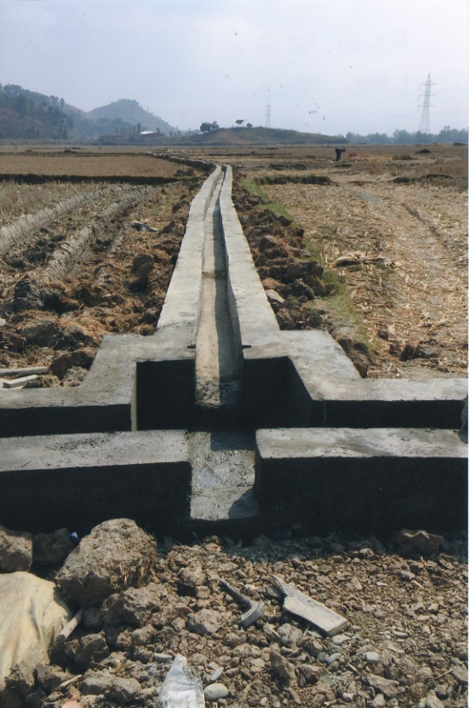
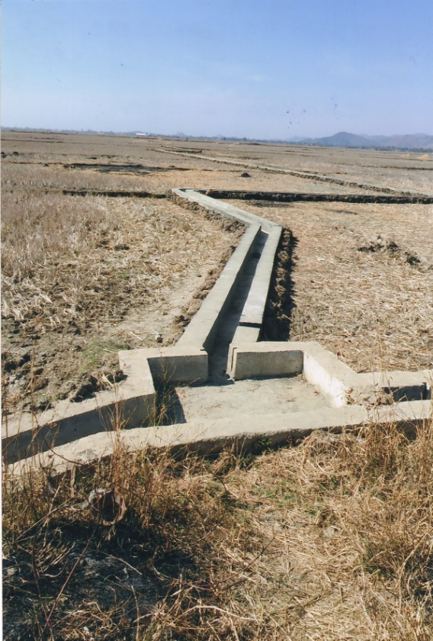
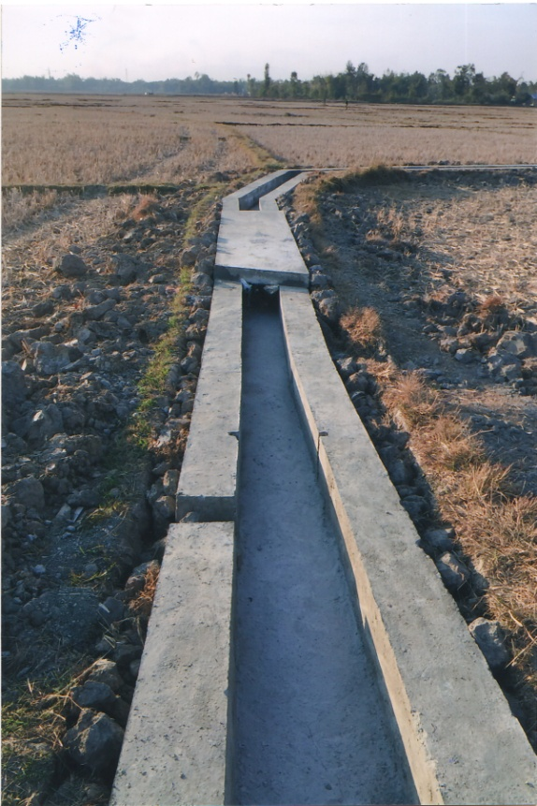
5th PIRC Meeting (Mt. Abu, 30th May 2019): Progress Review Presentations
Glimpses Of Project Progress
TMP (Ph-III) LSMC
RD No.18.83
Thokchom Loukon,
TMP (Ph-III) LSMC
RD No.19.754
Chakabi Loukon,
Uyun Khunou
TMP (Ph-III) LSMC
RD No.24.469
Khangabok Loukon,

Slide 155
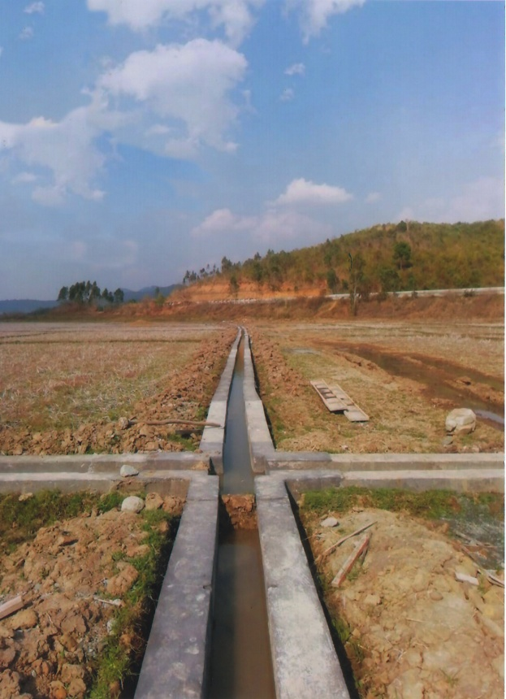
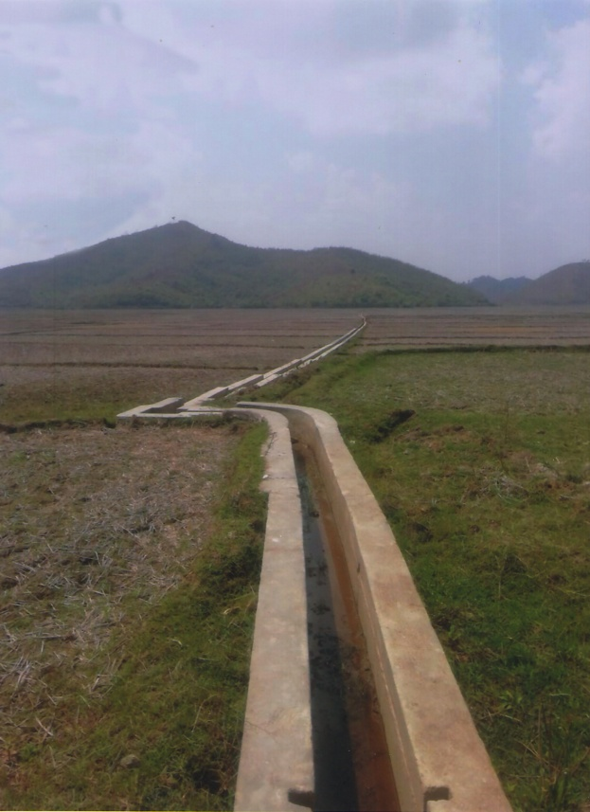
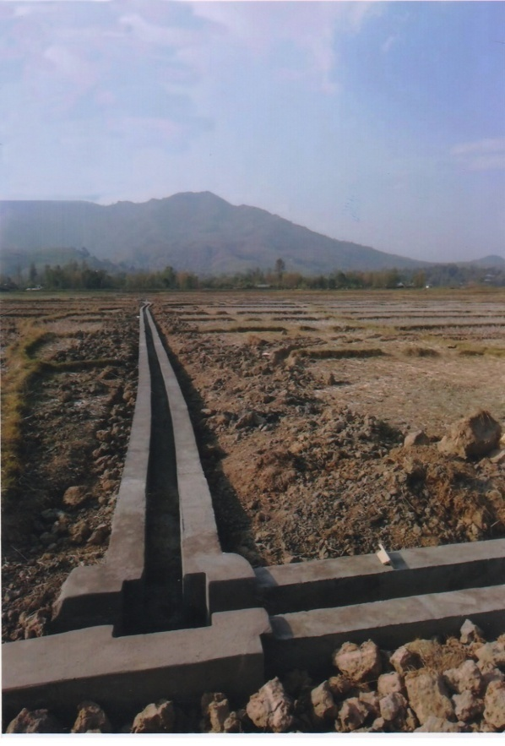
5th PIRC Meeting (Mt. Abu, 30th May 2019): Progress Review Presentations
Glimpses Of Project Progress
TMP (Ph-III) RSMC
Arangkot
TMP (Ph-III) RSMC
Changamdabi
TMP (Ph-III) RSMC
Andro Khunjao-1

Slide 156
5th PIRC Meeting (Mt. Abu, 30th May 2019): Progress Review Presentations
Key Reasons For Progress Delays
Status | Key Reason
X | Absence of Hydraulic Connectivity up to Outlet.
√ | Delay in Govt/Administrative clearances.
√ | State budget constraints.
X | Unwillingness of farmers.
X | Delays in tendering.
X | Capacity related issues of Implementing Agencies.
X | Capacity related issues of Contractors/Suppliers.
X | Other Issue (to be specified).

Slide 157
5th PIRC Meeting (Mt. Abu, 30th May 2019): Progress Review Presentations
ODISHA
Number of Projects : 8 Projects Included: 8 Projects Availing CA: 8 Projects Reporting Progress:7
Physical Progress

Slide 158
5th PIRC Meeting (Mt. Abu, 30th May 2019): Progress Review Presentations
CCA Progress
( Area in Th. Ha.)
Sr. No. | Project | Balance CCA Target | CCA Progress |  |  |  |  | Target for 2019-20
 |  |  | 2016-17 | 2017-18 | 2018-19 | Total | % Progress
1 | Upper Indravati Extn. | 23.83 | 5.35 | 18.48 | 0 | 23.83 | 100 | 0
2 | Ret | 8.5 | 0 | 2.417 | 6.083 | 8.5 | 100 | 0
3 | Rukura | 5.75 | 1.377 | 2.88 | 1.333 | 5.59 | 97.22 | 0
4 | Lower Indra | 29.9 | 0 | 0 | 10.02 | 10.02 | 33.51 | 19.88
5 | Telengiri | 9.952 | 0 | 0 | 0.864 | 0.864 | 8.682 | 9.088
6 | Subarnarekha | 68.83 | 2.76 | 1.701 | 0.094 | 4.555 | 6.618 | 5
7 | Ananapur | 60 | 0 | 1.505 | 0.297 | 1.802 | 3.003 | 1.24
8 | Kanupur | 29.58 | 0 | 0 | 0 | 0 | 0 | 0
 | Total | 236.3 | 9.487 | 26.99 | 18.69 | 55.17 | 23.35 | 35.21

Slide 159
5th PIRC Meeting (Mt. Abu, 30th May 2019): Progress Review Presentations
WUA Progress
(WUA’s in No’s)
Sr. No. | Project | WUA Target | WUA Progress |  |  |  |  |  | Target for 2019-20
 |  |  | Before April 2016 | 2016-17 | 2017-18 | 2018-19 | Total | % Progress
1 | Upper Indravati Extn. | 59 | 0 | 0 | 59 | 0 | 59 | 100 | 0
2 | Ret | 19 | 0 | 0 | 0 | 19 | 19 | 100 | 0
3 | Rukura | 15 | 0 | 3 | 10 | 2 | 15 | 100 | 0
4 | Lower Indra | 75 | 0 | 0 | 0 | 0 | 0 | 0 | 75
5 | Telengiri | 22 | 0 | 0 | 0 | 0 | 0 | 0 | 22
6 | Subarnarekha | 156 | 0 | 13 | 0 | 6 | 19 | 12.179 | 15
7 | Ananapur | 133 | 0 | 0 | 0 | 0 | 0 | 0 | 12
8 | Kanupur | 66 | 0 | 0 | 0 | 0 | 0 | 0 | 0
 | Total | 545 | 0 | 16 | 69 | 27 | 112 | 20.55 | 124

Slide 160
5th PIRC Meeting (Mt. Abu, 30th May 2019): Progress Review Presentations
CA Release Progress
(CA in Rs. Crores)
Sr. No. | Project | Overall CA Target | CA Release Progress |  |  |  |  | Target for 2019-20
 |  |  | 2016-17 | 2017-18 | 2018-19 | Total | % Progress
1 | Upper Indravati Extn. | 44.03 | 8.495 | 30.83 | 0 | 39.32 | 89.31 | 4.709
2 | Ret | 16.55 | 0 | 4.105 | 0 | 4.105 | 24.80 | 12.447
3 | Rukura | 10.21 | 2.41 | 0.802 | 0 | 3.212 | 31.46 | 6.998
4 | Lower Indra | 51.67 | 24.37 | 0 | 0 | 24.37 | 47.16 | 27.301
5 | Telengiri | 16.72 | 0 | 2.838 | 0 | 2.838 | 16.97 | 13.884
6 | Subarnarekha | 126 | 0 | 16.28 | 0 | 16.28 | 12.92 | 20
7 | Ananapur | 101.6 | 0 | 1.82 | 0 | 1.82 | 1.79 | 12
8 | Kanupur | 53.44 | 0 | 1.892 | 3.65 | 5.542 | 10.37 | 10
 | Total | 420.2 | 35.28 | 58.57 | 3.65 | 97.49 | 23.20 | 107.34

Slide 161
5th PIRC Meeting (Mt. Abu, 30th May 2019): Progress Review Presentations
Total Expenditure Progress
(TE in Rs. Crores)
Sr. No. | Project | Total Expenditure Target | Total Expenditure Progress |  |  |  |  | Target for 2019-20
 |  |  | 2016-17 | 2017-18 | 2018-19 | Total | % Progress
1 | Upper Indravati Extn. | 140.27 | 43.43 | 65.85 | 13.14 | 122.4 | 87.28 | 12.74
2 | Ret | 46.87 | 0.659 | 8.129 | 28.64 | 37.43 | 79.86 | 3.18
3 | Rukura | 31.71 | 4.82 | 11.06 | 5.118 | 20.99 | 66.20 | 4.71
4 | Lower Indra | 103.08 | 2 | 0 | 39.18 | 41.18 | 39.95 | 61.9
5 | Telengiri | 54.51 | 0 | 0.246 | 6.941 | 7.187 | 13.18 | 47.32
6 | Subarnarekha | 389.58 | 7.846 | 11.95 | 12.98 | 32.78 | 8.41 | 40
7 | Ananapur | 334.37 | 0 | 2.08 | 2.09 | 4.17 | 1.25 | 24
8 | Kanupur | 164.85 | 0 | 1.451 | 1.282 | 2.733 | 1.66 | 20
 | Total | 1265.2 | 58.76 | 100.8 | 109.4 | 268.9 | 21.25 | 213.85

Slide 162
5th PIRC Meeting (Mt. Abu, 30th May 2019): Progress Review Presentations
Broad Review
(CCA in Th. ha.)
Sr. No. | Project | CADWM |  |  |  |  | AIBP
 |  | Total CCA of Project | CCA developed before 31.03. 2016 (A)* | Progress in CCA for 99 Priority Projects (B) | Cumulative CCA developed (A+B) | % CCA Progress | Ultimate Irrigation Potential | Potential Created | % IPC
1 | Upper Indravati Extn. | 25.48 | 1.65 | 23.83 | 25.48 | 100 | 41.794 | 41.794 | 100
2 | Ret | 8.5 | 0 | 8.423 | 8.42 | 99.06 | 9.775 | 9.728 | 99.52
3 | Rukura | 5.75 | 0 | 5.59 | 5.59 | 97.22 | 7.648 | 6.796 | 88.86
4 | Lower Indra | 29.9 | 0 | 10.02 | 10.02 | 33.51 | 38.87 | 26.502 | 68.18
5 | Telengiri | 9.95 | 0 | 0.864 | 0.86 | 8.643 | 13.789 | 11.815 | 85.68
6 | Subarnarekha | 69.8 | 1.1 | 4.555 | 5.66 | 8.109 | 115.259 | 77.97 | 67.65
7 | Ananapur | 60 | 0 | 1.802 | 1.8 | 3 | 56.72 | 3 | 5.289
8 | Kanupur | 29.58 | 0 | 0 | 0 | 0 | 47.709 | 0 | 0
 | Total | 238.96 | 2.75 | 55.09 | 57.83 | 24.2 | 331.564 | 177.61 | 53.57
* i.e. CCA developed under CADWM (up to 31-03-2016) and before CADWM inclusion.

Slide 163
5th PIRC Meeting (Mt. Abu, 30th May 2019): Progress Review Presentations
Key Reasons For Progress Delays
Status | Key Reason
√ | Absence of Hydraulic Connectivity up to Outlet.
X | Delay in Govt/Administrative clearances.
X | State budget constraints.
X | Unwillingness of farmers.
X | Delays in tendering.
√ | Capacity related issues of Implementing Agencies.
X | Capacity related issues of Contractors/Suppliers.
X | Other Issue (to be specified).

Slide 164
5th PIRC Meeting (Mt. Abu, 30th May 2019): Progress Review Presentations
Rajasthan
Number of Projects : 2 Projects Included: 2 Projects Availing CA: 1 Projects Reporting Progress:2
Physical Progress

Slide 165
5th PIRC Meeting (Mt. Abu, 30th May 2019): Progress Review Presentations
CCA Progress
( Area in Th. Ha.)
Sr. No. | Project | Balance CCA Target | CCA Progress |  |  |  |  | Target for 2019-20
 |  |  | 2016-17 | 2017-18 | 2018-19 | Total | % Progress
1 | Narmada Canal | 0 | 0 | 0 | 0 | 0 | 0
2 | Mod. of Gang Canal | 43.49 | 6.86 | 7.22 | 7.08 | 21.17 | 48.67 | 9.50
 | TOTAL | 43.49 | 6.86 | 7.22 | 7.08 | 21.17 | 48.67 | 9.50

Slide 166
5th PIRC Meeting (Mt. Abu, 30th May 2019): Progress Review Presentations
WUA Progress
(WUA’s in No’s)
Sr. No. | Project | WUA Target | WUA Progress |  |  |  |  |  | Target for 2019-20
 |  |  | Before April 2016 | 2016-17 | 2017-18 | 2018-19 | Total | % Progress
1 | Narmada Canal | 2232 | 2144 | 56 | 1 | 14 | 2215 | 99 | 17
2 | Mod. of Gang Canal | 36 | 36 | 0 | 0 | 0 | 36 | 100 | 0
 | TOTAL | 2268 | 2180 | 56 | 1 | 14 | 2251 | 99 | 17

Slide 167
5th PIRC Meeting (Mt. Abu, 30th May 2019): Progress Review Presentations
CA Release Progress
(CA in Rs. Crores)
Sr. No. | Project | Overall CA Target | CA Release Progress |  |  |  |  | Target for 2019-20
 |  |  | 2016-17 | 2017-18 | 2018-19 | Total | % Progress
1 | Narmada Canal | 54.06 | 0 | 0 | 0 | 0 | 0 | 11.7
2 | Mod. of Gang Canal | 61.24 | 0 | 2.48 | 7.44 | 9.918 | 16.20 | 19.5
 | TOTAL | 115.3 | 0 | 2.48 | 7.44 | 9.918 | 8.60 | 31.2

Slide 168
5th PIRC Meeting (Mt. Abu, 30th May 2019): Progress Review Presentations
Total Expenditure Progress
(TE in Rs. Crores)
Sr. No. | Project | Total Expenditure Target | Total Expenditure Progress |  |  |  |  | Target for 2019-20
 |  |  | 2016-17 | 2017-18 | 2018-19 | Total | % Progress
1 | Narmada Canal | 97.48 | 0 | 0 | 0 | 0 | 0.00 | 19.5
2 | Mod. of Gang Canal | 123.01 | 10.43 | 13 | 14.9 | 38.27 | 31.11 | 39
 | TOTAL | 220.49 | 10.43 | 13 | 14.9 | 38.27 | 17.36 | 58.5

Slide 169
5th PIRC Meeting (Mt. Abu, 30th May 2019): Progress Review Presentations
Broad Review
(CCA in Th. ha.)
Sr. No | Project | CADWM |  |  |  |  | AIBP
 |  | Total CCA of Project | CCA developed before 31.03. 2016 (A)* | Progress in CCA for 99 Priority Projects (B) | Cumulative CCA developed (A+B) | % CCA Progress | Ultimate Irrigation Potential | Potential Created | % IPC
1 | Narmada Canal | 246.0 | 246.0 | 0 | 246.0 | 100 | 245.88 | 245.81 | 99.97
2 | Mod. of Gang Canal | 45.694 | 1.389 | 21.17 | 22.6 | 49.36 | 96.51 | 96.51 | 100
 | TOTAL | 291.694 | 247.389 | 21.17 | 269 | 92.07 | 342.39 | 342.32 | 99.98
* i.e. CCA developed under CADWM (up to 31-03-2016) and before CADWM inclusion.

Slide 170
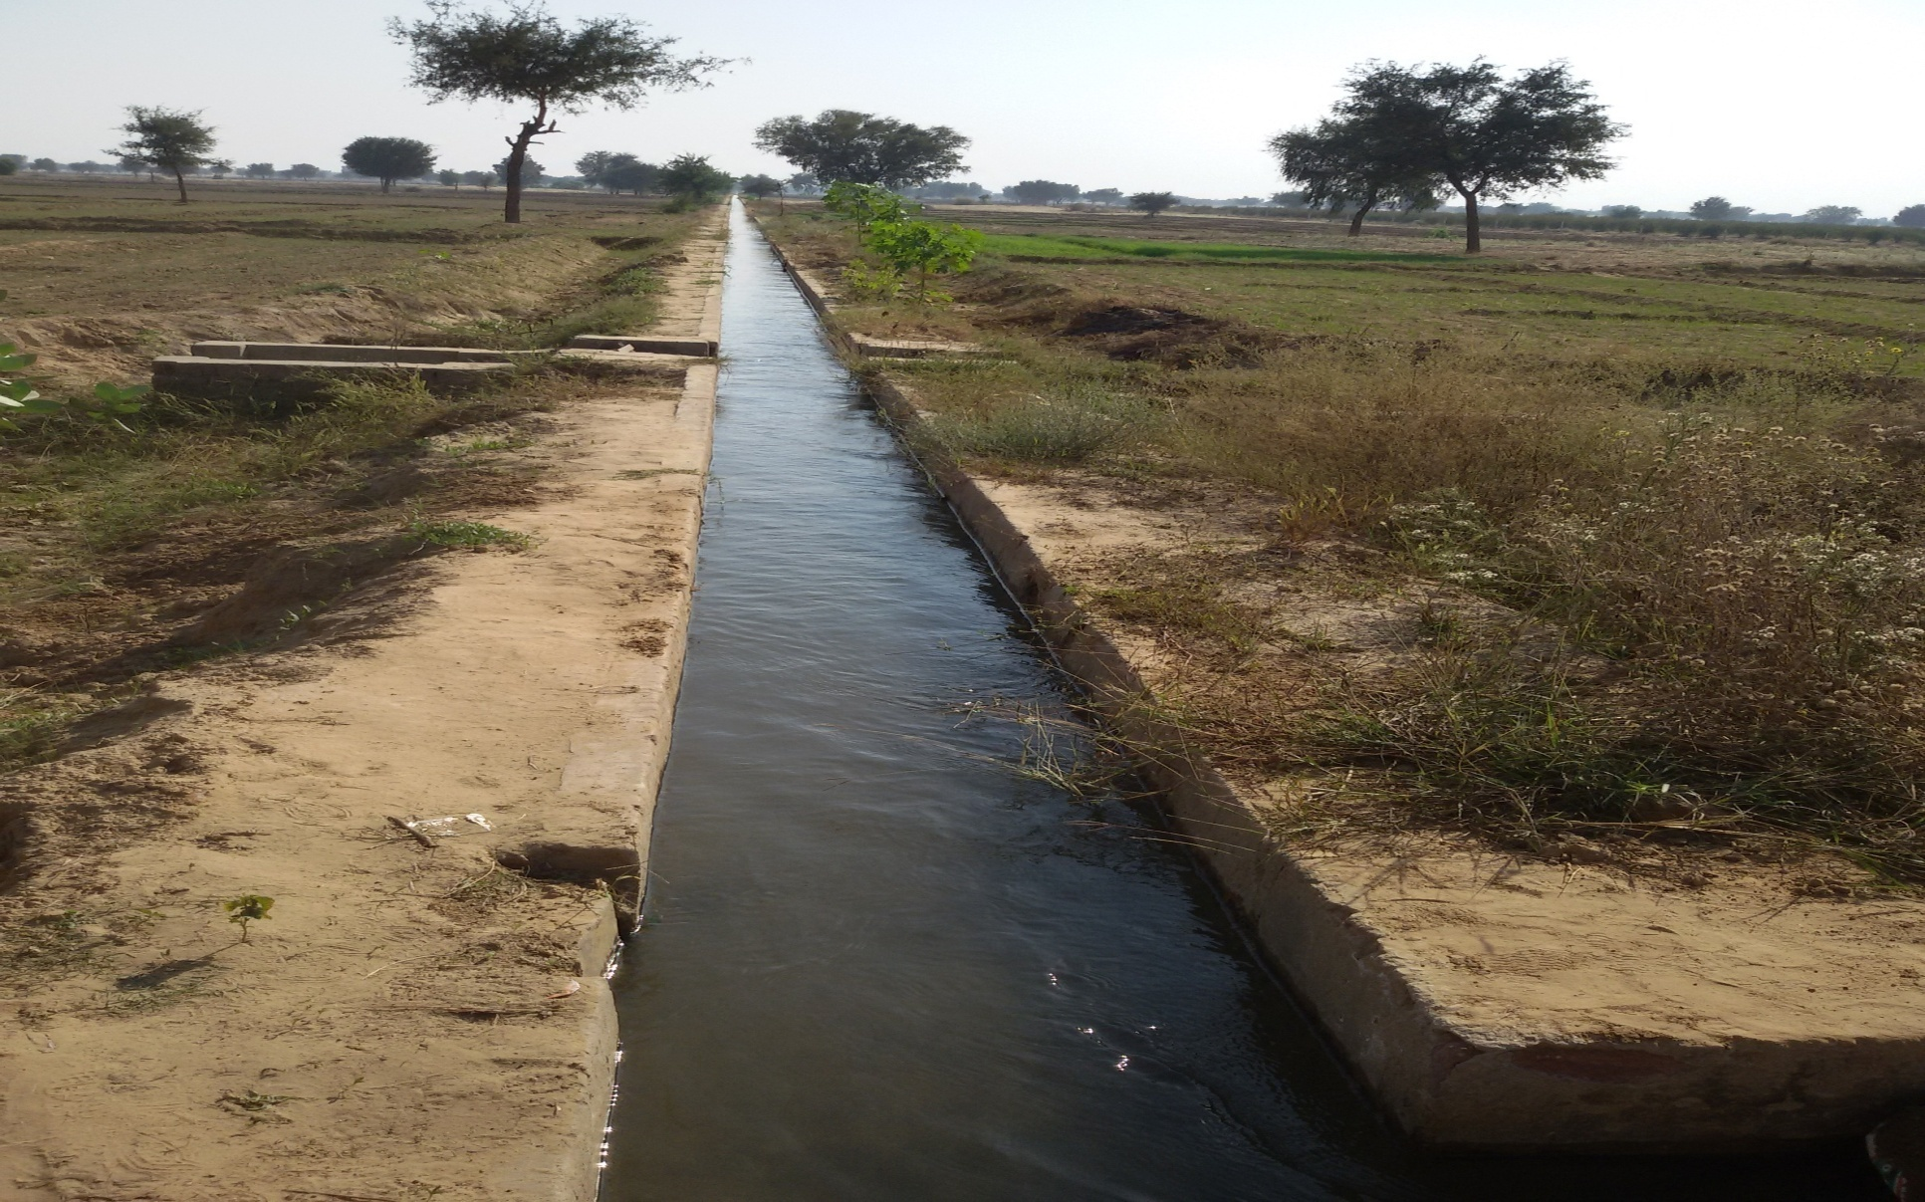
5th PIRC Meeting (Mt. Abu, 30th May 2019): Progress Review Presentations
Glimpses Of Project Progress
Water course at Chak No 73 NP of Gang Canal Project Phase-II
{.....Project Photographs (4/5) may be provided}

Slide 171
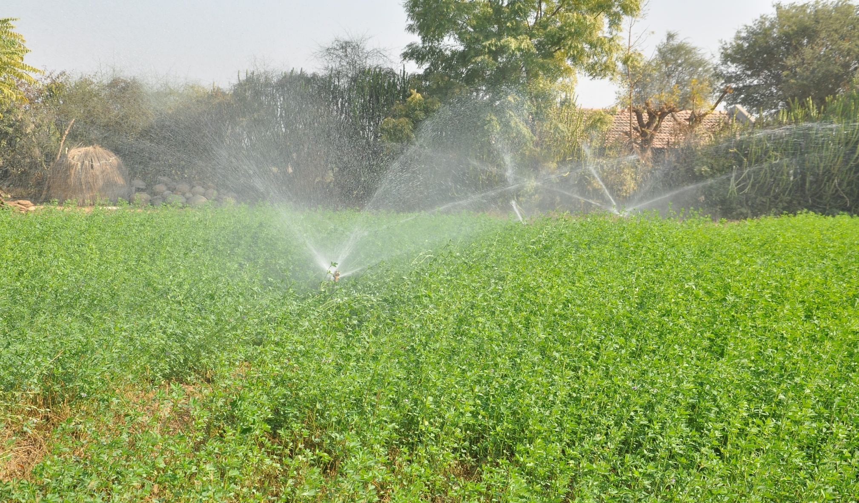
5th PIRC Meeting (Mt. Abu, 30th May 2019): Progress Review Presentations
Glimpses Of Project Progress
Sprinkler system at Jaisala Distributary of Narmada Canal Project
{.....Project Photographs (4/5) may be provided}

Slide 172
5th PIRC Meeting (Mt. Abu, 30th May 2019): Progress Review Presentations
Key Reasons For Progress Delays
Status | Key Reason
√ | Absence of Hydraulic Connectivity up to Outlet.
X | Delay in Govt/Administrative clearances.
X | State budget constraints.
√ | Unwillingness of farmers.
X | Delays in tendering.
X | Capacity related issues of Implementing Agencies.
X | Capacity related issues of Contractors/Suppliers.
X | Other Issue (to be specified).

Slide 173
5th PIRC Meeting (Mt. Abu, 30th May 2019): Progress Review Presentations
Extra Slides
{....Present Project-specific information and Issues}

Slide 174
5th PIRC Meeting (Mt. Abu, 30th May 2019): Progress Review Presentations
TELANGANA
Number of Projects : 11 Projects Included: 11 Projects Availing CA: 9 Projects Reporting Progress:0
Physical Progress

Slide 175
5th PIRC Meeting (Mt. Abu, 30th May 2019): Progress Review Presentations
CCA Progress
Sr. No. | Project | Balance CCA Target in Th. Ha | CCA Progress |  |  |  |  | Target for 2019-20
 |  |  | 2016-17 | 2017-18 | 2018-19 | Total | % Progress
1 | J. Chokha Rao LIS | 248.685 | 0 | 0 | 0 | 0 | 0 | 33.539
2. | Gollavagu Project | 3.845 | 0 | 0 | 0 | 0 | 0 | 1.538
3. | Mathadivagu Project | 3.44 | 0 | 0 | 0 | 0 | 0 | 1.547
4. | Palemvagu project | 2.014 | 0 | 0 | 0 | 0 | 0 | 1.007
5. | Peddavagu @ Jagannathpur | 6.073 | 0 | 0 | 0 | 0 | 0
6. | Peddavagu @ Neelwai | 5.26 | 0 | 0 | 0 | 0 | 0 | 2.367
7. | Rajiv Bheema L.I. Scheme | 82.153 | 0 | 0 | 0 | 0 | 0 | 30.000
8. | Rallivagu project | 0.918 | 0 | 0 | 0 | 0 | 0 | 0.367
9. | SriKomaram Bheem | 9.915 | 0 | 0 | 0 | 0 | 0 | 4.336
10. | SRSP St.II | 73.138 | 0 | 0 | 0 | 0 | 0 | 61.411
11. | Indiramma Flood Flow Canal | 93.587 | 0 | 0 | 0 | 0 | 0 | 5.669
 | Total | 529.028 | 0 | 0 | 0 | 0 | 0 | 141.781

Slide 176
5th PIRC Meeting (Mt. Abu, 30th May 2019): Progress Review Presentations
WUA Progress
(WUA’s in No’s)
Sr. No. | Project | WUA Target | WUA Progress |  | Target for 2019-20
 |  |  | Before April 2016 | WUAs Status
1 | J. Chokha Rao LIS | 498 | 0 | WUAs shall be formed after completion of the AIBP projects.
2. | Gollavagu Project | 8 | 0 |  | 4
3. | Mathadivagu Project | 7 | 0 |  | 3
4. | Palemvagu project | 8 | 0
5. | Peddavagu @ Jagannathpur | 15 | 0
6. | Peddavagu @ Neelwai | 11 | 0
7. | Rajiv Bheema L.I. Scheme | 164 | 0
8. | Rallivagu project | 3 | 0 |  | 1
9. | SriKomaram Bheem | 20 | 0
10. | SRSP St.II | 356 | 0
11. | Indiramma Flood Flow Canal | 58 | 0
 | Total | 1148 | 0 |  | 8

Slide 177
5th PIRC Meeting (Mt. Abu, 30th May 2019): Progress Review Presentations
CA Release Progress
(CA in Rs. Crores)
Sr. No. | Project | Overall CA Target | CA Release Progress |  |  |  |  | Target for 2019-20
 |  |  | 2016-17 | 2017-18 | 2018-19 | Total | % Progress
1 | J. Chokha Rao LIS | 380.35 | 0 | 10.22 | 0 | 10.22 | 2.69 | 7.04
2. | Gollavagu Project | 7.186 | 0 | 0 | 1.03 | 1.03 | 14.33 | 2.56
3. | Mathadivagu Project | 6.187 | 0 | 0 | 1.8 | 1.8 | 29.09 | 1.28
4. | Palemvagu project | 2.601 | 0 | 0 | 0.51 | 0.51 | 19.60 | 0.35
5. | Peddavagu @ Jagannathpur | 12.20 | 0 | 0 | 0 | 0 | 0.00 | 5.00
6. | Peddavagu @ Neelwai | 6.669 | 0 | 0 | 1.99 | 1.99 | 29.84 | 1.33
7. | Rajiv Bheema L.I. Scheme | 112.22 | 0 | 0 | 0 | 0 | 0.00 | 70.52
8. | Rallivagu project | 1.472 | 0 | 0 | 0.28 | 0.28 | 19.02 | 0.45
9. | SriKomaram Bheem | 19.84 | 0 | 0 | 5.89 | 5.89 | 29.69 | 4.35
10. | SRSP St.II | 103.241 | 0 | 0 | 11.56 | 11.56 | 11.20 | 9.00
11. | Indiramma Flood Flow Canal | 48.26 | 0 | 0 | 3.06 | 3.06 | 6.34 | 2.05
 | Total | 700.22 | 0 | 10.22 | 26.12 | 36.34 | 5.187 | 103.93

Slide 178
5th PIRC Meeting (Mt. Abu, 30th May 2019): Progress Review Presentations
Total Expenditure Progress
(TE in Rs. Crores)
Sr. No. | Project | Total Expenditure Target | Total Expenditure Progress |  |  |  |  | Target for 2019-20
 |  |  | 2016-17 | 2017-18 | 2018-19 | Total | % Progress
1 | J. Chokha Rao LIS | 759.94 | Inclusion on 31st March, 2017 | 0 | 0 | 0 | 0 | 385.725
2. | Gollavagu Project | 20.4 |  | 0 | 0 | 0 | 0 | 10.20
3. | Mathadivagu Project | 12.635 |  | 0 | 0 | 0 | 0 | 6.299
4. | Palemvagu project | 5.2 |  | 0 | 0 | 0 | 0 | 1.729
5. | Peddavagu @ Jagannathpur | 52.5496 |  | 0 | 0 | 0 | 0
6. | Peddavagu @ Neelwai | 25.121 |  | 0 | 0 | 0 | 0 | 9.319
7. | Rajiv Bheema L.I. Scheme | 239.519 |  | 0 | 0 | 0 | 0 | 150.78
8. | Rallivagu project | 5.57 |  | 0 | 0 | 0 | 0 | 2.785
9. | SriKomaram Bheem | 56.546 |  | 0 | 0 | 0 | 0 | 29.519
10. | SRSP St.II | 204.082 |  | 0 | 0 | 0 | 0 | 42.272
11. | Indiramma Flood Flow Canal | 97.23 |  | 0 | 0 | 0 | 0 | 9.396
 | Total | 1478.806 |  | 0 | 0 | 0 | 0 | 648.024

Slide 179
5th PIRC Meeting (Mt. Abu, 30th May 2019): Progress Review Presentations
Broad Review
(CCA in Th. ha.)
Sr. No. | Project | CADWM |  |  |  |  | AIBP
 |  | Total CCA of Project | CCA developed before 31.03. 2016 (A)* | Progress in CCA for 99 Priority Projects (B) | Cumulative CCA developed (A+B) | % CCA Progress | Ultimate Irrigation Potential | Potential Created | % IPC
1 | J. Chokha Rao LIS | 248.685 | 0 | 0 | 0 | 0 | 248.685 | 105.344 | 42.36
2. | Gollavagu Project | 3.845 | 0 | 0 | 0 | 0 | 3.845 | 3.845 | 100
3. | Mathadivagu Project | 3.44 | 0 | 0 | 0 | 0 | 3.440 | 3.44 | 100
4. | Palemvagu project | 2.014 | 0 | 0 | 0 | 0 | 4.100 | 2.077 | 50.65
5. | Peddavagu @ Jagannathpur | 6.073 | 0 | 0 | 0 | 0 | 6.073 | 0 | 0
6. | Peddavagu @ Neelwai | 5.26 | 0 | 0 | 0 | 0 | 5.260 | 3.24 | 61.59
7. | Rajiv Bheema L.I. Scheme | 82.153 | 0 | 0 | 0 | 0 | 82.153 | 59.582 | 72.52
8. | Rallivagu project | 0.918 | 0 | 0 | 0 | 0 | 0.918 | 0.918 | 100
9. | SriKomaram Bheem | 9.915 | 0 | 0 | 0 | 0 | 9.915 | 6.094 | 61.46
10. | SRSP St.II | 73.138 | 0 | 0 | 0 | 0 | 178.066 | 138.372 | 77.70
11. | Indiramma Flood Flow Canal | 93.587 | 0 | 0 | 0 | 0 | 93.587 | 1.214 | 1.29
 | Total | 529.028 | 0 | 0 | 0 | 0 | 636.042 | 324.12 | 60.68
* i.e. CCA developed under CADWM (up to 31-03-2016) and before CADWM inclusion.

Slide 180
5th PIRC Meeting (Mt. Abu, 30th May 2019): Progress Review Presentations
Key Reasons For Progress Delays
Status | Key Reason
√ | Absence of Hydraulic Connectivity up to Outlet.
√ | Delay in Govt/Administrative clearances.
X | State budget constraints.
X | Unwillingness of farmers.
X | Delays in tendering.
X | Capacity related issues of Implementing Agencies.
X | Capacity related issues of Contractors/Suppliers.
√ | Other Issue (to be specified). Due to election process progress is hampered.

Slide 181
5th PIRC Meeting (Mt. Abu, 30th May 2019): Progress Review Presentations
Uttar Pradesh (Greater Sharda Sahayak Command)
Number of Projects : 3 Projects Included: 2 Projects Availing CA: 2 Projects Reporting Progress:0
Physical Progress

Slide 182
5th PIRC Meeting (Mt. Abu, 30th May 2019): Progress Review Presentations
CCA Progress
( Area in Th. Ha.)
Sr. No. | Project | Balance CCA Target | CCA Progress |  |  |  |  | Target for 2019-20
 |  |  | 2019-20 | 2020-21 | 2021-22 | Total | % Progress
1 | Arjun Sahayak | 44.38 | 0 | 0 | 0 | 0 | 0 | 28.75
2 | Saryu Nahar Ph-III | 480.00 | 0 | 0 | 0 | 0 | 0 | 144
 | TOTAL | 524.38 | 0.00 | 0.00 | 0.00 | 0.00 | 0.00 | 172.75

Slide 183
5th PIRC Meeting (Mt. Abu, 30th May 2019): Progress Review Presentations
WUA Progress
(WUA’s in No’s)
Sr. No. | Project | WUA Target | WUA Progress |  |  |  |  |  | Target for 2019-20
 |  |  | Before April 2016 | 2016-17 | 2017-18 | 2018-19 | Total | % Progress
1 | Arjun Sahayak | 108 | 0 | 0 | 0 | 0 | 0 | 0 | .....
2 | Saryu Nahar Ph-III | 960 | 0 | 0 | 0 | 0 | 0 | 0
 | TOTAL | 1068 | 0 | 0 | 0 | 0 | 0 | 0
Note :- Formation of WUA is being done by Irrigation Department (U.P.)

Slide 184
5th PIRC Meeting (Mt. Abu, 30th May 2019): Progress Review Presentations
CA Release Progress
(CA in Rs. Crores)
Sr. No. | Project | Overall CA Target | CA Release Progress |  |  |  |  | Target for 2019-20
 |  |  | 2019-20 | 2020-21 | 2021-22 | Total | % Progress
1 | Arjun Sahayak | 77.86 | 0 | 0 | 0 | 0 | 0 | 50.05
2 | Saryu Nahar Ph-III | 837.06 | 0 | 0 | 0 | 0 | 0 | 250.26
 | TOTAL | 914.92 | 0.0 | 0.0 | 0.0 | 0.0 | 0.0 | 300.31

Slide 185
5th PIRC Meeting (Mt. Abu, 30th May 2019): Progress Review Presentations
Total Expenditure Progress
(TE in Rs. Crores)
Sr. No. | Project | Total Expenditure Target | Total Expenditure Progress |  |  |  |  | Target for 2019-20
 |  |  | 2019-20 | 2020-21 | 2021-22 | Total | % Progress
1 | Arjun Sahayak | 155.37 | 0 | 0 | 0 | 0 | 0 | 100
2 | Saryu Nahar Ph-III | 1672.7 | 0 | 0 | 0 | 0 | 0 | 500
 | TOTAL | 1828.1 | 0 | 0 | 0 | 0 | 0 | 600

Slide 186
5th PIRC Meeting (Mt. Abu, 30th May 2019): Progress Review Presentations
Broad Review
(CCA in Th. ha.)
Sr. No. | Project | CADWM |  |  |  |  | AIBP
 |  | Total CCA of Project | CCA developed before 31.03. 2019 (A)* | Progress in CCA for 99 Priority Projects (B) | Cumulative CCA developed (A+B) | % CCA Progress | Ultimate Irrigation Potential | Potential Created | % IPC
1 | Arjun Sahayak | 44.381 | 0 | 0 | 0 | 0 | 44.4 | 6 | 13.52
2 | Saryu Nahar Ph-III | 480 | 0 | 0 | 0 | 0 | 473 | 171.15 | 36.18
 | TOTAL | 524.381 | 0 | 0 | 0 | 0 | 663.9 | 221.15 | 33.31
* i.e. CCA developed under CADWM (up to 31-03-2019) and before CADWM inclusion.

Slide 187
5th PIRC Meeting (Mt. Abu, 30th May 2019): Progress Review Presentations
Key Reasons For Progress Delays
Status | Key Reason
√ | Absence of Hydraulic Connectivity up to Outlet.
X | Delay in Govt/Administrative clearances.
X | State budget constraints.
√ | Unwillingness of farmers.
X | Delays in tendering.
X | Capacity related issues of Implementing Agencies.
X | Capacity related issues of Contractors/Suppliers.
X | Other Issue (to be specified).

