Slide 1
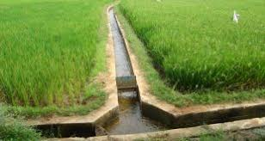

WELCOME
WELCOME
Government of Maharashtra
Water Resources Department
Pradhan Mantri Krishi Sinchan Yojana (PMKSY)
Review of (CADWM) Progress
Presenter
C. A. Birajadar Secretary (CAD) Govt. of Maharashtra
Government of Maharashtra
Water Resources Department
Pradhan Mantri Krishi Sinchan Yojana (PMKSY)
Review of (CADWM) Progress
(Dt. 13.03.2018)

Slide 2
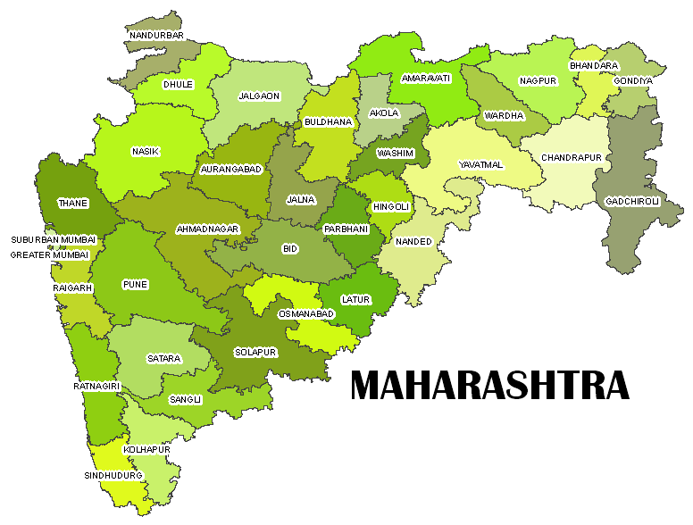
Location map of projects
1.Waghur 2. Bawanthadi
3. Lower Dudhana 4. Tillari
5. Lower Wardha 6. Lower Panzara
7. N Madhmeshwar 8. Gosikhurd
9. Upper Painganga 10. Bembala
11. Tarali 12. Dhom Balkawadi
13. Arjuna 14. Upper Kundlika
15. Aruna 16. K.K. LIS
17. Gadhnadi 18. Sangola Canal
19. Khadakpurna 20. Morna
21. Lower Pedhi 22. Kudali
23. Warna 24. Nardave
25. Wang 26. Dongargaon
1
6
21
5
8
2
9
7
19
10
26
3
14
18
11,12,22,20,25
13,17
16,23
4,15,24

Slide 3
Projects in PMKSY CAD-WM
1. | No. of Projects included in PMKSY | 26
2. | No. of Projects which does not requires CADWM (Warna, Naradave, Wang, Dongargaon) | 04
3. | Net Projects Under CADWM Programme | 22
4. | Area Included in CADWM Programme ( Ha.) | 5,07,494
5. | Total Cost of CADWM Programme(Cr) | 2123.99

Slide 4
Details of CCA and COST (Area in Ha. Cost in Rs. Cr)
Sr.No. | Name of Project | CCA | Cost
 |  |  | Total | Central Share | State share
1 | Waghur | 8270 | 22.96 | 11.48 | 11.48
2 | Bawanthadi | 2500 | 15.63 | 7.35 | 8.2839
3 | Lower Dudhna | 30035 | 145.49 | 72.75 | 72.745
4 | Tillari | 6570 | 32.43 | 16.22 | 16.215
5 | Lower Wardha | 62450 | 200.86 | 100.43 | 100.43
6 | Lower Panzara | 6785 | 35.52 | 17.76 | 17.76
7 | N. M. Ph-II | 20500 | 98.5 | 49.25 | 49.25
8 | Gosikhurd (NP) | 190000 | 780.28 | 390.14 | 390.14
9 | Upper Pain Ganga | 17289 | 69.62 | 26.46 | 43.1644
10 | Bembla | 29779 | 164.44 | 57.55 | 106.886
11 | Tarli | 13086 | 53.63 | 25.21 | 28.4239
12 | D. Balkawdi | 8130 | 71.05 | 35.53 | 35.525
13 | Arjuna | 5704 | 28.94 | 11.29 | 17.6534
14 | Upper Kundalika | 2800 | 14.63 | 5.56 | 9.0706
15 | Aruna | 5310 | 22.31 | 10.49 | 11.8243
16 | Krishna Koyana LIS | 52824 | 132.69 | 67.67 | 65.0181
17 | Gadnadi | 3111 | 19.12 | 6.12 | 13.0016
18 | Sangola Canal | 6883 | 32.44 | 13.95 | 18.4908
19 | Khadakpurna | 15720 | 79.42 | 31.77 | 47.652
20 | Morna (G) | 4229 | 16.79 | 8.23 | 8.5629
21 | Lower Pedhi | 10192 | 60.48 | 28.43 | 32.0544
22 | Kudali | 5327 | 26.76 | 10.7 | 16.056
 | Total | 507494 | 2123.99 | 1004.3 | 1119.69

Slide 5
A] DPR Status • Total no. of projects in CADWM : 22 • No of Projects Included in CADWM: 22 B] MOU Status • No. of Projects MOU Sent for Approval to Central Govt. – 22 • No. of Projects MOU Signed– 10 ( Tarali, KKLIS, Sangola Branch Canal, L.Dudhana, Upper Kundlika, Upper Painganga, Tillari, Arjuna, Gadnadi, Bawanthadi) C] CA Release Status • Proposals sent for Approval to Central Govt. = 22 • No. No. of Projects CA of Projects CA Released = 10 ( Tarali, KKLIS, Sangola Branch Canal, L.Dudhana, Upper Kundlika, Upper Painganga, Tillari, Arjuna, Gadnadi, Bawanthadi) • No. of Projects not requires CA for financial year 2017-18 – 4 (Lower Wardha, Morna Gureghar, Lower Pedhi, Aruna)
Status of DPR Inclusion, MOU & CA Release

Slide 6
Status of CA Release
Sr.No. | Name of project | Budget 2017-18 |  |  | Released in 2017-18
 |  | Central | State | Total | Central | State | Total
1 | Waghur | 3.8289 | 3.8589 | 7.6878 | 0 | 3.8589 | 3.8589
2 | Bawanthadi | 1.1325 | 1.2563 | 2.3888 | 0.53 | 1.2563 | 1.2563
3 | Lower Dudhana | 13.648 | 13.835 | 27.482 | 8.1 | 13.835 | 21.935
4 | Tillari | 3.7011 | 3.754 | 7.4551 | 1.81 | 3.754 | 5.564
5 | Lower Wardha | 9.5646 | 9.6533 | 19.218 | 0 | 9.6533 | 9.6533
6 | Lower Panzara | 5.4265 | 5.4375 | 10.864 | 0 | 5.4375 | 5.4375
7 | Nandur Madhmeshwar II | 6.638 | 6.6852 | 13.323 | 0 | 6.6852 | 6.6852
8 | Gosikhurd (NP) | 15.912 | 15.27 | 31.182 | 0 | 15.27 | 15.27
9 | Upper Painganga | 5.0436 | 4.9605 | 10.004 | 3 | 4.9605 | 7.9605
10 | Bembala | 13.043 | 15.044 | 28.087 | 0 | 15.044 | 15.044
11 | Tarali | 2.227 | 2.1512 | 4.3782 | 1.31 | 2.1512 | 3.4612
12 | Dhom Balkawadi | 1.575 | 1.5444 | 3.1194 | 0 | 1.5444 | 1.5444
13 | Arjuna | 2.5808 | 2.4986 | 5.0794 | 0.81 | 2.4986 | 3.3086
14 | Upper Kundlika | 1.126 | 1.0885 | 2.2145 | 0.52 | 1.0885 | 1.6085
15 | Aruna | 1.0786 | 1.0606 | 2.1392 | 0 | 1.0606 | 1.0606
16 | Krishna Koyna LIS | 6.5244 | 6.1681 | 12.693 | 3.81 | 6.1681 | 9.9781
17 | Gadnadi | 0.1043 | 0.1025 | 0.2068 | 0.04 | 0.1025 | 0.1425
18 | Sangola Branch Canal | 1.0707 | 1.0707 | 2.1414 | 0.56 | 1.0707 | 1.6307
19 | Khadakpurna | 5.6929 | 5.5198 | 11.213 | 0 | 5.5198 | 5.5198
20 | Morna (G) | 0 | 0 | 0 | 0 | 0 | 0
21 | Lower Pedhi | 2.8062 | 2.7711 | 5.5773 | 0 | 2.7711 | 2.7711
22 | Kudali | 0.4419 | 0.4291 | 0.871 | 0 | 0.4291 | 0.4291
 | Total | 103.21 | 104.16 | 207.37 | 20.49 | 104.16 | 124.12

Slide 7
Action Plan for Water User Association
Sr. No. | Name of Project | Under PMKSY (CADWM) | Year wise Planned Targets for WUA |  |  |  | No.of WUA’s formed upto Feb.2018
 |  | NO | 2017-18 | 2018-19 | 2019-20 | 2020-21
 |  |  | No | No | No | No
1 | Waghur | 78 | 17 | 61 | 0 | 0 | 6
2 | Bawanthadi | 60 | 30 | 30 | 0 | 0 | 0
3 | Lower Dudhna | 72 | 29 | 43 | 0 | 0 | 4
4 | Tillari | 18 | 5 | 8 | 5 | 0 | 4
5 | Lower Wardha | 139 | 30 | 35 | 0 | 0 | 97
6 | Lower Panzara | 13 | 3 | 10 | 0 | 0 | 0
7 | N.M. Ph-II | 121 | 0 | 6 | 0 | 0 | 115
8 | Gosikhurd (NP) | 387 | 50 | 75 | 85 | 98 | 79
9 | Upper Pain Ganga | 46 | 15 | 15 | 16 | 0 | 8
10 | Bembla | 175 | 50 | 20 | 0 | 0 | 105
11 | Tarali | 39 | 10 | 13 | 16 | 0
12 | Dhom Balaakwadi | 56 | 13 | 15 | 28 | 0 | 29
13 | Arjuna | 11 | 3 | 8 | 0 | 0 | 1
14 | Upper Kundalika | 7 | 7 | 0 | 0 | 0 | 7
15 | Aruna | 16 | 0 | 0 | 8 | 8 | 0
16 | Krishna Koyana LIS | 237 | 91 | 146 | 0 | 0 | 81
17 | Gadnadi | 7 | 2 | 3 | 3 | 0 | 0
18 | Sangola Canal | 40 | 0 | 10 | 6 | 0 | 16
19 | Khadakpurna | 66 | 9 | 25 | 29 | 0 | 45
20 | Morna | 36 | 0 | 20 | 16 | 0 | 0
21 | Lower Pedhi | 30 | 10 | 12 | 8 | 0 | 0
22 | Kudali | 13 | 2 | 6 | 5 | 0 | 0
 | Total | 1667 | 376 | 561 | 217 | 106 | 597

Slide 8
Financial Progress of work (Rs.in Cr.)
Sr.No. | Name of project | Budget 2017-18 |  |  | Budget Releases in 2017-18 |  |  | Proposed Budget 2018-19 |  |  | Expenditure upto Feb.2018
 |  | Central | State | Total | Central | State | Total | Central | State | Total
1 | Waghur | 3.8289 | 3.8589 | 7.6878 | 0 | 3.859 | 3.8589 | 9.625 | 9.625 | 19.25 | 0.71
2 | Bawanthadi | 1.1325 | 1.2563 | 2.3888 | 0.53 | 1.256 | 1.2563 | 1.41 | 1.59 | 3 | 0
3 | Lower Dudhana | 13.6476 | 13.8348 | 27.4824 | 8.1 | 13.83 | 21.9348 | 12.5 | 12.5 | 25 | 0
4 | Tillari | 3.7011 | 3.754 | 7.4551 | 1.81 | 3.754 | 5.564 | 5.5 | 5.5 | 11 | 0.8
5 | Lower Wardha | 9.5646 | 9.6533 | 19.2179 | 0 | 9.653 | 9.6533 | 9.125 | 9.625 | 19.25 | 9.06
6 | Lower Panzara | 5.4265 | 5.4375 | 10.864 | 0 | 5.438 | 5.4375 | 4.125 | 4.125 | 8.25 | 0.98
7 | Nandur Madhmeshwar II | 6.638 | 6.6852 | 13.3232 | 0 | 6.685 | 6.6852 | 5.5 | 5.5 | 11 | 0.15
8 | Gosikhurd (NP) | 15.9119 | 15.2697 | 31.1816 | 0 | 15.27 | 15.2697 | 14.265 | 14.265 | 28.53 | 0
9 | Upper Painganga | 5.0436 | 4.9605 | 10.0041 | 3 | 4.961 | 7.9605 | 2.75 | 2.75 | 5.5 | 1.17
10 | Bembala | 13.043 | 15.0437 | 28.0867 | 0 | 15.04 | 15.0437 | 6.7325 | 12.5125 | 19.25 | 7.05
11 | Tarali | 2.227 | 2.1512 | 4.3782 | 1.31 | 2.151 | 3.4612 | 3.102 | 3.498 | 6.6 | 0
12 | Dhom Balkawadi | 1.575 | 1.5444 | 3.1194 | 0 | 1.544 | 1.5444 | 3.575 | 3.575 | 7.15 | 0
13 | Arjuna | 2.5808 | 2.4986 | 5.0794 | 0.81 | 2.499 | 3.3086 | 0.78 | 1.22 | 2 | 0
14 | Upper Kundlika | 1.126 | 1.0885 | 2.2145 | 0.52 | 1.089 | 1.6085 | 1.045 | 1.705 | 2.75 | 0
15 | Aruna | 1.0786 | 1.0606 | 2.1392 | 0 | 1.061 | 1.0606 | 0.7755 | 0.8745 | 1.65 | 0
16 | Krishna Koyna LIS | 6.5244 | 6.1681 | 12.6925 | 3.81 | 6.168 | 9.9781 | 7.0125 | 6.7375 | 13.75 | 0
17 | Gadnadi | 0.1043 | 0.1025 | 0.2068 | 0.04 | 0.103 | 0.1425 | 0.32 | 0.68 | 1 | 0
18 | Sangola Branch Canal | 1.0707 | 1.0707 | 2.1414 | 0.56 | 1.071 | 1.6307 | 2.365 | 3.135 | 5.5 | 0
19 | Khadakpurna | 5.6929 | 5.5198 | 11.2127 | 0 | 5.52 | 5.5198 | 3.3 | 4.95 | 8.25 | 0
20 | Morna (G) | 0 | 0 | 0 | 0 | 0 | 0 | 0.539 | 0.561 | 1.1 | 0
21 | Lower Pedhi | 2.8062 | 2.7711 | 5.5773 | 0 | 2.771 | 2.7711 | 0.705 | 0.795 | 1.5 | 0
22 | Kudali | 0.4419 | 0.4291 | 0.871 | 0 | 0.429 | 0.4291 | 1.1 | 1.65 | 2.75 | 0
 | Total | 103.211 | 104.159 | 207.37 | 20.49 | 104.2 | 124.119 | 96.1515 | 107.3735 | 204.03 | 19.92

Slide 9
Physical progress of work (Area in ha.)
Sr.No. | Name of project | Total CCA | Progress upto March 2017 | Target in 2017-18 | Progress upto Feb.2018 | Remark
1 | Waghur | 8270 | 0 | 840 | 423 | Work in Progress
2 | Bawanthadi | 2500 | 0 | 500 | 40 | Work in Progress
3 | Lower Dudhana | 30035 | 0 | 7162 | 0 | Tender Process in Progress
4 | Tillari | 6570 | 0 | 6676 | 0 | Tender Process in Progress
5 | Lower Wardha | 62450 | 7633 | 15000 | 4208 | Work in Progress
6 | Lower Panzara | 6785 | 0 | 3348 | 0 | Tender Process and Estimation in Progress
7 | Nandur Madhmeshwar II | 20500 | 29748 | 10931 | 120 | Work in Progress
8 | Gosikhurd (NP) | 190000 | 0 | 20000 | 0 | Tender process in progress
9 | Upper Painganga | 17289 | 0 | 5830 | 818 | Work in Progress
10 | Bembala | 29779 | 0 | 12000 | 1850 | Work in Progress
11 | Tarali | 13086 | 0 | 1521 | 0 | Tender process in progress
12 | Dhom Balkawadi | 8130 | 11806 | 4400 | 0 | Tender process in progress
13 | Arjuna | 5704 | 0 | 526 | 0 | Preparation of PDN estimates in progress
14 | Upper Kundlika | 2800 | 0 | 100 | 0 | Survey and planning work in progress
15 | Aruna | 5310 | 0 | 0 | 0 | Survey work in progress, late inclusion in CAD-WM (12/2017)
16 | Krishna Koyna LIS | 52824 | 0 | 5520 | 0 | Survey and planning work in progress, late inclusion in CAD-WM (08/2017)
17 | Gadnadi | 3111 | 0 | 946 | 0 | Design of PDN in progress
18 | Sangola Branch Canal | 6883 | 0 | 290 | 0 | Survey and planning work in progress
19 | Khadakpurna | 15720 | 0 | 6978 | 1327 | Work in Progress
20 | Morna (G) | 4229 | 0 | 0 | 0 | CAD-WM works are proposed in 2018-19 & 2019-20
21 | Lower Pedhi | 10192 | 0 | 0 | 0 | PDN tenders are yet to be finalized
22 | Kudali | 5327 | 0 | 0 | 0 | Survey and planning work in progress
 | Total | 507494 | 49187 | 102568 | 8786

Slide 10
MONITORING FOR ENSURING TIMLY COMPLETION OF CAD-WM WORKS
Monthly meetings are being conducted and instructions are given by Principal Secretary and Secretary (CAD) to ensure timely progress and completion.
Follow up V.C’s and meetings are conducted at Joint Secretary and Chief Engineer level and difficulties if any are addressed quickly.

Slide 11
Status of Tenders /Works
Sr. No. | Name of project | CCA of project | cost of projcet | Details of tenders for CADWM works
 |  |  |  | No. of package | CCA (Ha) | cost &Rs cr) | Remark / States
1 | Waghur Project | 8270 | 22.96 | 7 | 18235 | 78.05 | Work in Progress
2 | Bawanthadi Project | 2500 | 15.63 | 9 | 2500 | 15.53 | Work in Progress
3 | Tilari | 6680 | 32.42 | 12 | 12892.71 | 2.05 | Tender Process in Progress
4 | L. Panzara | 9980 | 35.52 | 6 | 9980 | 12.86 | Tender process and Estimates in progress
5 | Gosikhurd (NP) | 186100 | 780.28 | 8 | 29237 | 92.1 | Tender process in progress
6 | Bembla | 45700 | 259.85 | 296 | 91416 | 519.7 | Work in Progress
7 | Arjuna | 5960 | 28.94 | --- | --- | --- | Preparation of PDN estimates in progress
8 | Aruna | 6370 | 22.31 | --- | --- | --- | Survey work in progress, late inclusion in CAD-WM (12/2017)
9 | Gadnadi | 3111 | 19.13 | --- | --- | --- | Design of PDN in progress
10 | Sangola Canal | 6883 | 32.45 | 1 | 3545 | 0.46 | Survey and planning work in progress
11 | Khadakpurna | 15720 | 79.42 | 1 | 15720 | 79.42 | Work in Progress
12 | Lower Pedhi | 10190 | 43.88 | --- | 12230 | 43.88 | PDN tenders are yet to be finalized
13 | Lower Wardha Project | 62450 | 200.86 | 224 | 36453 | 168.51 | Work in Progress
14 | Nandur Madhmeshwar Canal | 23116 | 98.50 | 176 | 49864 | 127.06 | Work in Progress
15 | Upper Kundalika | 2800 | 14.62 | 3 | 2800 | 12.41 | Survey and planning work in progress
16 | tarali | 13086 | 53.64 | 6 | 13086 | 53.64 | Tender process in progress
17 | Dhom Balkawadi | 16290 | 71.05 | 3 | 28100 | 88.36 | Tender process in progress
18 | Morna (Gureghar) | 4220 | 16.79 | 6 | 2449 | 16.79 | CAD-WM works are proposed in 2018-19 & 2019-20
19 | Kudali | 5333 | 26.7582 | 2 | 5327 | 26.76 | Survey and planning work in progress
20 | Lower Dudhana | 30035 | 145.49 | 10 | 30035 | 84.72 | Tender Process in Progress
21 | Krishna koyna LIS | 52820 | 132.69 | 3 | 312874 | 6.92 | Survey and planning work in progress, late inclusion in CAD-WM (08/2017)
22 | Upper Penganga | 17290 | 69.63 | 21 | 1680 | 4.63 | Work in Progress

Slide 12
General causes for delay in the implementation oF cad-wm works
Much time is consumed in survey and planning itself, due to standing crops in the fields, which leads to indicate slow progress, but at initial stages only.
Actual execution of the work becomes very slow due to Standing Crops, Access to the fields, oppose to the works by farmers (though in small numbers), time required to Convince the farmers.
Generally, only 3 to 4 months time becomes available for actual works, which is very small, considering the extent of area to be tackled and nature of works.
Lack of required departmental staff to supervise the works (average vacancy is above 40%).

Slide 13
Problems/difficulties during construction and maintenance
Lack of ownership among farmers.
Farmers demand compensation for land for construction of F.C.
Farmers opposition to continue F.C. to next fields.
Farmers reluctant to maintain F.C. after irrigation seasons.
Tendency of farmers to avail unauthorized water and constructing underground pipelines from canal to his field/wells.
Opposition to avail water on volumetric basis and install water measuring devices.
Leaving F.C. to natural water sources/wells/ponds (nala/stream) after completion of irrigation. Hence, obstructing others water rights.

Slide 14
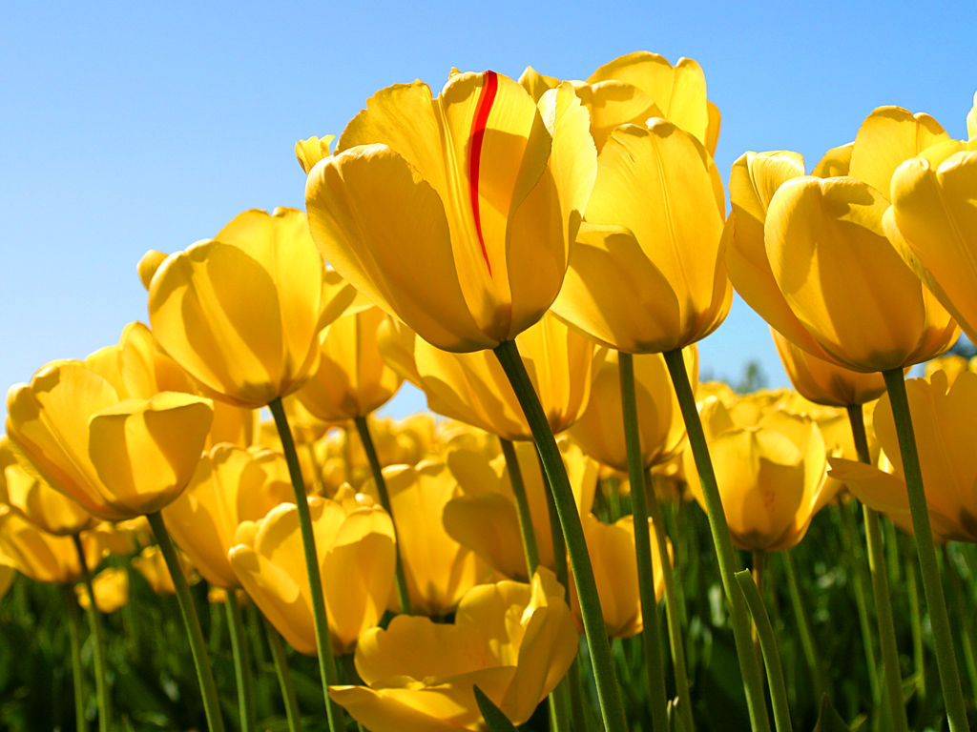
Thank-You

