Slide 1

Govt. Of Maharashtra
Water Resources Department
Review of CADWM Projects Under PMKSY
Name of Project : Krishna Koyna Lift Irrigation Project

Slide 2
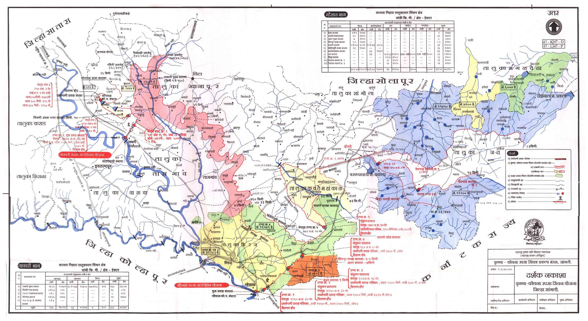
Index Map

Slide 3
Status of CADWM Works
Status -
Status of inclusion under CAD Programme : | Included vide letter no. N19011/29/2017-CADWM Govt. Of India, Ministry of WR, RD & GR, CADWM wing, New Delhi, Dt. 18/08/2017.
2) CCA included in CADWM (Ha) :- a) Proposed CCA (As per DPR) – 86234 Ha.
 | b) CCA Included in CADWM – 52824 Ha
3) Estimated cost of CAD Works | Proposed cost ( As per DPR) - Rs. 204.89 Cr. Approved cost by MoWR - Rs 132.69 Cr. ( CA - Rs. 67.39 CR & S.S.- Rs. 65.30 Cr).
4) Targeted date of CAD Work Completion :- March - 2020
5) Budget for CAD Works for 2017-18 :- Rs. 12.45 Cr.
6) Status of MoU & CA release Proposal . -- Submitted to The Sr. Joint Commissioner (CAD-1), Ministry of Water Resources, RD & GR, New Delhi vide ltr. No.डी.एम/नाग/ कँड/3/23/2017/787-791, dtd.10/10/2017. Released as Ist Installment of Rs. 3.815 Cr. (Out of Total C.A. Rs. 6.37 Cr.) on dtd. 20 Nov. 2017.

Slide 4
Status of CADWM / WUA’s
Status of Award of works
For Survey OFD Works – Takari Part - a) Awarded – Nill b) Under Tendering Process - 2 Nos. ( Area – 12000 Ha.) 2) Mhaisal Part - a) Awarded – 4 Nos. ( Area – 12000 Ha.) b) Under Tendering Process - 2 Nos. ( Area – 28000 Ha.)
Progress of works
Takari Part - Tender process for Survey of OFD Works nearly completed. & formation of WUA’s are in progress. 2) Mhaisal Part - Survey of OFD Works in progress . & formation of WUA’s are in progress.
Status of WUA’s Formation
WUA’s Formation - | Total No. WUA’s | No. of WUA’s formed | Section 1 & 2 | Section 3 | Programme for Formation
 |  |  |  |  | 2017-18 | 2018-19
 | 237 | -- | 237 | 116 | 91 | 146

Slide 5
Programme for CADWM
Area in -th-Hactare , Amount -Rs. in Lakhs.
Sr. No | Activities | Total |  | 2017-2018 |  | 2018-2019 |  | 2019-2020
 |  | Phys. | Finan. | Phys. | Finan. | Phys. | Finan. | Phys. | Finan.
 | l. Structural Interventations
a | Survey, Planning, Design of OFD Works. | 52.824 | 316.94 | 5.520 | 33.16 | 23.240 | 139.40 | 24.064 | 144.38
b | OFD works -
 | ii) Construction of Field Channels by laying of underground pipelines etc. for gravity flow. | 47.544 | 8320.20 | 5.52 | 967.27 | 20.74 | 3628.87 | 21.28 | 3724.07
 | iv) Micro irrigation infrastructure including components of sump, HDPE pipelines & pertinent Devices (Tank Feeding arrangement) | 5.280 | 2640.00 | 0.00 | 0.00 | 2.50 | 1250.00 | 2.78 | 1390.00
 | Total Structural Interventations |  | 11277.14 |  | 1000.43 |  | 5018.27 |  | 5258.45
 | Il. Non Structural Interventations
a | Onetime grant to registered/ elected water user associations (WUAs)
 | i) Functional grant to registered WUAS | 52.824 | 633.89 | 5.52 | 66.32 | 23.24 | 278.84 | 24.06 | 288.73
 | ii) Infrastructure grant to register WUAS | 237.00 | 711.00 | 27.00 | 82.90 | 99.00 | 296.05 | 111.00 | 332.05
b | Formation of WUA's ,Training, demonstration monitoring and adaptive trails (including micro irrigation, water use efficiency increased productivity and sustained irrigation) [actual] | 43.10 | 646.75 | 6.00 | 95.35 | 22.86 | 340.38 | 14.24 | 211.03
 | Total Non Structural Interventations |  | 1991.64 |  | 244.57 |  | 915.27 |  | 831.81
 | Total Non-structural Interventions (correction)
 | Grand Total (I+II) |  | 13268.78 |  | 1245.00 |  | 5933.53 |  | 6090.25
 | IIl. Target Under CADWM (Area in Thousand Ha. ) | 52.824 |  | 5.52 |  | 23.24 |  | 24.064

Slide 6
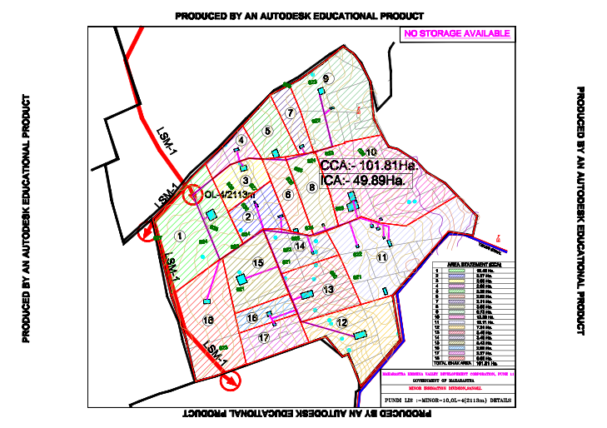

Slide 7
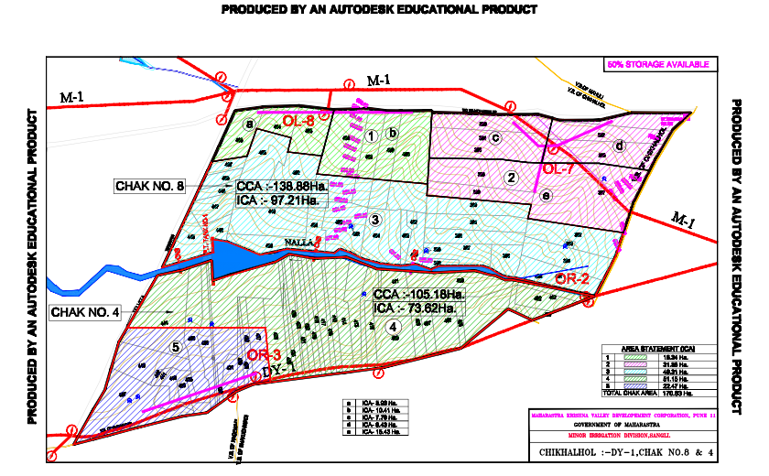

Slide 8
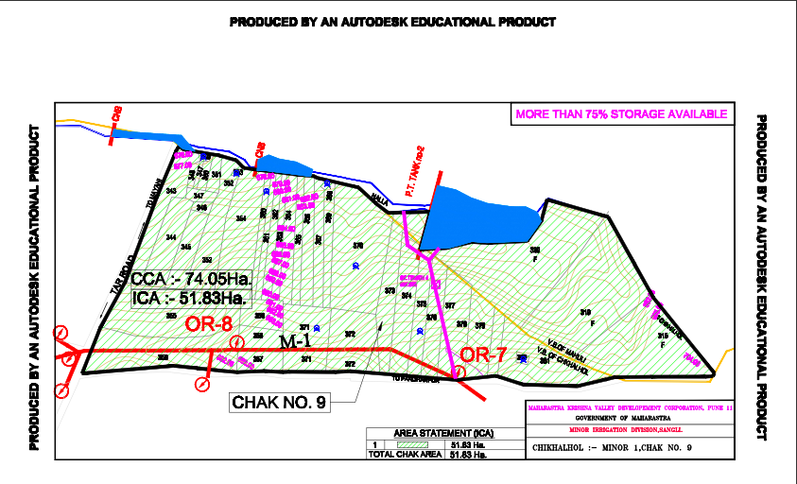

Slide 9
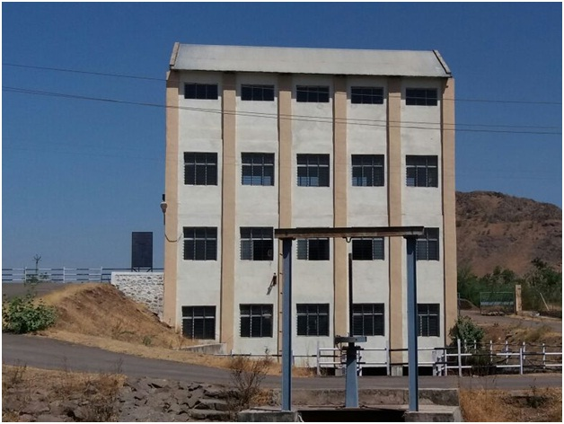
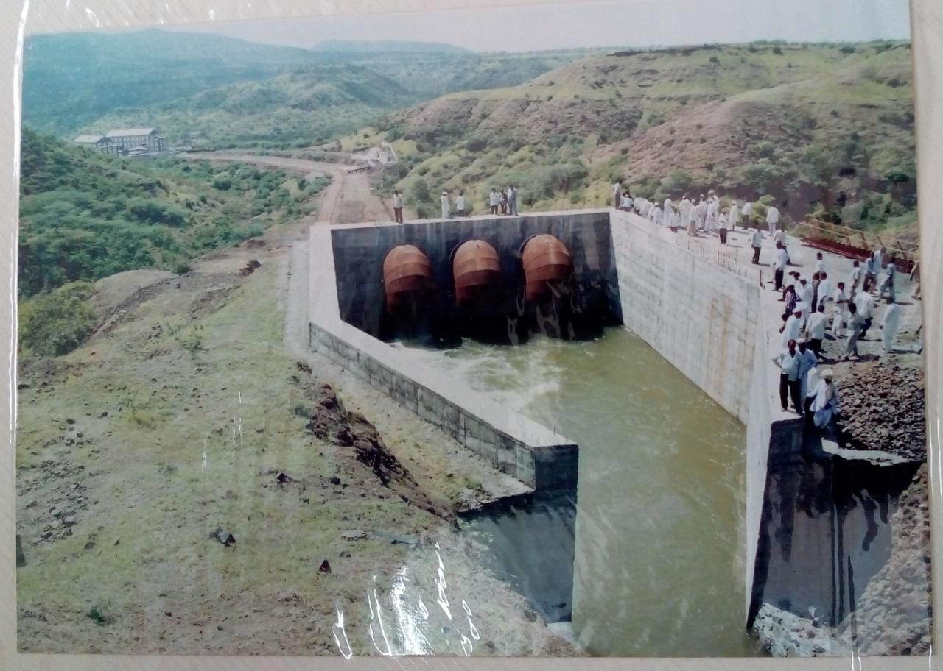
Water released in Canal

Slide 10
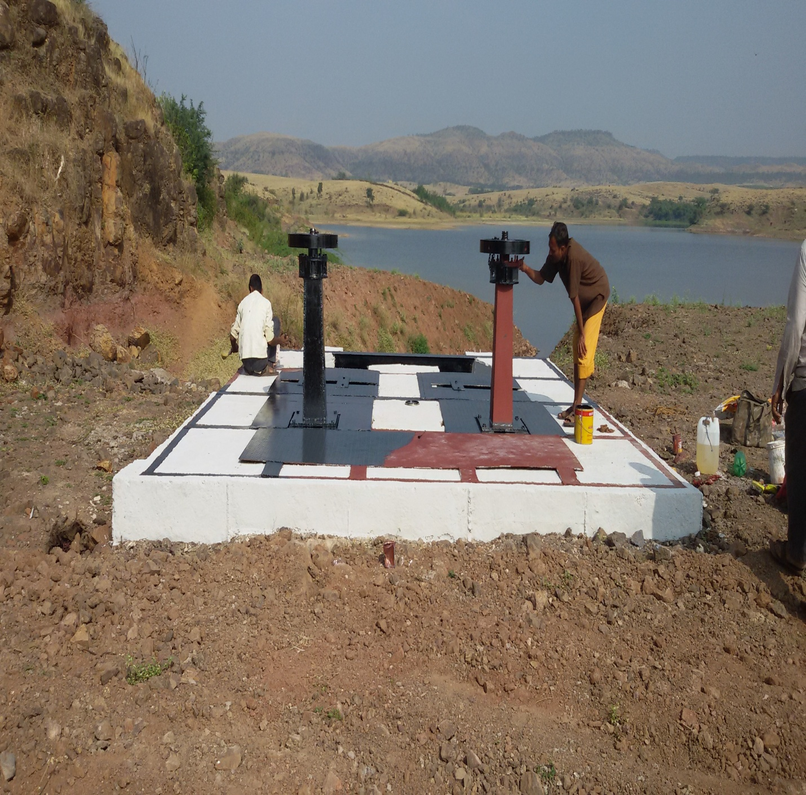
PDN works – Intake Chamber

Slide 11
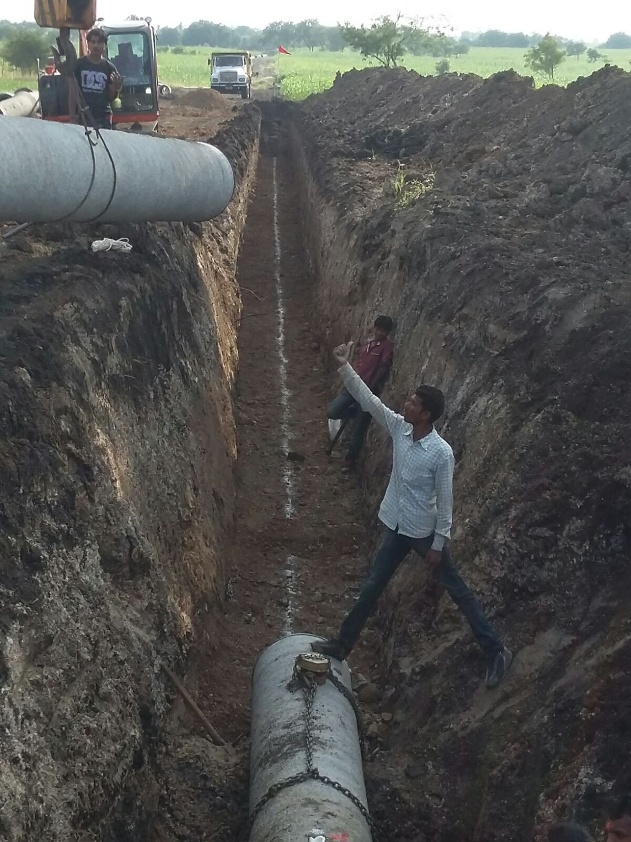
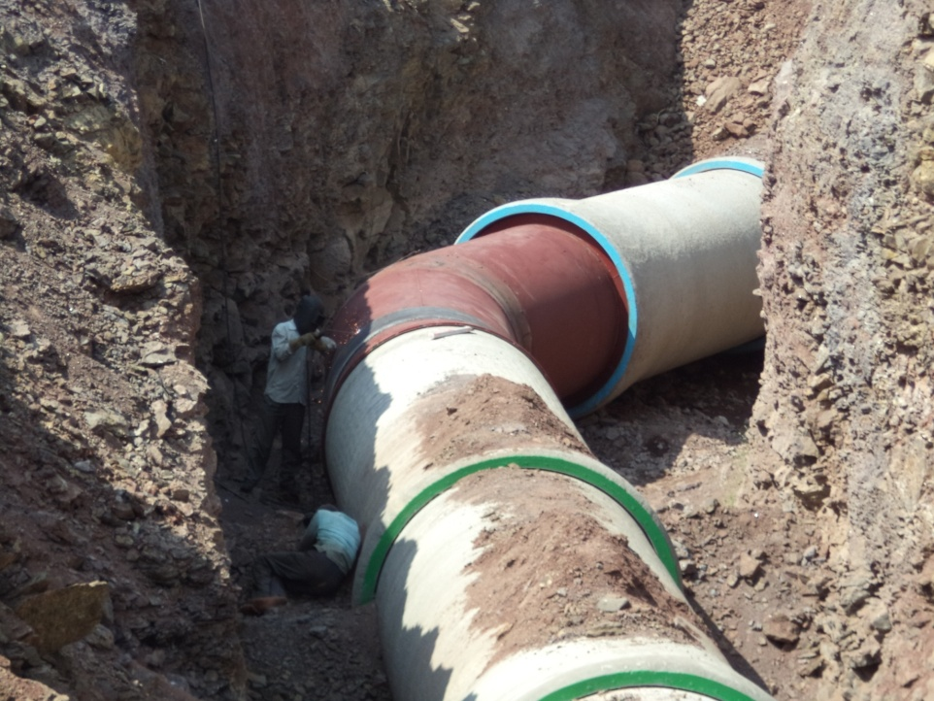
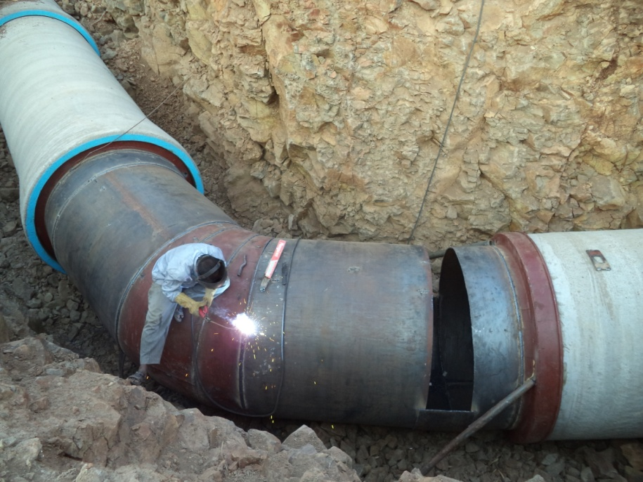
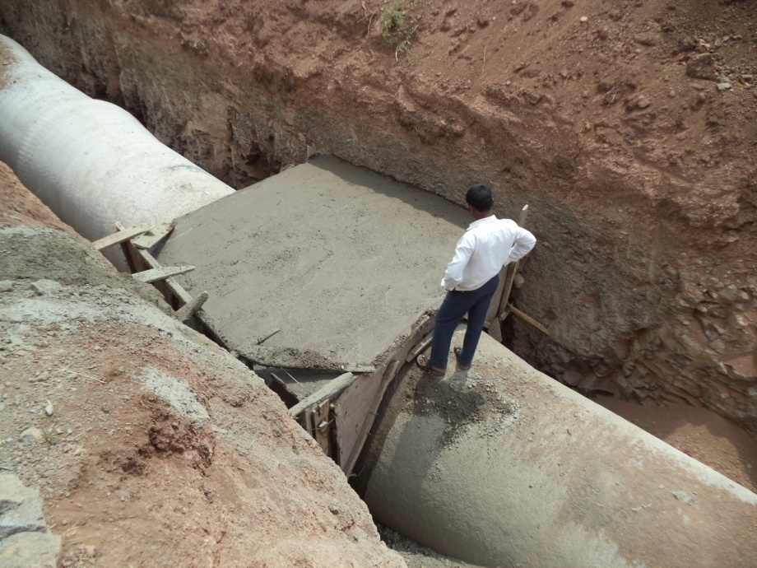
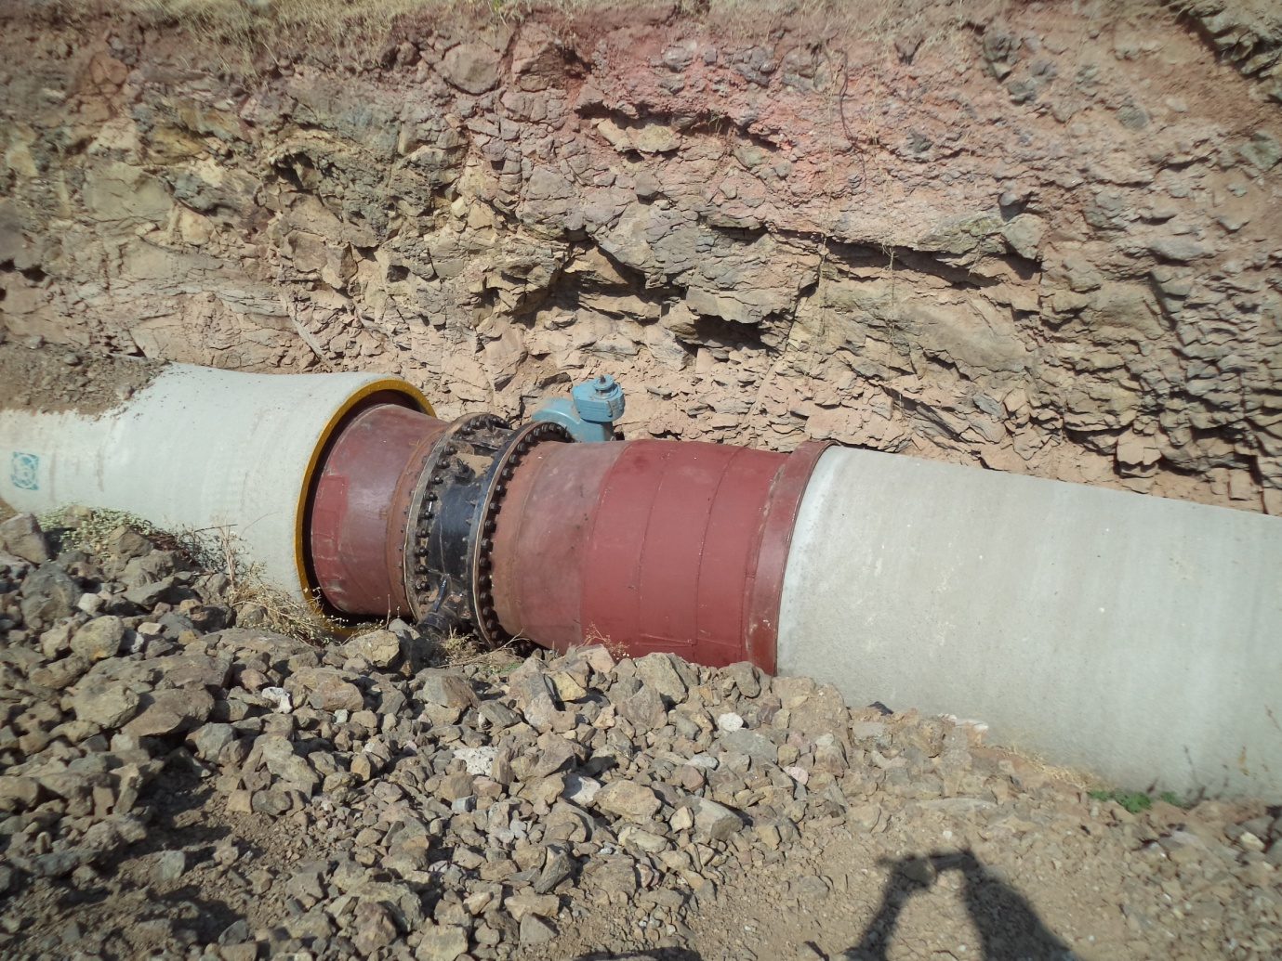
Progress of PDN Works

Slide 12
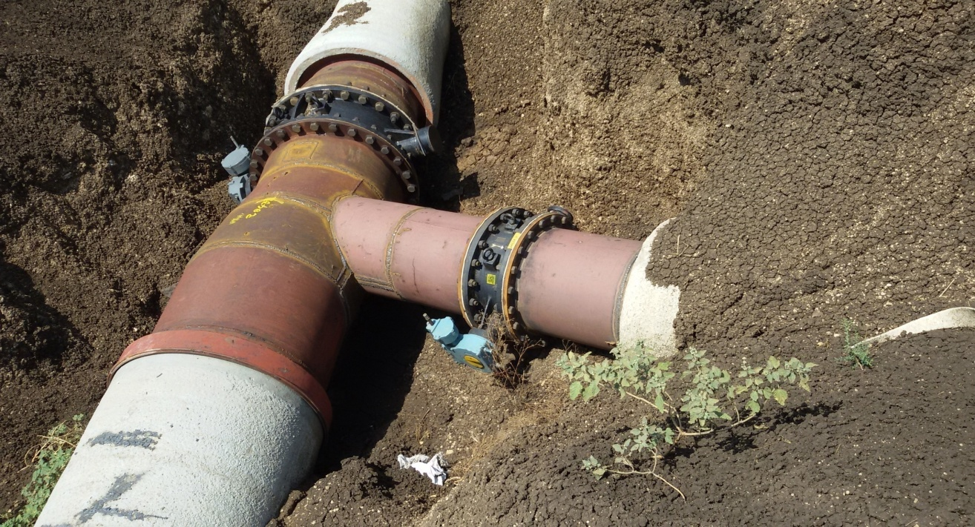
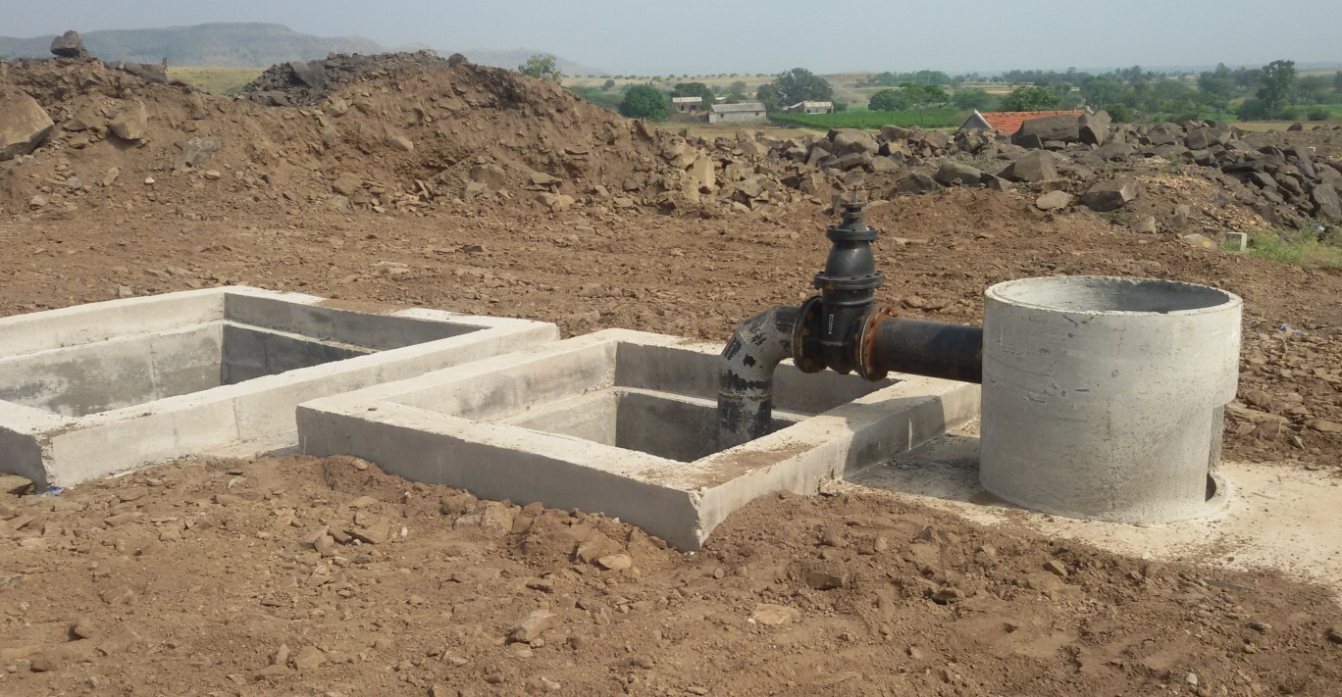
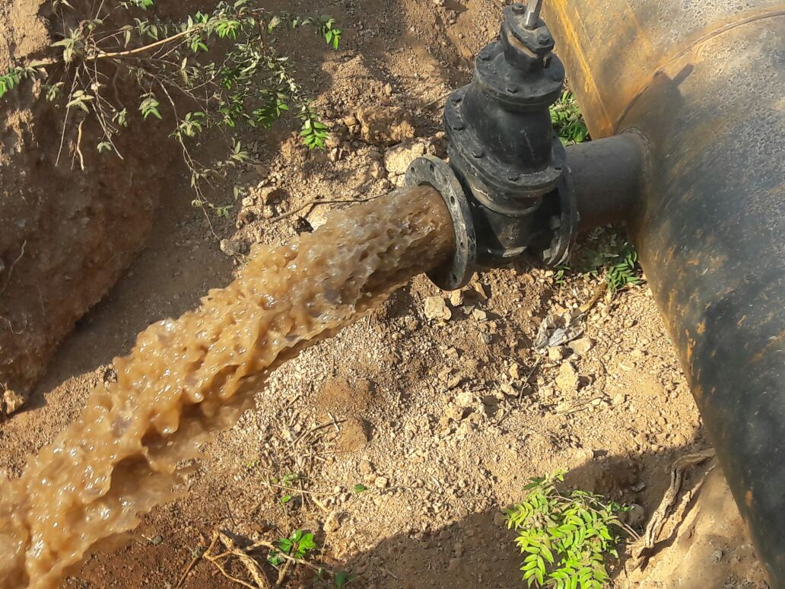
PDN Works –
Pipe Joints & Outlet with Valve

Slide 13
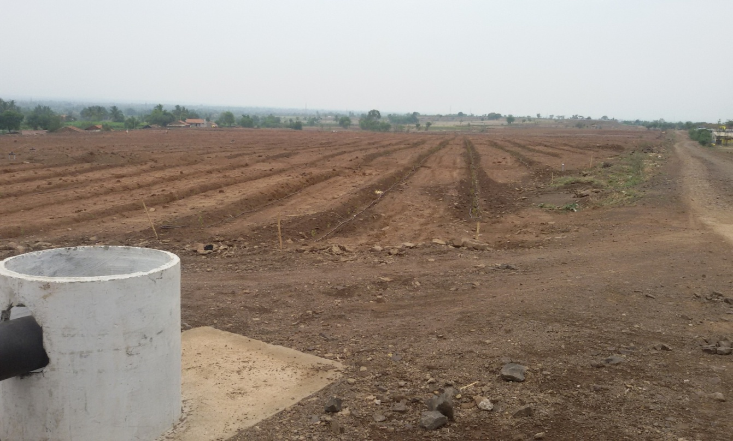
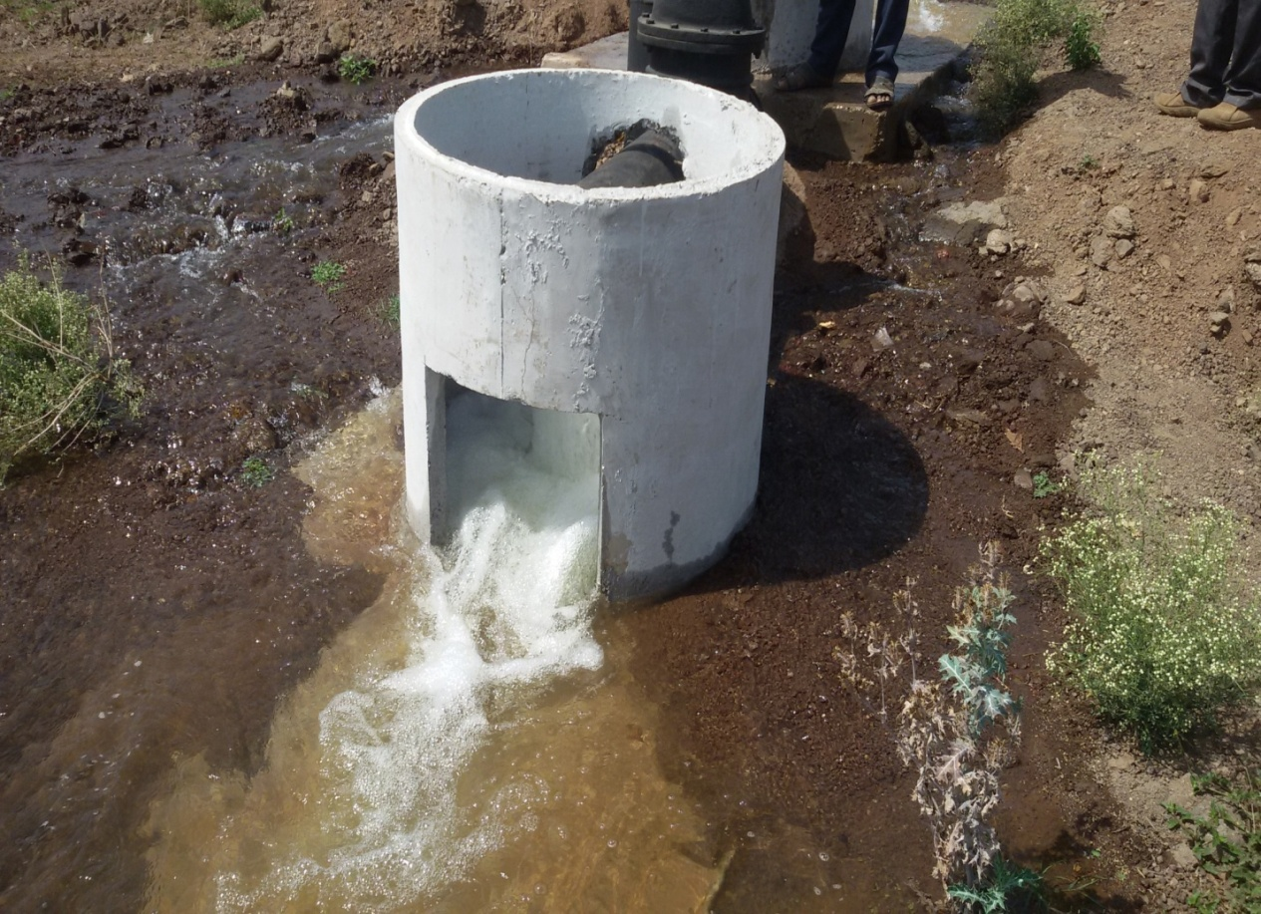
Outlet Position
& released water through outlet

Slide 14
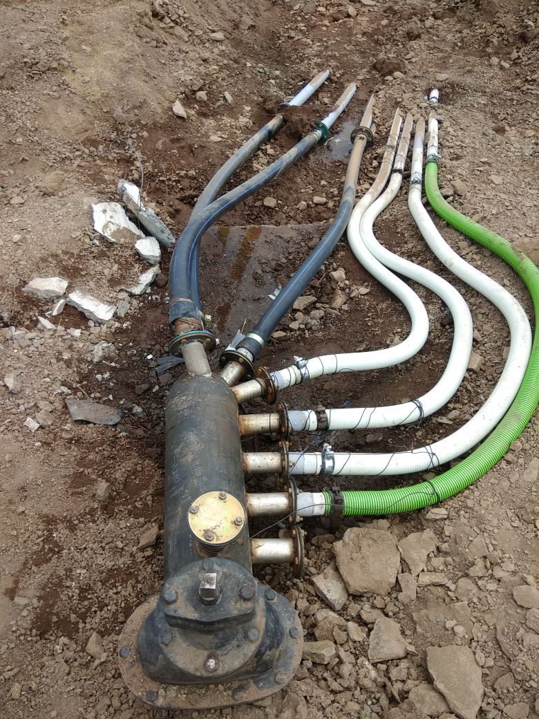
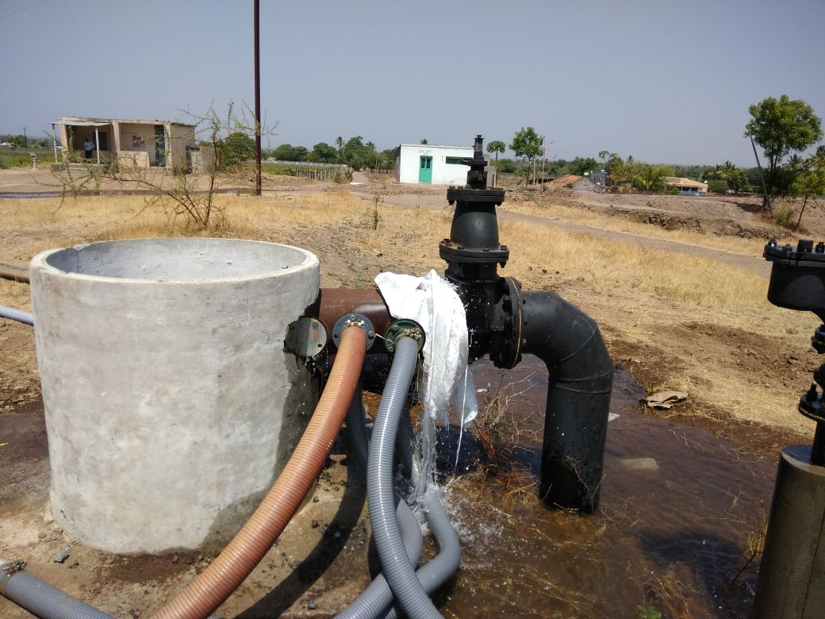
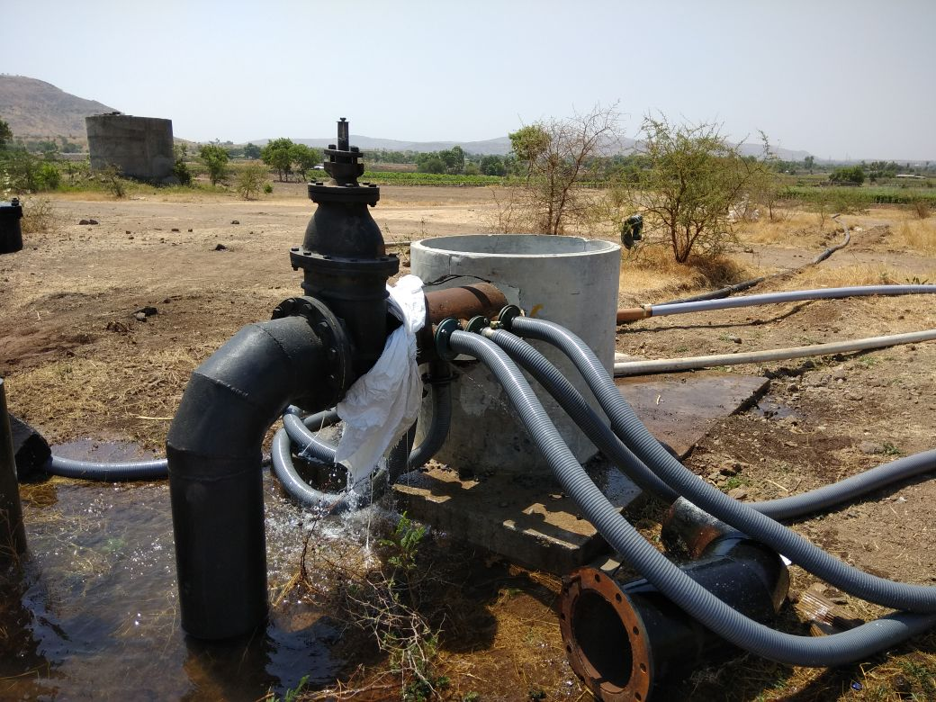
Arrangement for feeding Field Tanks
(Done by Farmers)

Slide 15
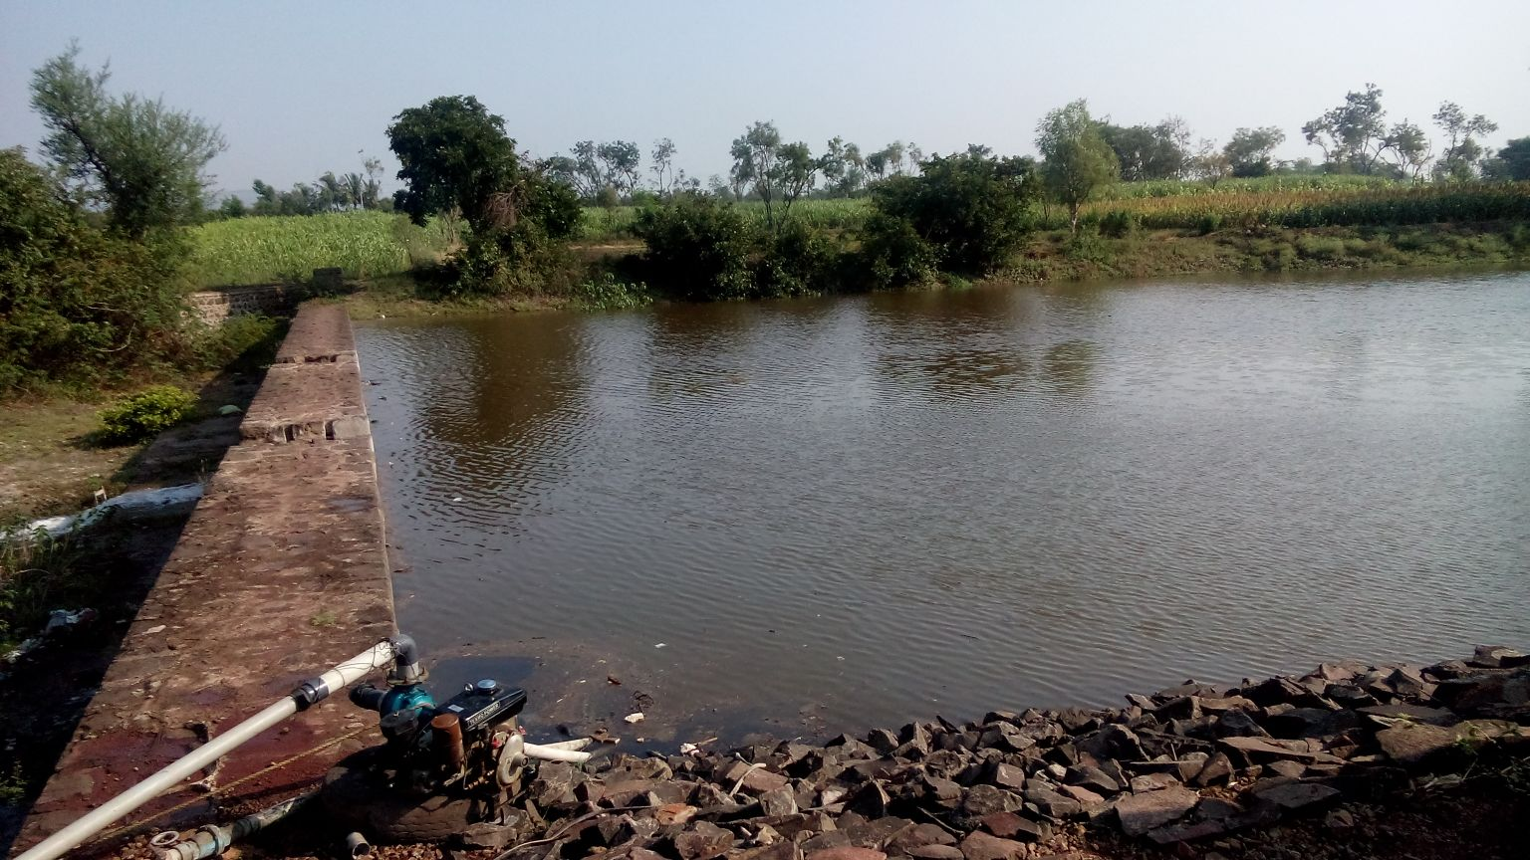
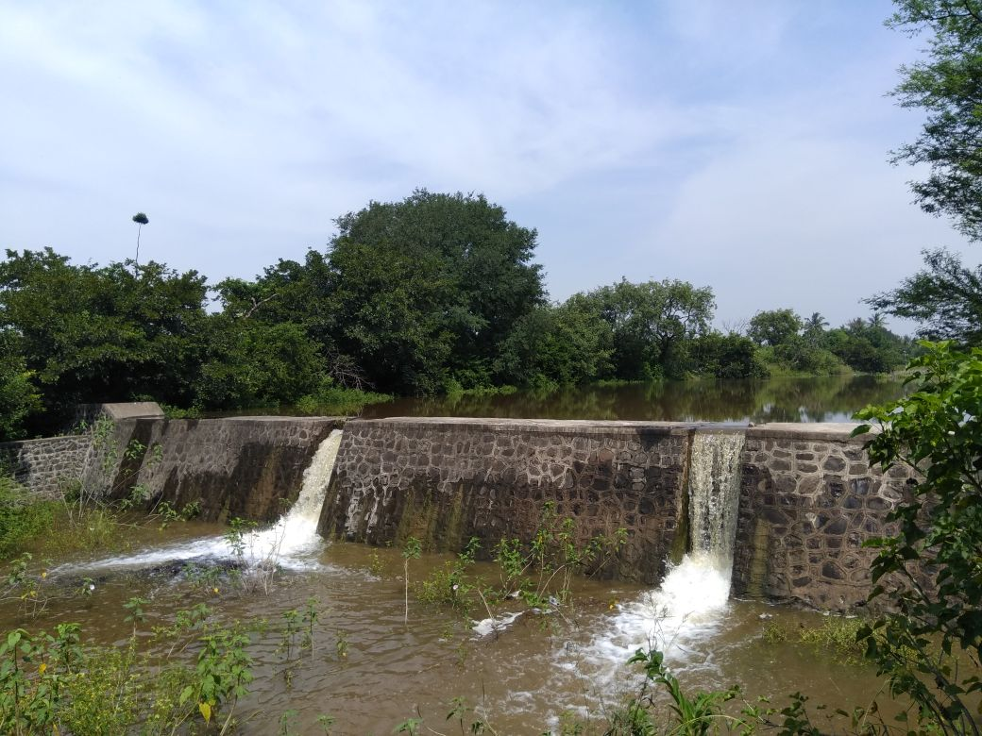
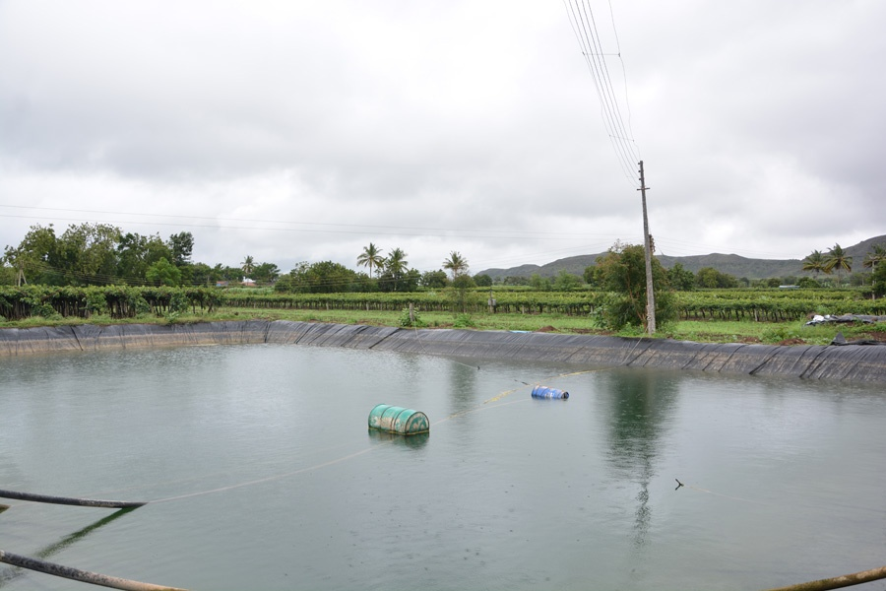
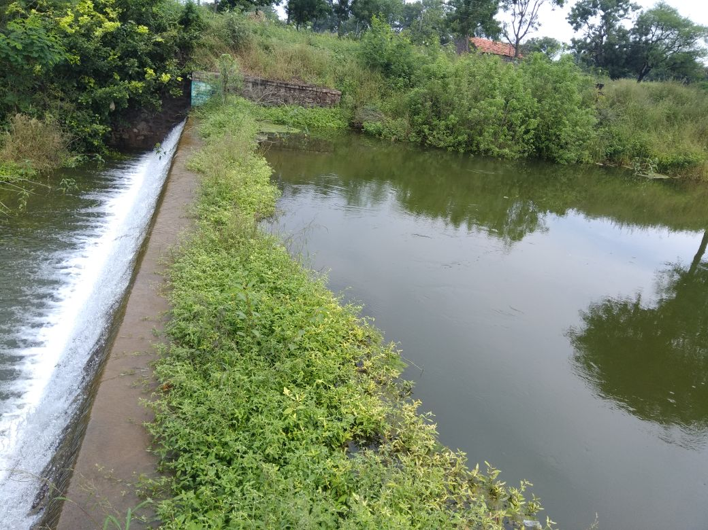
Feeding Fields Tanks / Nalla Bandhre in Command area of Project

Slide 16
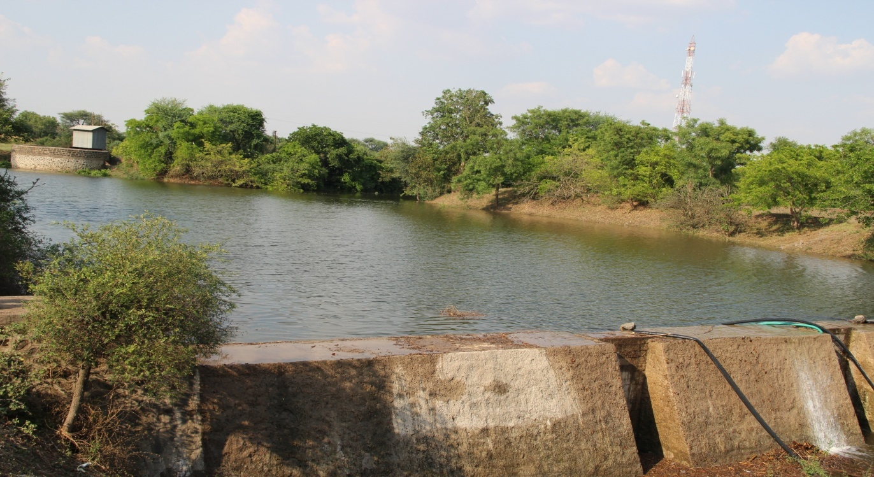
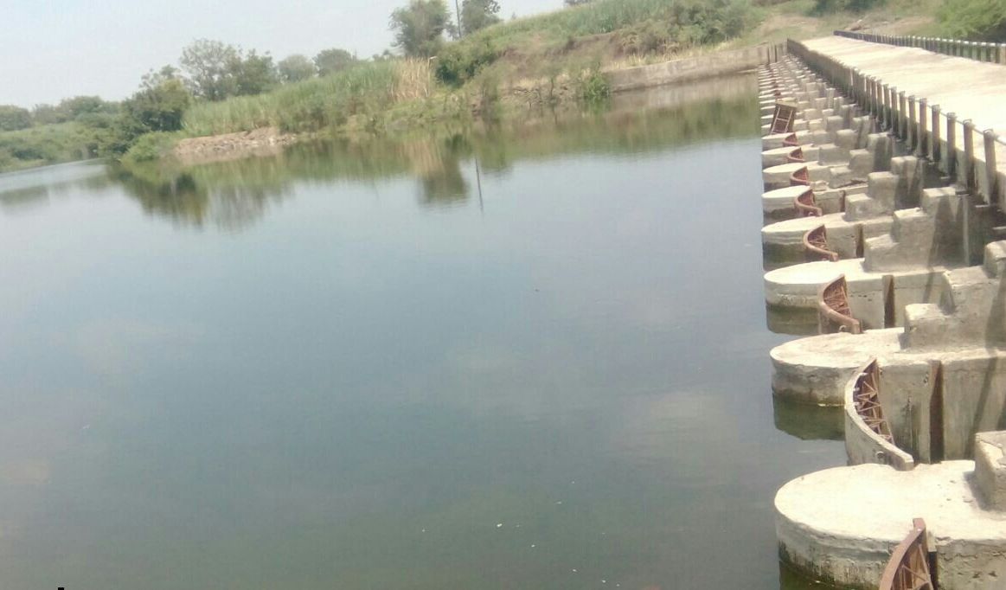
Feeding K.T. Weirs & Vasant Bandhre in Command area of Project

Slide 17

Thank You.

