Slide 1

COMMAND AREA DEVELOPMENT AND WATER MANAGEMENT (CADWM)
PROGRAMME IMPLEMENTATION
UNDER PMKSY
जल ईश्वर का दिया अमूल्य वरदान है।
T. D. SHARMA
Ministry of Water Resources, River Development & Ganga Rejuvenation
13th March 2018

Slide 2
PMKSY- Status of CADWM Projects:
99 prioritised AIBP Projects have been identified for completion in Mission mode under PMKSY along with the ‘Command Area Development (CAD)’ works. Out of 99 projects, CAD works are not required in 9 projects, as intimated by state governments. As of now, 82 projects targeting CAD works in balance Culturable Command Area (CCA) of 42.40 lakh hectares have been included under CADWM programme with an estimated Central Assistance (CA) of Rs. 8077.874crores.

Slide 3
CADWM: 99 Prioritized Projects of AIBP
Structural Intervention: includes Survey, Planning, Design and execution of:
On-Farm Development (OFD) works comprising field channels, micro-irrigation, land leveling, as required
Construction of field, intermediate and link drains
Reclamation of Waterlogged Areas
Correction of System Deficiencies (up to 4.25 cumecs)
Non-Structural Intervention: Activities directed at strengthening of PIM, including:
One time functional grant to Water Users’ Associations (WUAs) – Rs. 1200 per hectare
One time infrastructure grant to WUAs – Rs. 3 lac
Trainings, demonstration and adaptive trials

Slide 4
Status - Contd..
Sl. No. | Name of State | No. of prioritized projects | Included/ deemed completed | Pending for inclusion | As per Cabinet Note |  | As per Project Inclusion
 |  |  |  |  | CCA (th.ha) | CA in Cr. | CCA (th.ha. ) | CA in Cr.
1. | Andhra Pradesh | 8 | 5(+1) | 2 | 261.87 | 523.65 | 143.558 | 278.98
2. | Assam | 3 | 2 | 1 | 121.232 | 242.45 | 48.27 | 55.56
3. | Bihar | 2 | 1 | 1 | 35.67 | 71.35 | 32.467 | 74.288
4. | Chhattisgarh | 3 | 3 | 0 | 47.63 | 95.25 | 42.625 | 79.58
5. | Goa | 1 | 1 | 0 | 8.791 | 17.6 | 11.777 | 68.96
6. | Gujarat | 1 | 1 | 0 | 1680.5 | 3361 | 1363.859 | 2510.883
7. | J&K | 4 | 3(+1) | 0 | 8.891 | 17.75 | 2.46 | 11.639
8 | Jharkhand | 1 | 0 | 1 | 236.848 | 473.7 | … | ….
9. | Karnataka | 5 | 4 | 1 | 242.533 | 485.05 | 69.219 | 116.33
10. | Kerala | 2 | 1 | 1 | 37.75 | 75.5 | 19.237 | 48.71
11. | Madhya Pradesh | 14 | 14 | 0 | 806.849 | 1613.7 | 573.74 | 1347.74
12. | Maharashtra | 26 | 22(+4) | 0 | 759.697 | 1519.375 | 550.847 | 1019.421
13. | Manipur | 2 | 2 | 0 | 28.99 | 58 | 22.036 | 61.357
14. | Odisha | 8 | 8 | 0 | 293.773 | 587.55 | 236.398 | 419.4
15. | Punjab | 2 | 0(+2) | 0 | 32.43 | 64.86 | 0 | 0
16. | Rajasthan* | 2 | 2 | 0 | 291.574 | 583.15 | 44.875 | 115.3
17. | Telangana | 11 | 11 | 0 | 585.103 | 1170.206 | 554.312 | 943.726
18. | Uttar Pradesh** | 4 | 2(+1) | 1 | 1502.913 | 3005.75 | 524.381 | 926
 | Total | 99 | 82 (+9) | 8 | 6983.044 | 13965.89 | 4240.061 | 8077.874
* For Narmada Project only non Structural Interventions Included, ** 2 Projects of UP are under process for inclusion

Slide 5
CADWM: Frontal States with 80% (physical/ financial) coverage in 99 Projects Scheme
Frontal States:
Total 10, out of 18 States
Slow performance: Telangana, U.P
Non-starter:Jharkhand

Slide 6
PMKSY- Status of CADWM Projects - Contd..

Slide 7
PMKSY- Status of CADWM Projects - Contd..

Slide 8
Physical & Financial Progress of CADWM works
The CA of Rs 853.95 Crore was released during 2016-17 targeting CAD works in CCA of 5 lakh hectare. States have reported physical progress of 4.80 lakh hectare during 2016-17 as per Utilisation Certificates submitted by them.
During 2017-18 CA amounting to Rs 601.6 Crores have been released and proposals for CA release of 332.08 Crore are under process, totaling to Rs 933.674 Crore for a target CCA of 6.21 lakh hectare.
Overall, for the 82 included projects, 22% of the estimated Central Assistance has been released; Works are completed in 11% of CCA, while it is under progress in another 15% of the target area.

Slide 9
Physical & Financial Progress of CADWM works- contd.
Sl. No | Name of State | As per Project Inclusion |  | Financial (CA in Rs. Crore) |  |  |  |  | Physical (CCA in Th.ha)
 |  | CCA (th.ha. ) | CA in Cr. | 2016-17 | 2017-18 |  |  | % progress of CA | 2016-17 (based on UC) | 2017-18 (Target) | % Physical progress
 |  |  |  |  | Relea-sed | Under Process | Total
1. | Andhra Pradesh | 143.558 | 278.98 | 0 | 3.645 | 0.000 | 3.645 | 1.3 | 0.000 | 5.830 | 4.1
2. | Assam | 48.27 | 55.56 | 0 | 0 | 3.550 | 3.550 | 4.0 | 0.000 | 3.254 | 6.7
3. | Bihar | 32.467 | 74.288 | 12.643 | 8.765 | 0.000 | 8.765 | 38.5 | 2.240 | 18.278 | 63.2
4. | Chhattisgarh | 42.625 | 79.58 | 0 | 9.941 | 11.400 | 21.340 | 26.8 | ….. | 20.550 | 0.0
5. | Goa | 11.777 | 68.96 | 0 | 0 | 0.000 | 0.000 | 0.0 | ….. | 0.000 | 0.0
6. | Gujarat | 1363.859 | 2510.883 | 681.644 | 414.286 | 276.190 | 690.470 | 54.6 | 385.282 | 395.049 | 57.2
7. | J&K | 2.46 | 11.639 | 0 | 0 | 0.000 | 0.000 | 0.0 | ….. | 0.000 | 0.0
8 | Jharkhand | … | …. | 0 | 0 | 0.000 | 0.000 | 0.0 | ….. | 0.000 | 0.0
9. | Karnataka | 69.219 | 116.33 | 31.426 | 0 | 15.240 | 15.240 | 40.1 | 4.780 | 13.197 | 26.0
10. | Kerala | 19.237 | 48.71 | 0 | 0 | 0.000 | 0.000 | 0.0 | ….. | 0.000 | 0.0
11. | Madhya Pradesh | 573.74 | 1347.74 | 77.794 | 102.785 | 0.000 | 102.785 | 13.4 | 71.821 | 75.947 | 25.8
12. | Maharashtra | 550.847 | 1019.421 | 15.174 | 19.97 | 13.370 | 33.340 | 4.8 | ….. | 40.317 | 0.0
13. | Manipur | 22.036 | 61.357 | 0 | 0 | 0.000 | 0.000 | 0.0 | ….. | 0.000 | 0.0
14. | Odisha | 236.398 | 419.4 | 35.276 | 39.728 | 12.330 | 52.060 | 20.8 | 9.367 | 36.447 | 19.4
15. | Punjab | 0 | 0 | 0 | 0 | 0.000 | 0.000 | 0.0 | ….. | 0.000 | 0.0
16. | Rajasthan* | 44.875 | 115.3 | 0 | 2.479 | 0.000 | 2.479 | 2.2 | 6.863 | 12.500 | 43.1
17. | Telangana | 554.312 | 943.726 | 0 | 0 | 0.000 | 0.000 | 0.0 | ….. | 0.000 | 0.0
18. | Uttar Pradesh | 524.381 | 926 | 0 | 0 | 0.000 | 0.000 | 0.0 | ….. | 0.000 | 0.0
 | Total | 4240.061 | 8077.874 | 853.956 | 601.599 | 332.080 | 933.674 | 22.1 | 480.353 | 621.369 | 26.0

Slide 10
Financial Progress of CADWM works- contd.

Slide 11
Financial Progress of CADWM works- contd.

Slide 12
Monitoring of CADWM works
CAD cells of CWC have undertaken Monitoring visits to 19 CAD projects under PMKSY during 2017-18
Project Monitoring Unit (PMU) have undertaken Monitoring visits to 41 Projects under PMKSY during 2017-18
Two meetings of the Project Implementation Review Committee (PIRC), have been held during 2017-18 (Bhubaneshwar- April, 2017; Shivpuri- November, 2017)
Ho’nble Minister, WR took 5 review meetings of PMKSY Projects of various states at Delhi, Mumbai and Nagpur during 2017-18 with focus on CAD implementation.
During 2017-18, Secretary WR has taken 3 review meetings with different states by video-conferencing and 4 review meetings at Delhi to monitor progress of PMKSY Projects including CADWM works.
Command Area Development & Water Management Information System (CADWM-IS) has become operational. State-Nodal and Project-Nodal Officers have been identified and role based activities initiated. Including the Central-Nodal Officers, a total of 210 user-IDs have been activated.
MIS Data has been captured for about 38 projects and information/ analysis in respect of these projects is available on Dashboard. Scope of CADWM-IS is also being enhanced for facilitating CA release process.

Slide 13
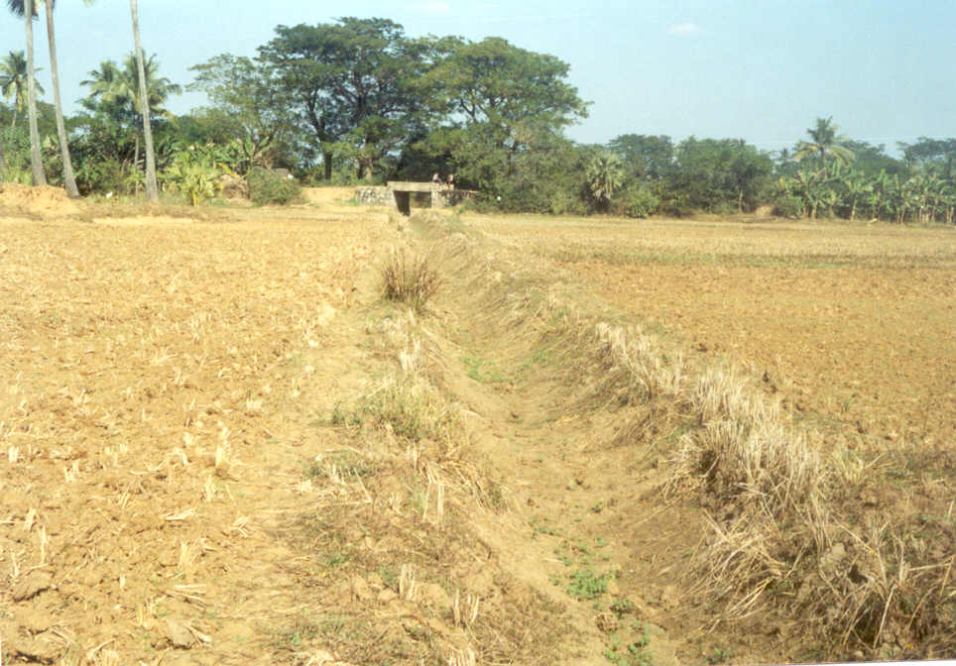
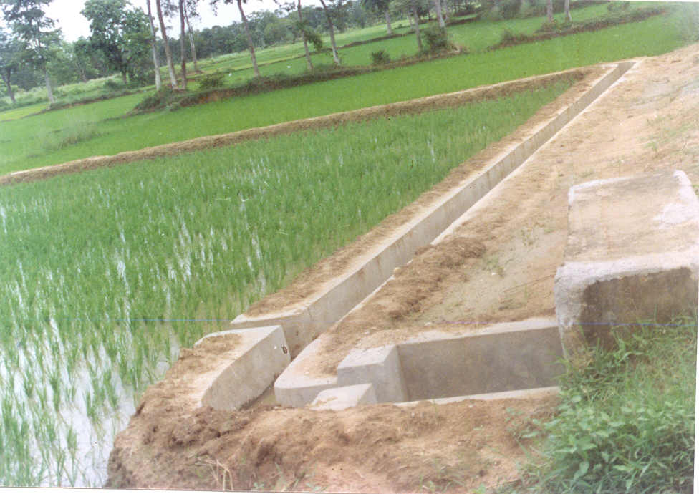
Field Channels

Slide 14
CADWM Progress- Reasons for Delay
Lag in progress of AIBP components delaying the hydraulic connectivity.
Issues of defects in existing canal networks of the old projects.
Insufficient budgetary allocation by state governments.
Small contract packages for CAD works, mostly done through WUAs.
Slow pace in creation of WUAs and implementation of non-structural interventions.
Measures Undertaken
Measures being taken to expedite progress of AIBP components; linked progress of CAD works likely to pick momentum.
State governments advised to take up large contract packages. The Guidelines tailored to encourage large contract packages.
State government have been repeatedly advised to keep sufficient budgetary provisions.
States governments advised to take up underground pipe network, wherever feasible.
States are encouraged to take advantage of cross-learning through meetings, field visits, and projection of success stories. .

Slide 15
Command Area Development & Water Management Information System (CADWM-IS)
Brief Overview
जल ईश्वर का दिया अमूल्य वरदान है।

Slide 16
INTRODUCTION
CADWM-IS is a comprehensive integrated and user-friendly software for capturing and monitoring the progress of CADWM projects, analysis of project Information and long term archiving of project data. CADWM-IS has been developed with a view to help project officials in easy online recording of the voluminous project data including outlet wise kulawa details, details of contract packages, details of Water Users’ Association, and time series data of projects physical/ financial progress.

Slide 17
Role Management
The Role Management permits the authorization of different users for accessing the specific features/ resource of the program. The five fold roles, which can be administered in a cascading manner, includes: Administrator to control whole application; create Central and State nodal users. Central Nodal to view/edit the details/data of specific State and the projects therein. State Nodal to view/edit the details/data of his/ her State and the projects therein. Project Nodal to enter the details/ data of the specific project(s) assigned to the user. General User is like a guest user who can be created by any of the Central/ State/ Project Nodal. He/ She can only view the data within the domain of the concerned nodal.

Slide 18
Modular Framework
CADWM-IS provides a sound framework for gathering and dissemination of information in a modular manner covering: Physical and financial progress of Structural Intervention Physical and financial progress of Non-Structural Intervention Monitoring Visits’ observation and follow-up compliance. Financial audit and its compliances Cascading administration of authorized users Archiving of important project documents and project/ event photographs

Slide 19
Report Generation
Reports communicate formatted information compiled from the desired analysis of data. Different types of Reports presently available in the Application are: Physical Progress of Structure Intervention and Non-Structure Intervention Financial Progress of Structure Intervention, Non-Structure intervention and Establishment cost Monitoring visits observation and compliance Reports Financial Audit and Compliance Reports Reports containing abstracts of Project, details, Completed Outlets, No of WUAs created, Districts benefitted etc.

Slide 20
CADWM-IS UPGRADATION
The CADWM-IS is being upgraded to include tools for: submission of proposals for Central Assistance(CA) by State Govts, recommendations by CWC Regional Offices, processing of CA release by the Union Ministry/ NWDA. Further enhancement of CADWM-IS is expected to cover capturing of Water Users’ Association’s working, crop production/ productivity, farmers’ income etc.

Slide 21
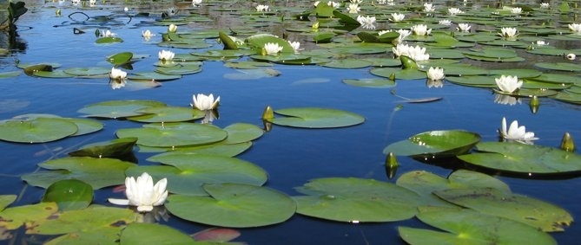
THANK YOU

