Slide 1
Conference on Command Area Development
MINISTRY OF WATER RESOURCES, RIVER DEVELOPMENT AND GANGA REJUVENATION 13-3-2018

Slide 2
Challenges - Irrigation Sector:
Promotion of Convergence, Expansion of Cultivable Area, Water Management, Water Use Efficiency
Water: finite resource and main input for agriculture; Canal irrigation efficiency India - 25 %; Israel, China, Japan - 60 %.
Large gaps between Irrigation Potential Created (IPC) and Irrigation Potential Utilized (IPU).
Poorly maintained Irrigation assets: require huge investments
65% of Irrigated area is dependent on Ground Water which is rapidly depleting – unsustainable
Reforms urgently required for efficiency improvement: participatory irrigation management (PIM); transfer of assets to Water User’s Association (WUA); delivery through pipes; micro irrigation; change in cropping and consumption pattern etc.
Demand management key to water sector reforms.

Slide 3
Pradhan Mantri Krishi Sinchayee Yojana
Promotion of Convergence, Expansion of Cultivable Area, Water Management, Water Use Efficiency
AIBP
HKKP
CAD MoWR,RD&GR
SMI
RRR
Per Drop more Crop – Micro Irrigation (DAC&FW)
Watershed Development (DoLR)

Slide 4
Pradhan Mantri Krishi Sinchayee Yojana
Component | Potential/ CCA (Lakh Ha.) | Outlay (Rs. Crore)
2015-16 to 2019-20
AIBP | 7.5 | 11060
CAD | 15 | 9050
GW/RRR/SMI | 6
MICRO IRRIGATION | 100 | 16300
WATERSHED DEVELOPMEMNT | 11.5 | 13590

Slide 5
99 ongoing projects with CAD – completion by 2019 with Long Term Irrigation Fund (LTIF) in NABARD
Category | No. of Projects | Fund required for completion (Rs. in crore) |  |  | Central Share (Rs. in crore) | Irrigation Potential Utilisation (Lakh Ha.)
 |  | AIBP | CAD | TOTAL
Priority-I projects (Completion by 3/2017) | 23 | 7956 | 5466 | 13423 | 6535 | 14.53
Priority-II projects (Completion by 3/2018) | 31 | 8080 | 4825 | 12905 | 4269 | 12.95
Priority-III projects (Completion by 12/2019) | 45 | 32510 | 18757 | 51268 | 20538 | 48.55
TOTAL | 99 | 48546 | 29049 | 77595 | 31342 | 76.03
5
Notes:
5

Slide 6
Progress of Prioritized Projects- AIBP
S.No. | % Progress | Progress (Dec,16) | Present Progress
 |  |  | Total
1 | Completed | 2 | 18
2 | 90 and above | 21 | 24
3 | 80 to < 90 | 25 | 19
4 | 70 to < 80 | 13 | 8
5 | 60 to < 70 | 12 | 15
6 | < 60 | 33 | 22
 | Total | 106* | 106*
*99 Projects and 7 Phases

Slide 7
Monitoring & Review of projects
S. No. | Item | 2016-17 | 2017-18
1 | Monitoring by CWC/NITI Aayog/NABARD/PMU through field visits | 200+ | 180+
2 | Review at Ministers Level | Oct.,16. & Nov.,16 | May, 17/Oct 24-25/Nov,17/Feb,18
3 | Review at Secretary Level | Regular Review (with all States-Sept,16 & Feb,17) | (Video Conferencing /meetings with States/CWC - April, 17, July, 17, 7th Sept,17, Feb,18)
4 | Review by PMKSY Council | Oct.,16. | May,17
5 | Review in Jal Manthan-4 |  | 28-07-17
Progress reviewed by PS to PM (3-11-2016 , 17-3-2017, 4-8-17, 10-10-17 & 04-11-17) and Hon’ble PM also reviewed the progress (30-3-2017).

Slide 8
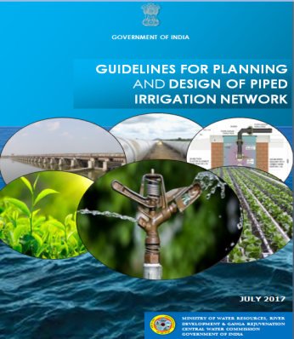
INNOVATIVE MEASURES
Adoption of Piped Distribution Network (PDN) to reduce the Land Acquisition.
Guidelines for Piped Irrigation Network prepared and circulated to the States
Workshop on the “ Use of Large Diameter Pipelines for Mega Water Conveyance Projects” held on 09.03.2017
Special Provision for RR by Maharashtra (Goshikhurd & Nandur Projects) and for faster land acquisition by Odisha.
MIS Dashboard fully functional. State/ CWC nodal officers for each project identified and all user IDs are active.
.
In Odisha & Maharashtra, Land acquisition of 2970 ha & 2060 ha avoided in distribution system by adopting underground PDN- Appx cost saving- Rs. 1050 cr. MP also using PDN extensively.

Slide 9
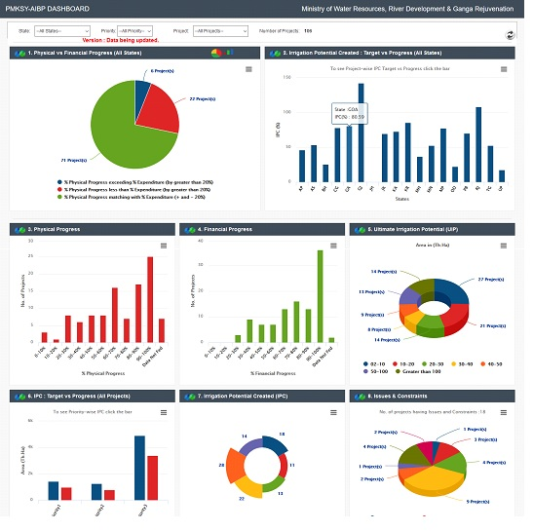
PMKSY-AIBP Dashboard

Slide 10
Development of Remote Sensing Tools
Details of 99 prioritized projects delineated on GIS platform.
Digitisation of canal network of the projects (works completed, in progress and planned) through available google/sentinal/NRSA imageries for all 99 projects completed through BISAG.
Drone Monitoring and mapping the progress of Lower Dudhana project (Mah.) on GIS platform initiated as Pilot project.
Cropped Area Estimation for 2016 for each of the project through remote sensing completed and for 2017 in advanced stage.

Slide 11
Overall Funds released during 2016-17 & 2017-18
Sr. No. | Item | Funds Released (Rs in cr.)
 |  | 2016-17 | 2017-18
1 | AIBP | 3308 | 1438.1*
2 | CAD | 854 | 579.2*
3 | Polavaram Project | 2514 | 2000.0
4 | State Share from LTIF | 3334 | 4276.4*
 | Total | 10010 | 8293.7
Release of CA of Rs. 1540 Cr under AIBP , Rs. 355 Cr. under CAD and State Share of Rs. 450 Cr. under process.

Slide 12
Stage-I (AIBP component) Completion-June,2017
Sl. No. | State | No. of Project | Ultimate Irrigation Potential (Th. Ha.)
1 | Andhra Pradesh | 1 | 1.42
2 | Chhattisgarh | 2 | 24.82
3 | Karnataka | 1 | 13.8
4 | Madhya Pradesh | 3 | 41.04
5 | Maharashtra | 4 | 92.02
6 | Odisha | 2 | 93.6
7 | Punjab | 2 | 91.95
8 | Telangana | 3 | 9.72
Total cropped area from 99 projects assessed as 32.5 L. ha. Additional Potential Creation : 5.00 L. Ha.

Slide 13
28 more projects anticipated for completion by June,18
S.No. | State Name | No. of Projects | Balance cost (AIBP) as on 1.4.2016 | Balance CA admissible | CA released under AIBP during 2016-17 | CA released/ ready under AIBP during 2017-18 | Targeted Irrigation Potential (Th. Ha.)
1 | Andhra Pradesh | 6 | 502.823 | 55.567 | 7.40 | 11.79 | 251.87
2 | Assam | 2 | 242.36 | 40.51 | - | - | 111.37
3 | Karnataka | 1 | 66.72 | 44.49 | 22.44 | - | 24.29
4 | Madhya Pradesh | 4 | 650.00 | 217.85 | 122.65 | 11.84 | 312.07
5 | Maharashtra | 4 | 1402.08 | 106.49 | 68.61 | 12.04 | 74.35
6 | Odisha | 3 | 1275.75 | 424.59 | 182.47 | 178.78 | 58.20
7 | Rajasthan | 2 | 718.92 | 459.90 | 45.89 | 108.44 | 315.57
8 | Telangana | 5 | 1256.61 | 215.66 | 72.16 | 13.24 | 280.31
9 | Uttar Pradesh | 1 | 487.60 | 143.51 | 64.64 | 63.36 | 150.13
 | TOTAL | 28 | 6602.80 | 1708.57 | 586.26 | 399.49 | 1578.20

Slide 14
PMKSY-AIBP State performance
High Performing: Gujarat, Maharashtra, Odisha, Punjab,
Medium Performing: M.P., Jharkhand, Chhattisgarh, Rajasthan, Karnataka, A.P. Telangana
Required to pick up pace (10 No.)
U.P.(3), Assam(2), Manipur(2), J&K (2) , Bihar (1)]
Yet to Start (3 No.)
[Kerala (2), Goa (1)]
Hon’ble MoS & HM (WR,RD & GR) took meetings with UP on 14.6.17, 25.6.17 & All States on 24.10.17,25.10.17, 01.11.17 & Feb, 18 to expedite the projects.
Secretary (WR, RD & GR) took meetings with States in April,17, July,17, Sept.,17 & Feb,18 to expedite the projects.
High Performing
Medium Performing
To pick up pace
Yet to start
No projects in States

Slide 15
Status of HKKP (SMI & RRR)
Sl. No. | Scheme/Item | SMI | RRR | Total
1 | No. of Project Included | 4857 | 1701 | 6558
2 | Estimated Cost | 12222.0 | 1409.66 | 13631.66
3 | Expenditure upto 03/2017 | 6489.3 | 498.46 | 6987.76
4 | Balance Cost | 5732.7 | 911.2 | 6643.90
5 | CA release upto 03/2017 | 5077.83 | 264.67 | 5342.50
6 | CA Release in 2017-18 (till date) | 412.30 | 55.30 | 467.60
7 | No. of Scheme Completed | 2466 | 581 | 3047
8 | Potential Planned | 9.88 | 1.26 | 11.14
9 | Potential Created | 5.08 | 0.61 | 5.69
Rs. In Cr. ; Potential in Lakh Ha.

Slide 16
Activities under Watershed Projects
Soil & moisture conservation measures
Rainwater harvesting measures
Afforestation, horticulture and pasture development
Livelihood activities including production systems & micro-enterprises
Capacity building and awareness generation
People’s participation - Entry Point; Planning & Implementation; Sustainability

Slide 17
Watershed Development Component
The Integrated Watershed Management Programme (IWMP) amalgamated as the Watershed Development Component (WDC) of the Pradhan Mantri Krishi Sinchayee Yojana (PMKSY) in 2015-16.
8214 watershed development projects sanctioned during 2009-10 to 2014-15 in 28 States (except Goa) involving an area of about 39.07 million ha with Rs.33,642.24 crore as Central share (Total cost: Rs. 50,739.58 crore).
Central share of Rs.15,475.51 cr. released since 2009 -10 upto Feb’18. (During 2017-18: Rs. 1490.17 cr.)
1195 (15%) projects Completion Reported (Administrative reports received), 351 projects (4%) in Consolidation Phase, 4342 (53%) in Works Phase and 2,326 (28%) projects in Preparatory Phase.

Slide 18

PMKSY-Per Drop More Crop Physical Progress (Up to 07.03.2018)
Area in Lakh Ha
Financial year
Notes:
*Micro irrigation Physical Achievement for FY 2017-18 is 2.46 up to September
*PDMC Fund Release fro FY-2017-18 is 3400 Crore and release of this year 1517

Slide 19

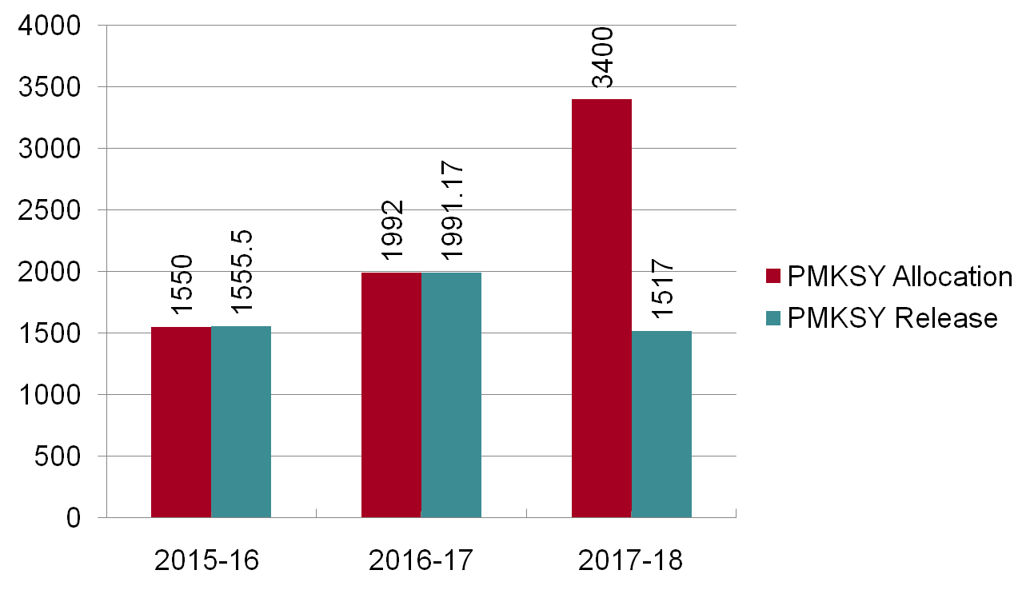
PMKSY-Per Drop More Crop Financial Progress (Up to 20.09.2017)
PMKSY-Per Drop More Crop Financial Progress
Amount in Crore(Rs.)
Financial year
For 2017-18 as available

Slide 20
CONVERGENCE WITH MGNREGS
MISSION WATER CONSERVATION
Actionable Framework jointly with MoWR and MoA & FW
Leverages the synergies amongst MGNREGS and PMKSY
2264 Mission Water Conservation Blocks identified
At least 65% of total expenditure on NRM in these Blocks
NRM works to be part of DIP under PMKSY.

Slide 21
PMKSY – Contributions From MGNREGS
NRM priority under MGNREGS
Renewed Focus on NRM and Water related works - FY 15-16 onwards
Expenditure on NRM and Water Related Works
Farm Ponds
* As Available
Type of Work | FY 2015-16 | FY 2016-17 | FY 2017-18
NRM | Rs.29000 Cr | Rs.33000 Cr | Rs.25000Cr*
Water Related | Rs.19400Cr | Rs. 23000 Cr | Rs. 18600Cr
Name of Work | FY 2015-16 | FY 2016-17 | FY 2017-18
Farm Ponds | 1.57 lakh | 5.95 lakh | 2.16 lakh*

Slide 22
THANKS

Slide 23
Summary of 99 Priority projects (Rs. In crore)
Sl. No. | State Name | No. of Projects |  |  |  | Balance cost as on 01.04.16 | Balance CA admissible as on 01/04/2016 | Balance State Share as on 1/4/16 | Targeted Irrigation Potential (Th. Ha.)
 |  | Priority-I | Priority-II | Priority-III | Total
1 | Andhra Pradesh |  | 8 |  | 8 | 1818 | 611 | 1208 | 263
2 | Assam | 2 |  | 1 | 3 | 832 | 307 | 525 | 125
3 | Bihar |  |  | 2 | 2 | 459 | 199 | 260 | 37
4 | Chhattisgarh |  |  | 3 | 3 | 715 | 199 | 516 | 48
5 | Goa |  |  | 1 | 1 | 44 | 26 | 18 | 14.5
6 | Gujarat |  |  | 1 | 1 | 8107 | 3686 | 4421 | 1792
7 | J & K | 3 |  | 1 | 4 | 356 | 184 | 172 | 61.4
8 | Jharkhand |  |  | 1 | 1 | 3426 | 2233 | 1193 | 236.8
9 | Karnataka | 2 |  | 3 | 5 | 3185 | 1837 | 1347 | 252.8
10 | Kerala |  |  | 2 | 2 | 220 | 98 | 121 | 38.1
11 | Madhya Pradesh | 2 | 11 | 1 | 14 | 11732 | 3625 | 8107 | 872.6
12 | Maharashtra | 7 |  | 19 | 26 | 19950 | 5503 | 14447 | 850.8
13 | Manipur | 2 |  |  | 2 | 602 | 310 | 292 | 37.0
14 | Odisha | 1 | 2 | 5 | 8 | 4628 | 2300 | 2328 | 327.7
15 | Punjab | 2 |  |  | 2 | 363 | 144 | 219 | 92.0
16 | Rajasthan | 1 |  | 1 | 2 | 1564 | 733 | 831 | 315.6
17 | Telangana | 1 | 9 | 1 | 11 | 7666 | 4226 | 3440 | 585.1
18 | Uttar Pradesh |  | 1 | 3 | 4 | 11929 | 5121 | 6808 | 1653
 | TOTAL | 23 | 31 | 45 | 99 | 77595 | 31342 | 46253 | 7603

Slide 24
State wise CA proposals processed (2016-17 & 2017-18)-AIBP
Sl. No. | Project Name | Balance Cost (Rs. Crores) 03/16 | Balance CA (Rs. Crores) 03/16 | CA Released (Rs. Crores) 2016-17 | CA Released (Rs. Crores) 2017-18
1 | Andhra Pradesh | 789.54 | 80.92 | 7.40 | 11.79
2 | Assam | 315.00 | 63.97
3 | Bihar | 439.01 | 196.09 |  | 46.32
4 | Chhattisgarh | 463.58 | 83.44 | 13.29 | *
5 | Goa | 8.69 | 8.69
6 | Gujarat | 9873.26 | 4797.51 | 961.88 | 555.88
7 | Jammu Kashmir | 125.41 | 61.92 |  | 9.57
8 | Jharkhand | 1892.10 | 1373.68 | 145.75 | *
9 | Karnataka | 1580.80 | 1237.90 | 135.47 | 222.01
10 | Kerala | 68.52 | 22.78
11 | Madhya Pradesh | 5404.36 | 1370.04 | 300.15 | 99.13
12 | Maharashtra | 21356.38 | 3251.67 | 379.88 | 133.67
13 | Manipur | 633.41 | 251.87 | 127.00
14 | Odisha | 6214.59 | 1668.85 | 457.74 | 238.06
15 | Punjab | 220.80 | 52.42 | 52.42
16 | Rajasthan | 718.92 | 459.9 | 45.89 | 108.44
17 | Telangana | 8450.06 | 1252.92 | 545.45 | 13.24
18 | Uttar Pradesh | 7608.62 | 1622.98 | 135.63 | *
 | Total | 66163.05 | 17857.55 | 3307.95 | 1438.1
* In Process along with other proposals amounting Rs. 1540 Cr.

Slide 25
Details of Ongoing SMI Schemes
(Rupees in Cr. & Potential in La. Ha.)
Sl No. | States | No of schemes included | Estimate Cost | Cum. Exp. 03/2017 | Bal. cost 03/2017 | Cum. CA released 03/2017 | CA Released2017-18 | No of Schemes completed 03/2017 | Target Pot. | Cum. Pot. Achieved 03/2017
1 | Arun.Pradesh | 315 | 230.7 | 166.6 | 64.1 | 176.0 | 0.0 | 185.0 | 0.2 | 0.2
2 | Assam | 1010 | 4975.4 | 2267.6 | 2707.8 | 2053.5 | 286.7 | 546.0 | 4.2 | 2.0
3 | Bihar | 176 | 351.6 | 163.5 | 188.1 | 115.3 | 0.0 | 117.0 | 0.7 | 0.4
4 | Chhattisgarh | 147 | 722.2 | 535.5 | 186.6 | 200.4 | 0.0 | 73.0 | 0.5 | 0.3
5 | H.P. | 150 | 411.9 | 73.7 | 338.2 | 33.5 | 49.3 | 21.0 | 0.2 | 0.0
6 | J&K | 419 | 1317.4 | 442.6 | 874.9 | 387.1 | 21.8 | 121.0 | 1.2 | 0.7
7 | Jharkhand | 82 | 75.3 | 38.4 | 36.9 | 19.4 | 0.0 | 26.0 | 0.1 | 0.0
8 | Karnataka | 465 | 594.9 | 481.5 | 113.4 | 162.4 | 0.0 | 271.0 | 0.4 | 0.3
9 | M.P. | 276 | 1817.4 | 1426.3 | 391.1 | 987.7 | 0.0 | 209.0 | 1.1 | 0.3
10 | Manipur | 102 | 170.4 | 39.5 | 130.8 | 82.3 | 0.0 | 0.0 | 0.1 | 0.1
11 | Meghalaya | 192 | 495.7 | 140.7 | 355.0 | 209.2 | 0.0 | 66.0 | 0.3 | 0.1
12 | Mizoram | 36 | 42.5 | 2.4 | 40.0 | 2.0 | 3.9 | 0.0 | 0.0 | 0.0
13 | Nagaland | 434 | 312.8 | 272.0 | 40.9 | 263.1 | 9.2 | 434.0 | 0.2 | 0.2
14 | Sikkim | 381 | 115.0 | 62.3 | 52.7 | 56.6 | 9.0 | 225.0 | 0.1 | 0.1
15 | Tripura | 21 | 47.3 | 19.7 | 27.6 | 17.8 | 0.0 | 0.0 | 0.0 | 0.0
16 | Uttarakhand | 651 | 541.4 | 356.9 | 184.5 | 311.6 | 32.4 | 172.0 | 0.4 | 0.2
 | TOTAL | 4857 | 12222.0 | 6489.4 | 5732.7 | 5077.8 | 412.3 | 2466.0 | 9.9 | 5.1

Slide 26
Details of Ongoing RRR Schemes
(Rupees in Cr. & Potential in La. Ha.)
Sl. No. | States | No of WBs included | Estimate Cost | Cum. Exp. 3/2017 | Bal. cost 03/2017 | Cum. Release 03/2017 | CA Released 2017-18 | No of completed WBs 03/2017 | Potential Planned (ha)/CCA | Pot. restored 3/2017
1 | M.P | 125 | 183.2 | 136.1 | 47.1 | 37.7 | 0.0 | 82.0 | 0.3 | 0.3
2 | Manipur | 4 | 65.4 | 12.0 | 53.5 | 10.4 | 0.0 | 0.0 | 0.0 | 0.0
3 | Meghalaya | 9 | 11.4 | 2.5 | 8.9 | 2.5 | 0.0 | 0.0 | 0.0 | 0.0
4 | Orissa | 863 | 449.0 | 234.6 | 214.5 | 107.6 | 3.0 | 370.0 | 0.5 | 0.3
5 | Rajasthan | 68 | 187.8 | 58.7 | 129.1 | 35.9 | 14.3 | 24.0 | 0.1 | 0.1
6 | Tamilnadu | 154 | 78.1 | 16.1 | 62.1 | 9.2 | 0.0 | 105.0 | 0.0 | 0.0
7 | Telengana | 399 | 338.7 | 0.0 | 338.7 | 44.9 | 38.0 | 0.0 | 0.2 | 0.0
8 | U.P. | 74 | 83.4 | 37.1 | 46.3 | 16.4 | 0.0 | 0.0 | 0.0 | 0.0
9 | Uttrakhand | 5 | 12.5 | 1.4 | 11.1 | 0.0 | 0.0 | 0.0 | 0.0 | 0.0
 | Grand Total | 1701 | 1409.7 | 498.5 | 911.2 | 264.7 | 55.3 | 581.0 | 1.3 | 0.6

Slide 27
Completion of Priority projects 2016-17
Sl. No. | Project Name | Ultimate Irrigation Potential (Th. Ha.)
 | Andhra Pradesh
1 | Maddigedda | 1.42
 | Chhattisgarh
2 | Maniyari Tank | 14.52
3 | Kharung | 10.3
 | Karnataka
4 | Sri Rameswar Irrigation | 13.8
 | Madhya Pradesh
5 | Singhpur Project | 10.2
6 | Mahuar Project | 13.78
7 | Sagad | 17.06
 | Maharashtra
8 | Bawanthadi (IS) | 27.71
9 | Lower Panzara | 6.79
10 | Dongargaon | 2.77
11 | Warna | 54.75

Slide 28
Completion of Priority projects by June, 2017
Sl. No. | Project Name | Ultimate Irrigation Potential (Th. Ha.
 | Odisha
12 | Upper Indravati(KBK) | 85.95
13 | Rukura-Tribal | 7.65
 | Punjab
14 | Kandi Canal Extension (Ph.II) | 23.33
15 | Rehab of Patiala Feeder & Kotla Branch Project | 68.62
 | Telangana
16 | Gollavagu Project | 3.85
17 | Rallivagu project | 2.43
18 | Mathadivagu Project | 3.44

Slide 29
Completion of Priority projects during 2017-18
S.No. | Project Name | Balance cost as on 1.4.2016 | Balance CA admissible as per latest data | CA released under AIBP during 2016-17 | CA released under AIBP during 2017-18 | Targeted Irrigation Potential (Th. Ha.)
 | Andhra Pradesh
1 | Gundlakamma | 175.42 | 19.87 | 0.0000 | 11.7900 | 32.40
2 | Tadipudi LIS | 79.53 | 0.00 | 0.0000 |  | 83.61
3 | Thotapally | 152.47 | 15.85 |  |  | 48.56
4 | Musurumilli | 33.86 | 14.52 | 7.4000 |  | 9.16
5 | Pushkara LIS | 34.00 | 0.00 | 0.0000 |  | 71.18
6 | Yerracalva | 27.54 | 5.33 |  |  | 6.96
 | Total | 502.823 | 55.567 | 7.4 | 11.79 | 251.87
 | Assam
7 | Dhansiri | 119.75 | 0.00 | 0.0000 |  | 86.37

Slide 30
Completion of Priority projects during 2017-18
S.No. | Project Name | Balance cost as on 1.4.2016 | Balance CA admissible as per latest data | CA released under AIBP during 2016-17 | CA released under AIBP during 2017-18 | Targeted Irrigation Potential (Th. Ha.)
8 | Champamati | 122.61 | 40.51 |  |  | 25.00
 | Total | 242.36 | 40.51 | 0.00 | 0.00 | 111.37
 | Karnataka
9 | Bhima LIS | 66.72 | 44.49 | 22.4400 |  | 24.29
 | Madhya Pradesh
10 | Sindh Project Phase II | 229.44 | 39.46 | 35.5170 |  | 162.10
11 | Indira Sagar Project Canal Phase - I & II (km. 0 to km. 142) | 40.96 | 40.96 | 16.3500 | 7.34 | 62.20
12 | Omkareshwar Project Canal Phase-IV (OSP lift) | 235.07 | 98.15 | 61.2700 | 4.50 | 54.63
13 | Indira Sagar Project Canal Phase - V (Khargone Lift ) | 144.53 | 39.28 | 9.5100 |  | 33.14
 | Total | 650 | 217.849 | 122.647 | 11.84 | 312.07

Slide 31
Completion of Priority projects during 2017-18
S.No. | Project Name | Balance cost as on 1.4.2016 | Balance CA admissible as per latest data | CA released under AIBP during 2016-17 | CA released under AIBP during 2017-18 | Targeted Irrigation Potential (Th. Ha.)
 | Maharashtra
14 | Lower Dudhna | 624.61 | 56.26 | 39.6200 | 4.7486 | 44.48
15 | Tillari' | 299.55 | 17.91 | 11.9400 |  | 6.57
16 | Nandur Madhmeshwar Ph-II | 400.46 | 17.24 | 16.0400 | 0.2471 | 20.50
17 | Upper Kundalika | 77.46 | 15.09 | 1.0130 | 7.0395 | 2.80
 | Total | 1402.08 | 106.49 | 68.61 | 12.04 | 74.35
 | Odisha
18 | RET irrigation | 466.06 | 110.78 | 34.4010 | 47.12 | 8.50
19 | Telengiri | 478.85 | 208.91 | 58.3160 | 131.66 | 13.83
20 | Lower Indra (KBK) | 330.84 | 104.90 | 89.7500 |  | 35.87
 | Total | 1275.75 | 424.59 | 182.47 | 178.78 | 58.20

Slide 32
Completion of Priority projects during 2017-18
S.No. | Project Name | Balance cost as on 1.4.2016 | Balance CA admissible as per latest data | CA released under AIBP during 2016-17 | CA released under AIBP during 2017-18 | Targeted Irrigation Potential (Th. Ha.)
 | Rajasthan
21 | Narmada Canal | 686.84 | 427.82 | 40.7900 | 99.9960 | 245.88
22 | Mod. of Gang Canal | 32.08 | 32.08 | 5.1000 | 8.4400 | 69.69
 | Total | 718.92 | 459.90 | 45.89 | 108.44 | 315.57
 | Telangana
23 | Peddavagu @ Neelwai project | 92.09 | 4.60 | 0.6700 |  | 6.07
24 | Palemvagu project | 34.09 | 0.00 | 0.0000 |  | 4.10
25 | SRSP St.II | 266.16 | 48.36 | 17.0120 | 13.2420 | 178.07
26 | Rajiv Bheema L.I. Scheme | 716.72 | 162.71 | 54.4800 |  | 82.15

Slide 33
Completion of Priority projects during 2017-18
S.No. | Project Name | Balance cost as on 1.4.2016 | Balance CA admissible as per latest data | CA released under AIBP during 2016-17 |  | CA released under AIBP during 2017-18 | Targeted Irrigation Potential (Th. Ha.)
27 | SriKomaram Bheem project | 147.55 | 0.00 | 0.0000 |  |  | 9.92
 | Total | 1256.61 | 215.66 | 72.16 |  | 13.24 | 280.31
 | Uttar Pradesh
28 | Bansagar Canal | 487.60 | 143.51 | 64.6370 |  | 63.3606 | 150.13
 | Grand Total | 6602.8 | 1708.57 | 586.26 | 399.49 |  | 1578.17

Slide 34
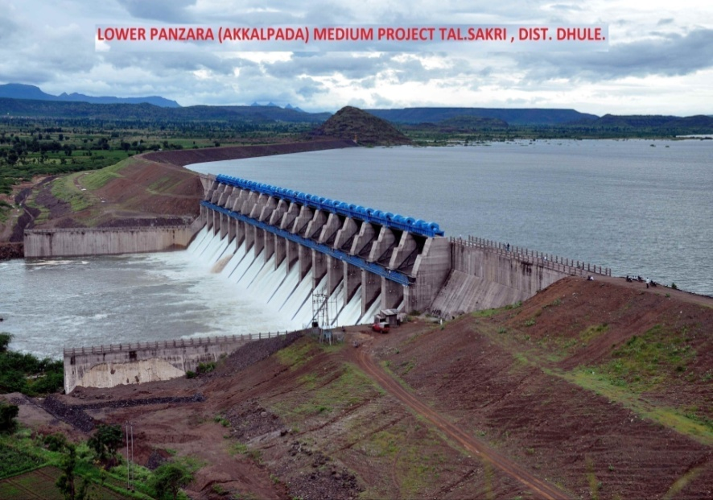
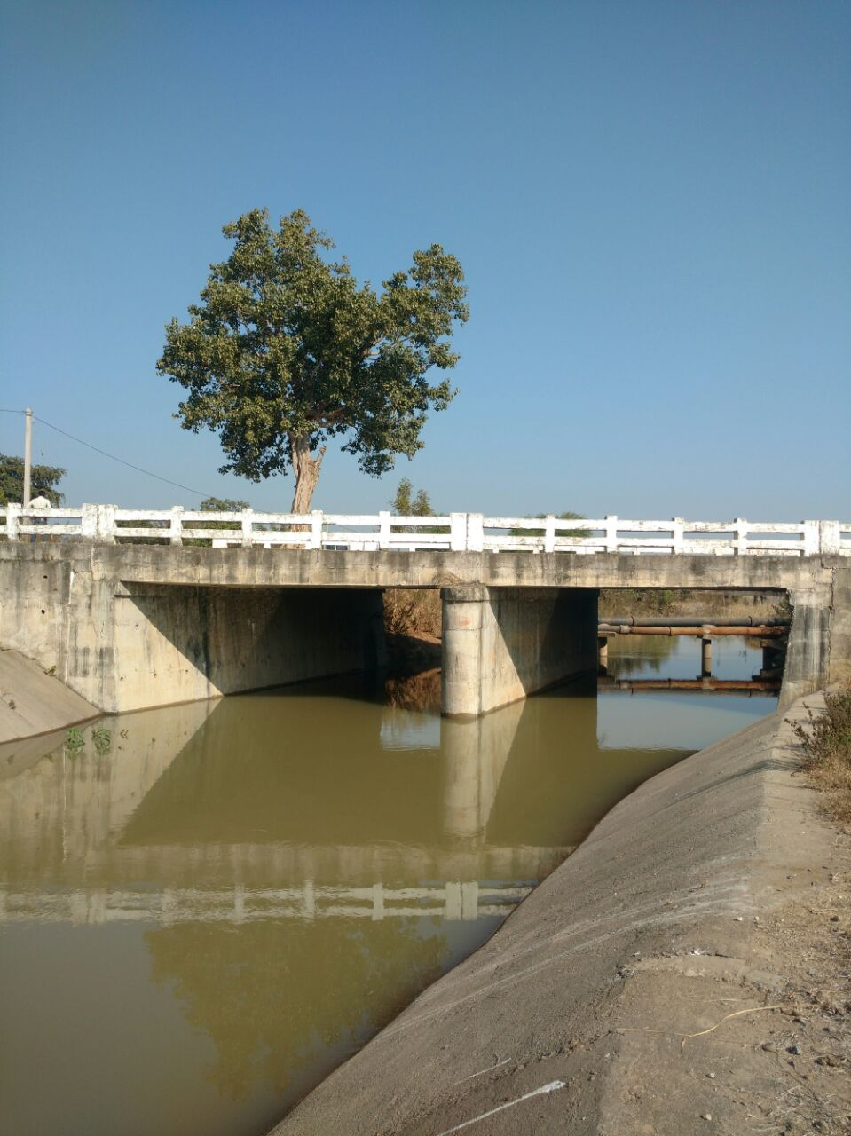
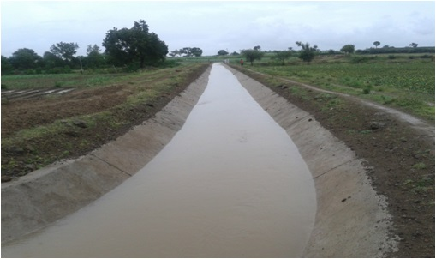
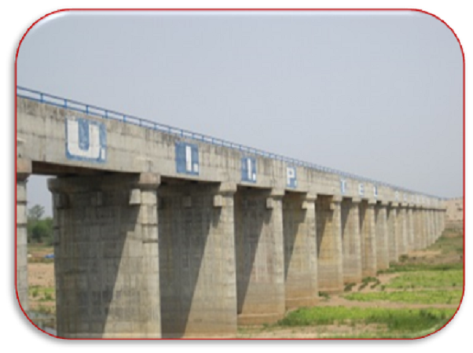
Photographs of projects getting completed
Lower Panzara (Mah.)
Rukura (Odisha)
Sri Rameshwara (Kar.)
Upper Indravati Extn. (Odisha)

Slide 35
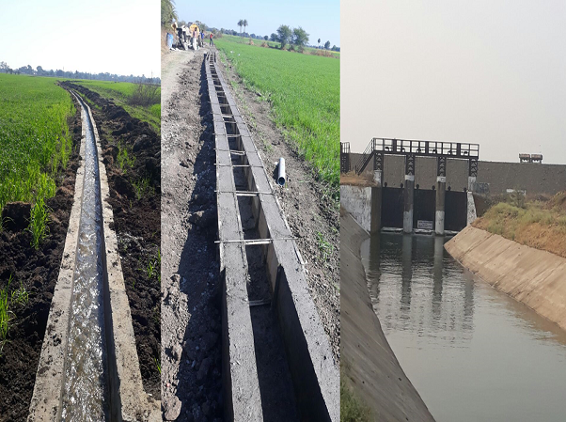
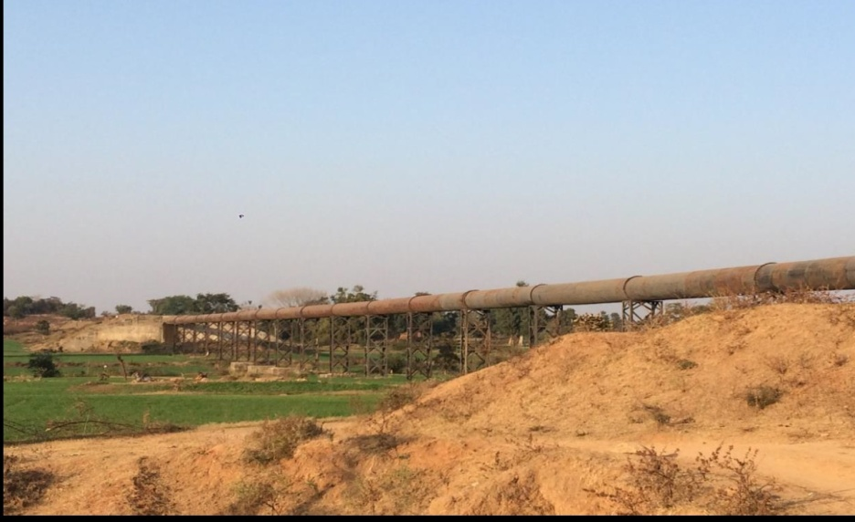
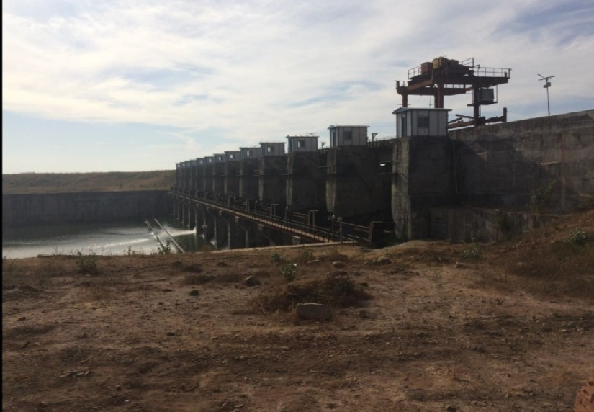
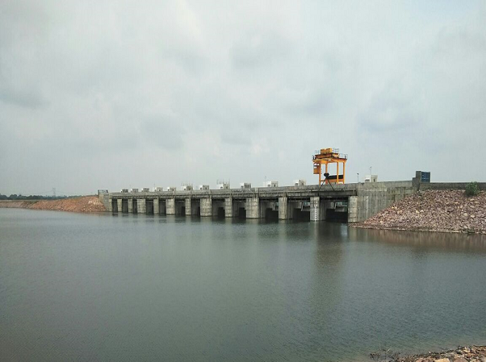
Photographs of projects getting completed
Sagad (M.P.)
Mahuar (M.P.)
Mahuar (M.P.)
Singhpur (M.P.)

