Slide 1
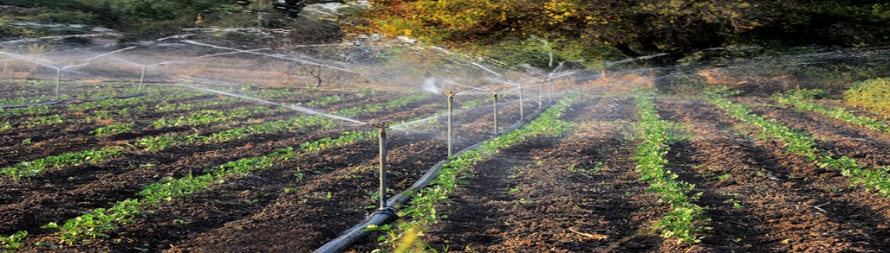
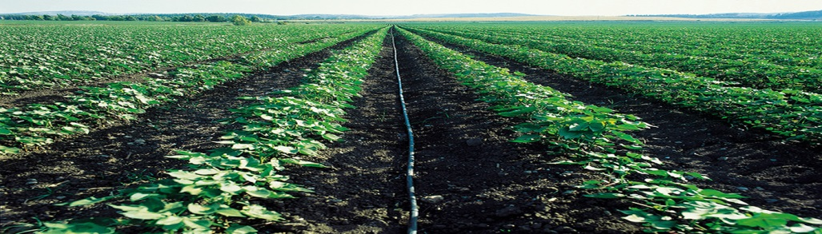
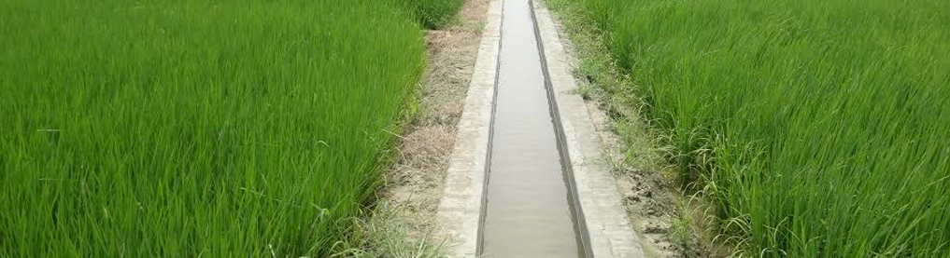
CADWM Programme and Present Day Challenges
Avinash Mishra
Jt. Adviser (WR & LR)
NITI Aayog
13.03.2018

Slide 2
Water Scenario in India
Reducing per capita water availability
Per capita water availability in m³ /year
Water stress 1700 m³/capita/year
Water scarcity 1000 m³/capita/year

Slide 3
Water Use Scenario in Country
Low Water use Efficiency in every aspect of water use i.e. Irrigation, Industries , domestic i.e. 30 to 38% in Irrgn.35 to 45 % Distribution losses in water supply, Industries consuming 3to 6 times more than Global average
Poor Storage possibility in the Country i.e. only 262 m³/capita as compared to 1964m³ /capita in USA, 1112 m³ /capita in China, 753.65 m³ /capita in South Africa.
Uneven distribution of water in Time and Space.
  75-80% run-off in four months (June to September)
  59% of available water resources in Ganga- Brahmaputra-Barak water basin
Insufficient storage capacity at present: only 253.4 BCM out of total 690 BCM utilizable surface water whereas

Slide 4
Irrigation Potential: Facts at a Glance
Ultimate Irrigation Potential of Country | 139.43 Million Ha
Irrigation Potential Created (IPC) | 112.53 Million Ha
Irrigation Potential Utilized (IPU) | 89.26 Million Ha
Gap between IPC & IPU | 23.27 Million Ha
As per the Planning Commission definition the irrigation water made available up to the outlet of minors (minor canals) will be treated as the Irrigation Potential Created.

Slide 5
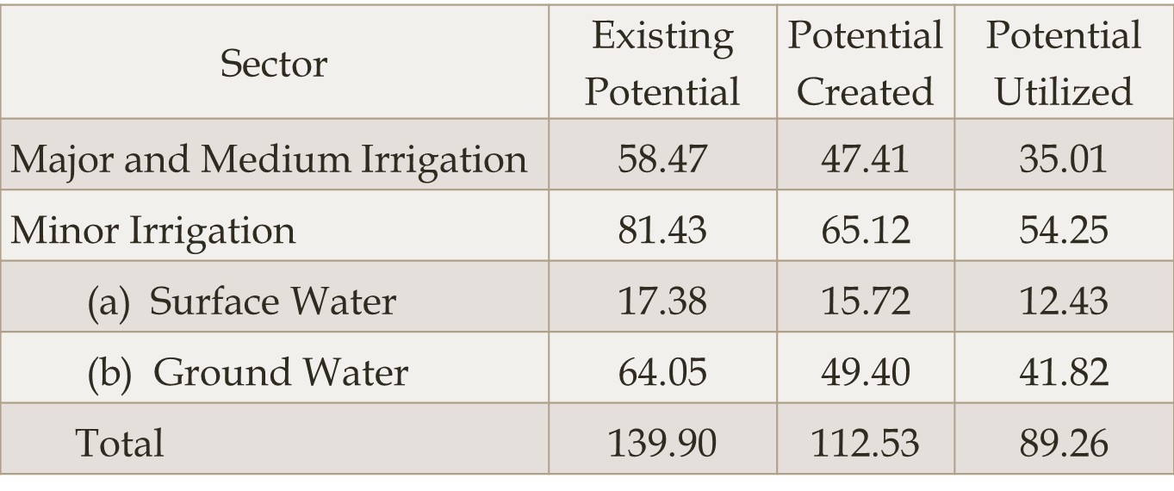
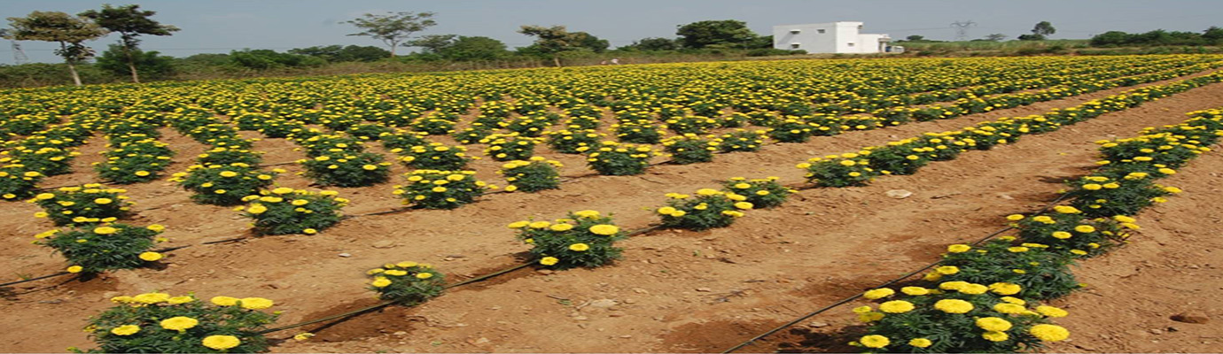
Sector wise Irrigation Potential creation and Utilization
Factors | Sprinkler Irrigation System | Drip Irrigation | Surface Irrigation
Overall irrigation efficiency | 50-60% | 80-90% | 30-35%
Application efficiency | 70-80% | 90% | 60-70%
Water saving | 30% | 60-70% | NA

Slide 6
Reason for IPC-IPU Gap
The lack of CAD works below the outlet
  Resulting into free flooding of farms
  Leading to over irrigation
Dilapidated structures, poor maintenance of canal distributaries and minors.
Change in cropping patterns from designed cropping pattern based on agro-climatic condition
The projects are constructed on 75% dependability i.e. water in the reservoirs will be adequate in three out of four years.
Water Use Efficiency - low in India at 38% comparing with 45% in Malaysia and Morocco, 50-60% in Israel, Japan, China and Taiwan.

Slide 7
Reasons for IPC-IPU Gap …contd
Presently the gap is 23 Million Ha which indicates that it has resulted into non-utilisation of investment made on creating 23 Million Ha which is at the average of Rs. 4.5 Lakh/ha resulting into Rs. 1.03 Million crore of blocked investment.
Development of irrigation projects are constrained because of the issues related to environmental clearances, Land Acquisition and Rehabilitation and Resettlement.
The need of the hour is to achieve the full utilization of irrigation potential which is already created.
Formation of WUAs will have socio-equitable distribution of water.
The Irrigation efficiency like application of micro irrigation method and conveyance efficiency will be positively impacted as a result of the formation of WUAs.

Slide 8
Introduction of CAD
CAD programme was initially started in the Ministry of Agriculture in 1974-75 and was transferred to Ministry of Water Resources in the early eighties.
The programme has been modified from time to time as per requirements felt during its implementation.
Reclamation of waterlogged areas was added as a component w.e.f. 01.04.1996.
CAD Programme was restructured as Command Area Development and Water Management (CADWM) Programme w.e.f. 01.04.2004.
The scheme was being implemented as a State Sector Scheme during the XI Five Year Plan (2008-09 to 2011-12).
The programme is being implemented pari-passu with Accelerated Irrigation Benefits Programme (AIBP) during XII Plan.

Slide 9
Objective : CADWM programme
for development of adequate delivery system of irrigation water up to farmers’ field with an objective
to bridge the gap between potential created and utilised and
to enhance water use efficiency and production and productivity of crops per unit of land and water
for improving socio-economic condition of farmers.
The programme envisages integration of all activities relating to irrigated agriculture in a coordinated manner with multi-disciplinary team under a Command Area Development Authority

Slide 10
Components under CAD Programme
OFD Works (comprising construction of field channels, land leveling where necessary) also micro-irrigation,
Reclamation of Waterlogged Areas (surface & sub-surface drainage)
Correction of System Deficiencies in canals between outlet upto 4.25 cumecs (150 cusec) capacity
Participatory Irrigation Management (PIM)-One time functional grants and One time infrastructure grant to Water Users’ Associations
  One time infrastructure grant to WALMIs/IMTIs Training of Functionaries of CADAs and Farmers
  Adaptive Trials and Demonstrations (including on micro-irrigation, land leveling, water use efficiency) on farmers’ field for promotion of improved practices
  Monitoring and Evaluation
  Establishment- limited to 10% of the works carried out for OFD Works, Field Drains, Reclamation of Water Logged Area & Correction of System Deficiency.

Slide 11
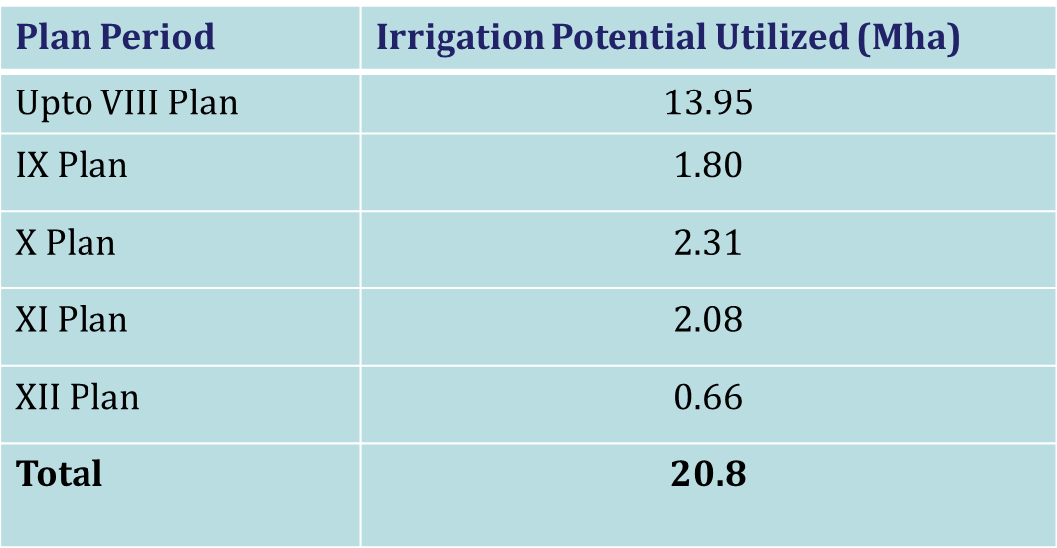
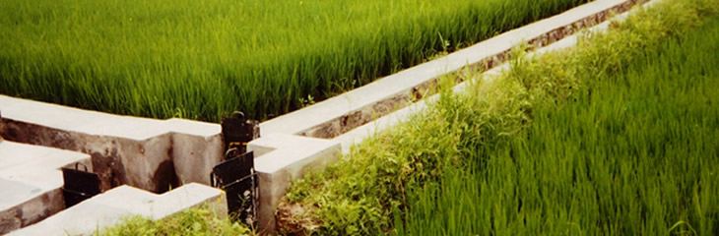
IPU under CADWM Programme

Slide 12
Pradhan Mantri Krishi Sinchayee Yojana
(PMKSY)
PMKSY has been approved with an indicative outlay of Rs.50000 crore over a period of five years from 2015-16 to 2019-20 . Further in july 2016 PMKSY mission established to complete 99 Priority Projects including CAD Component.
  to ensure access to some means of protective irrigation to all agricultural farms (Har Khet Ko Pani) in the country,
  to produce ‘per drop more crop’, thus bringing much desired rural prosperity.
  The programme is an amalgamation of on-going schemes of Ministry of Water Resources, River Development and Ganga Rejuvenation, Ministry of Agriculture & Cooperation and Ministry of Rural Development.

Slide 13
PMKSY - Convergence
  PMKSY will also seek convergence of
    Mahatma Gandhi National Rural Employment Guarantee Scheme (MGNRES),
    Rashtriya Krishi Vikas Yojana (RKVY),
    Jawaharlal Nehru National Solar Mission and Rural Electrification programmes (JLNNSM&REP),
    Rural Infrastructure development Fund (RIDF),
    Member of Parliament Local Area Development Scheme (MPLAD),
    Member of Legislative Assembly Local Area Development Scheme (MPLALAD),
    Local body funds (LBF),
    Working Plan of State Forest Department (WPSFD) etc.

Slide 14
Impact of CADWM on GDP: Some examples
Some States have achieved very good progress under CADWM
  States like Haryana, Punjab, Tamil Nadu which have developed /utilised Irrigation Potential has shown higher GDP
Similarly, Madhya Pradesh has achieved miraculous progress in optimization of water resources
  Land under cultivation rose 21% in 10 years to 2012-13
  State’s GDP has grown more than 9% points consistently since 2009-10; agri growth >20% in these years.

Slide 15
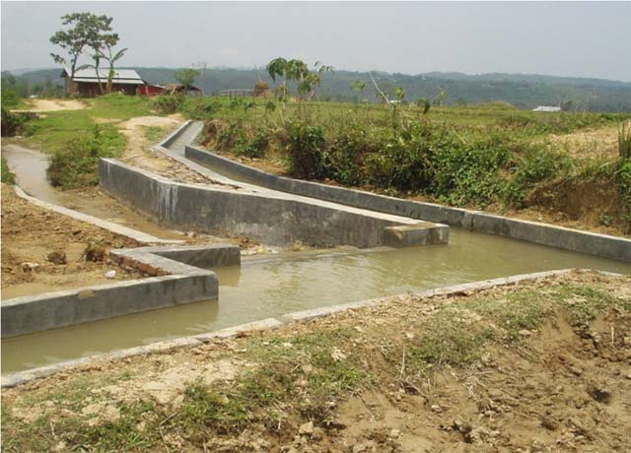
Way Forward
Development of CAD works will also promote the innovative & technological intervention for water use efficiency such as Sprinkler Irrigation and Drip Irrigation.
The efficient water application may even lead to higher utilization of created potential because of modern technology.
To promote participatory approach, a functional grant is provided to the Water Users’ Associations (WUAs) to operate and maintain the irrigation system in their jurisdiction. So far, 84779 WUAs have been formed in various States covering an area of 17.842 MHa.

Slide 16
THANKS

