Slide 1
Global scenario and priorities of CAD program
Avinash Chand Tyagi
Water and Climate Expert
CONFERENCE ON COMMAND AREA DEVELOPMENT
CSMRS Auditorium, Olof Palme Marg, Hauz Khas, New Delhi-110016
13th March, 2018

Slide 2
Global Water Scarcity
Source: IWMI

Slide 3
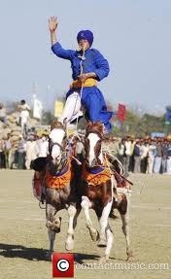
Water Management
Population
Quality
Climate Change
Urbanization
Land use
Change
Demand
Better
Standards
Supply
Water
Management

Slide 4
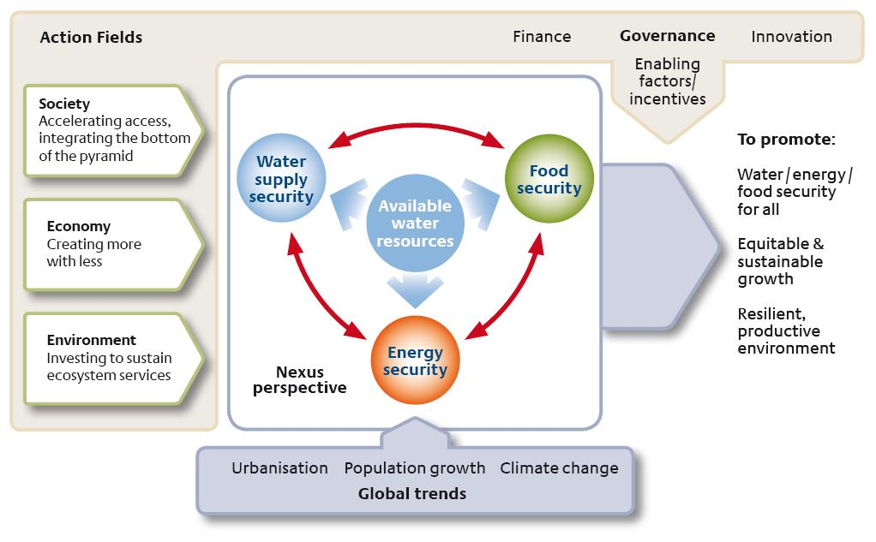
Water Food Energy Nexus

Slide 5
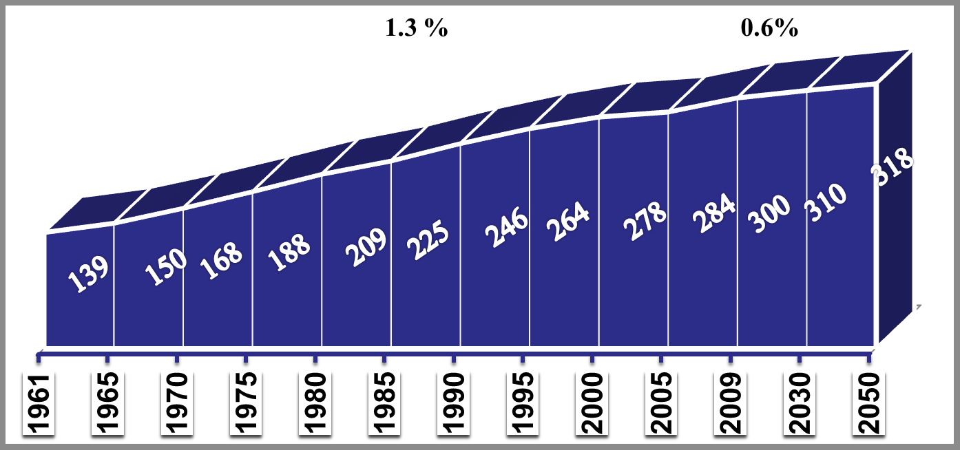
Growth of world area equipped for irrigation
(million ha)
2.3%
1.0%
(Source: FAOSTAT/ICID)

Slide 6
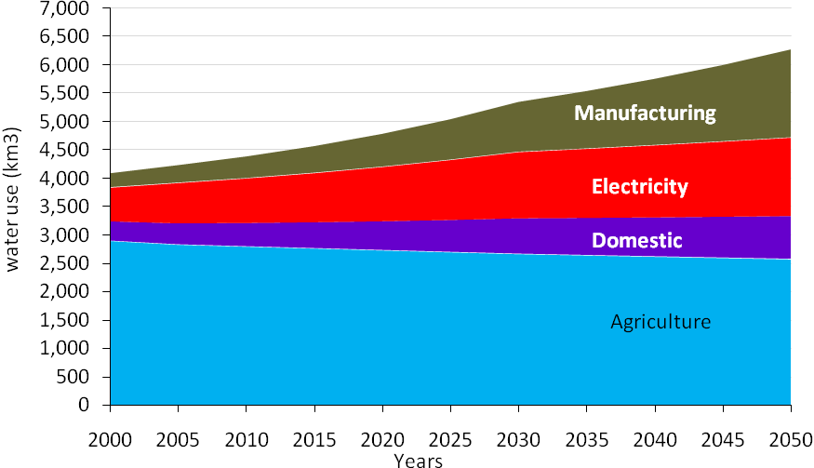
Challenges of sustainable food production
Diminishing freshwater supplies for agriculture
80-90% of the increase to come from already cultivated lands
Aging irrigation infrastructures
Weak institutions and poor water governance
Climate variability and change affecting agricultural production
Lack of institutional and individual capacity
Notes:
sustainable agricultural intensification means producing more output from the same area of land (and volume of water) while reducing negative impacts and concurrently increasing contributions to natural capital and the flow of environmental services.

Slide 7
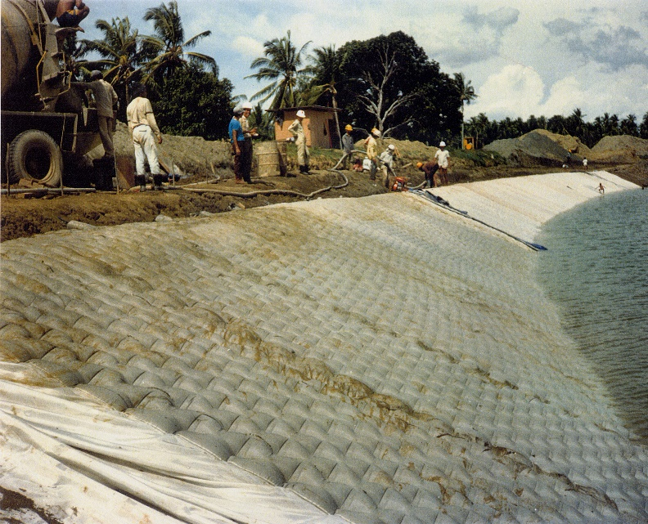
Possible options
Sustainable development of irrigated agriculture lies around
Modernization and revitalisation of irrigation systems and related services to improve performance
Reform of management institutions
Improving water and land productivity supported by financial mechanisms
Increasing awareness about water scarcity
Adoption of efficient water management techniques including recycle and reuse of waste water
Use of modern technologies and adoption of climate smart agriculture
Capacity development of service providers and farmers etc.

Slide 8
ICID Review of Institutional Reforms
Australia, China, India, Indonesia, Iran, Japan, Malaysia, Mexico, Nepal, South Korea, Sudan, Chinese Taipei, Turkey, and Ukraine.
Evaluation related to
institutional and organizational reforms with focus on the legal and organizational framework structure;
Participatory Irrigation Management (PIM) and Management Transfer; and
Public–Private–Partnership (PPP)
The term WUA has been used for
Self-managed Irrigation Groups (Taiwan)
Rural Water Cooperatives (China)
Farmers’ organizations (Malaysia)
Water Cooperatives

Slide 9
Classification of irrigation management systems
Privately-managed;
Jointly-managed, and
Agency-managed.
Management by WUAs through various types of ownership,
private companies,
Cooperatives or trusts, and
State-owned corporations;
In Australia, for example: 30% area is managed by WUA and 55% jointly with other agencies and remaining managed by agencies.

Slide 10
Challenges
Institutional
internal disagreements between different players and departments,
institutional overlap,
unclear mandate,
lack of capacity and
lack of vertical, and horizontal coordination.
WUA
lack of capacity/resources (technological, financial, human and institutional) of the WUAs,
older infrastructure requiring rejuvenation,
insufficient water information or accounting,
lack of water pricing mechanism,
unavailability of knowledge and skilled professionals to support WUAs,
absence of private participation (PPP),
difficulty in upscaling of the WUAs
lack clarity of the IMT objectives and its methodology

Slide 11
Looking Forward
Standardizing the management of rural water cooperation organizations and exploring development models that suit local conditions;
Diversification of business of WUAs;
Introducing private capital into the establishment and management of WUAs.
Enhancing capacity building and formulating policies of government subsidies;
Organizing training and encouraging experience exchange to improve management;
Better demand-supply management and technological upgrades for irrigation management;
Enabling regional autonomy;

Slide 12
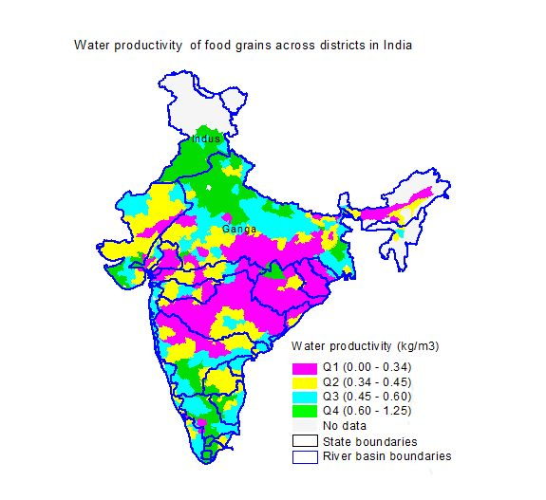
Large scope for increasing WP
Large variation in WP
A significant gap exists between the actual and maximum WP
Reducing the gap alone will substantially reduce additional need for irrigation water
Great opportunity to increase yield & WP in rainfed districts and irrigated areas
Source: Upali et al. (2010)

Slide 13
Use of emerging Technologies and Innovations
Sustainable agriculture water management
Closing gaps between IPC & IPU
Micro-level Land Use Planning and Management
Resource Recovery and Reuse
Multiple water use based Integrated farming systems
Soil Health Management
Multiple stress tolerant/Improved crop varieties
Climate resilient/smart practices

Slide 14
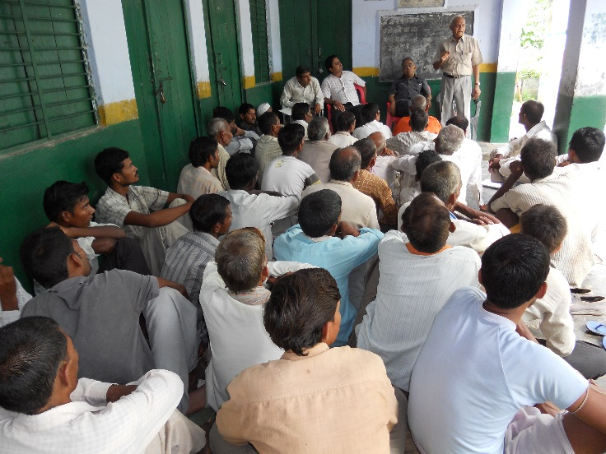
Capacity development
Support to farmers: for participation in managing irrigation systems
Irrigation as a Service: Irrigation Institutions were not service oriented
Cadre management: of irrigation departments and their capacity to adapt to new challenges remains limited
Social skills: Irrigation managers lacked negotiation and dispute resolution skills
Effective WALMIs: could not serve their designed purpose

Slide 15
India Irrigation Forum
Mission:
Enhance the science based discourse in policy making, field implementation of new technologies, skill development at various levels and sharing of experiences in the field of agriculture water management in India.
Objectives:
Providing a platform for networking, interaction and sharing of knowledge and experiences amongst various professionals;
Facilitating interdisciplinary understanding and dialogue;
Skill development of all stakeholders including WUA functionaries by organizing courses, trainings workshops and seminars on thematic topics of interest;
Taking advances in research, new technology and successful innovations from lab to farmers’ field;

Slide 16

IIF- Stakeholders
Farmers’ Associations
Staff of state irrigation department,
Scientists from Agriculture organizations
Professional bodies involved in water resources development, management and research,
Professionals of allied disciplines like socio-economic, environment and energy
Universities and research institutes
Financial institutions such as NABARD
Private sector:
Manufacturers
Consultancy services
Contractors
Other service providers
International organisations with programmes in the field of Irrigation and Drainage

Slide 17
Consultancies
Agriculture Universities
Companies
Research Institutions
Extension services
India Irrigation Forum
(????)
Min of Env
Financial Institutions
Farmers’ Organisations
Ministry of Agriculture
State Irrigation Departments
Ministry of Rural Development
Command Area Development and Water Management Program whose objectives are enshrined in the objectives of India Irrigation Forum should take the lead in organizing an India Irrigation Forum.

Slide 18
Thanks for kind attention….. avinash.c.tyagi@gmail.com

