Slide 1

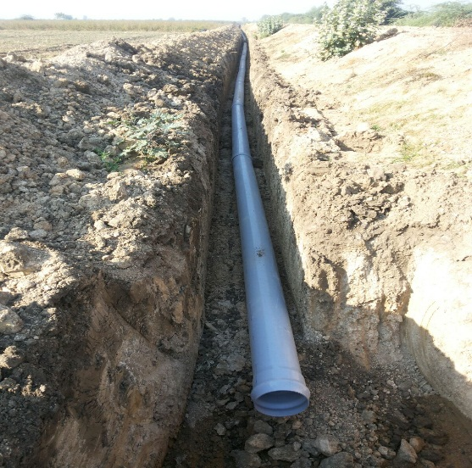
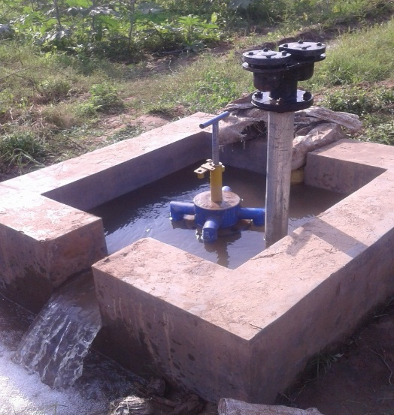
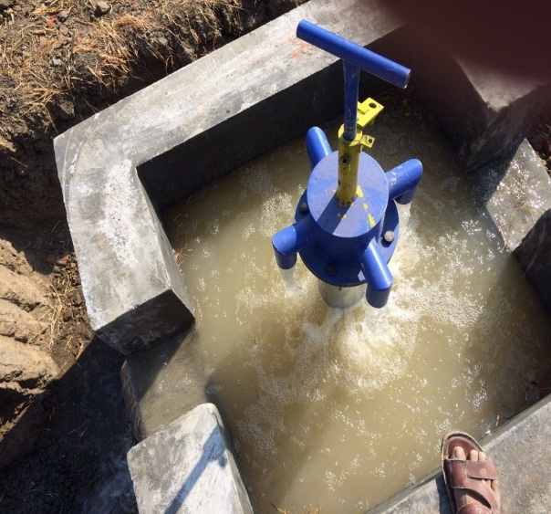
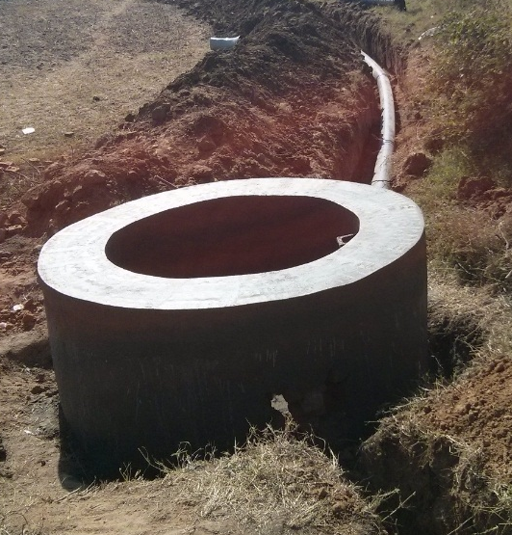
Sardar Sarovar Narmada Nigam Limited
UGPL INITIATIVE IN SSP
Sardar Sarovar (Narmada) Project, Gujarat
13 March 2018
01

Slide 2
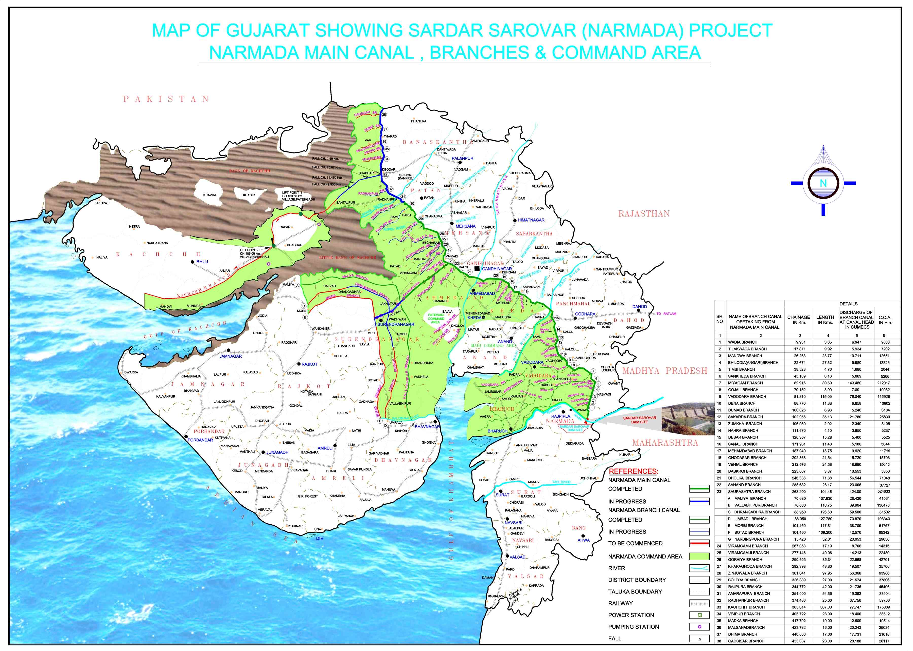
Sardar Sarovar Project, Gujarat, CCA 17.92 lac Hectare
02

Slide 3
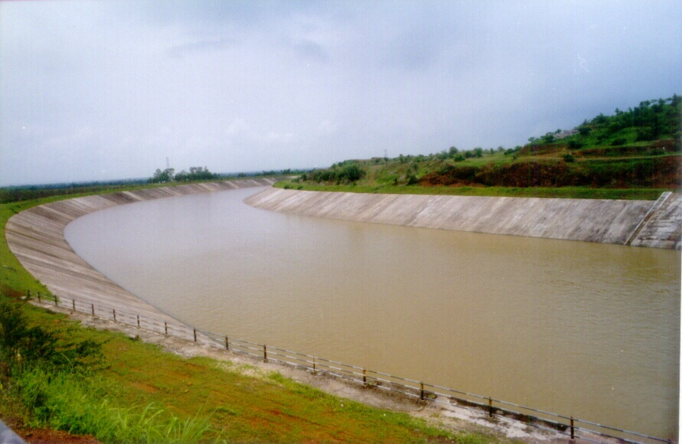
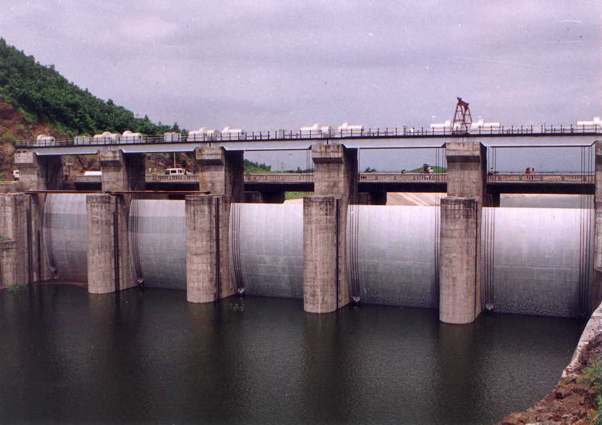
Physical Progress
Type of canal | Total Length in Km | Completed Length in Km up to Feb 2018
Main Canal | 458 | 458
Branch Canal | 2731 | 2604
Distributaries | 4569 | 4206
Minors | 15670 | 12912
Sub-minors | 48320 | 32051
Total | 71748 | 52231
03

Slide 4
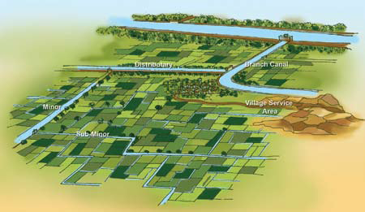
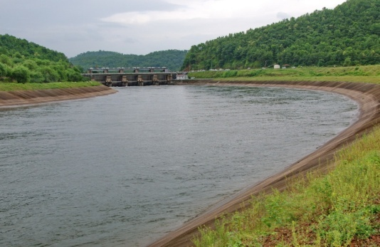

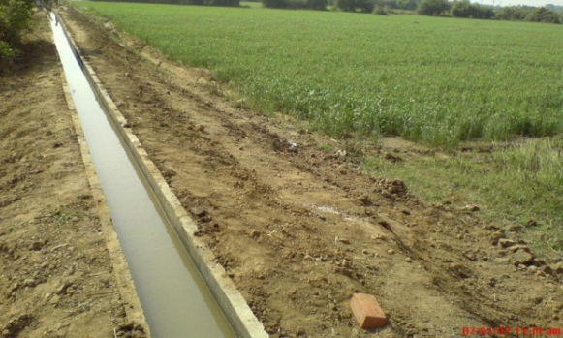
Narmada Canal Network
100%
92%
95%
82%
Open Gravity Channels
66%
Culturable Command Area Developed
11.52 lakh Ha.
4
04

Slide 5
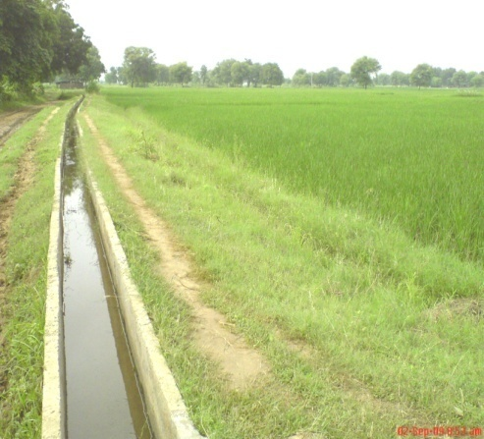
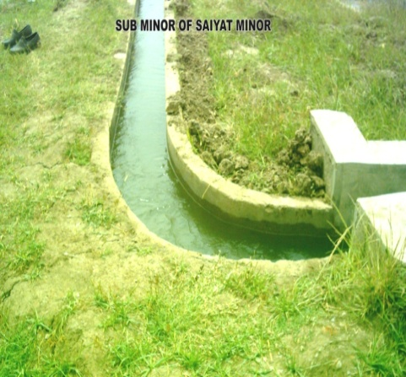
Conventional System of Open Gravity Channels
In Phase I of the SSP Command Area, Sub-Minors were constructed as conventional open channels (gravity based) and following limitations were experienced
  Permanent loss of land
  More time for construction
  Large nos. of Drainage Structures and Bridges
  Low Water Use Efficiency
  Vulnerable to damages / flooding
  Liable to Water Logging and Soil Deterioration
  Reluctance of farmers due to limited land holding and fragmentation
05

Slide 6
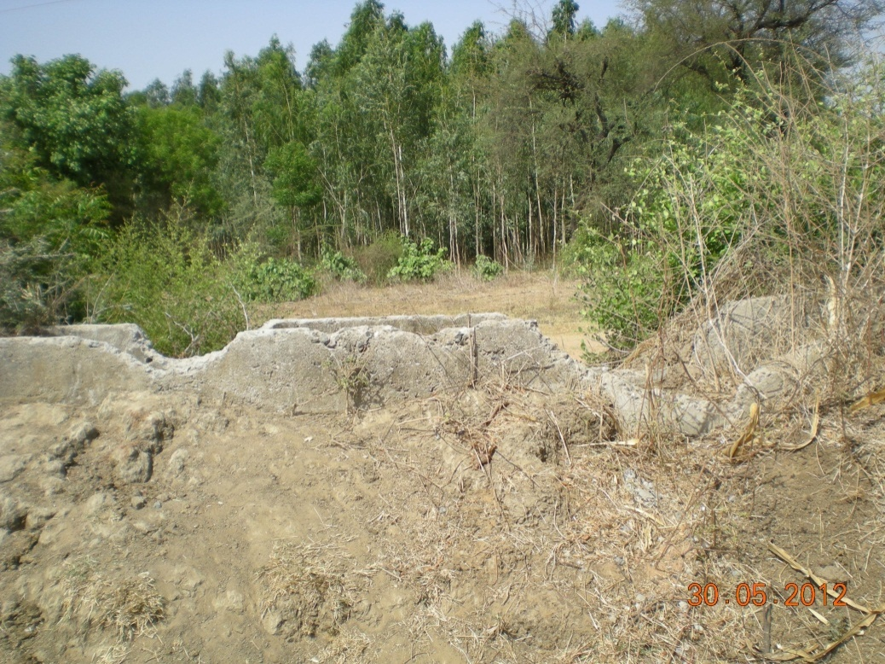
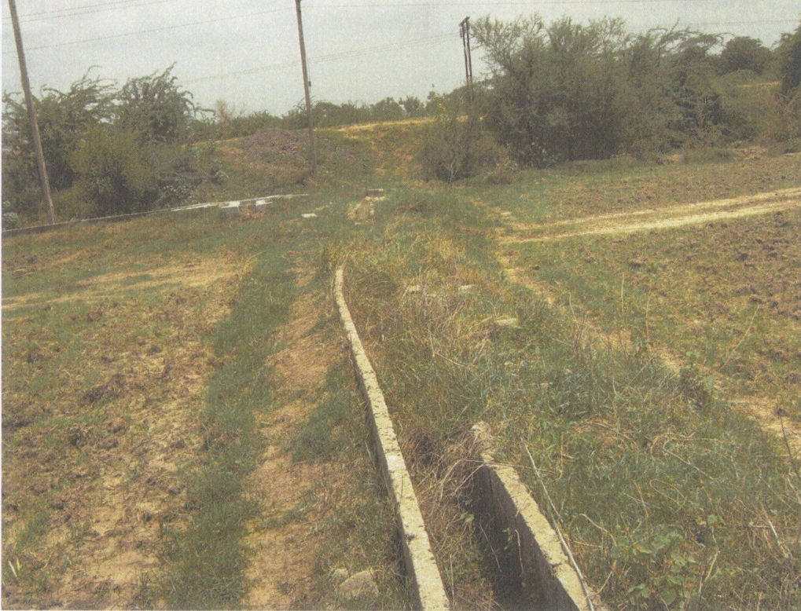
Open Channel Sub-Minors – Vulnerable to Damages
06

Slide 7
Under Ground Pipe Line (UGPL)
Mammoth task of constructing about 38,000 km length of Sub-Minors was remaining to achieve the Last Mile Connectivity
Farmers were reluctant to part with their precious land
Government therefore decided to give option of Underground Pipelines, having following advantages
  Land saving and water saving (up to 10-20 %)
  Less implementation period
  Feasible even in flood zone / Undulating area
  Land fragmentation can be avoided
  Field Channels can be integrated with the Sub-Minors
  O & M expenditure is less
  Future integration with PINS/MIS possible
  Prevent seepage losses and evaporation
  Less vulnerable to pilferage & damage
  Assured water supply to the Tail-enders
07

Slide 8
Under Ground Pipe Line (UGPL) - Implementation
Consultation with Beneficiary Farmers after finalizing Chak and Sub-chak
(SSNNL & Implementing Agency) (> 6 lakh farmers)
Fixing the UGPL Alignment and locations of Turnouts
(SSNNL, Implementing Agency)
Preparation of Drawings & Estimates
(SSNNL/WAPCOS / Implementing Agency)
Technical Sanction to the Estimates
(SSNNL)
08

Slide 9
Under Ground Pipe Line (UGPL) - Implementation
Collecting 2.5% contribution from the Beneficiary Farmers
(Implementing Agency)
Tri-partite Agreement (Farmers, Agency & SSNNL)
Issuance of Letter of Intent (LOI)
(SSNNL)
Payment of 5% Security Deposit (Agency)
Issuance of Work Order (SSNNL)
09

Slide 10
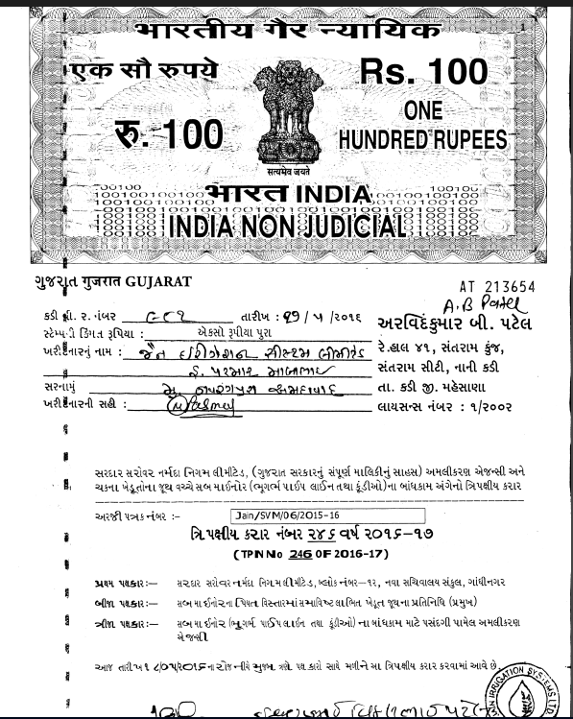
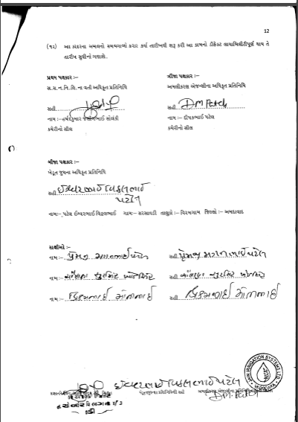
10

Slide 11
Policy & Scheme
UGPL Policy
Farmers have an option to select – Open Channel or UGPL (uPVC Pipes of 180 to 355 mm)
Alignment & turnout locations in consultation with farmers
SSNNL to pay 97.5% of the total cost
The group of farmers is expected to pay 2.5% of the cost (cash or as a labour component). The purpose is to inculcate a sense of ownership in farmers.
41 Pipe Manufacturers are empaneled.
For Quality Control, TPI through reputed Institutions like CIPET & GIRDA
O&M of sub minor will be responsibility of beneficiary farmers of chak.
Defect liability of agency will be 5 years from completion
11

Slide 12
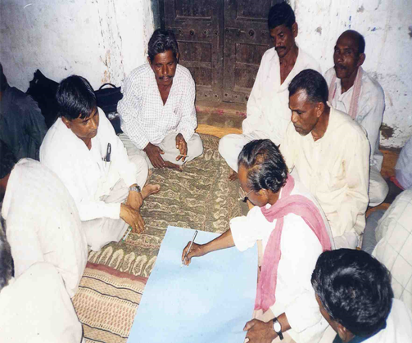
UGPL - Accomplishments so far
Between January 2015 and February 2018
  Length completed 21,841 km
  Command Area developed 7.80 lakh hectare
  Benefitting > 6 lakh farmers
  Tri-partite Agreements > 18,700 chaks
  Cost incurred > 3100 crore
12

Slide 13
Tendering and Price Discovery
UGPL work was taken up in two Phases
Phase-I
67 Agencies submitted tenders and 38 Agencies were qualified for UGPL works.
For each Item, Minimum quoted rates (excluding abnormal low rates) were considered to decide unit rates of different items.
Agencies were awarded work at the approved Unit Rates regardless of their quoted rates
Approximately 250 Implementing Agencies were involved in Phase I to ensure speedy execution and UGPL work in 6.18 Lakh ha completed up to year 2016-17.
Phase-II
198 Agencies submitted tenders online, 147 Agencies qualified for UGPL works.
Same procedure for Price Discovery was adopted for finalizing Unit Rates and UGPL work in 1.70 lakh ha completed in current year upto Feb 2018
13
13

Slide 14
CADWM Works in SSP, Gujarat
In about 15 months time (Jan-16 to Mar-17), 6.18 lakh hectare command area was developed by constructing about 15,500 km length of UGPL.
As per the information available on the website of Ministry of Water Resources, Ganga Rejuvenation and River Development, during Eleventh Five Year Plan period, in the entire country command area development work (sub-minors/field channels) was completed in 20.80 lakh hectare area.
Thus, more than 6.18 lakh hectare area in just 15 months is a record in the country’s history of command area development.
14
14

Slide 15

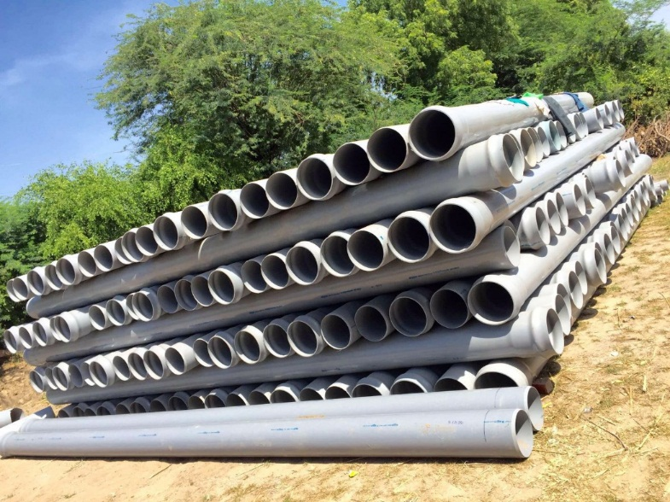
Sokli U.G.P.L. Ta. Viramgam, Dist. Ahmedabad
Laying & Stacking of uPVC Pipes
15

Slide 16
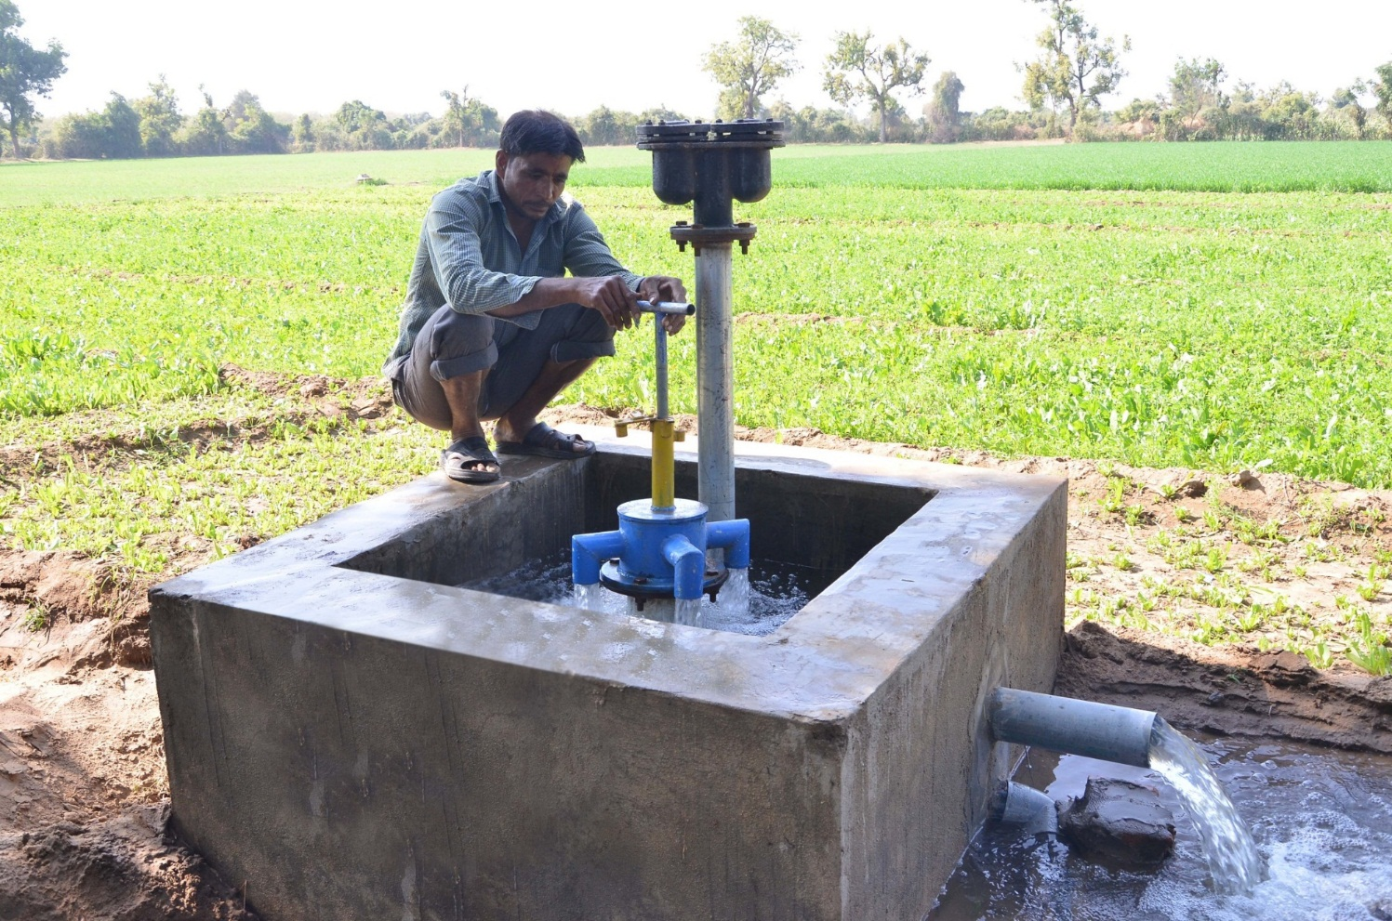
Jashpura UGPL, Ta. Detroj Dist. Ahmedabad
16

Slide 17
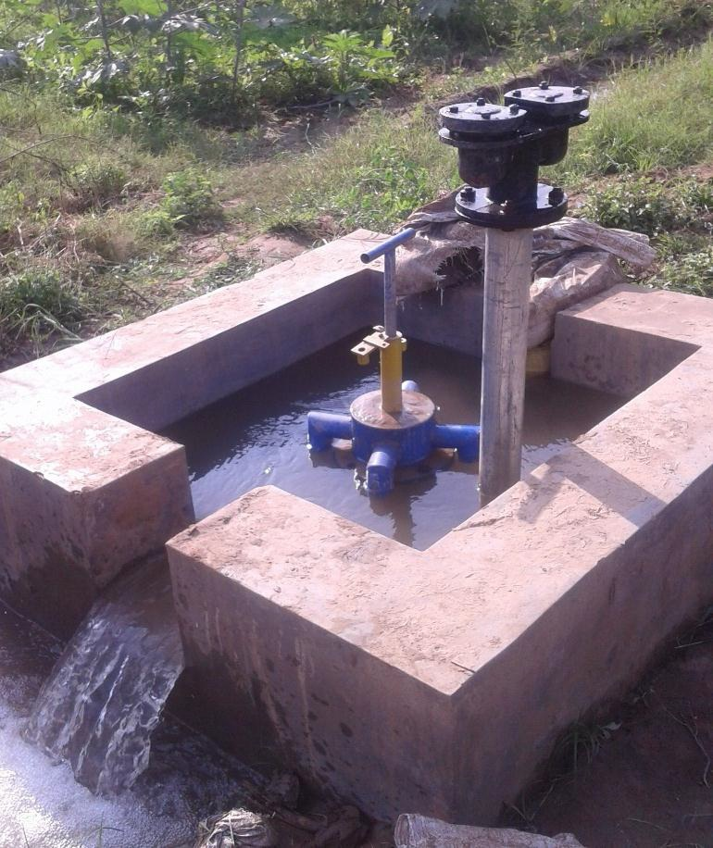
UGPL Turnout
17

Slide 18
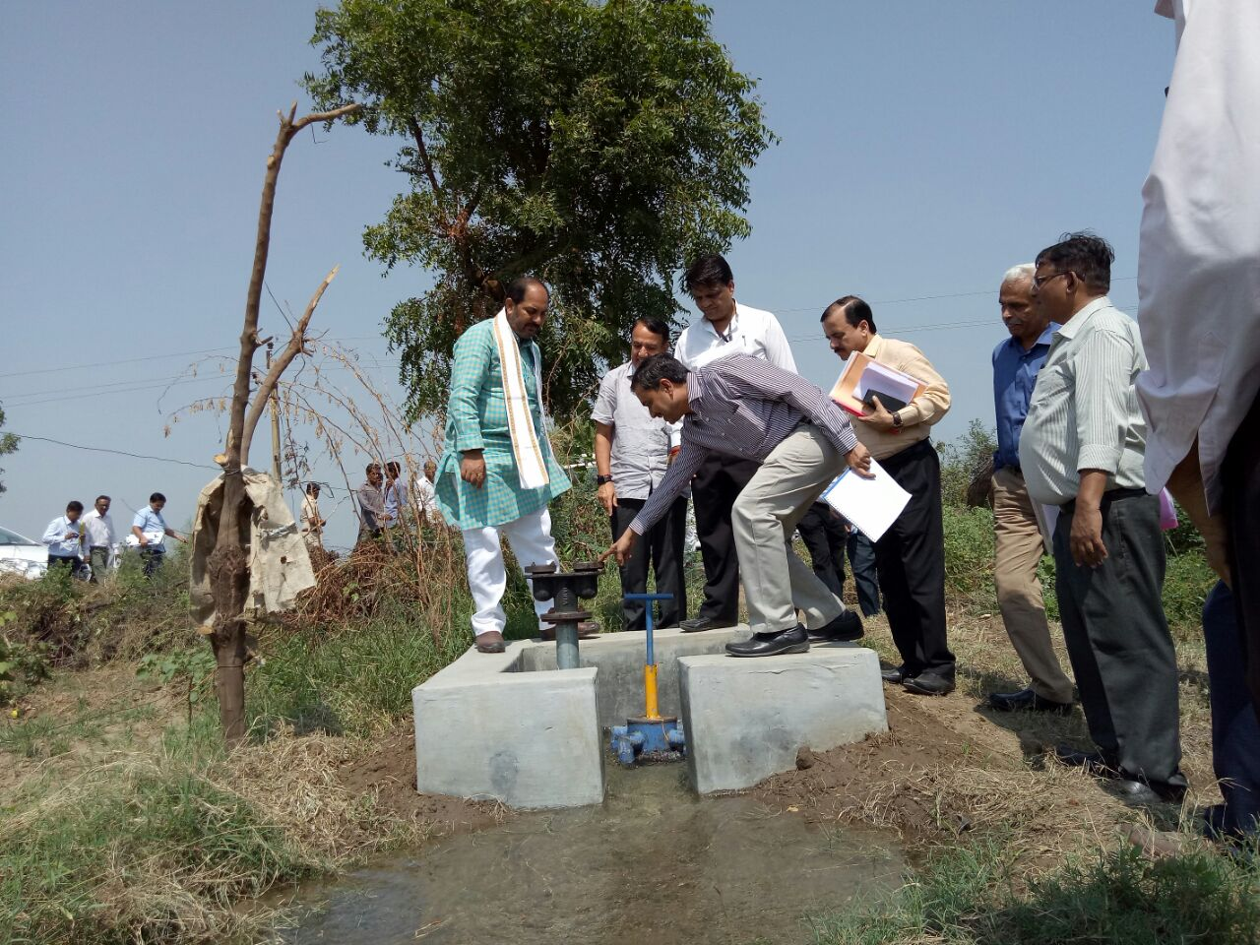
Site Visit of Hon. Shri Upendra Tiwari, State Minister (WS), UP
18

Slide 19
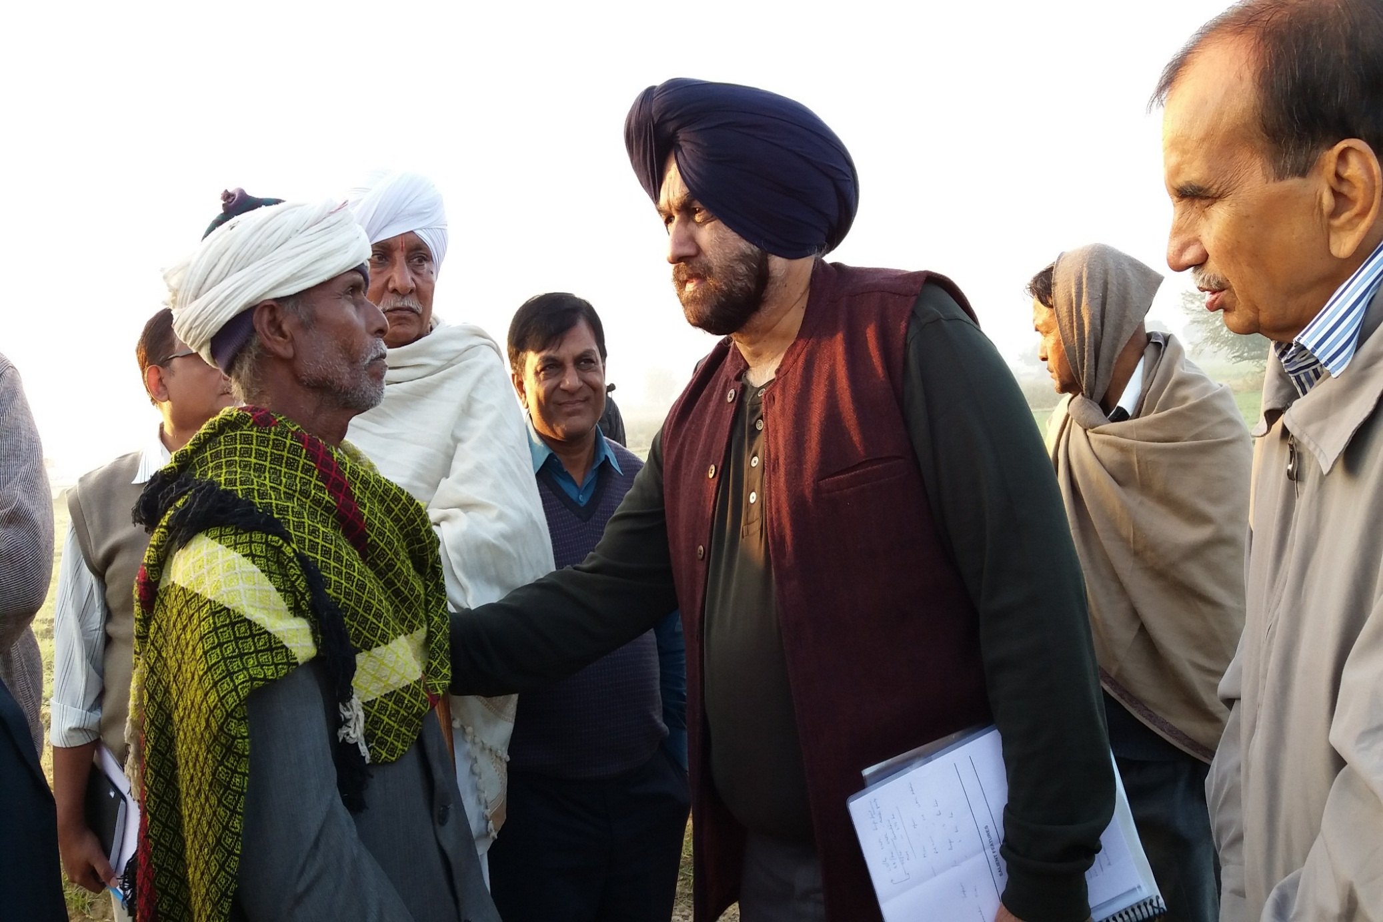
Site Visit of Hon. Secretary, MoWR, RD & GR, New Delhi
19

Slide 20
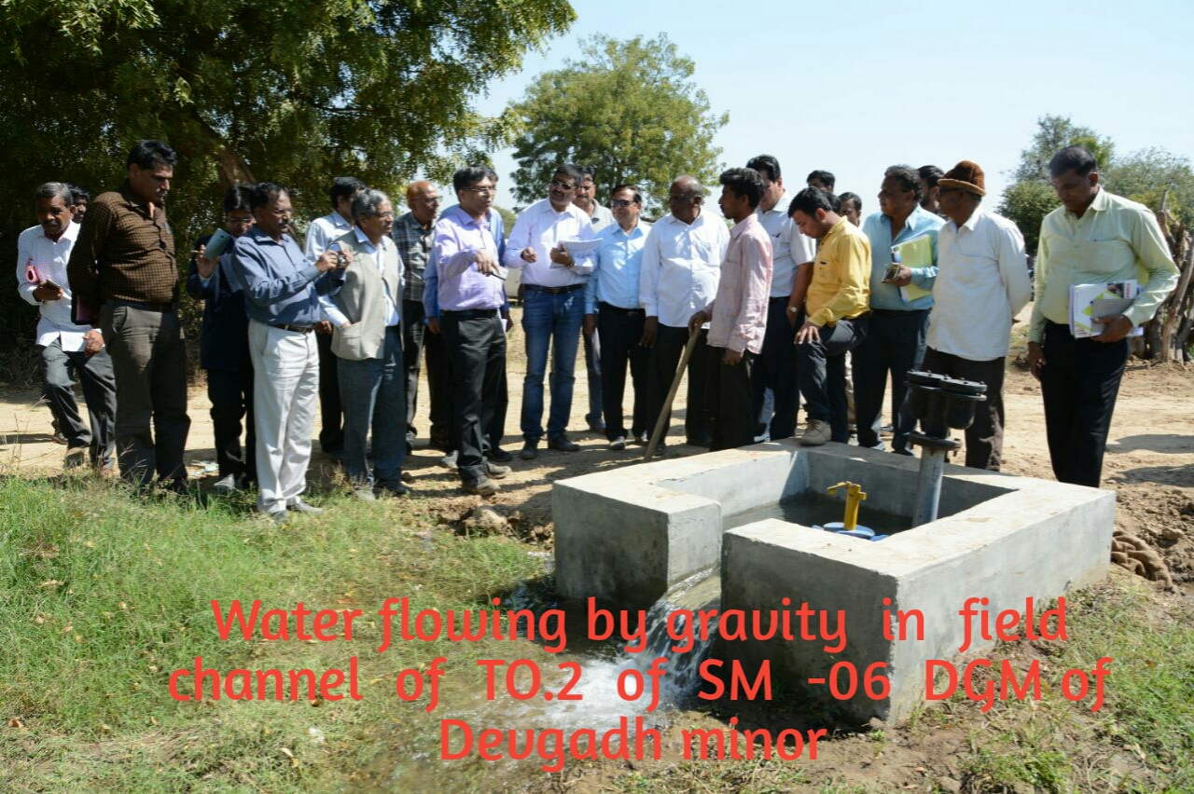
Visit of Dr. B R K Pillai, Commissioner (CAD), MOWR, RD & GR, New Delhi
20

Slide 21
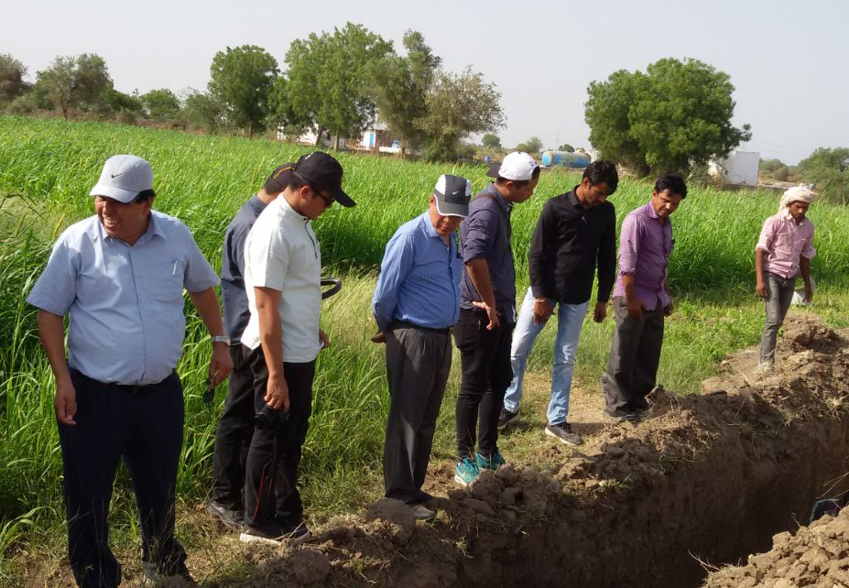
Visit of Shri K. Kirtisingh, SE, Irrigation Dept., Manipur
21

Slide 22
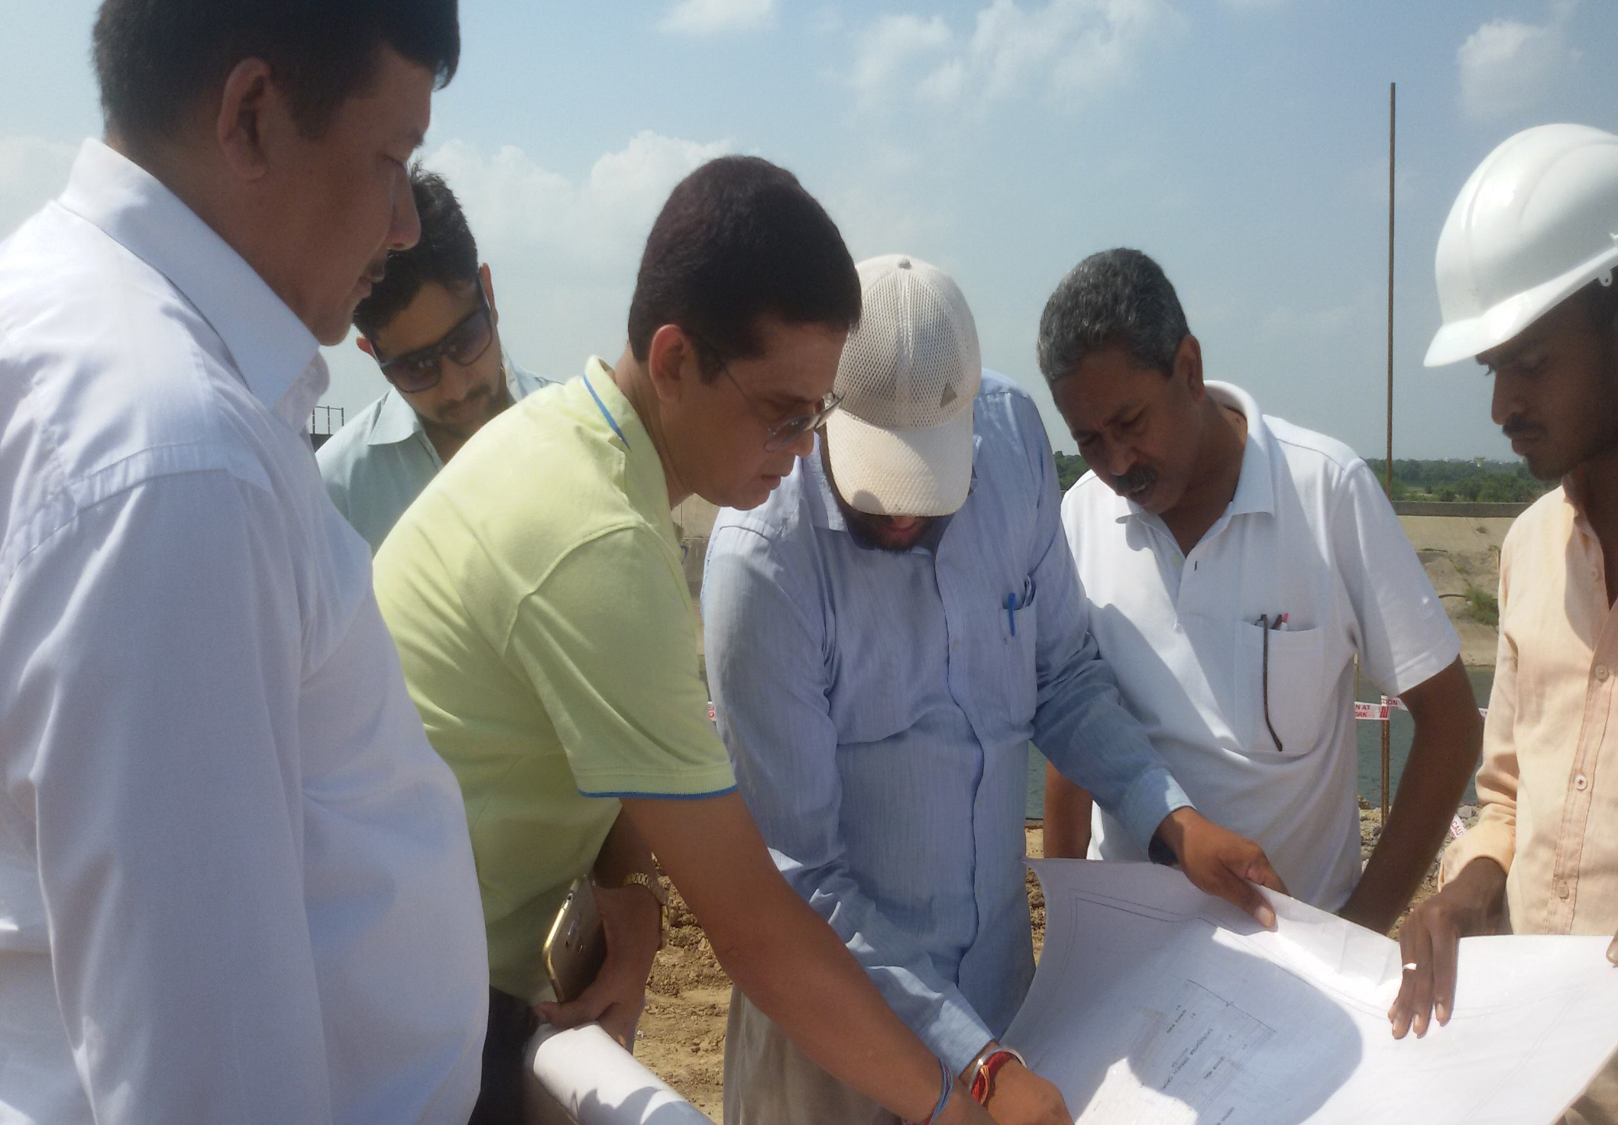
Visit of Shri Anil Ch. Deori, ACS, Irrigation Dept., Assam
22

Slide 23
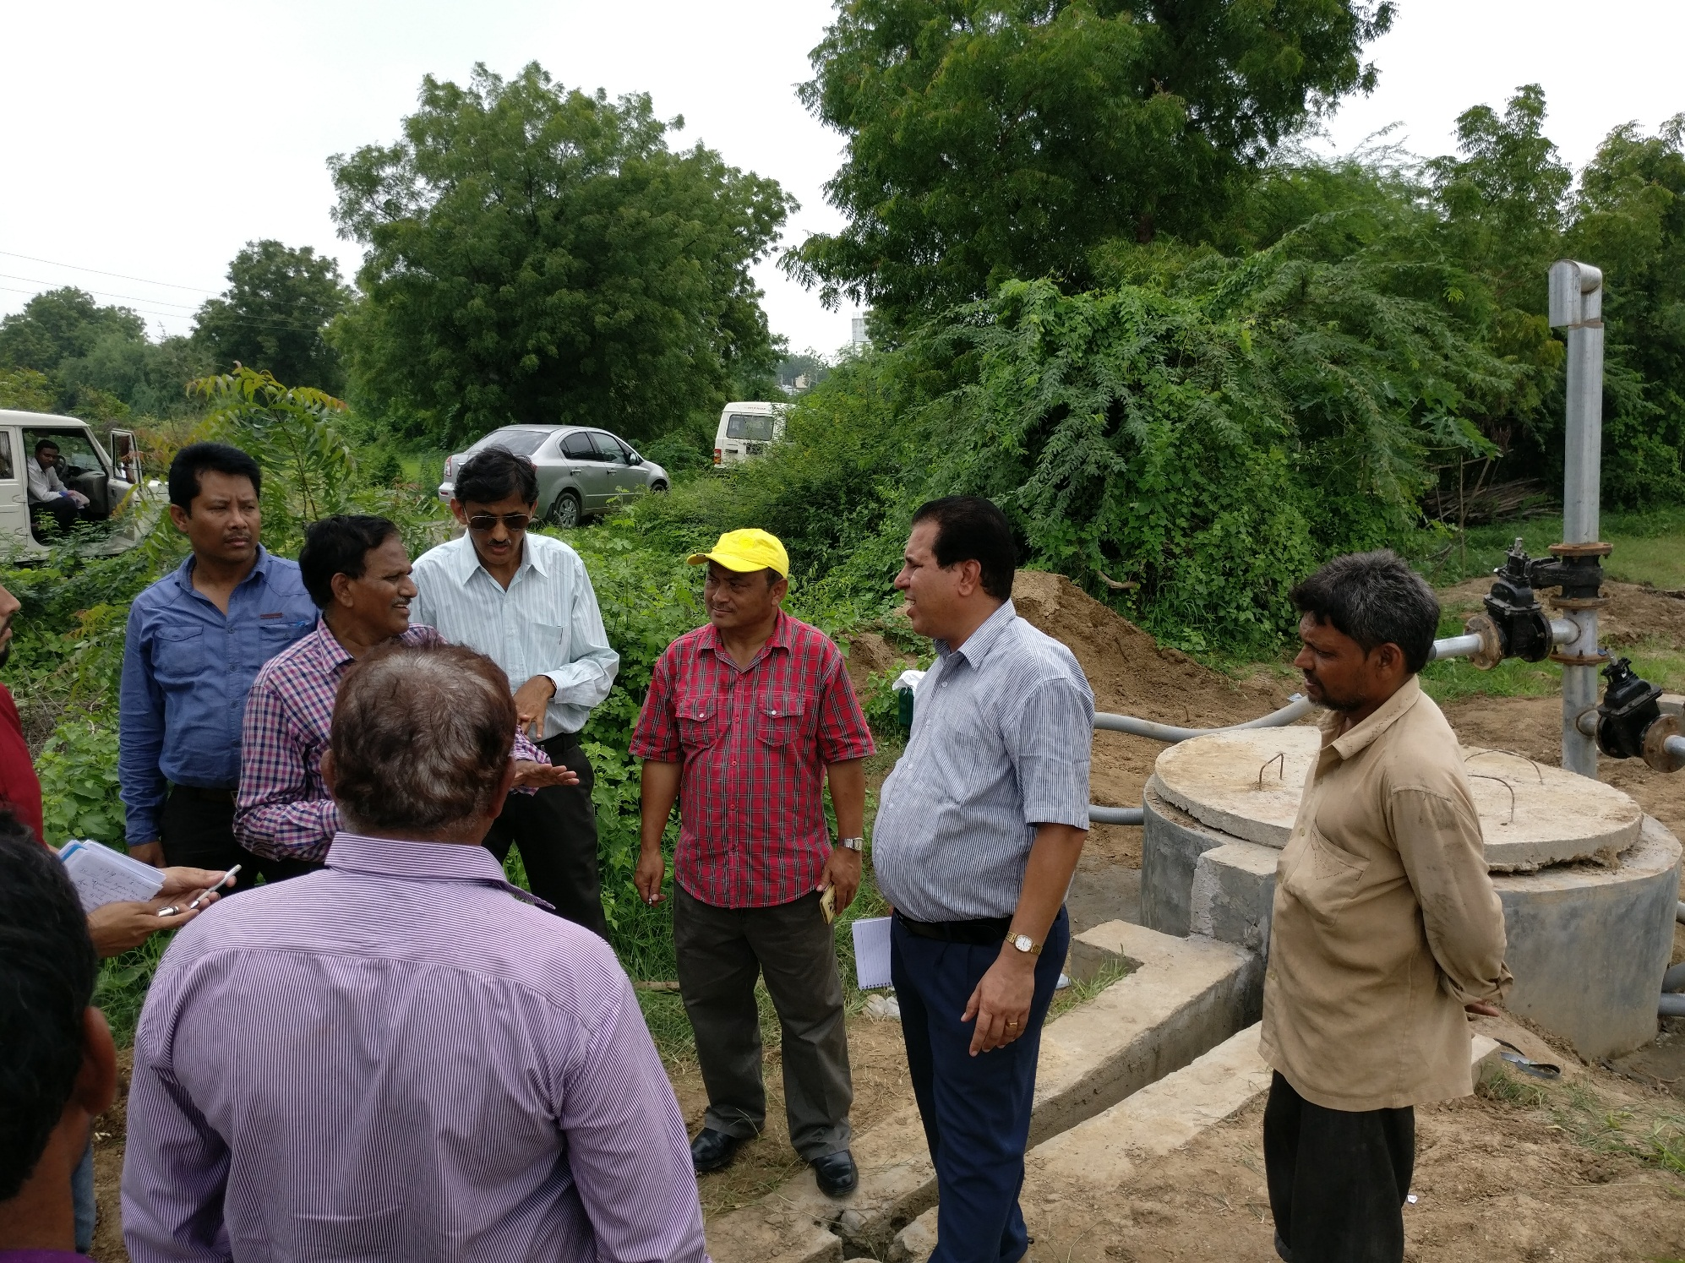
Visit of Shri P.M.Scott, C.E. (CWC) Shillong & Shri B. B. Saikya, Director (CWC), Guwahati
23

Slide 24
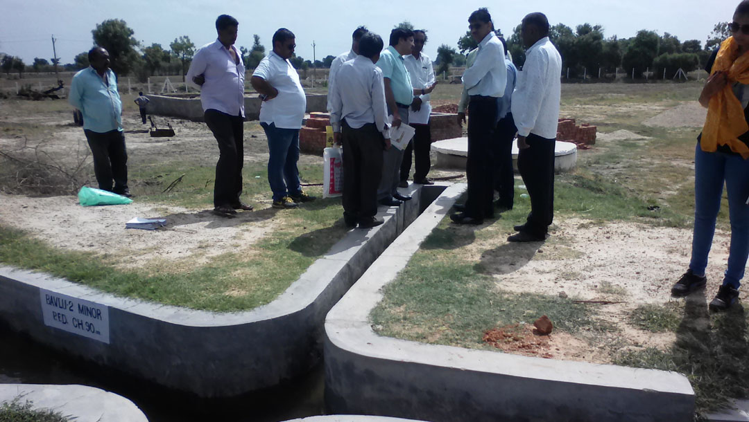
Visit of Dr Sanjay Belesere, Chief Engineer, Irrigation Department, Maharashtra
24

Slide 25
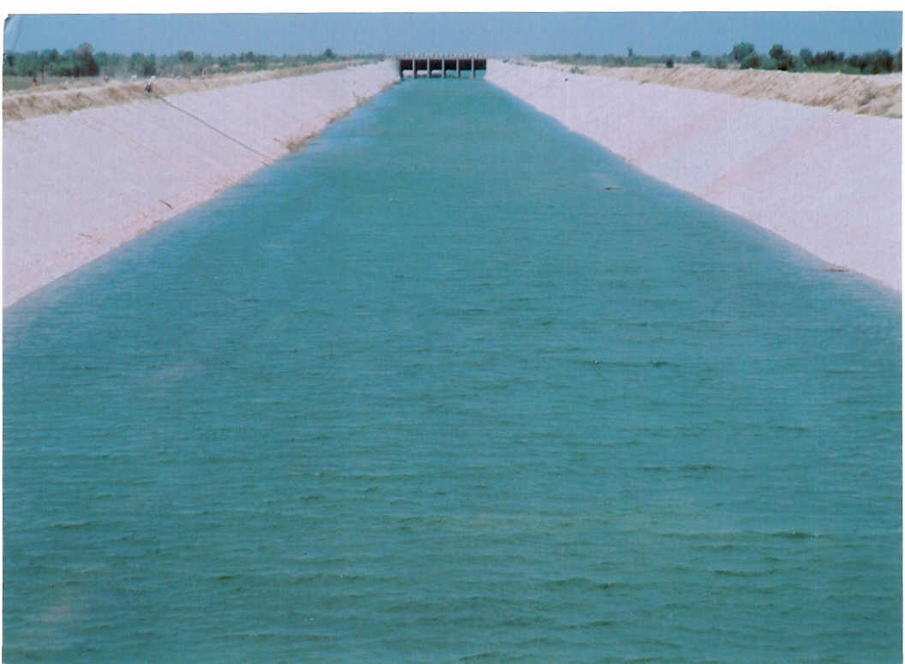
Thank You
SARDAR SAROVAR NARMADA NIGAM LIMITED
25

