Slide 1
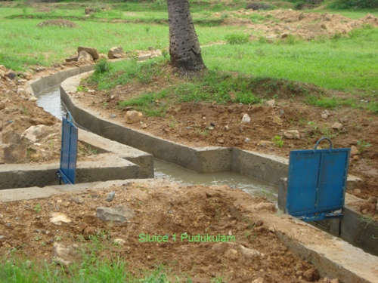
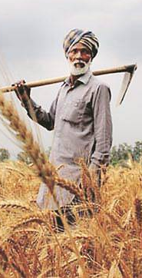
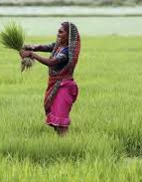
Welcome
13th March 2018
Dr. B.R.K. Pillai
Commissioner MoWR,RD&GR
Command Area Development & Water Management
Need for New Interventions

Slide 2
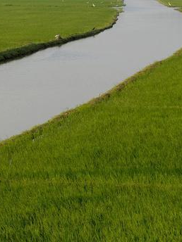
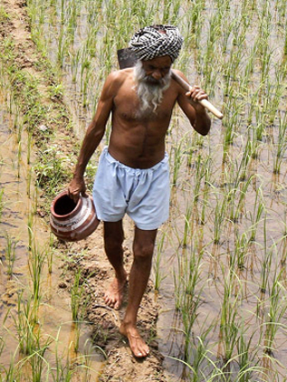
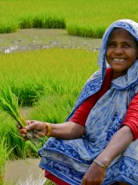
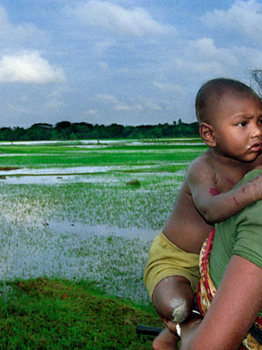
CAD Program was launched in 1974-75.
It was restructured and renamed as CADWM in 2004
Objectives of CADWM Program
Utilize irrigation potential created
Improve water use efficiency
Bring sustainability in irrigated agriculture in a participatory environment
Increase agriculture productivity & production

Slide 3
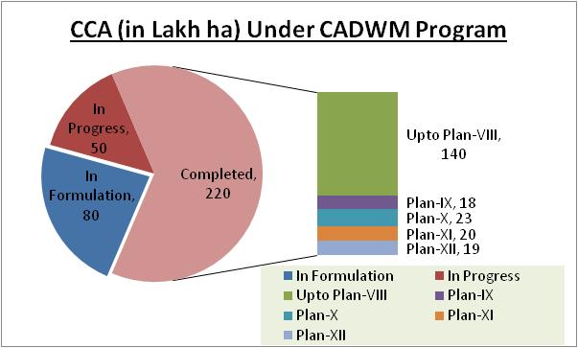
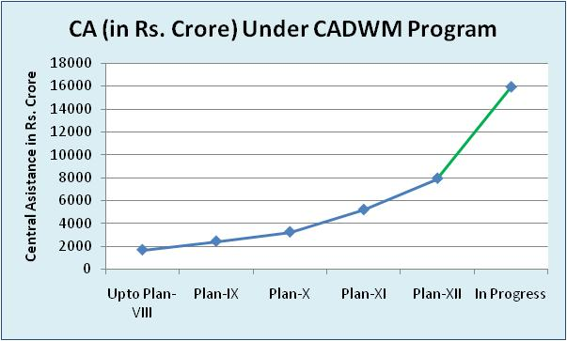
CADWM Implementation & Achievements
Total CCA of 220 Lakh ha developed till 12th Plan
As part of 99 prioritize projects, CAD works in CCA of 50 lakh ha in progress
New Scheme targeting CAD works in CCA of 80 lakh ha in formulation
Total CA of Rs. 7950 crore released till 12th Plan (PV ?)
CA share of Rs. 8000 crore in the ongoing 99 projects
New Scheme presently under formulation targets CA share of Rs. 38000 crore

Slide 4
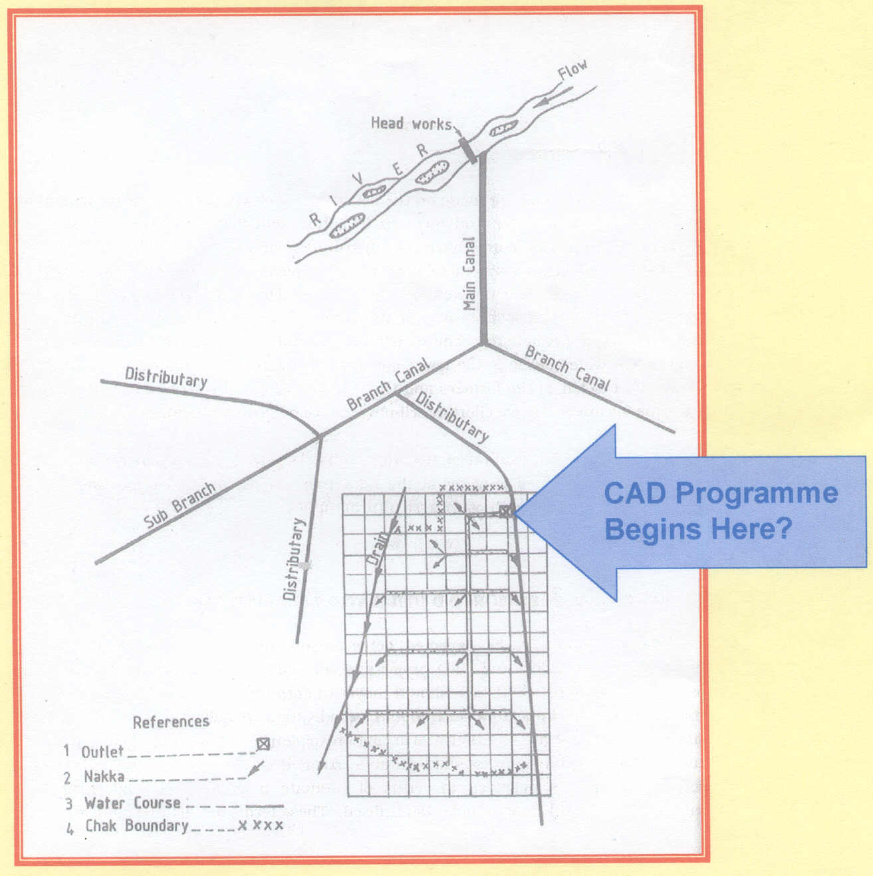
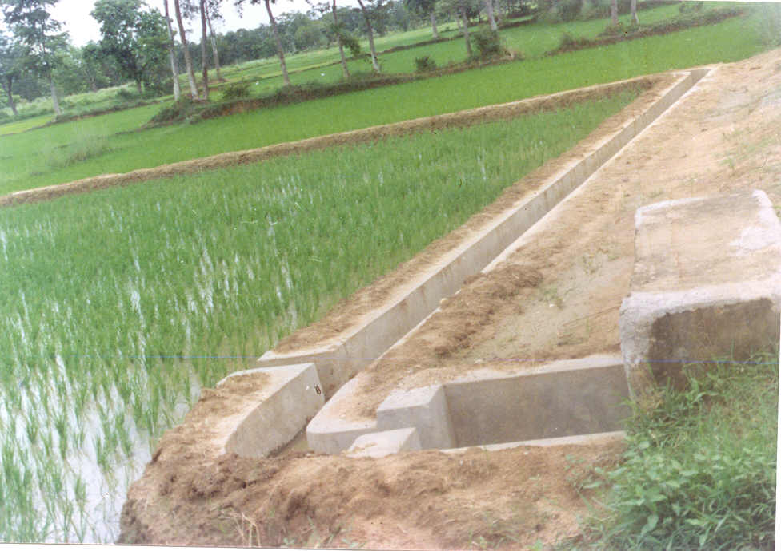
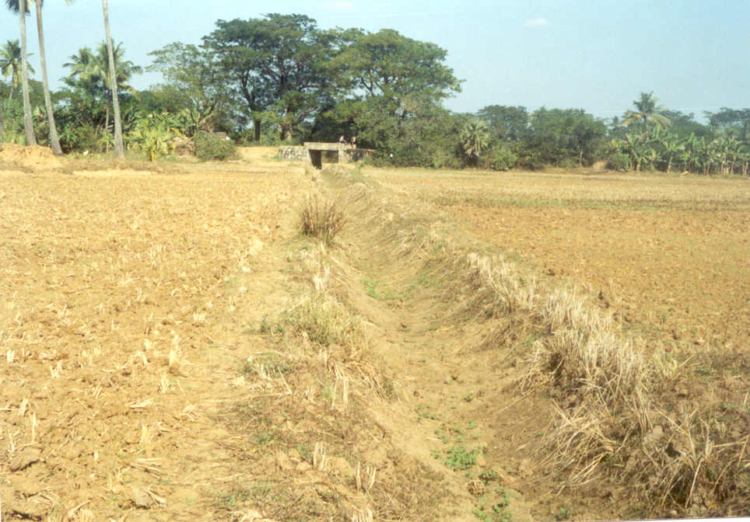
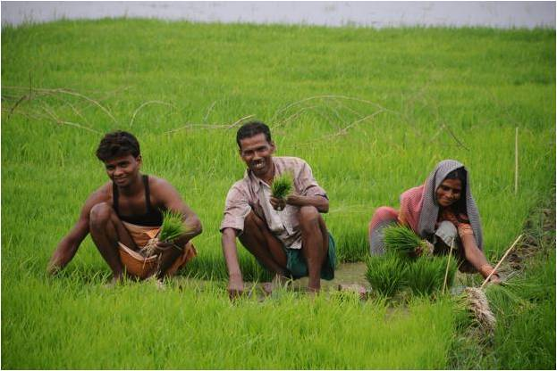
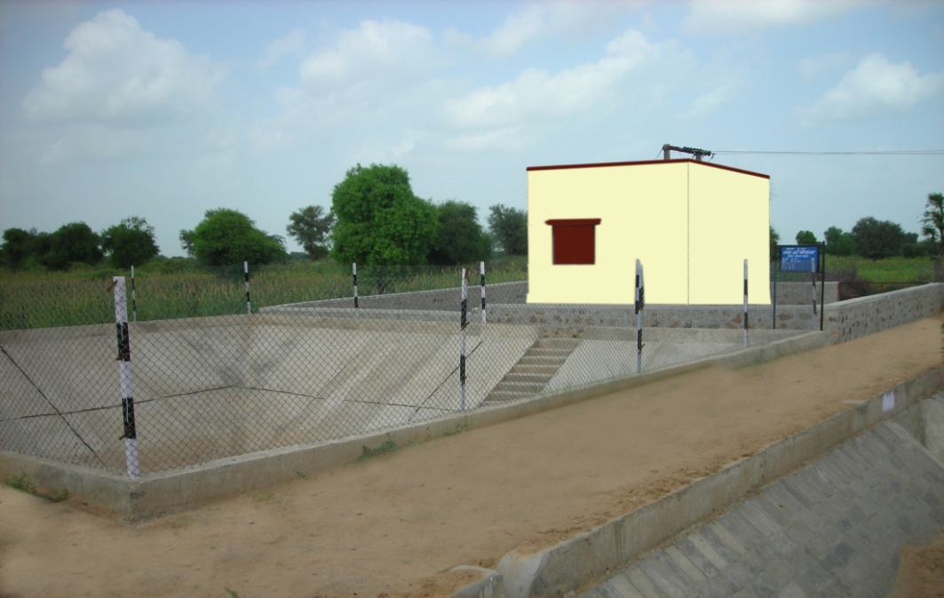
Distinct Features of CADWM Program
Last mile connectivity for irrigation
Area is unit of network development, instead of its linear measures
Only basic level of engineering involved
Land is not procured
Engineering saturation is essential
Farmers’ participation (i.e. Participatory Irrigation Management) is Central requirement

Slide 5
Sustainability of Participatory Irrigation Management
Evaluation and Impact Study of 11th Plan by AFC (2013)
{151 then-ongoing (28 States) & 15 completed (4 States) Projects}
System handed over to only about 10% of 77,330 WUAs
Key observations from sample study of WUAs are:
WUAs yet to develop clear institutional vision and mission
WUAs lack clear understanding of roles and responsibilities, and also lack capacities to perform their roles effectively
Inability to develop transparent & participatory system/procedure
Inability to follow the concept of equity and / or equality
Inability to establish linkages with outside agencies including the government, non-government and private agencies
Lack access & capacities to negotiate with departments/agencies
WUAs have not developed regular source of income
WUAs lack capacity to deal with internal conflicts
Absence of visionary and dynamic leadership

Slide 6
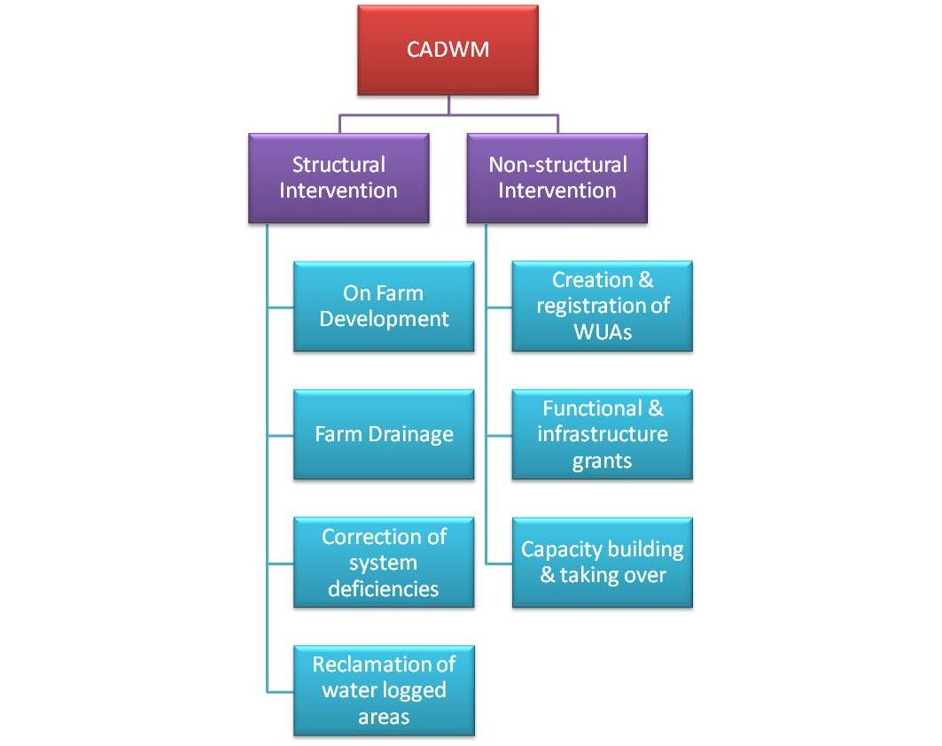
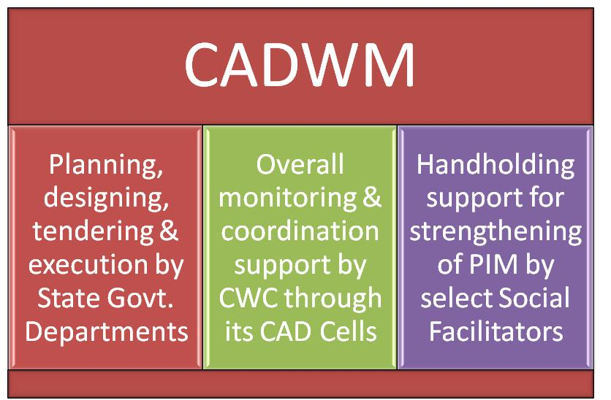
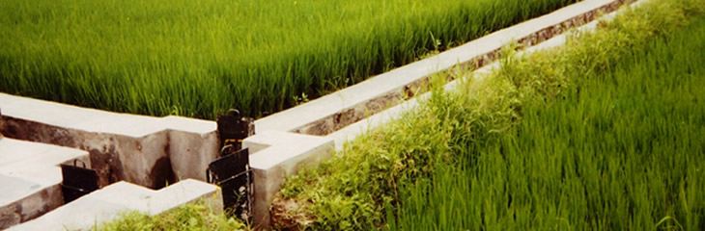
Micro Irrigation
Institutional Arrangement for CADWM
New CADWM Guidelines
(issued in January 2017)
Activities under CADWM

Slide 7

UGPL
Cluster level MI
Social Facilitators
CADWM -
New Initiatives
Potential Interventions
Har Khet ko Pani
(Completion Time )
(Reliability of Supply)
Water-use Efficiency
(Farmer’s Investment)
(Service/ Support)
PIM
(Trained Manpower)
(Sustainability )
3 Pillars of New Initiatives

Slide 8
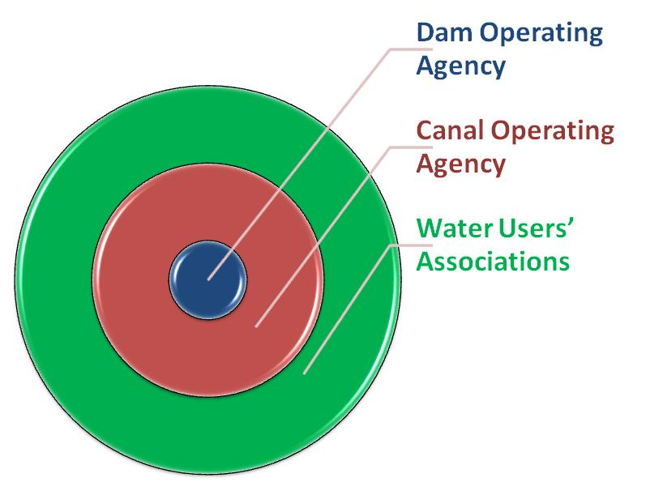
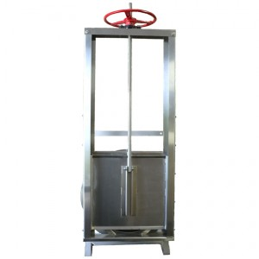
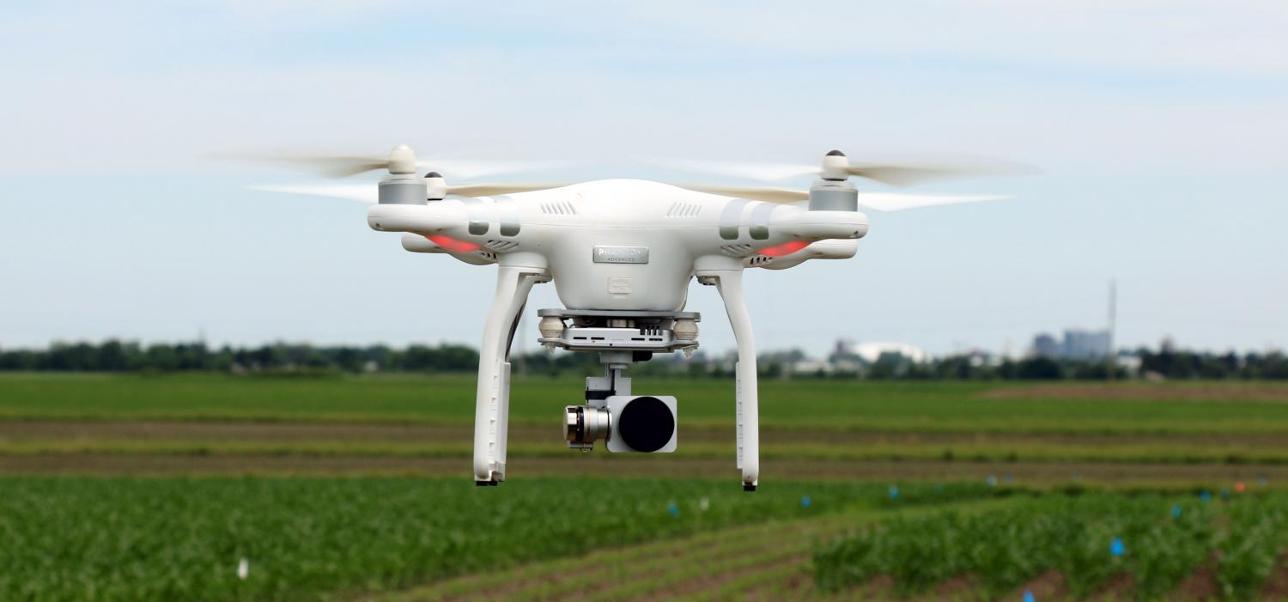
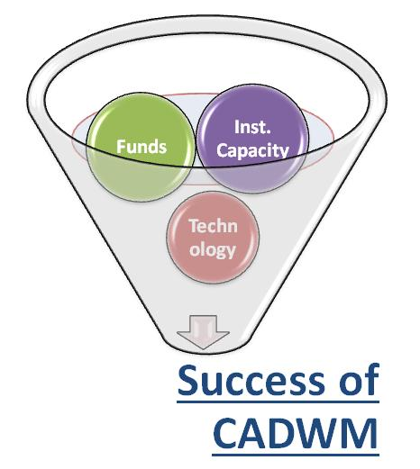
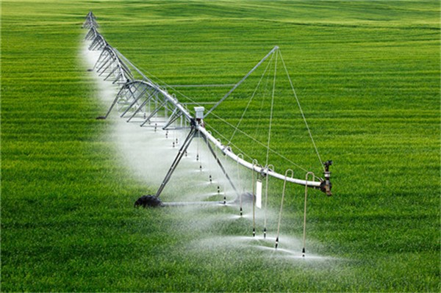
3 Potential Technologies:
Drones supported mapping for Survey & Planning/ monitoring
‘Measurement’ & ‘Control’ using Canal Automation technologies
Pivot-irrigation for cost-effective/ flexible/ large-scale micro-irrigation
Project financing (Central & State share) through LTIF/ MIF
New Institutional Framework:
Clear demarcation of ‘Service-provider’ and ‘Client’
‘Assured Service’ against rational (subsidized) ‘Service Fee’
Three-tiered Institutional Structure
Institutional Capacity
Mission-mode Funding
Implementable Technology
Thanks

